Slide 1
Recent Advances: Meat
Dr. Asif Ahmad

Slide 2
Intensive meat production is advantageous to consumer happiness and public health.
Academic and industrial groups are striving to improve the sensory features of plant-based meat as well as researching fledgling approaches using cellular agriculture methodology.
The application of meat-processing technologies to replace traditional energy-intensive meat processes has the potential to cut energy consumption and production costs and improve the meat sector’s sustainability without requiring infrastructure upgrades.
The study gives a quick overview of four new food-processing methods. High-pressure processing (HPP) is used to ensure the safety and stability of packaged high-value products, resulting in longer shelf life. Due to the batch-based treatment technique, it has some restrictions. HPP equipment should be designed in the future to focus on improvements in energy efficiency. Meat tenderization is the primary goal of the shockwave (SW) or dynamic HPP development. The limited number of unique applications complicates the technology’s broad research and comparison. However, if used on a small scale and aimed at replacing long aging processing, the technology appears to be more ecologically benign and economically effective.

Slide 3
Ohmic Heating
Ohmic heating (OH) is a new direct electric heating technology for industrial meat processing . Previous experiments and investigations have shown that it has the potential to be a cost-effective technique for treating meat products at a faster rate . More technological advancements and commercial penetration are projected in the near future.

Slide 4
Another processing method that uses direct electric energy is the pulsed electric field (PEF). It has a variety of applications in the meat-processing industry, but additional research is needed. Other possible PEF applications, such as PEF-assisted cooking, should be investigated since it could open up new prospects for improving and retaining the sensory quality of cooked meat, particularly for tough meat cuts

Slide 5
Meat Consumption data
The world’s population, which is currently at 7.3 billion people, is anticipated to exceed 9 billion by 2050. According to the Food and Agriculture Organization (FAO), more than 70 percent food will be required in 2050 to meet the expanding population’s need. Even though meat consumption is dropping in affluent countries, it is rising worldwide. As these people begin to work full-time, they seek out more luxury products, such as meat and other animal products. Meat is one of the most popular agricultural products because it contains essential proteins, minerals, and vitamins for human nutrition and wellness. Because of rising interest in economic creation, increasing amount, and medical issues, the meat industries have been on the rise. Consumers have always been on the search for high-quality meat products with an appealing appearance and nutritional value. People select meat from a variety of species, animals of varying ages, sizes, and cuts based on their religious beliefs, social status, origin, diverse cultures, previous experience, the volume of muscle and fat in the carcass, as well as the texture and flavor/aroma characteristics of the meat

Slide 6
Food companies all over the world are creating novel methods and meat products in order to reach client demand. As a consequence, technological innovations such as nanotechnology can have a massive effect on the meat-handling sector by promoting the development of new utilitarian meats as well as novel packaging for those things. Nanomaterials in food have the potential to improve bioavailability, antimicrobial effects, sensory absorption, and bioactive chemical delivery. However, there are obstacles in the application of nanoparticles due to knowledge gaps in the processing of substances such as the stability of delivery systems in meat products, along with potential risks associated with the same features that provide benefits. Nanotechnology is used in meat processing in the form of nanomaterials that aid in food handling, financial matters and quality purpose

Slide 7
Ultrasound Application in Meat
Ultrasound has been effectively utilized across several fields of food technology to either replace or support traditional forms (cutting, degassing, and meat tenderization). However, more research is needed to improve the potential for efficient use of current processes by optimizing process conditions (scaling up ultrasound equipment). When coupled with ultrasound, quite a few technologies have demonstrated the ability to properly regulate food microbes. Ultrasonography does have the potential to contribute to breakthroughs in food safety, processing, and preservation as a result of these possibilities

Slide 8
IR Use in Meat
Because infrared (IR) light passes through multiple layers of tissue, different creators have assessed and disclosed strategies that focus on the use of representing approximately NIR spectroscopy for the investigation of a wide range of properties related to meat quality in either farm animals or carcass evaluation. According to recent evidence, a strategy based on the use of short frequencies (700–1100 nm) in the NIR region of the electromagnetic range can non-invasively gauge boundaries relevant to meat quality in live animals. Furthermore, this approach was said to be capable to remove tissues (such as fat and lean) measured through the skin. It is unknown that rapid and non-invasive methods depending on NIR spectroscopy can assess and analyze the value of meat quality in live animals

Slide 9
Non Thermal Preservation techniques in Meat
Meat source | Plant source | Whole food/extract | Non-thermal processing | Meat product | Improvement
Beef | — | Milk-derived bioactive peptides | — | Beef nuggets | Increase the stability and functional properties of beef nuggets
Ostrich & chicken | Kale | Kale leaf power | Gamma irradiation | Patties | Increase shelf life
Chicken | Moringa | Moringa leaf powder | Gamma irradiation | Meat balls | Reduce oxidation and improve amino acids
Duck | — | — | e-beam irradiation | Smoked duck meat | Improve the microbiological quality
Duck | — | — | e-beam irradiation | Frozen duck meat | Reduce microbe growth
Beef | Wheat | Wheat germ oil and wheat bran fiber | — | Beef patties | Produce low-fat beef patties
Chicken | Moringa | Moringa leaf powder | Gamma irradiation | Meat balls | Reduce the total aerobic bacteria and coliform counts
Duck | — | — | e-beam irradiation | Smoked duck meat | Change fatty acids and amino acids
Chicken | Turmeric | Turmeric powder | Gamma irradiation | Chicken patties | Enhance the stability and antioxidant status of chicken meat
Shrimp | Guava and papaya leaves | Extract | Ultrasound-assisted extraction | Shrimp patties | Shrimp patties enriched with guava leaf and papaya leaf show better antioxidant capacity, stability, and sensory characteristics
Meat | — | — | High hydrostatic pressure |  | HHP can influence meat protein conformation
Chicken | — | — | High hydrostatic pressure | White chicken meat | Improve the overall texture and quality of cooked chicken meat

Slide 10
Polyphenols (flavonols, tannins, and anthocyanins) and essential oils are the major bioactive components of plant food that can be used by the meat industry (mostly made of terpenes). These chemicals can be found in seeds, leaves, and fruits. For example, black pepper is a common ingredient that is grown primarily in tropical climates

Slide 11
Nitrite is mostly exploited in meat production as a crosslinking agent, and it has been linked to health impacts. The impact of various methods for replacing synthetic nitrate and nitrite in order to obtain green-label meat products is outlined, also with their impact on various possible dangers. Nitrites improve taste, flavor, and scent while preserving the meat’s red-pinkish color and reducing the danger of bacterial infection, especially from Clostridium botulinum. Unfortunately, a recent study has revealed some of the flaws in this method. Most research groups are investigating the effects of nitrates and nitrites because some N-nitroso compounds have been connected to the development of stomach cancer. This one discusses the many food sources of nitrites and nitrates as well as the current legislative restrictions on their use in meat products

Slide 12
The future of meat
Humans consume 350 million tons of meat every year — roughly the weight of 1,000 Empire State Buildings — and the figure is expected to climb to more than 550 million tons by 2050 due to a growing world population, rising incomes, and increased consumption per meat-eater.
Livestock are already responsible for 14.5% of global greenhouse gas emissions. These emissions are mainly generated by producing feed for the animals — tractors, fertilizer, land use, etc. — and by cows themselves, which release the potent greenhouse gas methane from both ends of their digestive tracts. If we want to meet the demand for meat without further harming our planet, we’re going to need to produce it more sustainably.

Slide 13
Growing meat
By creating the right environment around animal muscle cells, scientists can coax them into growing into meat that’s molecularly identical to the kind we get from livestock — eliminating the need to raise actual animals.
One of the biggest challenges facing the lab-grown meat industry has been replicating the texture of cuts of meat, which contains layers of fat and muscle — and if people can’t get lab-grown steak, they’ll continue to eat the real kind.
In 2021, Japanese researchers showed how 3D-printing tech could be used to give lab-grown beef the distinct marbling of fat found in Wagyu steaks — opening the door to not only creating steak in the lab, but also custom designing our perfect cut of sustainable beef.

Slide 14
In July 2022, Dutch biotech company Meatable unveiled a sausage made from lab-grown pork — and unlike the first lab-grown hamburger and most other cultured meat products, the company didn’t use FBS to cultivate it.
Exotic meats: Most cultured meat startups are working to replicate pork, poultry, and beef — the most commonly consumed meats — but early-stage UK startup Primeval Foods is thinking wilder, developing lab-grown lion, tiger, and zebra meat.

Slide 15
The bottom line: While lab-grown meat is cheaper today than it was in 2013, when it cost $300,000 to grow enough meat for a hamburger, it’s still far more expensive than traditional meat, so manufacturers will need to continue to find ways to cut costs while scaling-up production.
They’ll also need to navigate regulatory red tape — Singapore is currently the only nation where cultured meat is approved for sale, though experts believe we could see a product on Americans’ dinner plates as soon as 2023.

Slide 16
Hacking livestock
To make the future of meat more sustainable, some scientists propose we hack the diets — and genes — of livestock to make them less of a burden on the environment.
Bugging out: Instead of feeding livestock grains — the production of which contributes to deforestation in the Amazon and adds more greenhouse gasses to the atmosphere — Texas State University researchers think we should let the animals dine on insects.

Slide 17
larvae of black soldier flies can be fed to cattle in lieu of traditional protein sources, such as soybean meal, without any noticeable negative effects, and in 2023, they plan to publish a paper detailing how the bug-feed may reduce the animals’ methane emissions, too.
Seaweed snack: In March 2021, UC Davis researchers published the results of a study in which a small amount of seaweed was added to the diets of beef cattle.
This seaweed inhibited an enzyme linked to methane production in the animals’ digestive systems. As a result, the cattle produced 82% less methane emissions than their standard-diet counterparts. The seaweed didn’t affect the animals’ weight or the taste of their meat, either.

Slide 18
Better breeding: Some cattle seem to naturally produce less methane than others, but no one knew why until 2019, when a team led by University of Aberdeen researchers published a study detailing how genetics strongly influences the makeup of microbes in a cow’s gut.
Armed with this knowledge, they say farmers could choose to breed only those animals whose genes make them low emitters — or use gene-editing tech such as CRISPR (clustered regularly interspaced short palindromic repeats) to quickly make any breed of cattle climate-friendly.
The bottom line: These options would require farmers to rethink how they raise livestock — and, in the case of gene-editing, require greenlights from regulators — but they’d be easier to scale up than lab-grown meat.

Slide 19
While there are a range of estimates, as much as 30% of the calories consumed globally by humans come from meat products (USDA, 2017).
And according to the United Nations, livestock contribute nearly two-thirds of agricultural greenhouse gas emissions and 78% of agricultural methane emissions — with cattle representing the bulk of that amount.

Slide 20
Representatives of five companies discussed ways to reconcile this consumption with eco-friendliness, with various approaches. Speakers included:
Pat Brown, CEO of Impossible Foods, which develops plant-based substitutes for meat products.
Charley Cummings, whose Walden Local raises and distributes sustainable meat through a farm-share-like program.
Jill Marshall Gould, founder of Butter Meat Co., which focuses on mature, organic local beef.
Cara Nicoletti, whose Seemore Meats & Veggies produces carbon-neutral, vegetable-forward sausages.
Brian Spears, CEO of New Age Meats, which grows meat from the cells of animals that have not been slaughtered, a process known as “cultivated meat” or “cell-based meat.” The company’s products are not yet for sale.

Slide 21
Futuristic meat companies, meanwhile, hope that their practices will remain unencumbered by disease.
New Age’s Spears asserted how conventional meat creation increases disease risk: people in very tight quarters side-by-side, conducting repetitive operations. In contrast, his company creates meat from the cells of unharmed animals.
“A meat supply that relies on humans to be in close proximity to the carcasses of animals and be covered in the fluids of animals presents a transmission risk,” he said. “These platform is fundamentally less prone to that safety risk.”

Slide 22
Affordability is a challenge — and a mandate
High-quality meat is also prohibitively expensive for many, which threatens to turn eco-friendly eating into a socioeconomic issue.
For its part, Impossible Foods has an ambitious goal: completely replace the use of animals as a food source by 2035, with a focus on distribution to malnourished populations. It is estimated that one-third of the world’s population is affected by anemia and that half of those cases are due to iron deficiency. As many as two billion people worldwide are iron-deficient.

Slide 23
Perspective of Cultivated meat
To give you some background on this emerging industry, a 1998 U.S. patent filed by Jon F. Vein laid claim to the “production of tissue engineered meat for human consumption, wherein muscle and fat cells would be grown in an integrated fashion to create food products such as beef, poultry and fish.”
In 2008, PETA offered a $1 million prize to the first company to bring lab-grown chicken meat to consumers by 2012.
In November 2009, scientists from the Netherlands announced they had managed to grow meat in the laboratory using the cells from a live pig.
In 2010, Google co-founder Sergey Brin’s family foundation reached out to Dr. Mark Post to support his efforts in developing cultured meat. They also encouraged Mark to create a huge media event where the first cultured hamburger would be tasted, supporting the costs of the research and the event.
In 2012, a total of 30 laboratories around the world were conducting cultured meat research.

Slide 24
Other new markets will be things like kosher meats, vegan meats, non-GMO meats, and vegetarian meats.
It would be surprised if cultured meats grow to more than 10% of the meat market by 2040, and I only see half of that affecting our existing livestock and meat production. The rest will come from opening new markets.

Slide 25
Which sectors will be the most affected by 2040: farmers, veterinarians, slaughterhouses, processing plants?
Cultured meats will have a cascading effect on other industries, but it will take time.
Over time it will affect demands for feedstock, water, acreage for grazing, hay, veterinarians, animal medications, trucking, auction houses, auctioneers, slaughterhouses, processing plants, western wear, horses, 4H competitions, feed suppliers, meat inspectors, feed additives, FDA personnel, animal drug industry, and the overall demand for ranchland. But all this will take time and during these decades of transition it will be the perfect time to discover new opportunities.

Slide 26
After the initial “race to be first” – first cultured bison, first cultured swordfish, first cultured rattlesnake in the mid-2020s, I expect we’ll see a period where people will try to “grow their own cultured meat farms,” followed by an underground movement of people attempting to design “super hacker foods.”
Cultured meats will be developed for non-edible materials similar to leathers, plastic, and rubber.
most consumers will rely on their own testing devices to sort through a product’s efficacy and value. For this reason, many of today’s concerns over topics like GMO, organic, or responsibly farmed foods, will be replaced with apps used for “certified testing” and managing “personal markers.” The work happening at today’s feed mills will be largely invisible to the end users in the future.

Slide 27
Much of the work done at feed mills will get absorbed into the cultured meat production facilities. Many of these “meat labs” will evolve into sophisticated research facilities where many of tomorrow’s grocery store products will be born.

Slide 28
What will be the jobs of the future in our animal nutrition sector?
New age cultured meat producers will become known as “vat farmers” (or something similar). Each production facility will be run from a central control room with constant monitoring and testing to guide the overall quality of the product. Consumer data, in turn, will drive this, from the body sensors of those who consume the products. For this reason this emerging new industry will be run by lab techs, data analytics techs, control room monitors, account managers, salesmen, delivery people, and the grunt workers filling and cleaning the vats. Over time many of these tasks will become automated, but it will be many years before the jobs become refined enough for significant automation to take place.

Slide 29
Is artificial intelligence THE key to feeding a global population of 9 billion+ people in 2040 in a sustainable manner?
As the global economy improves, worldwide demand for food will continue to increase. At the same time, we are moving towards far more hyper-individualized diets, with far more concern over our individual health and well-being. The amount of data the food industry will be dealing with is about to explode exponentially, far exceeding any individual’s ability to make sense of it. That’s where AI comes into play. A person with a toolbox is generally more valuable than one without. A person with a robot, is generally more valuable than one without. And a person with AI is generally more valuable than someone without AI.

Slide 30
Cultured meat Investment
Investment in cultured meat has grown steadily in the eight years since Mosa Meat debuted those hamburgers in 2013, when Crunchbase data records $25 million in global investment to the industry.
In 2020, investors poured more than $1.2 billion into startups around the world working on cell-cultured meat and other cell-cultured meat alternatives. So far this year, venture investors have bet another $913 million on the industry, Crunchbase data shows.

Slide 31
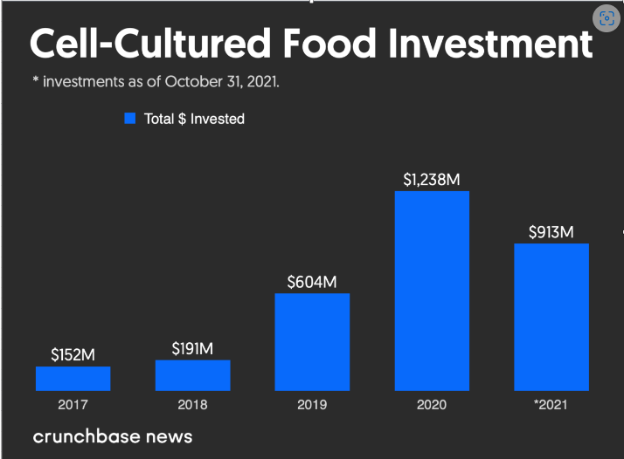
Cultured meat Investment

Slide 32
The cultured meat industry is predicted to be worth $572 million by 2027, representing a compounded annual growth rate of 15%. This expansion is set to continue and reflects a recent boost in industry activity. In December 2020, The Singapore Food Agency approved EAT Just’s cultured chicken for human consumption. This was the first approval of its kind, paving the way for further consumer and regulatory acceptance. The world’s first restaurant serving cultured meat was also launched in Israel at the end of 2020, and in April 2021, Israeli start-up MeaTech raised $25 million through its listing on the NASDAQ, making it the first cultured company to be listed on a US stock market. According to research, consumers are increasingly interested in consuming cultured meat. A literature review found that a high proportion of people would try it, and a 2021 study found that around 80% of UK and US consumers would be ‘somewhat likely’ to try it. This blog explores what cultured meat is, the potential for disruption in the global protein supply chain, and some of the ESG risks and opportunities investors should consider when looking at the industry.

Slide 33

Companies Location

Slide 34
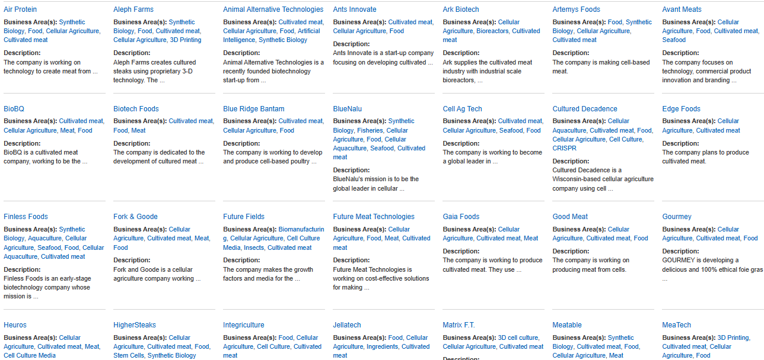

Slide 35
Top 5 Companies in Cultured Meat
Mosa Meat: The company that kicked off the trend was Mosa Meat, founded in 2013 by Dr Mark Post of Maastricht University. In August 2013, Dr Post cooked and tasted the world’s first cell-cultured hamburger in front of a crowd of journalists in London, UK. The hamburger was produced from bovine muscle cells grown in the lab and reportedly cost over €250,000 to produce. Luckily, things have moved on since then, with Mosa Meat currently claiming it can grow a ‘beef’ patty for around €9. To grow its beef patties, Mosa Meat takes myosatellite cells (muscle stem cells) from live cattle via a small biopsy. A bioreactor then proliferates them, creating trillions of myosatellite cells, which then differentiate into muscle cells by changing their growth medium. These form myotubes – primitive muscle fibres less than 0.3mm in length – which are placed in a gel that aids their formation into more substantial muscle fibres, which can then be harvested as meat. The company is aiming for a small-scale commercial release within the next few years, following scale up of production facilities and regulatory approval.

Slide 36
Memphis Meats
Harnessing the might of US capital, Memphis Meats is a Californian cultured meat startup founded by cardiologist Dr Uma Valeti and cell biologist Dr Nicholas Genovese in 2015. Similarly, Memphis Meats uses myosatellite cells as a base from which to grow its meat products, but this company has produced cultured chicken nuggets and beef meatballs, as well as duck tissue.
In 2020, the company completed a $161 million Series B fundraising, by far the largest funding round ever completed by a cultured meat company, which they intend to use to construct a pilot production facility. With over $181 million in private funding from backers, including Richard Branson, Bill Gates, and meat industry giant Tyson Foods, many are expecting Memphis Meats to be the first company to successfully release a commercially-available cultured meat product.

Slide 37
Aleph Farms is an Israeli startup developing cultured meat products that go a step further. Rather than growing “unstructured” meat products such as burgers and nuggets, the firm is creating cultured steaks using proprietary 3D technology.
The process involves using a specially designed scaffold to co-culture muscle, fat and connective tissue, alongside vasculature to produce a fully formed steak within three to four weeks. Aleph Farms claims its technologies allow several types of cells to grow together into a complex shape, a feat that has hitherto been a major hurdle in developing structured meat products. The company is aiming to reach the market with a limited launch within three to four years.

Slide 38
BlueNalu
This San Diego startup has big plans for commercialising a large-scale cultured seafood products facility.
Its planned five phases start with R&D and small-scale pilot testing, before moving onto market research testing and culminating in 150,000-square foot facilities. Each will produce up to 18 million pounds of cultured seafood, ranging from finfish, to crustaceans and molluscs; the equivalent of 72 million four-ounce seafood fillets.
In June 2020, the company expanded its administrative, R&D and manufacturing space with a new facility that represents a six-fold increase over its current space. The larger facility will include a Good Manufacturing Practices (GMP) pilot-scale food production plant for the commercial production of its various cell-based seafood products.

Slide 39
Finless Foods
This Californian startup is currently focusing on cultured bluefin tuna – an expensive and endangered animal that cannot be farmed but is highly sought after.
Finless Foods believes that there are several advantages to developing cultured fish meat compared with cultured mammal or bird tissue. Fish have a much lower body temperature than mammals or birds, so cells are cultured at 24-26°C. Fish cells are also more tolerant to temperature shifts, this reduces energy costs and simplifies production. Creating an accurate texture is also easier with cultured fish meat. Fish naturally has a thin, sheet-like texture, which is simpler to recreate through culture than the complex 3D structure of animal muscle.

Slide 40
Final Thoughts
As global incomes improve, meat consumption rates will grow exponentially over the coming years. Demand for meat in Asia is expected to grow rapidly over the coming years.
Even some of the large companies in the meat industry are beginning to take notice. It was reported in December that mega processor Tyson had opened a $150 million fund to invest in startups that are preparing for a meatless future.

