Slide 1

EMERGING COATING TECHNOLOGIES
FT-722
PROF. DR. ASIF AHMAD

Slide 2
CONVENTIONAL COATING TECHNQIUES
Some of the most common conventional coating methods include:
Brushing: Coatings are applied manually with a brush, typically used for small-scale projects or touch-up work.
Spraying: Coatings are applied using a spray gun, typically used for large-scale projects, such as painting a building or vehicle.
Dipping: Parts or objects are dipped into a coating solution or bath, allowing the coating to adhere to the surface.
Roll-to-roll coating: Coatings are applied to a continuous strip of material as it passes through rollers, typically used in the manufacturing of films, foils, and papers.
Electrophoretic deposition: A charged coating is deposited onto a surface by attracting it with an electric field.
Electroplating: A metallic coating is deposited onto a surface by electrochemical reaction.
Powder coating: A dry powder coating is applied to a surface using an electrostatic charge and cured through heat.
Thermal spraying: A coating material is melted and sprayed onto a surface to create a protective layer.
These methods have been used for many years and are still widely used in various industries, but they have some limitations and drawbacks that have led to the development of alternative coating technologies.

Slide 3
DRAWBACKS OF CONVENTIONAL COATING METHODS
Conventional coating methods have been widely used in many industries for a long time, but they have some drawbacks that can limit their effectiveness and impact on the environment. Some of the drawbacks of conventional coating methods include:
Environmental impact: Traditional coating methods often involve the use of solvents, which can release volatile organic compounds (VOCs) into the air and contribute to air pollution. Additionally, many coating materials are derived from non-renewable resources, making them unsustainable in the long term.
Health and safety concerns: The use of solvents and other chemicals in conventional coating methods can pose health and safety risks to workers, as well as to the end-users of coated products. Exposure to these chemicals can cause respiratory problems, skin irritation, and other health issues.
Inefficiency: Conventional coating methods often involve multiple steps, including surface preparation, application of the coating, and drying or curing. These steps can be time-consuming and can result in reduced production efficiency.
Limited functionality: Traditional coating methods typically provide limited functionality, such as corrosion resistance or aesthetic enhancement, and may not offer additional properties such as self-cleaning, self-healing, or antimicrobial properties.
Inability to coat complex shapes: Conventional coating methods may not be effective for coating complex shapes or intricate surfaces, as they may not be able to reach all areas or achieve a uniform coating.

Slide 4
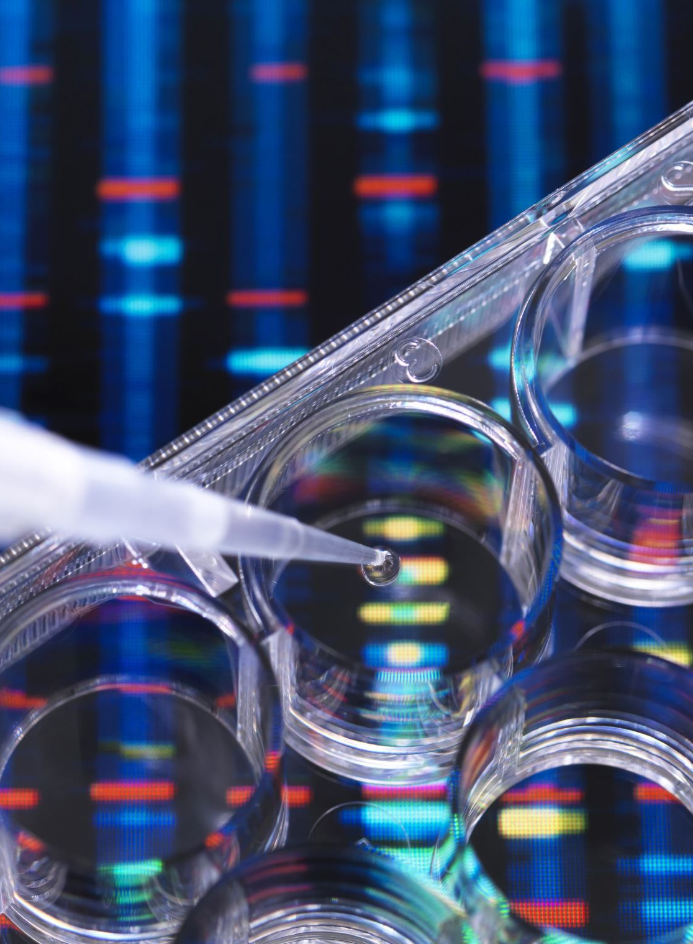
EMERGING COATING TECHNOLOGIES
Emerging coating technologies refer to new and innovative ways of applying coatings to surfaces, materials or products. Some examples of emerging coating technologies are:
Nano-coatings: These are thin coatings made up of nanoparticles, usually less than 100 nanometers in size. They provide enhanced properties such as improved scratch resistance, durability, and water resistance.
Smart coatings: These are coatings that can respond to external stimuli such as temperature, light or pressure, and change their properties accordingly. Smart coatings can be used for a variety of applications such as self-healing coatings, anti-fog coatings, and self-cleaning coatings.
Bio-based coatings: These are coatings made from renewable resources such as plants, animals or microorganisms. They are considered environmentally friendly and sustainable alternatives to traditional petroleum-based coatings.

Slide 5
4. Multifunctional coatings: These are coatings that provide multiple functions such as corrosion resistance, UV protection, and antimicrobial properties, in a single layer. They are used in a variety of applications such as automotive, aerospace, and healthcare.
5. 3D printing coatings: 3D printing technology is increasingly being used to create complex and customized parts. 3D printing coatings can be used to improve the surface finish, texture, and functionality of these parts.
6. Electrochromic coatings: These coatings change color or transparency in response to an electric current. They are used in smart windows, automotive mirrors, and eyewear.
7. Electrospinning: Electrospinning has the potential to produce food packaging materials with improved properties such as antimicrobial activity, oxygen and moisture barrier, and mechanical strength. The technology has been used to produce chitosan-based nanofibers that could be used as food packaging material to extend the shelf life of perishable foods.
8. Atomic Layer Deposition (ALD): ALD can be used to deposit very thin coatings on food packaging materials to improve their barrier properties, extend shelf life, and provide better protection from moisture, oxygen, and light. For example, ALD coatings have been used to improve the oxygen and moisture barrier properties of biodegradable packaging materials such as cellulose nanofibers.

Slide 6
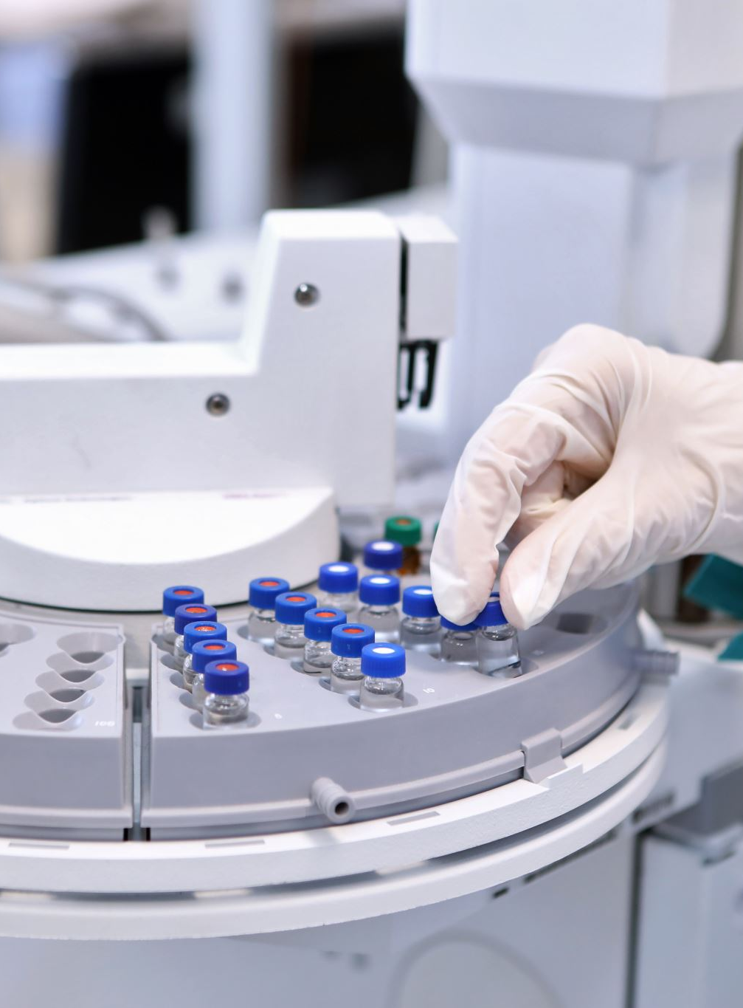
9. Plasma Coating: Plasma coating can be used to produce antimicrobial coatings on food packaging materials to prevent the growth of bacteria and fungi. Plasma coating can also be used to enhance the hydrophobicity of packaging materials, making them more resistant to moisture and water absorption.
10. Supercritical Fluid Coating: Supercritical fluid coating can be used to produce functional coatings on food products such as edible films and coatings, encapsulated flavors and nutrients, and probiotic microorganisms. The technology can also be used to produce stable emulsions for food processing and production.
Overall, emerging coating technologies have the potential to revolutionize the way we protect and enhance the surfaces and materials we use in our daily lives. However, as with any new technology, it is important to carefully evaluate their safety, performance, and environmental impact before widespread adoption in the industry.

Slide 7
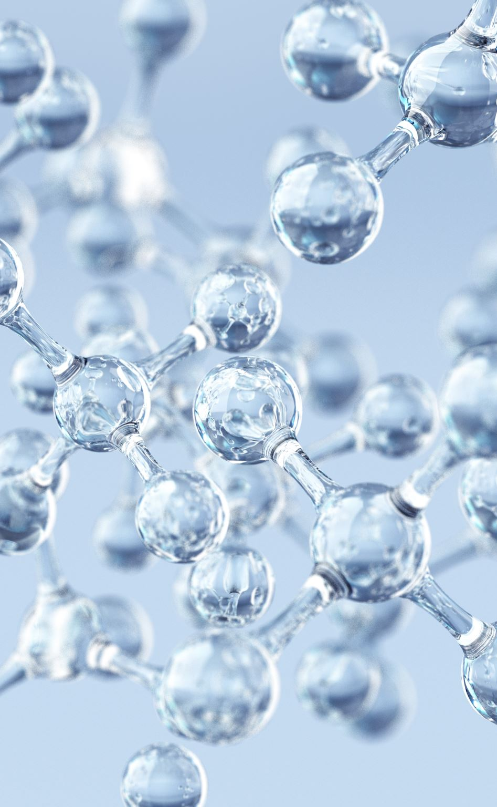
1. Nano-coatings:
Nano-coatings are typically made up of particles that are less than 100 nanometers in size, which provides a large surface area to volume ratio, giving rise to unique physical and chemical properties. These coatings can be applied to various substrates such as metals, glass, and polymers to provide improved properties such as hardness, wear resistance, and hydrophobicity. Nano-coatings have been extensively studied in the scientific literature, and there are numerous examples of their use in different industries. For example, silver nanoparticles have been used in medical devices to provide antimicrobial properties, while titanium dioxide nanoparticles have been used in sunscreens and coatings to provide UV protection.

Slide 8
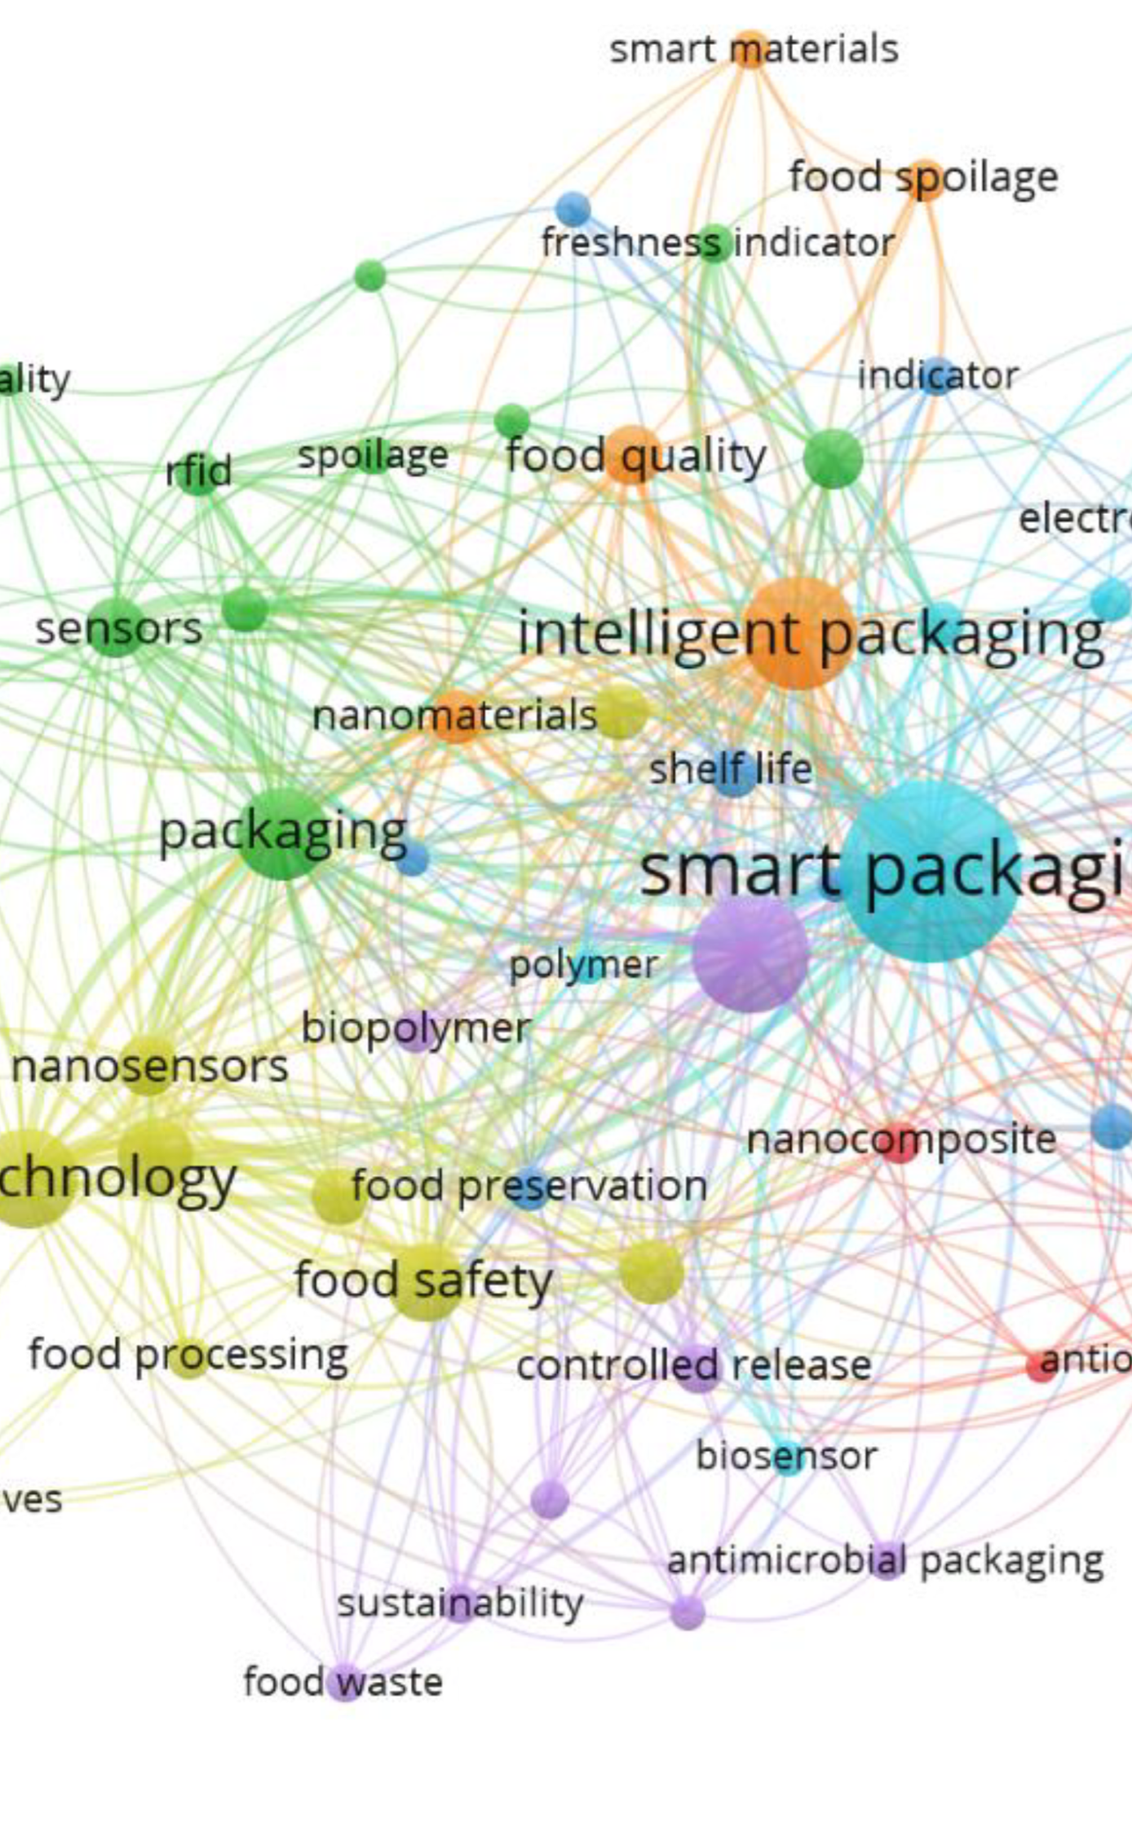
2. Smart coatings:
Smart coatings are designed to respond to external stimuli such as temperature, light, or humidity, and can change their properties accordingly. Some examples of smart coatings include self-healing coatings, which can repair themselves when damaged, and anti-fog coatings, which prevent the formation of condensation on surfaces. There has been a lot of research in this area, with many different types of smart coatings being developed and studied for various applications. For example, researchers have developed a smart coating that can change color in response to temperature changes, which could be used in building materials to regulate temperature and energy consumption.

Slide 9
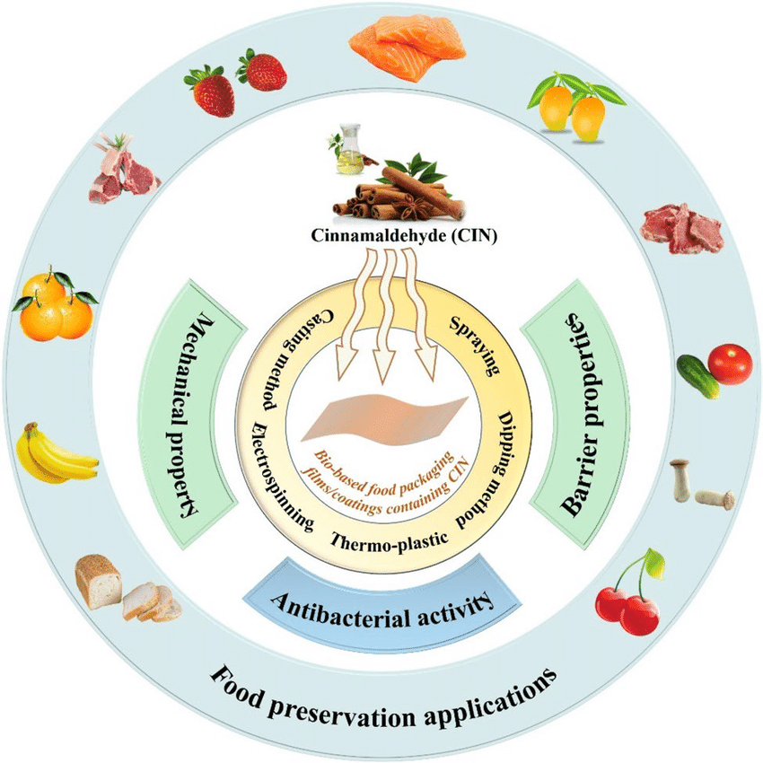
3. Bio-based coatings:
Bio-based coatings are coatings made from renewable resources such as plants, animals or microorganisms. These coatings are considered environmentally friendly and sustainable alternatives to traditional petroleum-based coatings. There is increasing interest in bio-based coatings due to their potential to reduce the environmental impact of coating technologies. For example, researchers have developed a bio-based coating made from chitosan, a natural biopolymer derived from shellfish, that can be used to provide water resistance and durability to paper products.

Slide 10
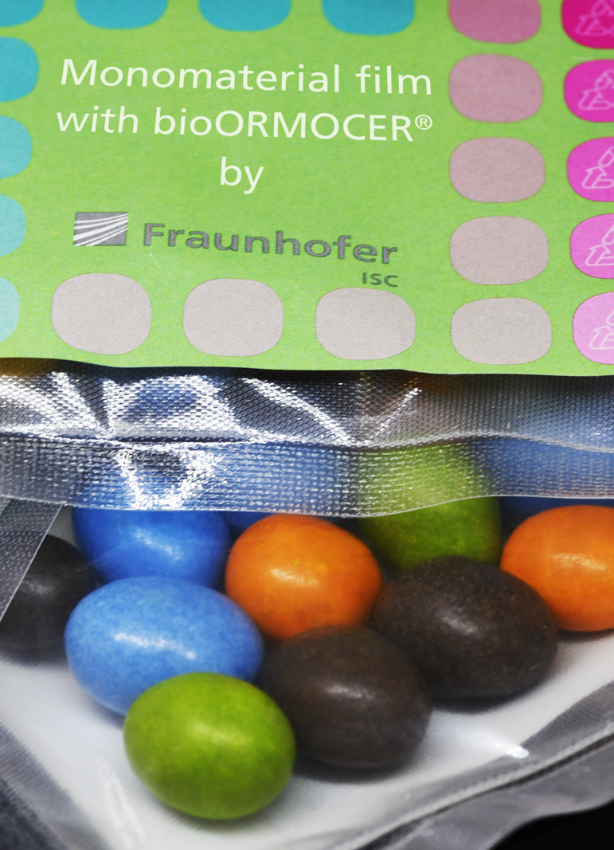
4. Multifunctional coatings:
Multifunctional coatings are coatings that provide multiple functions, such as corrosion resistance, UV protection, and antimicrobial properties, in a single layer. These coatings have been studied extensively in various industries, including automotive, aerospace, and healthcare. For example, researchers have developed a multifunctional coating made from graphene oxide, which can provide corrosion resistance, mechanical strength, and thermal insulation to metal surfaces.

Slide 11
5. 3D printing coatings:
3D printing coatings can be used to improve the surface finish, texture, and functionality of 3D-printed parts. There is a growing body of research on 3D printing coatings, with various materials being studied for this application. For example, researchers have developed a 3D printing coating made from a mixture of nanoparticles and polymers, which can be used to provide enhanced mechanical properties and surface finish to 3D-printed parts.

Slide 12
6. Electrochromic coatings:
Electrochromic coatings are coatings that change color or transparency in response to an electric current. These coatings have been studied extensively for various applications, including smart windows, automotive mirrors, and eyewear. For example, researchers have developed an electrochromic coating made from tungsten oxide, which can be used to create smart windows that can regulate the amount of light and heat that enters a building.

Slide 13
7. Supercritical Fluid Coating:
Supercritical fluid coating has been used to produce edible films and coatings for food applications. A study published in the Journal of Agricultural and Food Chemistry (2018) reported that supercritical CO2-assisted atomization could produce gelatin-based coatings with high water vapor barrier properties and good adhesion to food surfaces. The study also reported that the coatings could improve the sensory quality and extend the shelf life of strawberries.

Slide 14
7. Electrospinning:
Electrospinning has been used to produce chitosan-based nanofibers for food packaging applications. A study published in Food Chemistry (2018) reported that electrospun chitosan nanofibers had a significantly higher water vapor barrier and antimicrobial activity than chitosan films, making them suitable for food packaging applications. Additionally, a study published in Carbohydrate Polymers (2021) reported that electrospun polyvinyl alcohol (PVA)/cellulose nanofiber composite membranes exhibited high tensile strength, flexibility, and water resistance, making them a promising candidate for food packaging applications.

Slide 15
8. Atomic Layer Deposition (ALD):
ALD has been used to deposit thin coatings on food packaging materials. A study published in the Journal of Food Engineering (2019) reported that ALD coatings of aluminum oxide and titanium dioxide could improve the barrier properties of cellulose nanofiber-based food packaging materials, reducing the permeation of oxygen and water vapor. The study also reported that ALD coatings could improve the mechanical properties of the packaging materials.

Slide 16
9. Plasma Coating:
Plasma coating has been used to produce antimicrobial coatings on food packaging materials. A study published in the Journal of Food Science (2016) reported that plasma coating of polyethylene films with allyl isothiocyanate (AIT) resulted in a significant reduction of Escherichia coli O157:H7 and Listeria monocytogenes, two common foodborne pathogens. The study also reported that the plasma coating did not affect the mechanical properties of the films.

Slide 17
APPLICATIONS IN FOOD INDUSTRY
Emerging coating techniques can be applied to a wide range of foods, including:
Fruits and vegetables: Electrospinning and supercritical fluid coating can be used to produce edible coatings for fruits and vegetables, which can help to maintain their freshness and extend their shelf life. Plasma coating can also be used to reduce the presence of harmful bacteria and fungi on the surface of fruits and vegetables.
Meat and poultry: Plasma coating and nanotechnology-based coatings can be used to prevent the growth of bacteria on the surface of meat and poultry, helping to improve their safety and extend their shelf life.

Slide 18
3. Dairy products: ALD coatings can be used to improve the barrier properties of dairy packaging materials, reducing the permeation of oxygen and water vapor and extending the shelf life of dairy products.
4. Snacks and confectionery: Supercritical fluid coating and nanotechnology-based coatings can be used to produce edible coatings for snacks and confectionery, which can help to improve their sensory quality and extend their shelf life.
Overall, emerging coating techniques have a wide range of potential applications in the food industry, from extending shelf life and improving food safety to enhancing sensory quality and reducing food waste for a variety of food products.

Slide 19
CHALLENGES RELATED TO THESE TECHNIQUES
While emerging coating techniques have a lot of potential for improving the quality and safety of food products, they also come with several challenges that need to be addressed. Here are some challenges related to these techniques:
Cost: Many emerging coating techniques involve the use of specialized equipment and materials, which can be expensive to acquire and operate. This can make it challenging to scale up these techniques for commercial use.
Safety: Some emerging coating techniques involve the use of chemicals or materials that may be hazardous to human health or the environment. It is important to ensure that these techniques are safe for both consumers and workers involved in their production.

Slide 20
3. Regulatory approval: Before emerging coating techniques can be used in the food industry, they must be approved by regulatory agencies such as the FDA or EFSA. This process can be time-consuming and expensive, and it may require additional research to demonstrate the safety and effectiveness of these techniques.
4. Compatibility: Emerging coating techniques may not be compatible with all types of food products or packaging materials. It is important to identify which techniques are best suited for specific applications to ensure that they are effective and safe.
5. Shelf life: While many emerging coating techniques have been shown to improve the shelf life of food products, they may also introduce new challenges related to storage and transport. For example, some coatings may be sensitive to temperature or humidity, which could affect their effectiveness over time.
Overall, addressing these challenges will be important for realizing the full potential of emerging coating techniques in the food industry. By doing so, we can develop new and innovative ways to improve the safety, quality, and sustainability of our food supply.

Slide 21
FUTURE PERSPECTIVE
What can be said is that there is an increasing trend towards the use of sustainable and eco-friendly coating techniques in the food industry. Consumers are becoming more aware of the impact of food production on the environment, and there is growing demand for products that are produced using environmentally-friendly processes. Therefore, coating techniques that offer sustainability benefits, such as those that use natural or biodegradable materials, are likely to gain more popularity in the future.
Furthermore, coating techniques that can be easily integrated into existing food production processes and that offer cost and time savings are also likely to be favored by the food industry. Techniques that require specialized equipment or extensive training may be more challenging to adopt on a large scale.
Ultimately, the choice of coating technique will depend on a variety of factors, including the specific food product, the desired properties of the coating, and the cost and feasibility of the technique for large-scale production.

Slide 22
FURTHER READING
https://pubs.rsc.org/en/content/articlehtml/2016/ra/c6ra13237e
https://ift.onlinelibrary.wiley.com/doi/abs/10.1111/1541-4337.12556
https://onlinelibrary.wiley.com/doi/abs/10.1002/adma.201200397
https://link.springer.com/article/10.1007/s11947-021-02753-5
https://www.sciencedirect.com/science/article/pii/S2468023020307264
https://www.sciencedirect.com/science/article/pii/S0924224419306491
https://www.sciencedirect.com/science/article/pii/S0001868620300671
https://www.sciencedirect.com/science/article/pii/S0963996920310061

