Slide 1
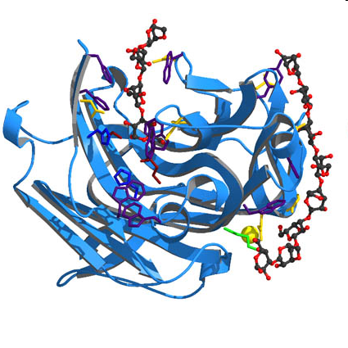
What are enzymes?
Biological catalysts made up of proteins

Slide 2
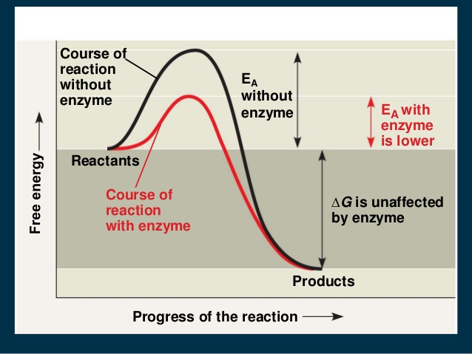
Function of Enzymes
Biological catalysts made up of proteins
Enzymes speed up the rate of chemical reactions in the body; both breaking down (e.g.: starch into maltose) and building up reactions. (e.g: amino acids into proteins).
Enzymes lower the activation energy required to start a chemical reaction

Slide 3
Examples of each type of metabolism:
Anabolic Pathways Catabolic Pathways
Protein Biosynthesis Glycolysis
Glycogenesis TCA (Krebs cycle)
Gluconeogenesis ß-oxidation
Fatty Acid Synthesis Respiratory Chain
Other useful generalizations:
Some of the steps in the anabolic path (going “uphill”) may not be
identical to the catabolic path--but some are shared.
ATP
Generated
Provides
Energy
FOR

Slide 4
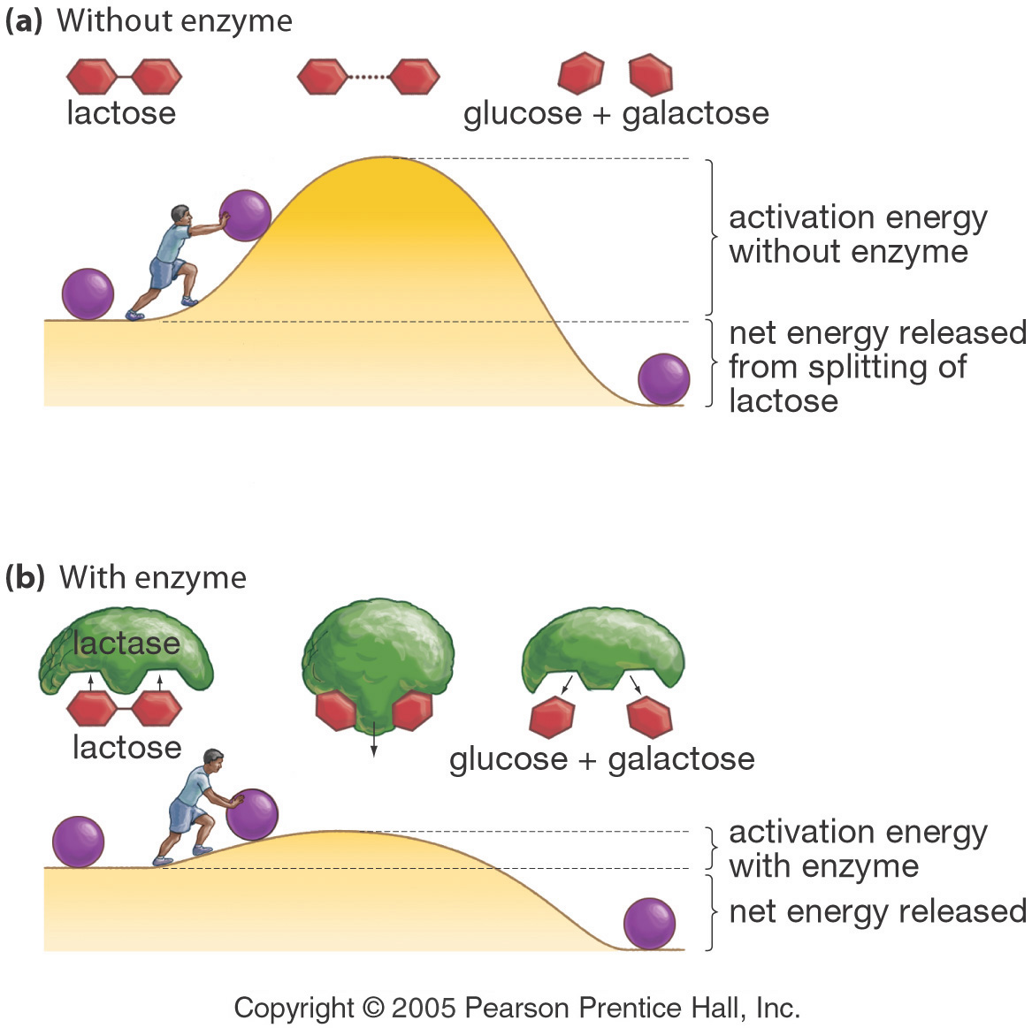
Enzymes Lower a Reaction’s Activation Energy
Notes:
4
Energy and Enzymes
3/20/2017
G. Podgorski, Biol. 1010
4
Activation energy is the push needed to start a reaction

Slide 5
Characteristics of Enzymes
Enzymes are highly specific in action.
Enzymes remain chemically unchanged at the end of the reaction.
Enzymes are required in minute amounts.

Slide 6
Structure of enzymes
Enzymes
Complex or holoenzymes (protein part and nonprotein part – cofactor)
Simple (only protein)
Apoenzyme (protein part)
Cofactor
Prosthetic groups
usually small inorganic molecule or atom;
usually tightly bound to apoenzyme
Coenzyme
-large organic molecule
-loosely bound to apoenzyme
Notes:
6

Slide 7
Enzymes
Substrate
Enzymes are organic catalysts.
1
Active Site
Cofactor/Coenzyme
Enzyme
Product
Enzyme-Substrate Complex
3
2
Enzyme
Notes:
15

Slide 8
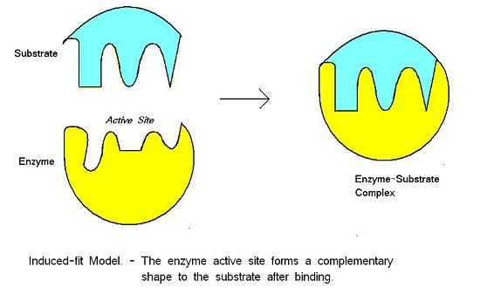
Induced Fit Theory – Most current
An enzyme-substrate complex forms when the enzyme’s active site binds with the substrate like a key fitting a lock.
The substrate molecule does not fit exactly in the active site. This induces a change in the enzymes conformation (shape) to make a closer fit.
After the reaction, the products are released and the enzyme returns to its normal shape.
Only a small amount of enzyme is needed because they can be used repeatedly.

Slide 9
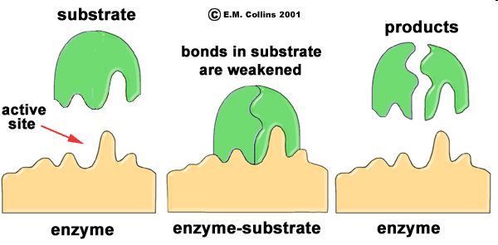
Mode of Action
Substrate fits in the enzyme active site,
just like a key fits into a lock.
An enzyme-substrate complex is formed.
Chemical reactions occur at the active site and products are formed.

Slide 10
Rate of Reaction
Reactions with enzymes are up to 10 billion times faster than those without enzymes.
Enzymes typically react with between 1 and 10,000 molecules per second. Fast enzymes catalyze up to 500,000 molecules per second.
Substrate concentration, enzyme concentration, Temperature, and pH affect the rate of enzyme reactions.

Slide 11
Enzyme Concentration
If there is insufficient enzyme present, the reaction will not proceed as fast as it otherwise would because there is not enough enzyme for all of the reactant molecules.
As the amount of enzyme is increased, the rate of reaction increases. If there are more enzyme molecules than are needed, adding additional enzyme will not increase the rate. Reaction rate therefore increases as enzyme concentration increases but then it levels off.
Even when adding more enzymes, there isn’t any more available substrate to create product at a faster rate
Rate of Reaction
Enzyme Concentration

Slide 12
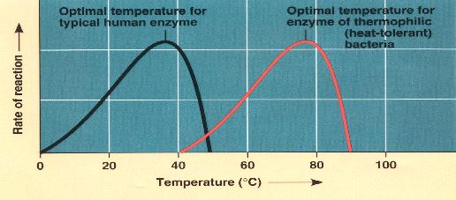
Effect of Temperature on Enzyme Activity
Notes:
23

Slide 13
Temperature
Higher temperature causes more collisions between the atoms, ions, molecules, etc. It therefore increases the rate of a reaction – “Turnover Rate”. More collisions increase the likelihood that substrate will collide with the active site of the enzyme.
Above a certain temperature, activity begins to decline because the enzyme begins to denature (unfold).
The rate of chemical reactions therefore increases with temperature but then decreases.
Rate of Reaction
30 40 50
Temperature

Slide 14
Denaturation
If the hydrogen bonds within an enzyme are broken, the enzyme may unfold or take on a different shape. The enzyme is denatured.
A denatured enzyme will not function properly because the shape of the active site has changed.
If the denaturation is not severe, the enzyme may regain its original shape and become functional.
The following will cause denaturation:
  Heat
  Changes in pH
  Heavy-metal ions (lead, arsenic, mercury)
  Alcohol
  UV radiation

Slide 15
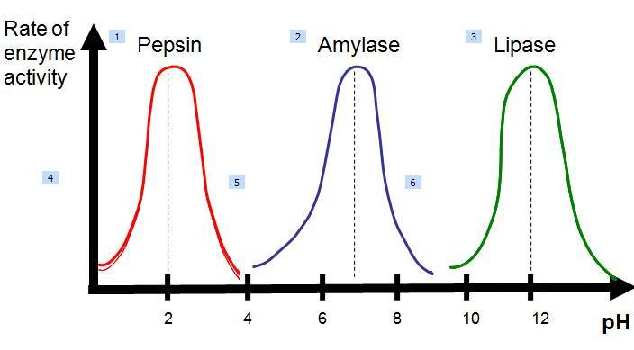
Effect of pH on enzyme activity
Enzyme works best within a narrow pH range
Each enzyme works best at particular pH, known as its optimum pH level.
At extreme pH levels, enzymes lose their shape and function and become denatured.

Slide 16
Metabolic Pathways and Enzymes
Metabolism refers to the chemical reactions that occur within cells.
Reactions occur in a sequence and a specific enzyme catalyzes each step.

Slide 17
Metabolic Pathways
Notice that C can produce either D or F. This substrate has two different enzymes that work on it.
A B C D E
enzyme 1 enzyme 2 enzyme 3 enzyme 4
F
enzyme 5
Enzymes are very specific. In this case enzyme 1 will catalyze the conversion of A to B only.
Notes:
4

Slide 18
A Cyclic Metabolic Pathway
In this pathway, substrate “A” enters the reaction. After several steps, product “E” is produced.
A
B
A + F → B
B → C → D
D → F + E
F
C
D
E
Notes:
7

Slide 19
Regulation of Enzymes
The next several slides illustrate how cells regulate enzymes. For example, it may be necessary to decrease the activity of certain enzymes if the cell no longer needs the product produced by the enzymes.

Slide 20
Regulation of Enzymes
Cell can turn on DNA genes to build more enzymes when needed
genetic
regulation
regulation of enzymes
already produced
Cells can use certain chemicals to slow down existing enzymes
competitive
inhibition
noncompetitive
Inhibition
(next slide)
Notes:
29

Slide 21
Competitive Inhibition
In competitive inhibition, a similar-shaped molecule competes with the substrate for active sites.
Notes:
27

Slide 22
Competitive Inhibition
This substrate cannot get into active site at this time
Active site is being occupied by competitive inhibitor
Notes:
28

Slide 23
Noncompetitive Inhibition
Active site
Inhibitor
Altered active site
Enzyme
Another form of inhibition involves an inhibitor that binds to an allosteric site of an enzyme. An allosteric site is a different location than the active site.
The binding of an inhibitor to the allosteric site alters the shape of the enzyme, resulting in a distorted active site that does not function properly.

Slide 24
Noncompetitive Inhibition
The binding of an inhibitor to an allosteric site is usually temporary. Poisons are inhibitors that bind irreversibly. For example, penicillin inhibits an enzyme needed by bacteria to build the cell wall. Bacteria growing (reproducing) without producing cell walls eventually rupture.

Slide 25
Feedback Inhibition
The goal of this hypothetical metabolic pathway is to produce chemical D from A.
A B C D
enzyme 1
enzyme 2
enzyme 3
B and C are intermediates.
Enzyme regulation by negative feedback inhibition is similar to the thermostat example. As an enzyme's product accumulates, it turns off the enzyme just as heat causes a thermostat to turn off the production of heat.
The next several slides will show how feedback inhibition regulates the amount of D produced.
Notes:
34

Slide 26
Feedback Inhibition
C and D will decrease because B is needed to produce C and C is needed to produce D.
The amount of B in the cell will decrease if enzyme 1 is inhibited.
X
X
A B C D
X
X
enzyme 1
enzyme 2
enzyme 3
Enzyme 1 is structured in a way that causes it to interact with D. When the amount of D increases, the enzyme stops functioning.
Notes:
35

Slide 27
Feedback Inhibition
B, C, and D can now be synthesized.
A B C D
X
X
X
B
C
D
enzyme 1
enzyme 2
enzyme 3
When the amount of D drops, enzyme 1 will no longer be inhibited by it.
Notes:
39

Slide 28
Feedback Inhibition
A B C D
X
enzyme 1
enzyme 2
enzyme 3
As D begins to increase, it inhibits enzyme 1 again and the cycle repeats itself.
Notes:
42

Slide 29
ENZYME INHIBITION

Slide 30
Inhibitors
Inhibitors are chemicals that reduce the rate of enzymic reactions
The are usually specific and they work at low concentrations
They block the enzyme but they do not usually destroy it
Many drugs and poisons are inhibitors of enzymes in the nervous system

Slide 31
The effect of enzyme inhibition
Irreversible inhibitors: Combine with the functional groups of the amino acids in the active site, irreversibly
Examples: nerve gases and pesticides, containing organophosphorus, combine with serine residues in the enzyme acetylcholine esterase

Slide 32
The effect of enzyme inhibition
Reversible inhibitors: These can be washed out of the solution of enzyme by dialysis.
There are two categories:
      Competative
      Non Competative

Slide 33
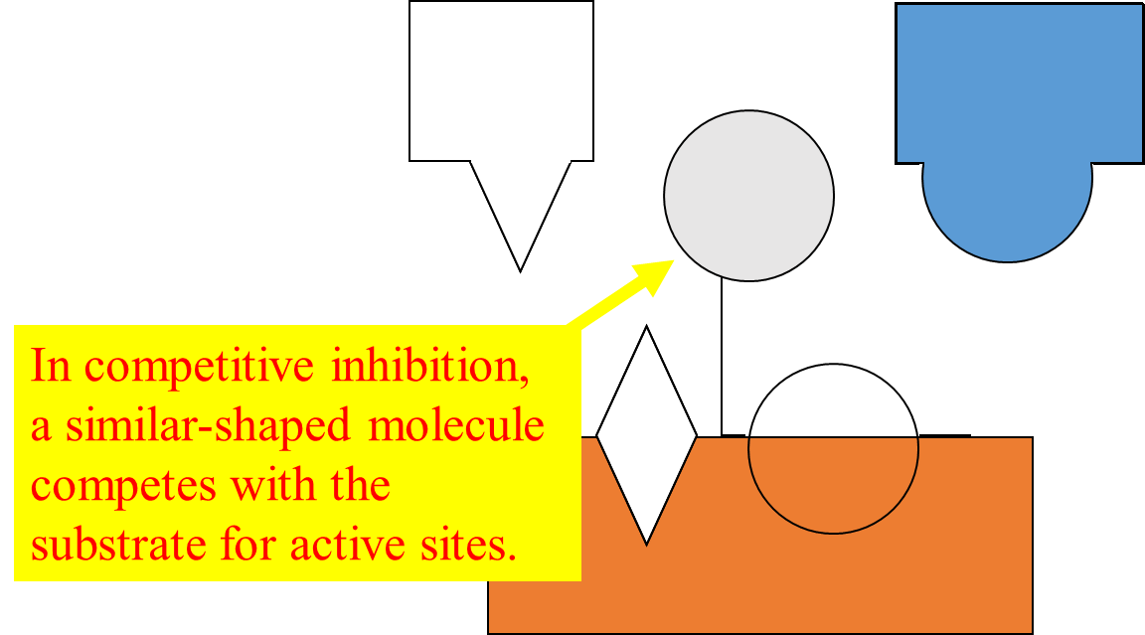
The effect of enzyme inhibition
Competitive: These compete with the substrate molecules for the active site
The inhibitor’s action is proportional to its concentration
Resembles the substrate’s structure closely
E + I
EI
Reversible reaction
Enzyme inhibitor complex

Slide 34
The effect of enzyme inhibition
Fumarate + 2H⁺+ 2e⁻
Succinate
Succinate dehydrogenase
CH₂COOH
COOH
CHCOOH
CH₂
CH₂COOH
CHCOOH
COOH
Malonate

Slide 35
The effect of enzyme inhibition
Non-competitive: These are not influenced by the concentration of the substrate. It inhibits by binding irreversibly to the enzyme but not at the active site
Examples
Cyanide combines with the Iron in the enzymes cytochrome oxidase
Heavy metals, Ag or Hg, combine with –SH groups.
These can be removed by using a chelating agent such as EDTA

Slide 36
Applications of inhibitors
Negative feedback: end point or end product inhibition
Poisons snake bite, plant alkaloids and nerve gases
Medicine antibiotics, sulphonamides, sedatives and stimulants

Slide 37
Enzyme pathways
Cell processes (e.g. respiration or photosynthesis) consist of series of pathways controlled by enzymes
A B C D E F
e_{A}
e_{B}
e_{C}
e_{D}
e_{F}
Each step is controlled by a different enzyme (e_{A}, e_{B}, e_{C} etc)
This is possible because of enzyme specificity

Slide 38
End point inhibition
The first step (controlled by e_{A}) is often controlled by the end product (F)
Therefore negative feedback is possible
A B C D E F
e_{A}
e_{B}
e_{C}
e_{D}
e_{F}
Inhibition
The end products are controlling their own rate of production
There is no build up of intermediates (B, C, D and E)

Slide 39
Example: Phosphofructokinase and ATP
Substrate: Fructose-6-phosphate
Reaction
fructose-6-phosphate + ATP → fructose-1,6-bisphosphate + ADP
phosphofructokinase

Slide 40
ATP is the end point
This reaction lies near the beginning of the respiration pathway in cells
The end product of respiration is ATP
If there is a lot of ATP in the cell this enzyme is inhibited
Respiration slows down and less ATP is produced
As ATP is used up the inhibition stops and the reaction speeds up again

Slide 41
The switch: Allosteric inhibition
Allosteric means “other site”
Active site
E
Allosteric site

Slide 42
Switching off
These enzymes have two receptor sites
One site fits the substrate like other enzymes
The other site fits an inhibitor molecule
Inhibitor molecule
Substrate
cannot fit into the active site
Inhibitor fits into allosteric site
© 2008 Paul Billiet ODWS

Slide 43
The allosteric site the enzyme “on-off” switch
Active site
E
Allosteric site empty
Conformational change
Substrate
fits into the active site
E
Inhibitor molecule is present
Substrate
cannot fit into the active site
The inhibitor molecule is absent
Inhibitor fits into allosteric site

Slide 44
A change in shape
When the inhibitor is present it fits into its site and there is a conformational change in the enzyme molecule
The enzyme’s molecular shape changes
The active site of the substrate changes
The substrate cannot bind with the substrate

Slide 45
Negative feedback is achieved
The reaction slows down
This is not competitive inhibition but it is reversible
When the inhibitor concentration diminishes the enzyme’s conformation changes back to its active form

Slide 46
Phosphofructokinase
This enzyme an active site for fructose-6-phosphate molecules to bind with another phosphate group
It has an allosteric site for ATP molecules, the inhibitor
When the cell consumes a lot of ATP the level of ATP in the cell falls
No ATP binds to the allosteric site of phosphofructokinase
The enzyme’s conformation (shape) changes and the active site accepts substrate molecules

Slide 47
Phosphofructokinase
The respiration pathway accelerates and ATP (the final product) builds up in the cell
As the ATP increases, more and more ATP fits into the allosteric site of the phosphofructokinase molecules
The enzyme’s conformation changes again and stops accepting substrate molecules in the active site
Respiration slows down

