Slide 1
ATP and metabolism
Adenosine triphosphate

Slide 2
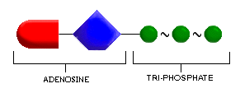
ATP and metabolism
Adenine
Ribose
phosphate

Slide 3
Functions of ATP
Under normal conditions, the oxidation of metabolic fuels is controlled by the availability of ADP, which, in turn is controlled by the rate at which ATP is being utilized in performing physical and chemical work. Work output, or energy expenditure, thus controls the rate at which metabolic fuels are oxidized, and hence the amount of food that must be eaten to meet energy requirements. Metabolic fuels in excess of immediate requirements are stored as reserves of glycogen in muscle and liver and as fat in adipose tissue. In all of the reactions in which ATP is utilized, what is observed overall is hydrolysis of ATP to ADP and phosphate (exothermic reaction).
concentration of ATP in cells is always very much higher than that of ADP (the ratio of ATP to ADP is about 500:1), again ensuring that the reaction will indeed proceed in the direction of ATP hydrolysis.

Slide 4
3 Mechanisms of ATP generation
  Substrate-level phosphorylation
    Transferring high-energy phosphate group from an intermediate directly to ADP
  Oxidative phosphorylation
    Remove electrons and pass them through electron transport chain to oxygen
  Photophosphorylation
    Only in chlorophyll-containing plant cells

Slide 5
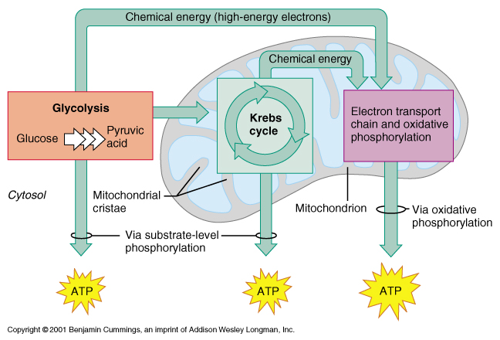

Slide 6
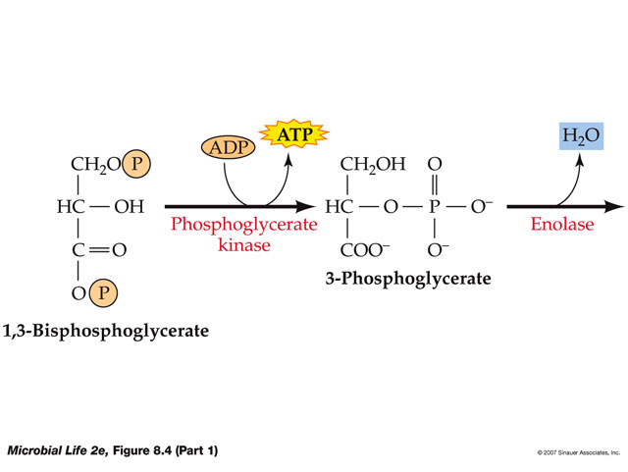
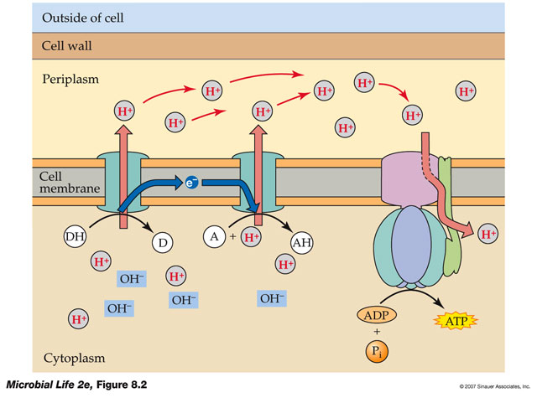
Chemical-based ATP synthesis:
Substrate level phosphorylation
Respiration-linked phosphorylation

Slide 7
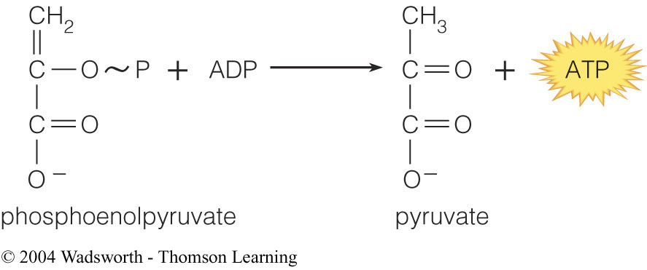
ATP synthesis by substrate-level phosphorylation
Phosphorylated intermediates are generated in:
  Glycolysis (Embden-Meyhof pathway)
  Tricarboxylic Acid Cycle (TCA)
  Fermentation
Finally, the Pi is transferred from a high energy phosphorylated intermediate to ADP by a kinase
ADP obtains phosphate from metabolic intermediate
molecule which has a high energy bond
ATP is formed

Slide 8
Substrate level phosphorylation of ADP to ATP
Substrate level phosphorylation: Some reactions involve direct transfer of phosphate from a phosphorylated substrate onto ADP, forming ATP – substrate-level phosphorylation.
Two such reactions are shown in following Figure

Slide 9
Oxidative phosphorylation
With the exception of glycolysis, which is a cytosolic pathway, most of the reactions in the oxidation of metabolic fuels occur inside the mitochondria, and lead to the reduction of nicotinamide nucleotide and flavin coenzymes. The reduced coenzymes are then reoxidized, ultimately leading to the reduction of oxygen to water. Within the inner membrane of the mitochondrion there is a series of coenzymes that are able to undergo reduction and oxidation. The first coenzyme in the chain is reduced by reaction with NADH, and is then reoxidized by reducing the next coenzyme. In turn, each coenzyme in the chain is reduced by the preceding coenzyme, and then reoxidized by reducing the next one. The final step is the oxidation of a reduced coenzyme by oxygen, resulting in the formation of water. The stepwise oxidation of NADH and reduction of oxygen to water is obligatorily linked to the phosphorylation of ADP to ATP. Approximately 3 mol of ATP is formed for each mole of NADH that is oxidized. Flavoproteins reduce ubiquinone, which is an intermediate coenzyme in the chain, and approximately 2 mol of ADP is phosphorylated to ATP for each mole of reduced flavoprotein that is oxidized. This means that 2 mol of ADP is required for the oxidation of a substrate such as succinate, but 3 mol of ADP is required for the oxidation of malate.

Slide 10
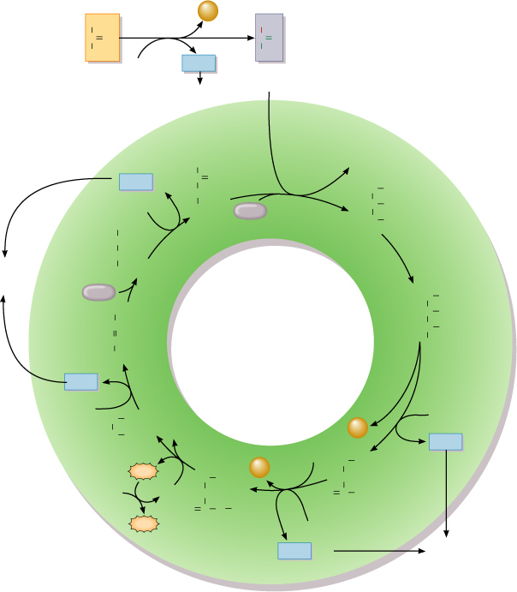
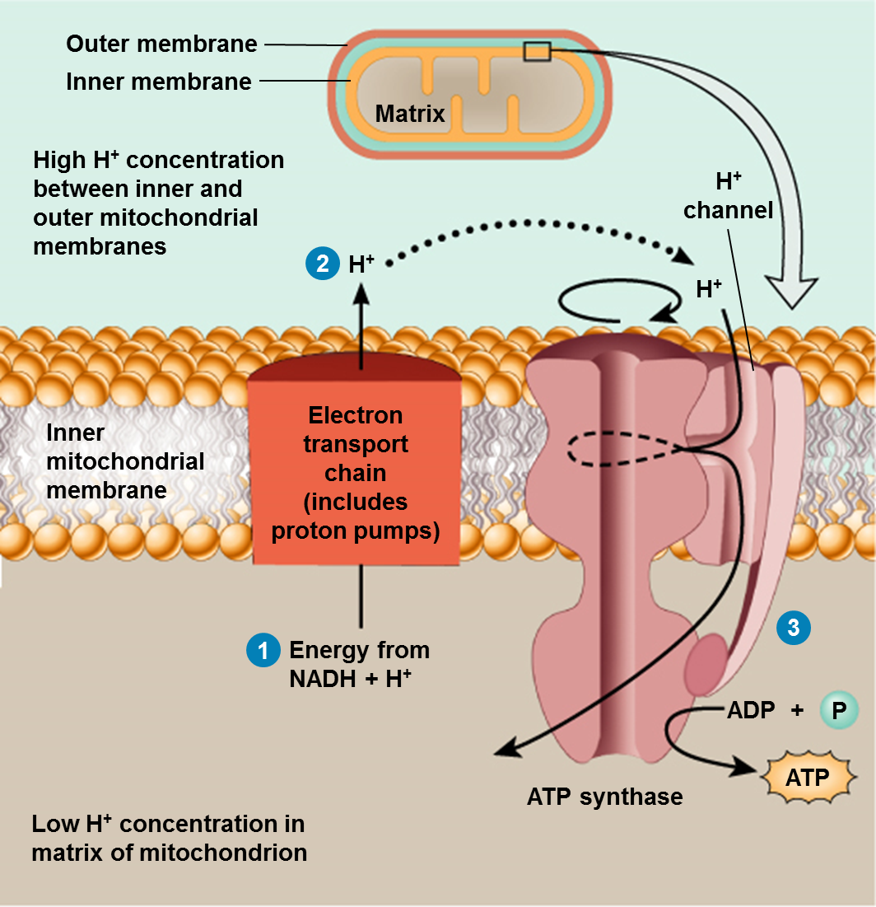
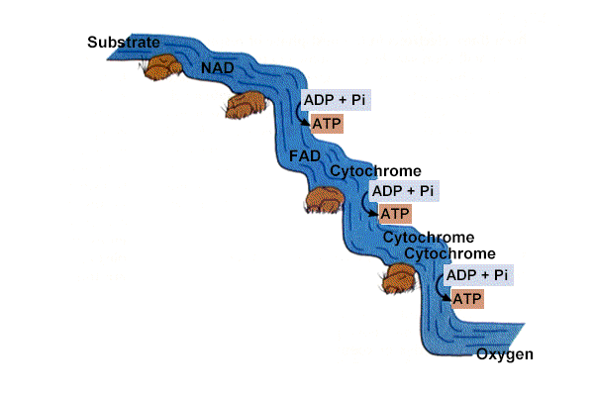
CH₃
CO₂
CoA
C
O
C
O
COOH
NAD⁺
NADH
+ H⁺
CH₃
Pyruvic
acid
Acetyl
coenzyme A
To electron
transport chain
Oxaloacetic acid
CoA
COOH
NADH
+ H⁺
C
O
H₂C
COOH
CH₂
1
HOC
COOH
NAD⁺
COOH
H₂O
H₂C
COOH
Citric acid
COOH
8
HCOH
To electron
transport
chain
CH₂
2
Malic acid
H₂O
COOH
7
H₂C
COOH
COOH
KREBS
CYCLE
HC
COOH
Fumaric acid
HC
CH
HOC
COOH
COOH
3
H
Isocitric acid
FADH₂
6
FAD
H₂C
COOH
CO₂
NAD⁺
H₂C
COOH
CoA
NADH
+ H⁺
Succinic acid
5
CO₂
H₂C
COOH
GTP
H₂C
COOH
4
HCH
ADP
GDP
O
CH₂
CoA
O
C
COOH
ATP
C
S
Alpha-ketoglutaric acid
Succinyl CoA
NAD⁺
NADH
+ H⁺
To electron
transport chain

Slide 11
Transport of materials across cell membranes
Compounds that are lipid soluble will diffuse freely across cell membranes, as they can dissolve in the lipid of the membrane – this is passive diffusion. Hydrophilic compounds require a transport protein in order to cross the lipid membrane – this is facilitated or carrier-mediated diffusion. Neither passive nor facilitated diffusion alone can lead to the concentration of the transported material being greater inside the cell than outside.
Concentrative uptake of the material being transported may be achieved in three main ways: protein binding, metabolic trapping and active transport. These last two mechanisms are both ATP dependent.

Slide 12
Protein binding → binding to an intracellular protein, for example, in the intestinal absorption of calcium and iron. Hydrophobic compounds are transported in plasma bound to transport proteins (e.g. the plasma retinol binding protein).
Metabolic trapping→ Glucose enters cells by carrier-mediated diffusion. Once inside the cell, it is phosphorylated to glucose 6-phosphate, a reaction catalysed by the enzyme hexokinase, using ATP as the phosphate donor. Glucose 6phosphate does not cross cell membranes, and therefore there is a net accumulation of [glucose plus glucose 6-phosphate] inside the cell, at the expense of 1 mol of ATP utilized per mole of glucose trapped in this way. Vitamins B2 (riboflavin) and B6 are similarly accumulated inside cells by phosphorylation at the expense of ATP.
Ion pumps and active transport → Active transport is the accumulation of a higher concentration of a compound on one side of a cell membrane than on the other, without chemical modification such as phosphorylation. The process is dependent on hydrolysis of ATP to ADP and phosphate, either directly, as in the case of ion pumps, or indirectly, as is the case when metabolites are transported by sodium-dependent transporters. when the membrane transport protein is phosphorylated it undergoes a conformational change that opens the transmembrane pore and permits it to transport an ion across the membrane. Before the ion can be released at the membrane surface, the transport protein has to be dephosphorylated. The key to understanding the role of ATP in the sodium pump lies in the fact that the hydrolysis is effected not by H2O, but by H+ and OH– ions, the ATPase that catalyses the hydrolysis of ATP to ADP and phosphate

Slide 14
Mitochondria
Mitochondria are intracellular organelles with a double-membrane structure. Both the number and size of mitochondria vary in different cells – for example, a liver cell contains some 800 mitochondria, a renal tubule cell some 300 and a sperm about 20. The outer mitochondrial membrane is permeable to a great many substrates, while the inner membrane provides a barrier to regulate the uptake of substrates and output of products. The inner mitochondrial membrane forms the cristae, which are paddle-shaped, double-membrane structures that protrude from the inner membrane into the matrix, as shown in Figure. The five compartments of the mitochondrion have a range of specialized functions:
The outer membrane contains the enzymes that are responsible for the desaturation and elongation of fatty acids, the enzymes for triacylglycerol synthesis from fatty acids and phospholipases that catalyse the hydrolysis of phospholipids.
The inter-membrane space contains enzymes involved in nucleotide metabolism, transamination of amino acids and a variety of kinases.

Slide 15
The inner membrane regulates the uptake of substrates into the matrix for oxidation. There is also a transport protein in the mitochondrial inner membrane that transports ADP into the matrix to undergo phosphorylation .
The membrane of the cristae contains the coenzymes associated with electron transport, the oxidation of reduced coenzymes, and the reduction of oxygen to water. The primary particles on the matrix surface of the cristae contain the enzyme that catalyses the phosphorylation of ADP to ATP .
The mitochondrial matrix contains the enzymes concerned with the oxidation of fatty acids , the citric acid cycle , a variety of other oxidases and dehydrogenases, the enzymes for mitochondrial replication and the DNA that codes for some of the mitochondrial proteins.

Slide 16
The mitochondrial electron transport chain
The mitochondrial electron transport chain is a series of enzymes and coenzymes in the crista membrane, each of which is reduced by the preceding coenzyme, and in turn reduces the next, until finally the protons and electrons that have entered the chain from either NADH or reduced flavin reduce oxygen to water. The sequence of the electron carriers shown in Figure: .
• Complex I catalyses the oxidation of NADH and the reduction of ubiquinone, and is associated with the phosphorylation of ADP to ATP.
• Complex II catalyses the oxidation of reduced flavins and the reduction of ubiquinone. This complex is not associated with phosphorylation of ADP to ATP.
• Complex III catalyses the oxidation of reduced ubiquinone and the reduction of cytochrome c, and is associated with the phosphorylation of ADP to ATP;
• Complex IV catalyses the oxidation of reduced cytochrome c and the reduction of oxygen to water, and is associated with the phosphorylation of ADP to ATP.

Slide 17
With an accumulation of protons in the crista space and an accumulation of hydroxyl ions in the matrix – i.e. creation of a pH gradient across the inner membrane. This proton gradient provides the driving force for the phosphorylation of ADP to ATP.
Hydrogen and electron carriers in the mitochondrial electron transport chain

Slide 18
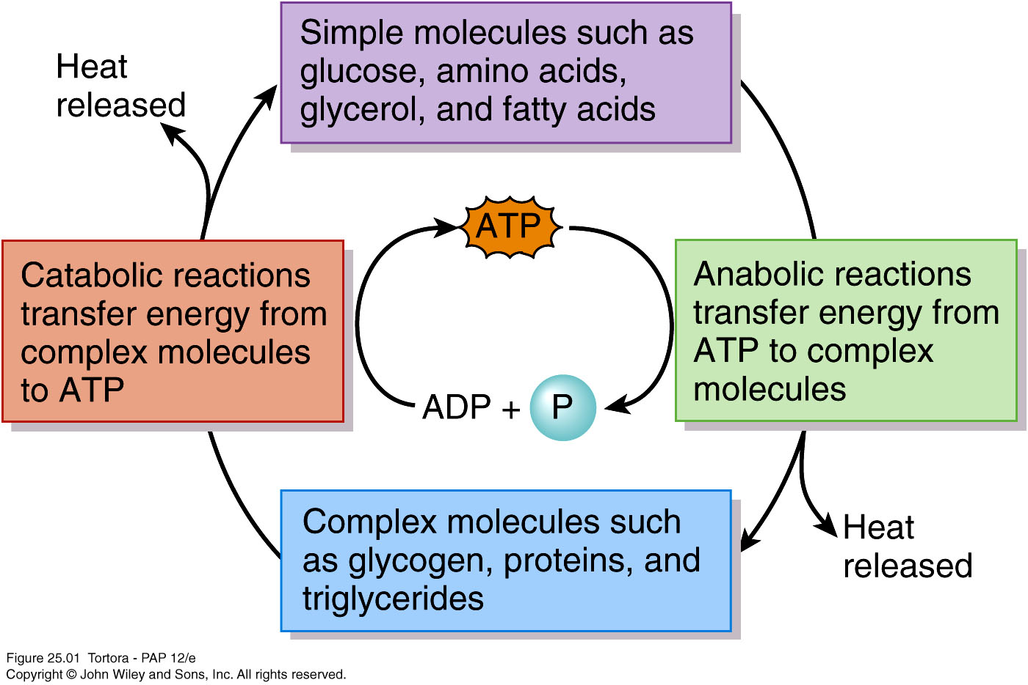
Role of ATP in linking anabolic and catabolic reactions

Slide 19
Examples
ATP ➔ ADP + P
  Oxidation, release energy
ADP + P ➔ ATP
  Reduction, stores energy
NAD + H ➔ NADH
FADH ➔ FAD + H
NH₄ + 1^{1/}₂O₂ ➔NO₂⁻ +H₂O + 2H + ATP
2H₂ + O₂ ➔ 2H₂ O

Slide 20
Respiration
Overview;
  Glucose to Carbon dioxide + Water +Energy
  C₆H₁₂O₆ + O₂ ➔ 6CO₂ + 6H₂O + 38 ATP
  Glucose is highly reduced; contains energy
  Oxygen receives the electrons to form energy
4 separate reactions
  Glycolysis, Transition Reaction, Krebs Cycle, Electron Transport, Chemiosomosis
Requires Oxygen

Slide 21
Carbohydrate metabolism
Fate of glucose depends on needs of body cells
  ATP production or synthesis of amino acids, glycogen, or triglycerides
GluT transporters bring glucose into the cell via facilitate diffusion
  Insulin causes insertion of more of these transporters, increasing rate of entry into cells
  Glucose trapped in cells after being phosphorylated

Slide 22
Glucose catabolism / cellular respiration
  Glycolysis
    Anaerobic respiration – does not require oxygen
  Formation of acetyl coenzyme A
  Krebs cycle reactions
  Electron transport chain reactions
    Aerobic respiration – requires oxygen

Slide 23
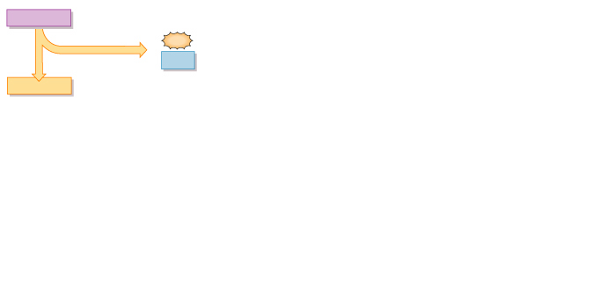
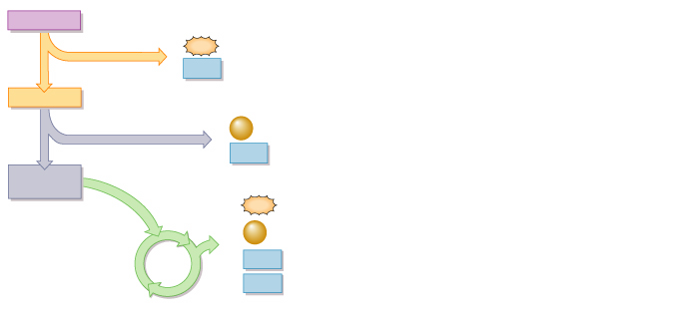
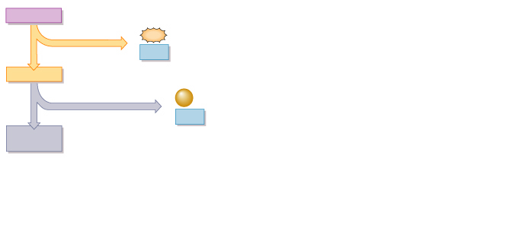
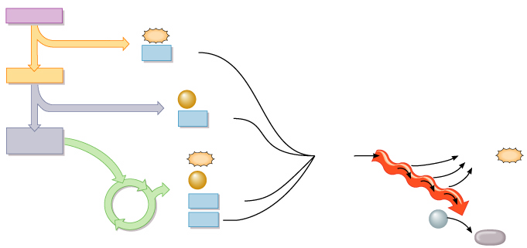
Cellular Respiration
1 Glucose
1 Glucose
1 Glucose
1 Glucose
2
2
2
2
ATP
ATP
ATP
1
ATP
1
1
1
GLYCOLYSIS
GLYCOLYSIS
GLYCOLYSIS
GLYCOLYSIS
2
2
NADH
NADH
+ 2 H⁺
2
+ 2 H⁺
2
NADH
NADH
+ 2 H⁺
+ 2 H⁺
2 Pyruvic acid
2 Pyruvic acid
2 Pyruvic acid
2 Pyruvic acid
2
2
2
FORMATION
OF ACETYL
COENZYME A
FORMATION
OF ACETYL
COENZYME A
FORMATION
OF ACETYL
COENZYME A
CO₂
CO₂
2
CO₂
2
2
2
2
2
NADH
NADH
NADH
+ 2 H⁺
+ 2 H⁺
+ 2 H⁺
4
ELECTRON
TRANSPORT
CHAIN
2 Acetyl
coenzyme A
2 Acetyl
coenzyme A
2 Acetyl
coenzyme A
2
ATP
Electrons
32 or 34
ATP
2
ATP
e–
4
4
CO₂
3
CO₂
e–
3
e–
6
6
NADH
KREBS
CYCLE
NADH
KREBS
CYCLE
+ 6 H⁺
+ 6 H⁺
2
FADH₂
6
O₂
2
FADH₂
6
H₂O

Slide 24
Glycolysis
Glycolysis
  Splits 6-carbon glucose into 2 3-carbon molecules of pyruvic acid
  Consumes 2 ATP but generates 4
  10 reactions
  Fate of pyruvic acid depends on oxygen availability
    If oxygen is scarce (anaerobic), reduced to lactic acid
      Hepatocytes can convert it back to pyruvic acid
    If oxygen is plentiful (aerobic), converted to acetyl coenzyme A

Slide 25
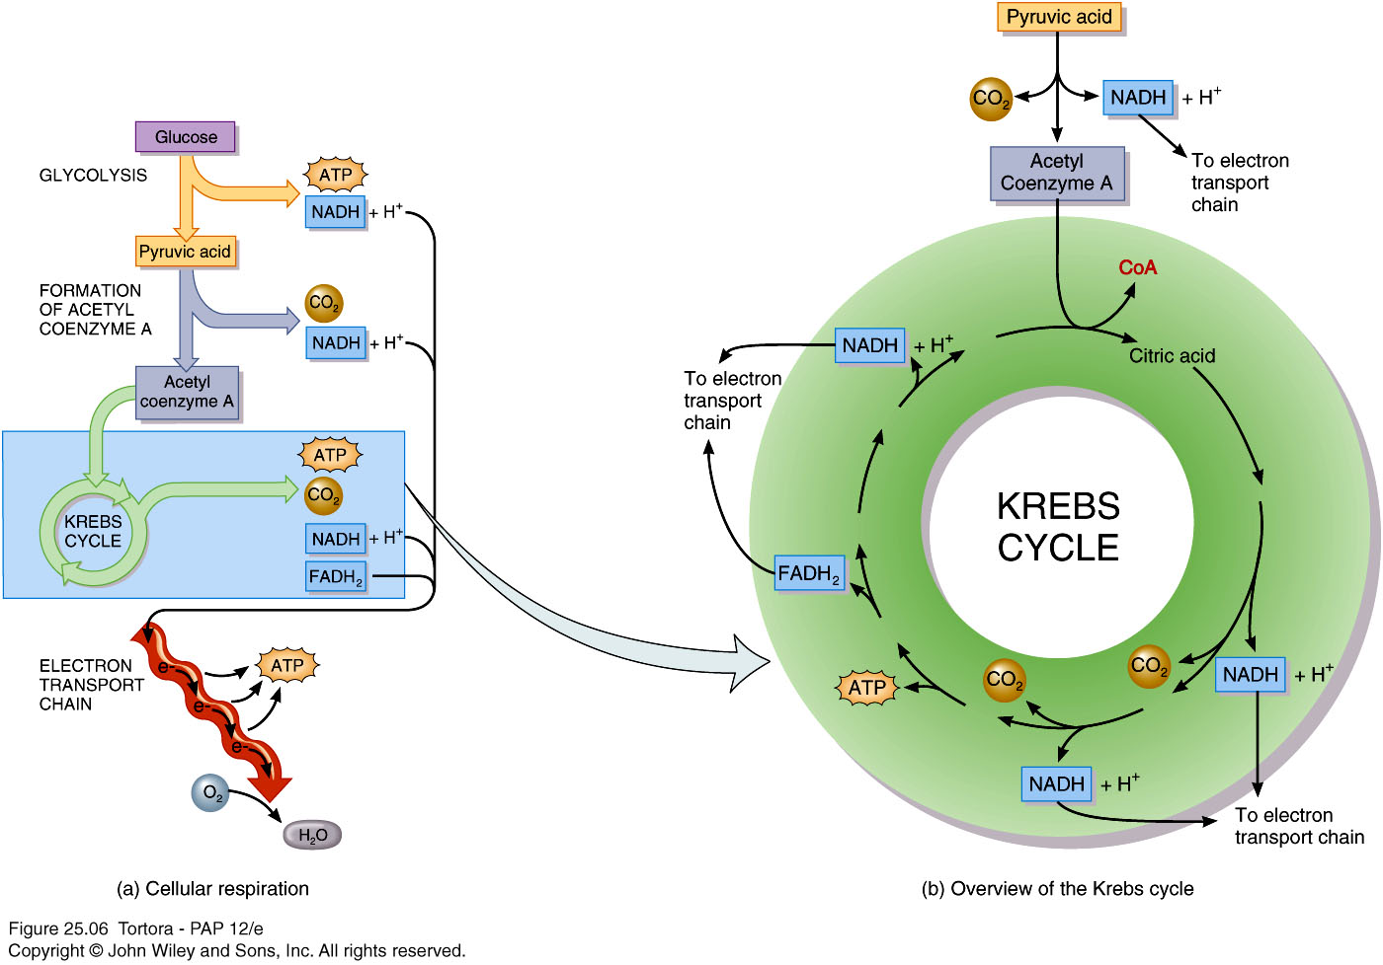
The Krebs Cycle

Slide 26
Electron transport chain
Electron transport chain
  Series of electron carriers in inner mitochondrial membrane reduced and oxidized
  As electrons pass through chain, exergonic reactions release energy used to form ATP
    Chemiosmosis
  Final electron acceptor is oxygen to form water

Slide 27
Chemiosmosis
  Carriers act as proton pumps to expel H⁺ from mitochondrial matrix
  Creates H⁺ electrochemical gradient – concentration gradient and electrical gradient
  Gradient has potential energy – proton motive force
  As H⁺ flows back into matrix through membrane, generates ATP using ATP synthase

Slide 28
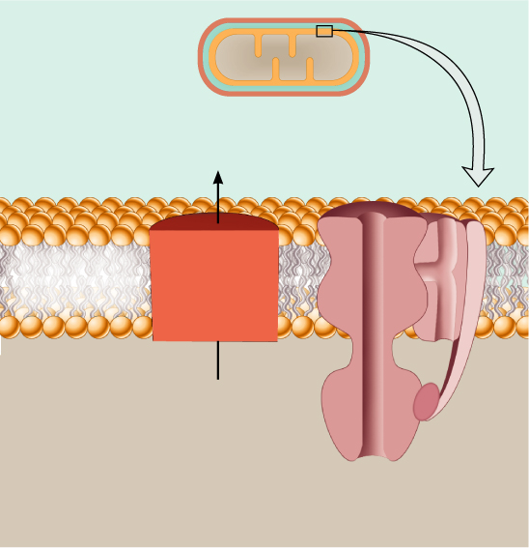
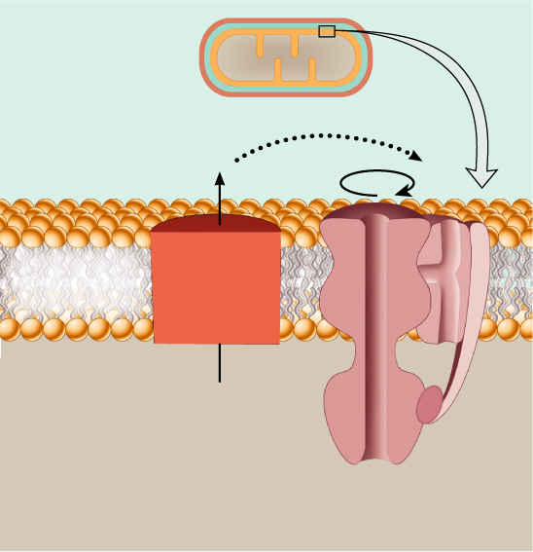
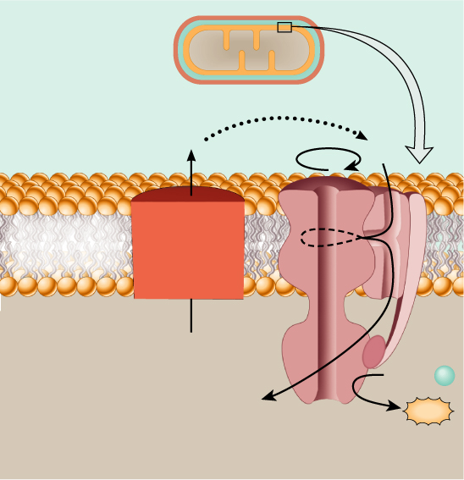
Outer membrane
Outer membrane
Outer membrane
Inner membrane
Inner membrane
Inner membrane
Matrix
Matrix
Matrix
High H⁺ concentration
between inner and
outer mitochondrial
membranes
High H⁺ concentration
between inner and
outer mitochondrial
membranes
High H⁺ concentration
between inner and
outer mitochondrial
membranes
H⁺
channel
H⁺
channel
H⁺
channel
2
2
H⁺
H⁺
H⁺
H⁺
H⁺
Electron
transport
chain
(includes
proton pumps)
Electron
transport
chain
(includes
proton pumps)
Inner
mitochondrial
membrane
Electron
transport
chain
(includes
proton pumps)
Inner
mitochondrial
membrane
Inner
mitochondrial
membrane
3
1
1
1
Energy from
NADH + H⁺
Energy from
NADH + H⁺
Energy from
NADH + H⁺
ADP +
P
ATP
ATP synthase
Low H⁺ concentration in
matrix of mitochondrion
Low H⁺ concentration in
matrix of mitochondrion
Low H⁺ concentration in
matrix of mitochondrion

Slide 29
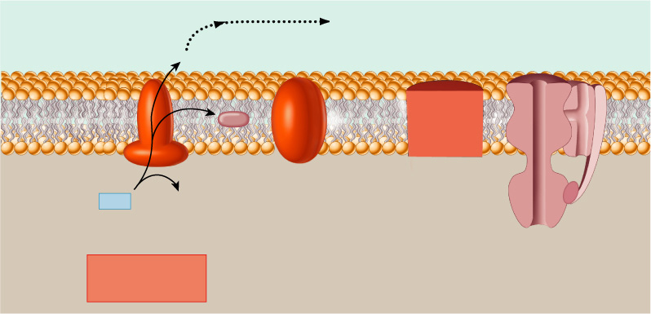
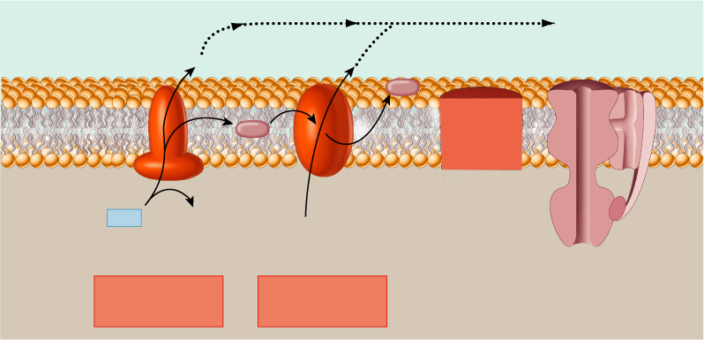
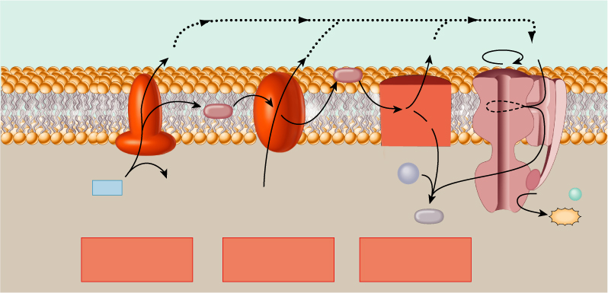
The actions of the three proton pumps and ATP synthase in the inner membrane of mitochondria
Space between outer
and inner mitochondrial
membranes
Space between outer
and inner mitochondrial
membranes
Space between outer
and inner mitochondrial
membranes
H⁺ channel
H⁺ channel
H⁺ channel
+
+
+
+
+
H⁺
+
+
+
+
+
+
+
+
+
+
+
+
+
+
+
H⁺
+
H⁺
H⁺
H⁺
Cyt c
Cyt c
Inner
mito-
chondrial
membrane
Inner
mito-
chondrial
membrane
Inner
mito-
chondrial
membrane
e–
e–
e–
Q
Q
Q
e–
e–
e–
e–
e–
e–
–
–
–
–
–
–
–
–
–
–
–
–
–
–
–
–
–
–
–
–
Mitochondrial
matrix
–
Mitochondrial
matrix
Mitochondrial
matrix
3
1 1/2
O₂
NAD
NAD
+ H⁺
NAD
+ H⁺
NADH
+ H⁺
NADH
NADH
H⁺
H⁺
ADP +
P
3
H₂O
ATP synthase
ATP
1
1
1
2
2
3
NADH dehydrogenase
complex: FMN and
five Fe-S centers
NADH dehydrogenase
complex: FMN and
five Fe-S centers
NADH dehydrogenase
complex: FMN and
five Fe-S centers
Cytochrome b-c₁
complex: cyt b, cyt c₁,
and an Fe-S center
Cytochrome b-c₁
complex: cyt b, cyt c₁,
and an Fe-S center
Cytochrome oxidase
complex: cyt a,
cyt a₃,and two Cu

Slide 30
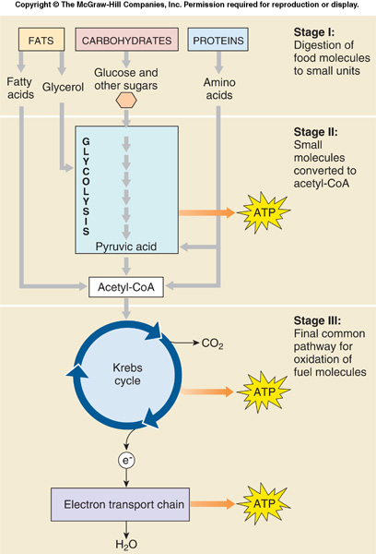

Slide 31
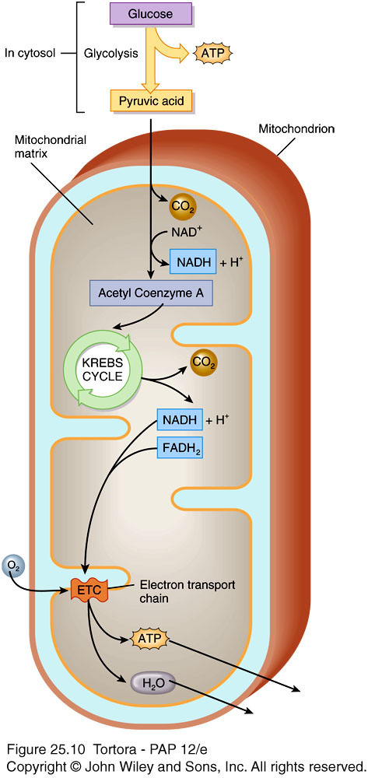
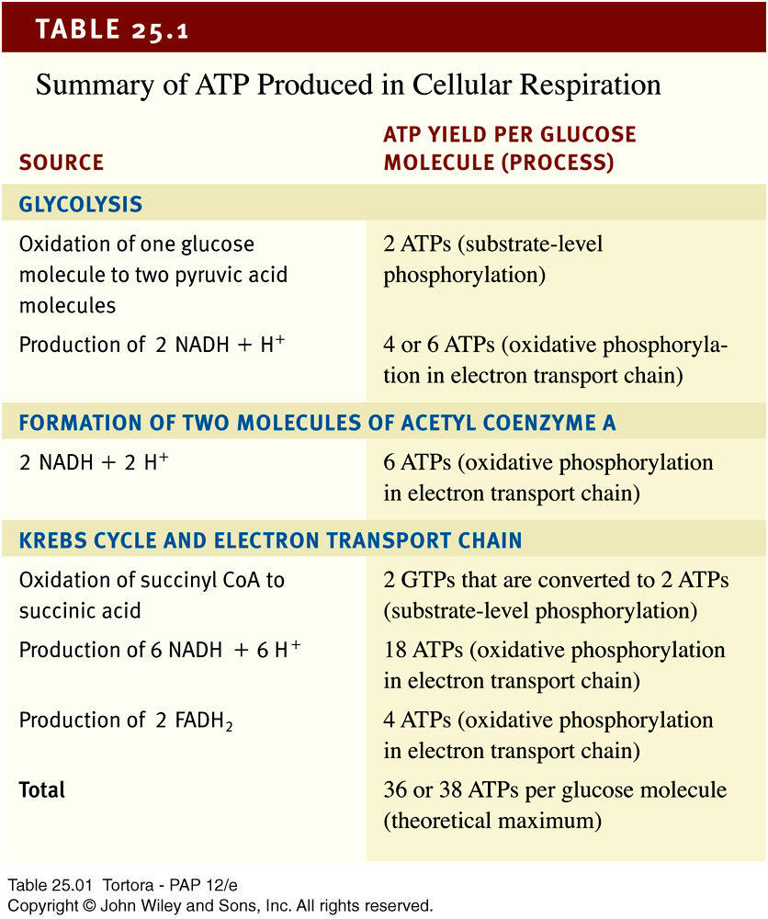
Summary of cellular respiration

Slide 32
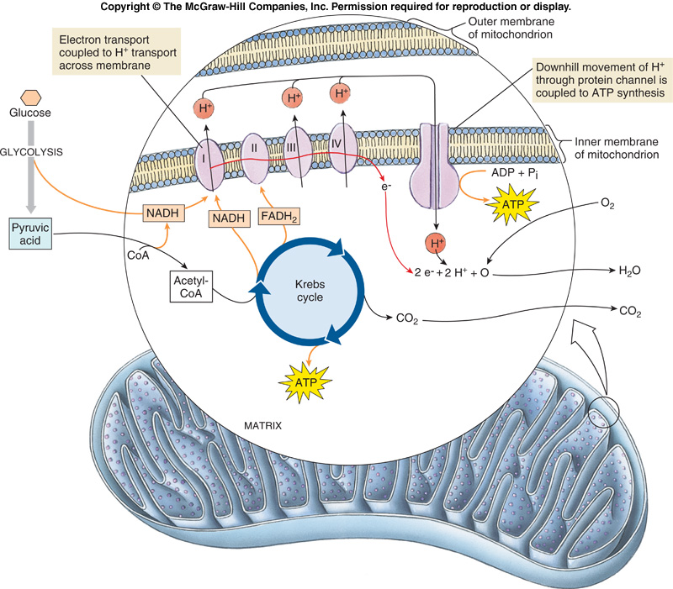
Using Electrons to Make ATP
NADH & FADH₂ contain energized electrons.
NADH molecules carry their electrons to the inner mitochondrial membrane where they transfer electrons to a series of membrane bound proteins – the electron transport chain.

Slide 33
Building an Electrochemical Gradient
In eukaryotes, aerobic metabolism takes place in the mitochondria in virtually all cells.
The Krebs cycle occurs in the matrix, or internal compartment of the mitochondrion.
Protons (H⁺) are pumped out of the matrix into the intermembrane space.

Slide 34
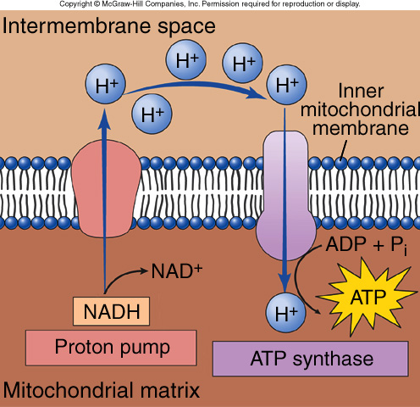
Producing ATP- Chemiosmosis
A strong gradient with many protons outside the matrix and few inside is set up.
Protons are driven back into the matrix.
  They must pass through special channels that will drive synthesis of ATP.
    Oxidative phosphorylation

