Slide 1
NANOEMULSION and NANOTECHNOLOGY
DR. ASIF AHMAD
FT-722

Slide 2
Nanotechnology
Nanotechnology is a field of science that deals with materials and structures on a nanoscale, which is typically between 1 to 100 nanometers in size. This field has the potential to revolutionize many industries, including food production and processing.
In food, nanotechnology can be used in a variety of ways, such as:
Food Packaging: Nanotechnology can be used to create food packaging with enhanced barrier properties, which can help to prevent spoilage and extend the shelf life of food. Nanoparticles can also be used to create packaging that is more resistant to moisture, oxygen, and UV light, which can help to maintain the quality and freshness of the food inside.
Food Processing: Nanotechnology can be used to improve the efficiency and effectiveness of food processing methods. For example, nanoparticles can be used as emulsifiers and stabilizers to improve the texture and consistency of food products, such as sauces and dressings.
Food Safety: Nanotechnology can also be used to improve food safety by detecting and removing harmful contaminants from food. Nanoparticles can be designed to selectively bind to specific contaminants, such as bacteria or toxins, making them easier to detect and remove from food.
Nutrient Delivery: Nanotechnology can also be used to improve the delivery of nutrients in food. Nanoparticles can be used to encapsulate vitamins, minerals, and other nutrients, protecting them from degradation and improving their absorption in the body.
Overall, nanotechnology has the potential to improve the safety, quality, and nutritional value of food, as well as reduce waste and increase efficiency in food production and processing. However, it is important to carefully study the potential health and environmental impacts of nanotechnology before implementing it on a large scale in the food industry.

Slide 3
Food Packaging
Enhancing barrier properties to prevent spoilage and extend shelf life
Resistance to moisture, oxygen, and UV light to maintain food quality and freshness

Slide 4
Food Processing
Improving efficiency and effectiveness of processing methods
Using nanoparticles as emulsifiers and stabilizers to improve texture and consistency

Slide 5
Food Safety
Detecting and removing harmful contaminants from food
Selectively binding to specific contaminants for easier detection and removal

Slide 6
Nutrient Delivery
Encapsulating vitamins, minerals, and other nutrients to protect from degradation and improve absorption in the body

Slide 7
Nano-emulsion technology refers to a process of creating stable emulsions with droplets that are typically less than 100 nanometers in size. Emulsions are mixtures of two immiscible liquids, such as oil and water, that are stabilized with the help of an emulsifier. Nano-emulsions have several unique properties, including increased stability, improved transparency, enhanced bioavailability, and increased absorption rates.
The process of creating nano-emulsions involves using high-pressure homogenizers or other mechanical techniques to break down the oil droplets into smaller sizes. This creates a more stable emulsion, as the smaller droplets are less likely to coalesce and separate.
Nano-emulsion technology has many potential applications in various industries, such as pharmaceuticals, cosmetics, food, and beverage. In the pharmaceutical industry, nano-emulsions can be used to improve drug delivery and bioavailability. In the food and beverage industry, they can be used to create clear beverages and to improve the stability and flavor of food products.
NANO-EMULSION TECHNOLOGY

Slide 8
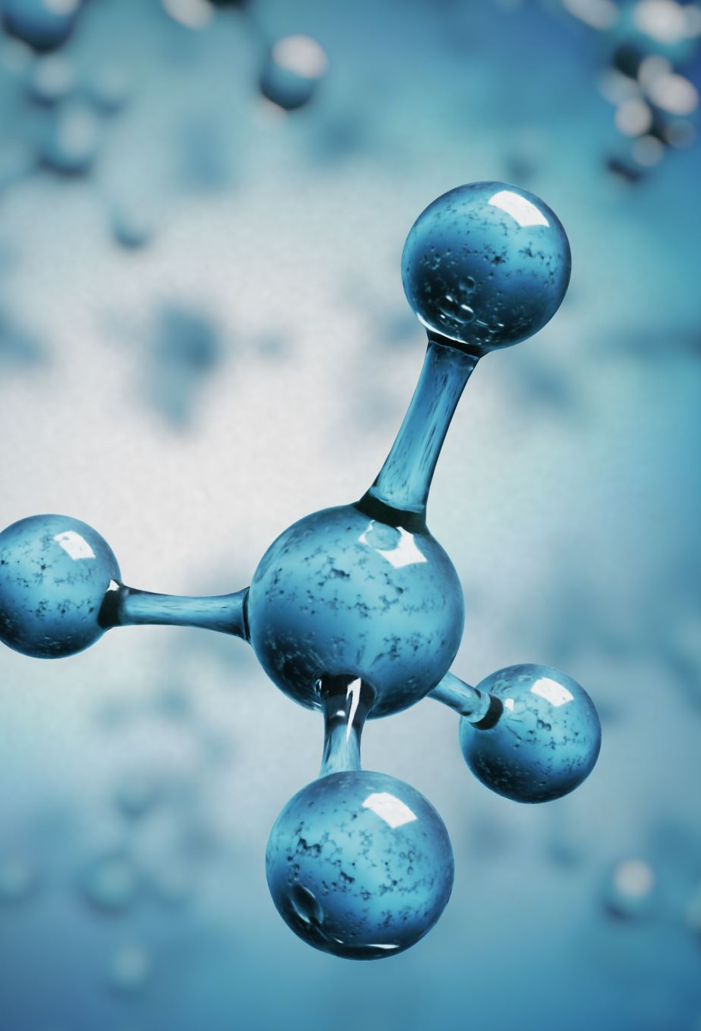
PROPERTIES OF NANO-EMULSIONS
Nanoemulsions have small droplet size and are kinetically stable colloidal systems.
They have enhanced functional properties in comparison to conventional emulsions.
The composition and structure of the nanoemulsions can be controlled for the encapsulation and effective delivery of bioactive lipophilic compounds.
Nanoemulsions have potential application in the food industry for the delivery of nutraceuticals, coloring and flavoring agents, and antimicrobials.
The nanoemulsion formulations of active ingredients can be used for developing biodegradable coating and packaging films to enhance the quality, functional properties, nutritional value, and shelf life of foods.

Slide 9
PHASES OF NANO-EMULSION
Nanoemulsions are colloidal dispersions of oil and water stabilized by an emulsifier, where the droplet size of the dispersed phase is typically in the range of 20-200 nm. The preparation of a nanoemulsion typically involves several phases, including:
Pre-emulsion phase: In this phase, the oil and water phases are mixed together along with the emulsifier to form a coarse emulsion.
High-shear phase: The pre-emulsion is subjected to high shear forces using a homogenizer, ultrasonicator, or other high-energy mixer to reduce the droplet size to the nanometer range.
Cooling phase: The temperature of the emulsion is lowered to enhance the stability of the nanoemulsion by reducing the Brownian motion of the droplets.
Post-processing phase: In this phase, the nanoemulsion is subjected to various post-processing steps, such as filtration, centrifugation, or freeze-drying, to remove any remaining impurities and to achieve the desired final product.
The specific phases involved in the preparation of a nanoemulsion may vary depending on the intended application, the choice of emulsifier, and the desired droplet size and stability.

Slide 10
COMMONLY USED FORMS
The commonly used liquids to form emulsion are water and oil. The oil droplets dispersed in an aqueous phase are known as oil-in-water (o/w) emulsions.
These emulsion systems can be used for the delivery of hydrophobic active substances. The water droplets dispersed in oil are called the water-in-oil (w/o) emulsions and are used for the delivery of hydrophilic compounds.
Multiple emulsion systems can also be developed such as the water-in-oil-in-water (w/o/w) and oil-in-water-in-oil (o/w/o) emulsions.
The w/o/w emulsions are made of large oil droplets, containing water droplets dispersed in an aqueous phase.
Whereas, in o/w/o emulsion system, water droplets containing oil droplets are dispersed in an oil phase.
Bicontinuous nanoemulsion contains microdomains of oil and water—interdispersed within the system

Slide 11
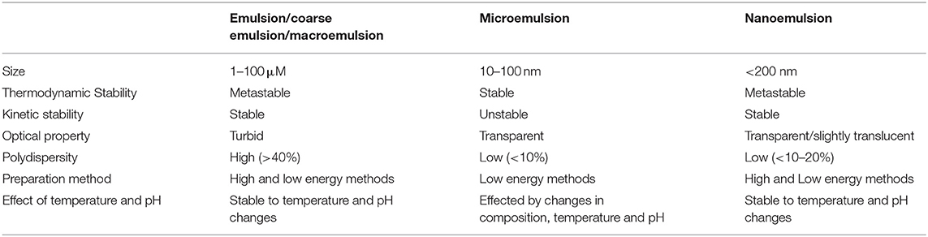

Slide 12
Preparation of Nanoemulsions
The nanoemulsions have numerous droplets which increases the surface area. Therefore, large amount of energy is required to create extra surface.
Thus, nanoemulsion formation is not spontaneous and requires energy input.
The energy required for the formation of nanoemulsions (ΔG) is estimated by the expression,
ΔG= ΔAγ-TΔS
Where,
ΔA is increase in interfacial area
γ is surface tension
TΔS is the entropy of dispersion

Slide 13
EMERGING TECHNIQUES FOR NANO-EMULSION
Nanoemulsions are stable, transparent or translucent dispersions of oil and water that contain droplets with a diameter of less than 100 nm. They have many applications in various fields, including food, pharmaceuticals, cosmetics, and biotechnology. Here are some of the emerging techniques for preparing nanoemulsions:
High-pressure homogenization: This is a commonly used technique for preparing nanoemulsions. The method involves the application of high pressure to the emulsion using a homogenizer to break down the droplets into smaller sizes. The homogenization process can be done either at a constant pressure or at a variable pressure.
Microfluidization: This is another popular technique for preparing nanoemulsions. It involves the use of a high-pressure pump to force the emulsion through a narrow gap or microchannel to break down the droplets into smaller sizes. Microfluidization can be used for both oil-in-water and water-in-oil emulsions.

Slide 14
3. Phase inversion temperature (PIT) method: This method involves the use of temperature to induce a phase inversion in the emulsion. The emulsion is heated to a temperature above the phase inversion temperature, and then rapidly cooled to induce the formation of nano-sized droplets
4. Membrane emulsification: This method involves the use of a membrane to form the emulsion. The emulsion is passed through a membrane with a pore size of less than 100 nm to form nano-sized droplets.
5. Ultrasonication: This is a technique that involves the use of high-frequency sound waves to break down the droplets in the emulsion into smaller sizes. The ultrasonication process can be done either in a batch or continuous mode.
Overall, these emerging techniques are providing new ways to produce nanoemulsions with improved stability, smaller droplet sizes, and enhanced properties for various applications.

Slide 15
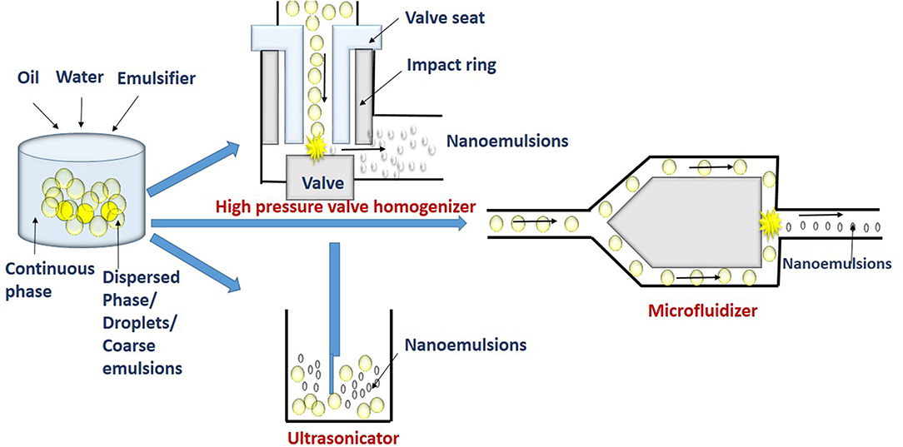
FORMATION OF NANOEMULSIONS

Slide 16
1. High Pressure Valve Homogenization Method
The device used in the high-pressure valve homogenization (HPVH) method, includes a positive displacement pump, pressure valve, and chambers for homogenization and interaction.
The coarse emulsion is sucked into the homogenization chamber by the suction stroke of the pump.
The homogenization chamber can be a simple orifice plate, colliding jet or radial diffuser assemblies (Stang et al., 2001; Donsı̀ et al., 2009).
High pressure of upto 300 MPa generated in the chamber during delivery stroke causes the coarse emulsion to be pushed out through small orifice of micrometric size by the homogenizer valve.
At this stage, the factors such as turbulence, shear stress, and cavitation disrupts coarse emulsions into very finer droplets (Tesch et al., 2003; Schultz et al., 2004).
Further, the fine droplets get stabilized in the interaction chamber. Thus, in the high-pressure homogenization, emulsification occurs in two stages.

Slide 17
2. Micro fluidization Method
The basic principle of emulsification by microfluidization is similar to the high-pressure valve homogenizer, except for the use of a special microchannel having dimensions in the range of 50–300 μm to form droplets in the microfluidization method.
In this technique, the coarse emulsion is pumped with high pressure (up to 270 MPa) at the inlet through a microchannel at velocities of 400 m/s. The channels at the downstream gets split into two small branches to form Y or T junction.

Slide 18
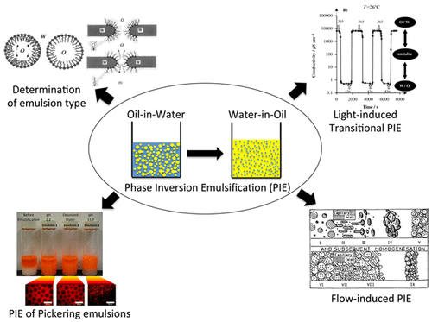
3. EMULSION PHASE INVERSION
Emulsion phase inversion is the process of interconversion between two types of simple emulsions: water-in-oil and oil-in-water emulsions.
Phase inversion can be induced by shifting the emulsifier affinity from one phase to the other, which is called transitional phase inversion.
It can also be triggered by a change in the water-to-oil ratio of the emulsion, which leads to a process known as catastrophic phase inversion.
With recent advances in the stabilization of emulsions using colloidal particles and stimuli-responsive surfactants, numerous novel emulsion systems that undergo emulsion phase inversion by means of various mechanisms have been developed.

Slide 19
4. MEMBRANE EMULSIFICATION
Membrane emulsification (ME) is a technique that offers an alternative to traditional methods for the production of emulsions in a highly efficient manner. The concept of ME was developed in the late 1980s by Nakashima et al., who initially produced oil-in-water and water-in-oil emulsions.
Reduction in energy utilization, control over droplet size and size distribution and potentially easy scaling up/down are the main distinguishing features of the ME process.
Recent studies by Syed et al. demonstrated the efficiency of the process in producing smaller and stable emulsions along with enhanced energy savings of the membrane emulsification technique over the conventional ultrasound emulsification technique.
Comparative studies evaluated the energy density to emulsions, whereby membrane-based process ensures a 99.5% reduction in energy expenditure to produce the same surface area by sonicators

Slide 20
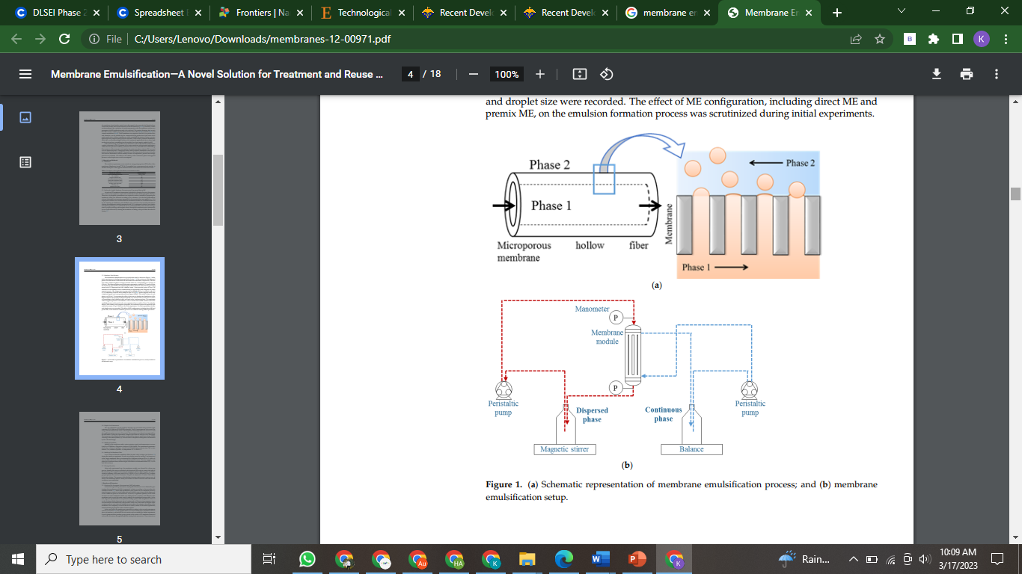
Membrane emulsification method

Slide 21
5. Ultrasonication Method
In this technique, the ultrasonic agitation by sound waves with more than 20 kHz frequency breaks coarse droplets into nanoemulsions.
Sound waves applied by sonotrode produce mechanical vibration and acoustic cavitation, and with the collapse of cavitations, strong shock waves generated break the coarse droplets (Behrend et al., 2000).
The acoustic and shock waves create high pressure and turbulence which collapse the droplets. At high frequency (mega Hz), nanoemulsions can even be prepared without using an emulsifier

Slide 22
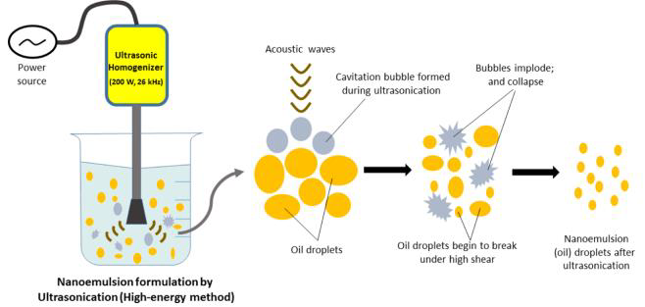
Ultrasonication method

Slide 23

APPLICATIONS IN FOOD INDUSTRY
Nanoemulsion based edible nanocoatings containing flavor and coloring ingredients, antioxidants, enzymes, antimicrobials, and antibrowning agents can be used to coat foods such as meats, dairy products such as cheese, fresh produce, and fresh cuts including fruit and vegetables and confectionaries to improve their shelf life. The nanoemulsion coatings can also prevent moisture and gas exchange, minimize moisture loss and oxidation of foods
Some common applications of nanoemulsions in the food industry include:

Slide 24
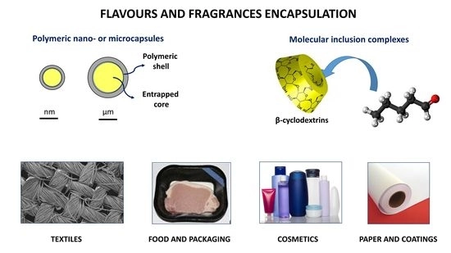
1. FLAVOR AND AROMA ENCAPSULATION
Nanoemulsions can be used to encapsulate flavors and aromas, protecting them from degradation and improving their stability. This can be particularly useful in the development of functional foods that incorporate health-promoting ingredients.

Slide 25
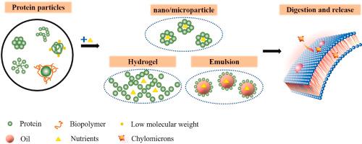
2. NUTRIENT DELIVERY
Nanoemulsions can improve the bioavailability of certain nutrients, such as vitamins and antioxidants, by increasing their solubility and dispersibility in aqueous systems. This can lead to better absorption and utilization of these nutrients by the body.

Slide 26
3. NANOEMULSIONS AND ENCAPSULATION OF LIPOPHILIC COMPONENTS
One of the most important applications of nanoemulsions in food industries is the encapsulation of lipophilic components such as vitamins, flavors, and nutraceuticals
Encapsulation is a useful tool to entrap a bioactive ingredient in a core or a fill within a carrier (coating, matrix, membrane, capsule, or shell) for improving the delivery of bioactive molecules within living cells
This technology has many applications in food industry for masking the unpleasant taste or smell of some bioactive materials, increasing the bioavailability of some components, improving the stability of food ingredients, decreasing air-induced food degradation or decreasing the evaporation of food aroma
One of the most interesting applications of encapsulation in food industry is probiotics. Probiotics are defined as microorganisms that provide health benefits when consumed in adequate amounts
Encapsulation of bioactive compounds in nanoemulsion-based delivery system was achieved for resveratrol

Slide 27
4. NANOEMULSIONS TO IMPROVE DRUG BIOAVAILABILITY AND PHARMACOLOGICAL EFFECTS
Low bioavailability of some naturally occurring active compounds hinders their efficient pharmacological activities. Nanoemulsions have been used as a suitable form to increase bioavailability of natural extracts.
Curcumin, 1,7-bis(4-hydroxy-3-methoxyphenyl)-1,6-heptadiene-3,5-dione, is a yellow-colored polyphenolic compound isolated from the rhizomes of turmeric (Curcuma longa, family Zingiberaceae). Curcumin has been used as a natural coloring agent health benefits such as anticarcinogenic, antioxidant, anti-inflammatory, and antimicrobial
Curcumin nanoemulsions showed significant inhibition of 12-O-tetradecanoylphorbol-13-acetate (TPA)-induced inflammation. However, low bioavailability hinders the efficiency of orally administrated curcumin. Flavored nanoemulsions have been prepared with improved curcumin digestibility compared to directly taken curcumin

Slide 28
Additionally, nanoemulsion formulation of oil-soluble vitamins such as alpha-tocopherol enhanced their oral bioavailability and pharmacological effects. α-Tocopherol, a type of vitamin E, is mainly present in olive and sunflower oils. Vitamin E supplements have important antioxidant, anticancer as well as cardiovascular protective activities.
Moreover, nanoemulsion preparations improved the bioavailability quercetin or methylquercetin
Quercetin, a polyphenol from the flavonoid group of, has been found in many fruits, vegetables, leaves, and grains. Quercetin supplements have been promoted as antioxidant and anticancer.

Slide 29
5. NANOEMULSIONS TO IMPROVE DIGESTIBILITY CHARACTERS
Food digestibility is a measure of how much of food is absorbed by the gastro-intestinal tract into the bloodstream. Nanoemulsions have been used as a suitable form to improve digestibility characters of food and natural extracts.
β-Carotene is a red-orange pigment that is found in plants such as carrots and colorful vegetables. β-Carotene is a member of the carotenes, which are terpenoids (isoprenoids), biosynthesized from geranylgeranyl pyrophosphate. β-Carotene is the best-known provitamin A carotenoid. β-Carotene flavored nanoemulsion with improved digestibility has been applied

Slide 30
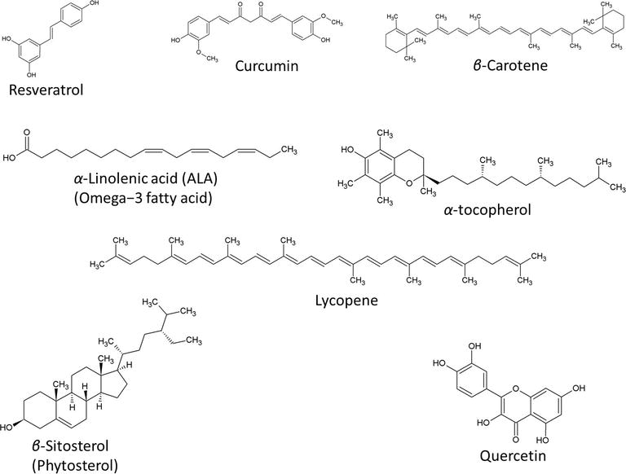
Digestibility improvement

Slide 31
6. FAT REDUCTION
Nanoemulsions can be used to replace some of the fat in food formulations, while still maintaining desirable sensory properties such as mouthfeel and texture.
The development of fat replacers to obtain healthier/functional foods is a constant challenge. With this aim, double emulsions (DE) with a blend of olive, linseed and fish oils as oil phase are developed.
The combination of two emulsifiers, lecithin and hydroxypropyl methylcellulose (HPMC), into emulsions is an interesting strategy to design fat replacers in food matrices.
The emulsification process of sunflower oil in water using high speed homogenizing was studied in presence of 30% oil, 3% emulsifier (Tween 40) supplemented with 0.4-0.8% vitamin E (α-tocopherole). The obtained emulsion was stable according its physio-chemical properties and particle size,

Slide 32
7. SHELF-LIFE ENHANCEMENT
The small droplet size of nanoemulsions can increase their stability and reduce the rate of oxidation and spoilage of food products, resulting in longer shelf life.
Recently, there has been a great deal of interest in implementing new nanotechnology-based approaches to improve the quality of food products. One of the relevant applications in this field is the use of nanoemulsions in the food packaging industry.
Notably, numerous factors, including bacterial growth and oxidation reduce the quality and safety of foods, fruits, and vegetables. In this case, new food packaging systems need to be smart, programmable, and multifunctional.

Slide 33
8. NANOEMULSIONS TO IMPROVE DRUG SOLUBILIZATION
Nanoemulsion formulation has been applied to increase the solubilization of phytosterols. Phytosterols have been shown to lower the blood cholesterol, and therefore, they reduce the risk of coronary heart diseases.
Among phytosterols, β-sitosterol has been isolated from many vegetables and fruits.
Moreover, nanoemulsions formulas increased also the solubilization of lycopene. Lycopene, a carotenoid pigment and phytochemical, has been found in tomatoes, other red fruits and vegetables. Lycopene has potential effects on prostate cancer and cardiovascular diseases.

Slide 34
9. BEVERAGES
Nanoemulsions can be used in the production of clear, stable, and homogeneous beverages, such as fruit juices and energy drinks.
Overall, nanoemulsions have a lot of potential in the food industry and their use is expected to increase in the future as new applications and benefits are discovered.

Slide 35
Further Reading
https://www.sciencedirect.com/science/article/abs/pii/S0308814618301481
https://www.sciencedirect.com/science/article/pii/S0268005X22001217
https://www.mdpi.com/2304-8158/11/16/2536
https://scialert.net/abstract/?doi=ajft.2016.54.62
https://link.springer.com/article/10.1007/s12393-021-09282-z
https://www.researchgate.net/publication/351850712_Employing_Nanoemulsions_in_Food_Packaging_Shelf_Life_Enhancement
https://www.ncbi.nlm.nih.gov/pmc/articles/PMC4678981/

