Slide 1

ASEPTIC PROCESSING
DR. ASIF AHMAD
FT-722

Slide 2
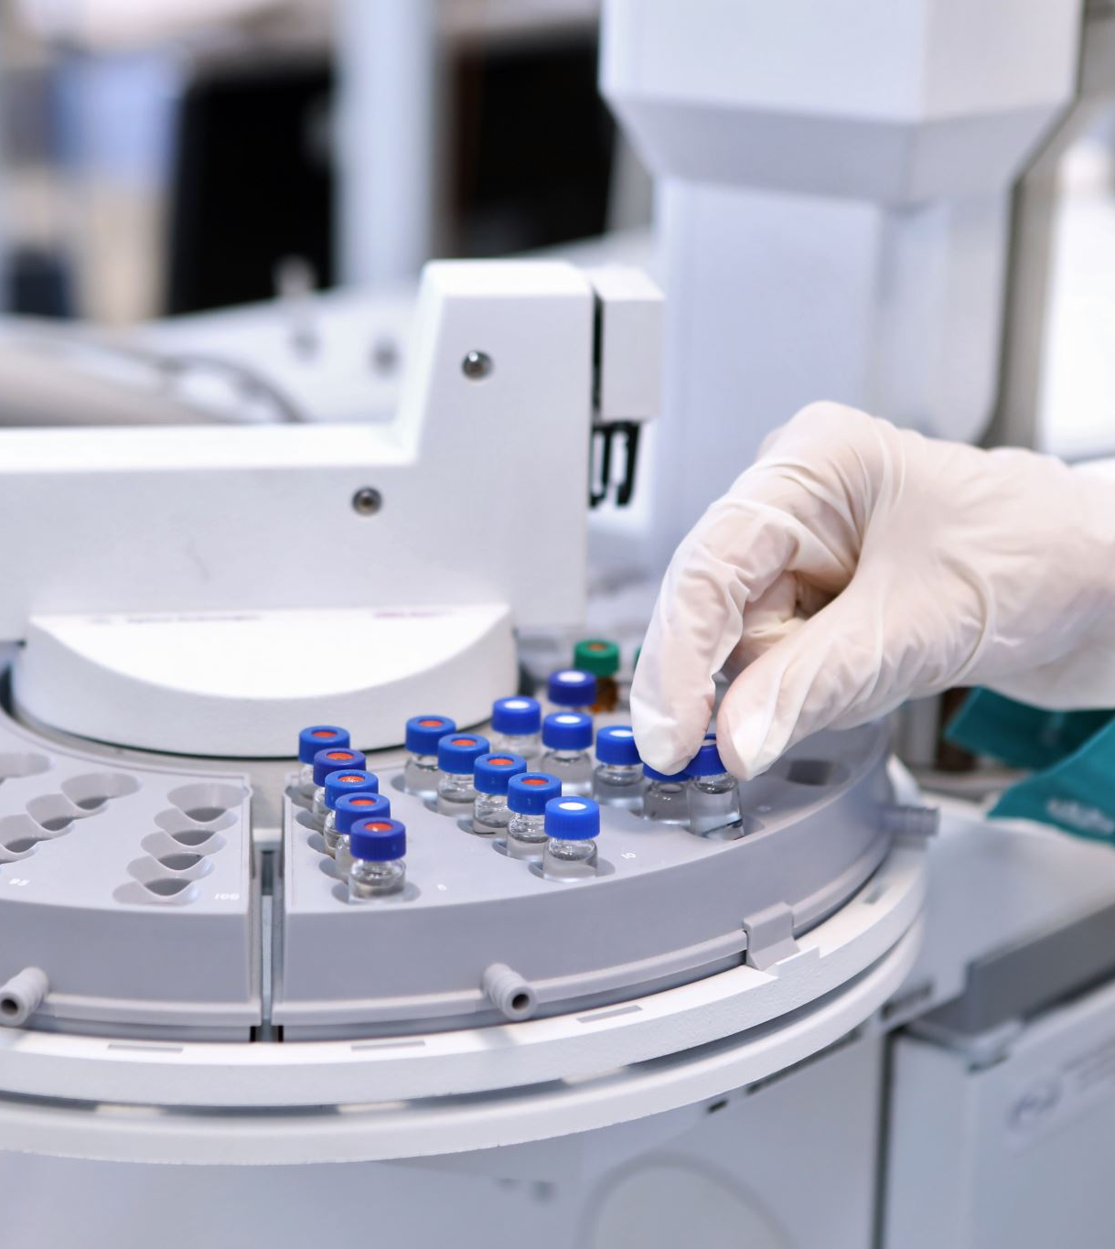
ASEPTIC PROCESSING
Aseptic processing is defined as “handling of sterile product, containers, and/or devices in a controlled environment, in which the air supply, materials, equipment, and personnel are regulated to maintain sterility” (ISO 13408-1, 2008). Aseptic processing includes compounding, filtration, and filling.
Aseptic processing equipment sterilization procedures often use steam or hot water under pressure. Packaging equipment and packaging materials are sterilized with various medium or combination of mediums (i.e., saturated steam, superheated steam, hydrogen peroxide and heat and other treatments).

Slide 3
Importance of Aseptic Processing
Aseptic processing allows for the food to be properly sterilized outside the container and then placed into a previously sterilized container, which is then sealed in a sterile environment. Most systems use ultra-high temperature (UHT) sterilization to sterilize the food product before it is packaged.
Prevent contamination of the specific microorganism we are working with.
Prevent contamination of the room and personnel with the microorganism we are working with.

Slide 4
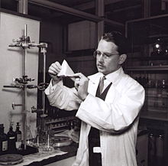
Principles of Aseptic Technique
Aseptic technique has following principles.
Use of personal protective equipment (PPE)
Respiratory hygiene and cough etiquette
Safe use of sharps
Environmental cleaning
Reprocessing of medical equipment
Appropriate handling of linen and waste management.

Slide 5
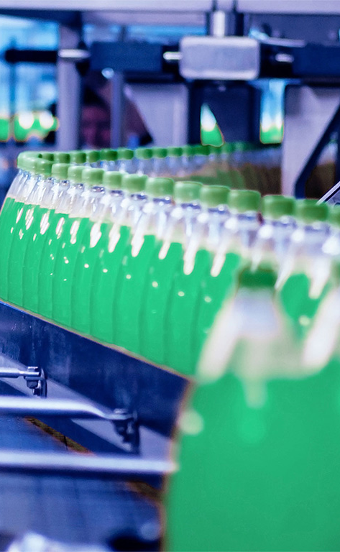
APPLICATIONS IN FOOD INDUSTRY
The early applications were liquid and semiliquid foods, such as cocoa drinks, custards, and banana puree. The packages were, invariably, metal cans and the process was therefore called “aseptic canning.”
The pumpable food was continuously heated to sterilizing temperature in heat exchangers, and after holding, continuously cooled. The cans and lids were sterilized with steam or a mixture of superheated steam and air.
The sterilized food and the sterile cans then come across in an aseptic enclosure that contained the filling machine and the seamer, closely coupled. Aseptic conditions were maintained by a number of measures such as disinfectants, a steady stream of superheated steam, UV radiation, etc. The aseptic enclosure was kept at slight overpressure to prevent penetration of air from outside.
Compared to normally canned foods, the products were of superior quality, but the process was cumbersome, slow, and expensive.

Slide 6
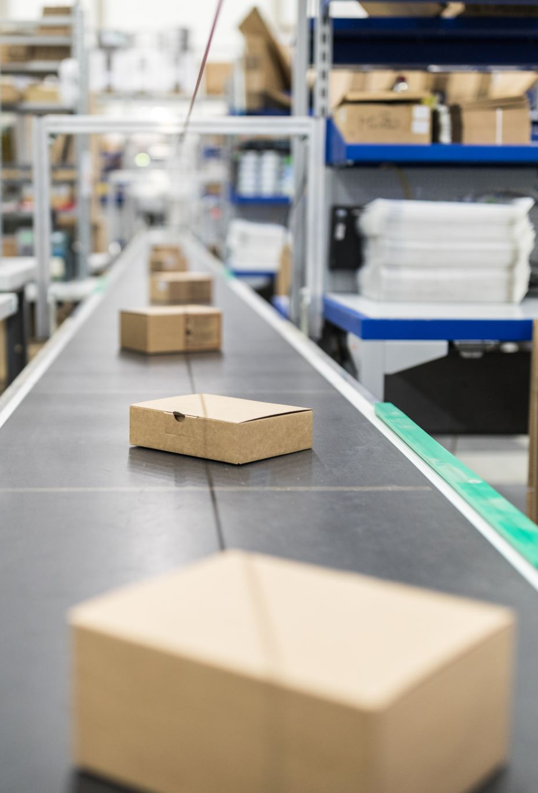
ADVANCEMENTS IN FOOD INDUSTRY
New technologies that allowed aseptic filling into flexible packages were developed in the 1960s. The output of the lines increased steadily. At first, the main product of commercial aseptic processing was UHT (ultrahigh-temperature) milk in cartons.
Gradually, applications expanded to almost any pumpable low- or high-acid food such as soups, gravy, dairy desserts, creams, soymilk, fruit juices, nectars, etc.
The innovations included in-place formation of the package from laminated paper, plastic sheet, or film, sterilization using hydrogen peroxide, followed by hot air, filling and sealing in one machine, etc. The packages suitable for aseptic processing now include carton boxes, pouches, trays, cups, large bags in boxes, metal barrels, etc.

Slide 7
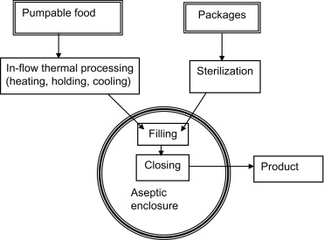
ASEPTIC PROCESSING OF FOOD PRODUCT

Slide 8
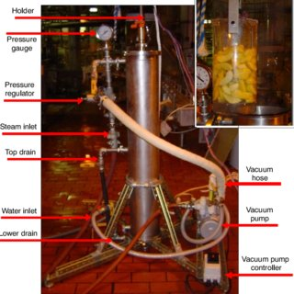
CONVENTIONAL METHODS
Aseptic processing involves three primary steps:
Thermal sterilization of the product
Sterilization of the packaging material
Conservation of sterility during packaging.

Slide 9
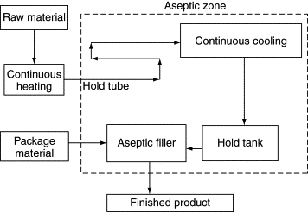
STEPS OF ASEPTIC FILLING

Slide 10
STEPS IN CONVENTIONAL ASEPTIC PROCESSING
Aseptic processing is the processing of commercially sterile and cooled food products being filled into commercially sterile containers under aseptic conditions. The package is hermetically sealed to produce a shelf-stable product that can be stored at ambient conditions.
As the food product and package are sterilized separately, a wide variety of package designs and materials can be used for aseptic processing as compared to pasteurization or retorting. In addition to rigid glass and metal containers, flexible polymeric materials and semi-rigid paper/Al/plastic composites that offer cost benefits and convenience can be used without sacrificing product quality (Floros, 1993).
However, flexible pouches lack rigidity, and package integrity may get compromised during handling and distribution. Aseptic filling systems have also been designed for HPDE and PET bottles (Ammann, 2001). Bottles made by blow molding are sterile and can be used directly for filling the product.

Slide 11
STEPS
For aseptic bulk packaging and storage, containers like tanks, totes, pouches, and bag-in-box systems are used. Factors like seasonality, cost, convenience, quality, and global competition have made aseptic bulk packaging popular, particularly for processed fruit and vegetable products (Floros et al., 1998).
Packages for aseptic processing can be sterilized by heat treatment (saturated steam, superheated steam, hot air, mixture of hot air and steam), mechanical processes (water/rinsing/flushing, air blasting, brushing, ultrasound), irradiation (ionizing rays, ultraviolet, infrared) or chemical treatments (hydrogen peroxide, ozone, chlorine, peracetic acid, etc). These treatments can be used alone or in combination (Floros, 1993)

Slide 12
RECENT ADVANCES IN ASEPTIC PROCESSING IN FOOD INDUSRTY
Aseptic processing is a technique that produces shelf stable products (foods or pharmaceuticals) with minimal loss of nutrients, natural texture, and other sensory properties such as taste, aroma, flavor and color. This is accomplished by minimizing the product to the processing sterilant (heat, chemical, microwave, electrical or radiation treatment).
To create the sterile zone within the packaging machine prior to a production run, chemicals such as hydrogen peroxide, peracetic acid and ethylene oxide can be used. Additionally, dry heat, steam or radiation can be used to sterilize the system. To sterilize the packaging materials, the methods used include heat, chemicals and radiation treatments.
These techniques are used on packages made from glass, metal, plastic and composites materials.

Slide 13
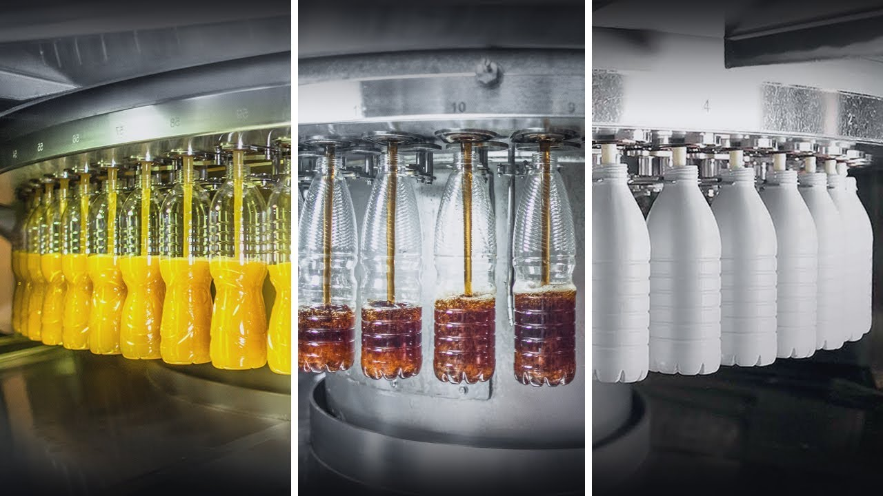
1. ADVANCED ASEPTIC PACKAGING MATERIALS
New packaging materials with improved barrier properties to maintain product quality and extend shelf life.
Aseptic food packaging is a specialized form of food packaging where the food and the package are independently processed and sterilized, and then brought together and the food is hermetically sealed within the package under aseptic conditions (David et al., 2013). Aseptic packaging and filling is very common and growing in the pharmaceutical industry. Aseptic packaging is considered to be one of the most actively growing areas of the US food and beverage industry and pharmaceutical industries.

Slide 14
MARKET SHARES
The aseptic market in the pharmaceutical and food industries is estimated to be approximately US $ 3.5 billion. The pharmaceutical industry is the main area where this packaging technology is growing fast. Today, foods in cans, plastic bottles, plastic cups, pouches, and paper boards can be found in most retail shelves around the world. The 2012 “Global Aseptic Packaging” report prepared jointly by Zenith International and Warrick Research Ltd. predicts that globally, approximately 153 billion liters of food and food-related liquids will be packaged into over 300 billion packs by 2016

Slide 15
ADVANCEMENTS IN ASEPTIC PACKAGING
A key advantage of this food packaging method is that the food can be processed under conditions that are optimized for the food in question, without the need to worry about issues of whether the packaging material and the seal can withstand the food processing conditions.
Food processors and retailers interested in shelf-stable food items that can withstand ambient storage conditions are particularly interested in aseptic packaging. Extensive research and development activities are on-going to optimize the sterilization process of both the food and the packaging materials, and formulation of new packaging materials.
A variety of novel plastic polymers such as polyethylene (PE) and polyethylene terephthalate (PET), which used to be used primarily for high acid foods, are now being used to hold low-acid shelf-stable beverages such as flavored coffees, sports drinks, etc. Today, there are well over 500 different aseptic systems for the manufacture of retail packages and bulk containers in the USA, and over two dozen manufacturers of aseptic filling equipment worldwide. There are a number of excellent research articles, reviews, book chapters and books covering the different aspects of aseptic packaging (Nelsom, 2010; David et al., 2013).
The focus of this chapter is on the role and potential applications of a sterilizing technology such as electron beam (eBeam) technology in aseptic food packaging, with special focus on the use of this technology for sterilizing packaging materials.

Slide 16
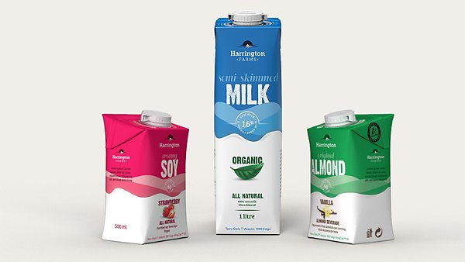
ASEPTIC PACKAGING OF MILK
Aseptic or long-life milk was originally introduced in Sweden called the “Tetra-pack” system. It consumes a laminate pre sterilizer and a filling environment heater.
Aluminium foil is an integral part of the flexible laminate in order to provide a barrier against light and gas. In UHT processing, milk is preheated to 73– 850C then rapidly raised to 135°C for fraction of second and then suddenly cooled by flashing into a vacuum chamber. It must be packed under completely sterile conditions. No refrigeration is necessary for at least 3-6 months.
If kept under refrigeration a shelf life of up to one year is possible. In the distribution system, the pouches are maintained in reusable multi-trip plastic crates. Tetra Pak aseptic cartons are formed of three basic materials that together result in a very efficient, safe and light-weight package. Each material gives a specific function.
Aseptic containers may extend in size from a few fluid ounces to a nearly 8-million-gallon aseptic tank on an ocean-going ship. Worldwide export and import of new, economical and safe food products done by aseptic processing. Other common package types are drink boxes and pouches (Hersom, 2009).

Slide 17
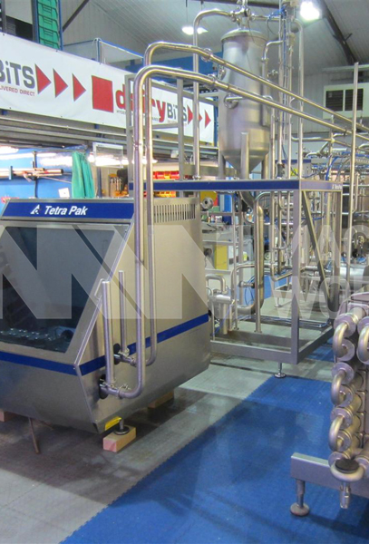
A MESSAGE FROM TETRA PAK
Aseptic technology keeps food safe and flavorful for at least six months — without refrigeration or preservatives. It allows food to retain more color, texture, taste and nutrition. Our aseptic packaging offers a variety of package shapes, consumer convenience and economies in energy and packaging materials.
​Our aseptic process ensures that both food and packaging materials are free of harmful bacteria when food is packaged. Everything in the production chain must be commercially sterile. That includes food and packaging materials, all machinery and the environment in which the packaging takes place. ​​

Slide 18
BULK ASEPTIC PACKAGING
‘Aseptic Bag-In-Box’ system caters to the packaging of ‘High’ as well as ‘Low’ acid products and products containing particles for filling range from 25 liters up to 1140 liters.
Applications are in fruit juices, concentrates, purees, tomato products, milk and cream, coconut products and jam.
Advantages of bulk aseptic packaging are safety, reliability, extended shelf-life and product quality.
Safety due to the steam sterilization of spout, and sterilization effect can be controlled and recorded, no chemical sprays used to sterilize the chamber, the spout is tamperproof, safer sterilization and easier to monitor, no risk of adding chemicals to the product and no risk of laminate material relating with chemicals. Reliability, because of the filling machine is uncomplicated as there is no sterile chamber, the filling is controlled by weight this ensures accuracy as no adjustments for specific gravity need to be made and the customer will have one partner with worldwide service organizations and long experience in processing and packaging technology.

Slide 19
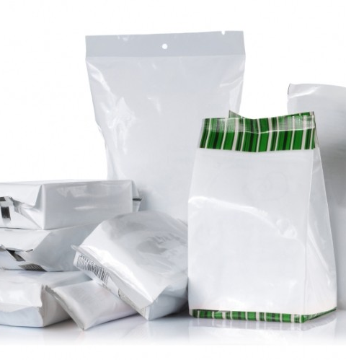
Bulk packaging
Extended shelf-life due to the high oxygen barrier of the laminate, the laminate is less susceptible to flex cracking, secure spout with limited possibility of oxygen permeation and there is no headspace in the bag.
A bulk aseptic bag is several layered structures consisting of an outer barrier laminate and an inner bag in contact with the product. Most of the bags are pre-sterilized using gamma irradiation and supplied flat. The level of gamma irradiation is specifically selected to facilitate packaging of high as well as low acid products (Pillai, and Shayanfa, 2014)

Slide 20
PROPERTIES OF ASEPTIC PACKAGING
Low water-vapor transmission rate. Low gas transmission rates, especially to oxygen. This is valuable to preserve the color, flavor and nutritional constituents in the products.
Good physical or mechanical strength, adequate to resist any physical damage during manufacture, handling, and distribution.
Good sealing characteristics to forbid the entrance of external contaminants and ability to perform into automatic fabricating and filling equipment.
Resistance to withstand the temperatures encountered during filling of the product as well as during storage and distribution.
Chemically resistant to the product packed and ability to endure sterilization packing material with a gas, liquid radiation.
Resistance to microbes, insects and other types of biological hazards.
Compatibility with the milk packed.
The constituents and additives etc. of the packaging material should be inert with low migration levels in accordance with the suitable codes of practice and standards of the country.
Economical in cost in comparison to the packaged product and readily available in the market (Fellows, 2016).

Slide 21

EXAMPLES AND ADVANTAGES
  Examples include multi-layered films, laminates, and coatings that provide enhanced oxygen and moisture barrier properties, preventing microbial contamination and spoilage.
  These materials help preserve the nutritional value, flavor, and texture of the food products, ensuring their quality over an extended period.

Slide 22
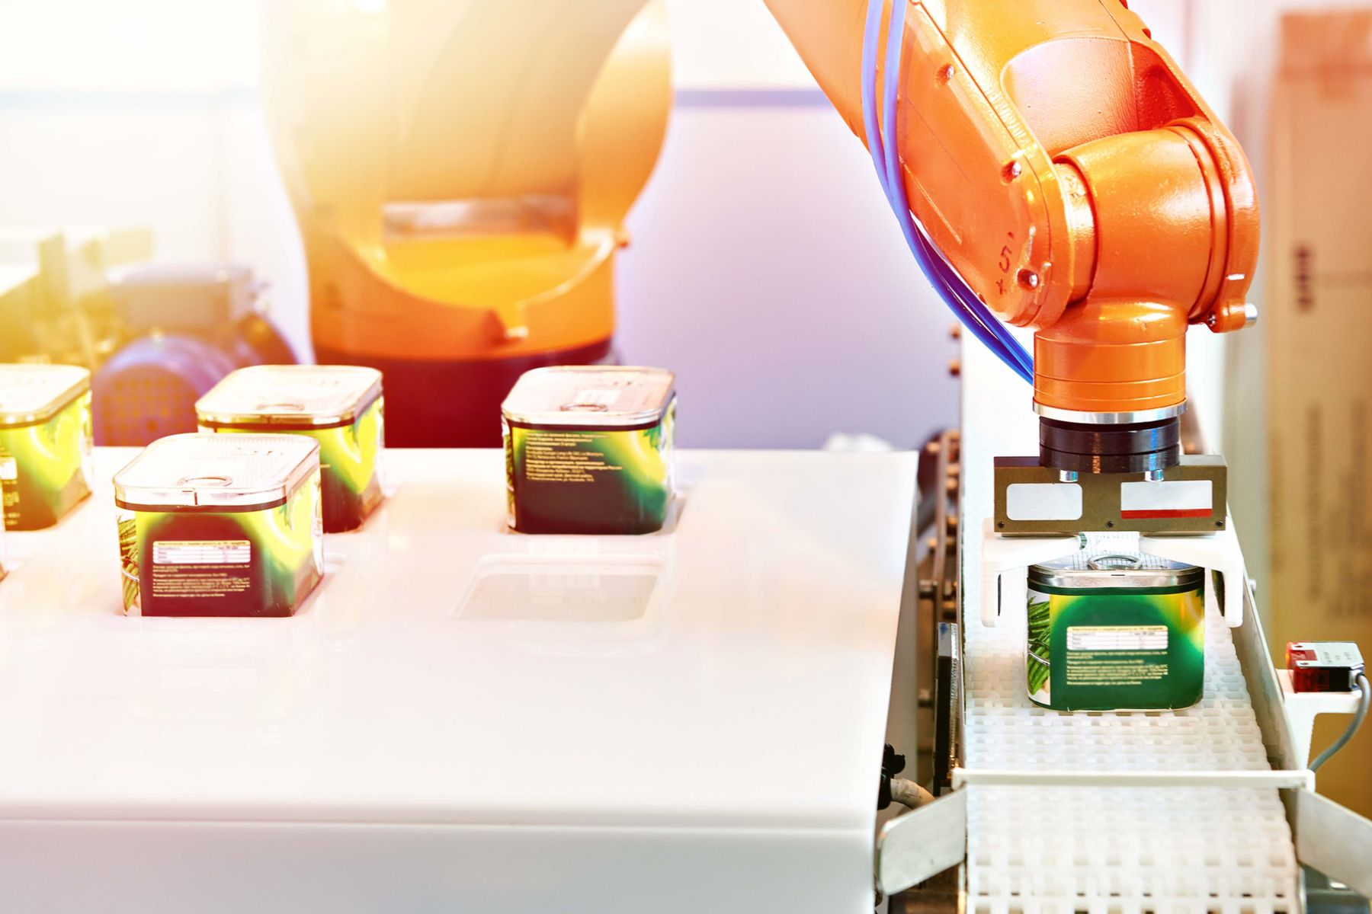
2. USE OF ROBOTICS IN ASEPTIC PROCESSING
Automation and robotics have revolutionized aseptic processing by increasing efficiency, accuracy, and reducing human errors.
Robotic systems are used for tasks such as filling, sealing, labeling, and packaging, ensuring precise and consistent operations.
Automation reduces the risk of contamination from human contact, improving product safety.
Additionally, automation enables faster production rates, reducing processing time and increasing overall productivity.

Slide 23
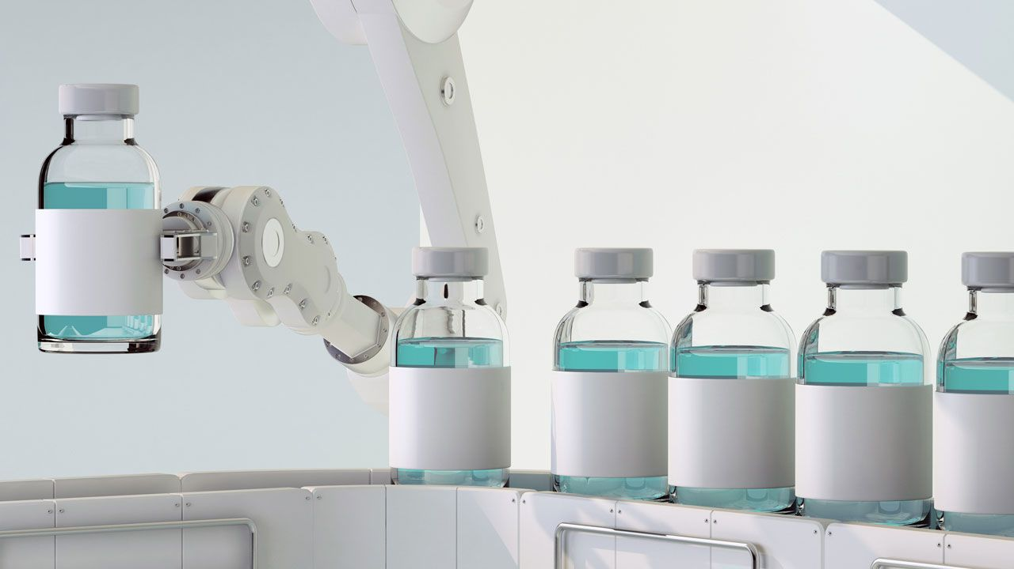
Automated Aseptic Processing

Slide 24
3. HIGH PRESSURE PROCESSING
HPP involves subjecting packaged food products to high levels of hydrostatic pressure to inactivate microorganisms while preserving the food's nutritional and sensory attributes.
HPP technology is effective against both spoilage-causing microorganisms and pathogens without the need for high temperatures.
It helps maintain the color, texture, and flavor of foods while extending their shelf life.
HPP is particularly useful for products like juices, sauces, dips, and ready-to-eat meals.

Slide 25
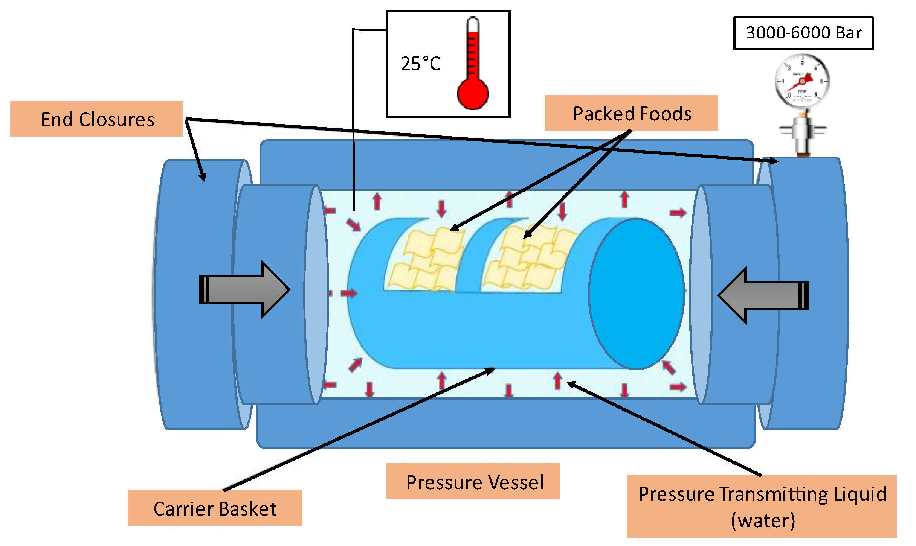
HPP

Slide 26
4. NOVEL STERILIZATION TECHNIQUES
Various novel sterilization techniques are being explored to enhance aseptic processing.
These include application of pulsed electric field, in producing safe and nutritious food, having extended shelf life and free from pathogens

Slide 27
PULSED ELECTRIC FIELD
Pulsed Electric Fields (PEF) is one such technique that applies short bursts of high-voltage electrical pulses to destroy microorganisms.
PEF technology offers several advantages, including reduced processing time, minimal impact on food quality, and energy efficiency.
Pulsed electric field processing or electroporation can significantly improve your processes and your product quality, utilizing its impact on cell membranes. The disintegration of biological tissue is a key function in food processing to enhance winning of valuable intracellular compounds from cells.

Slide 28
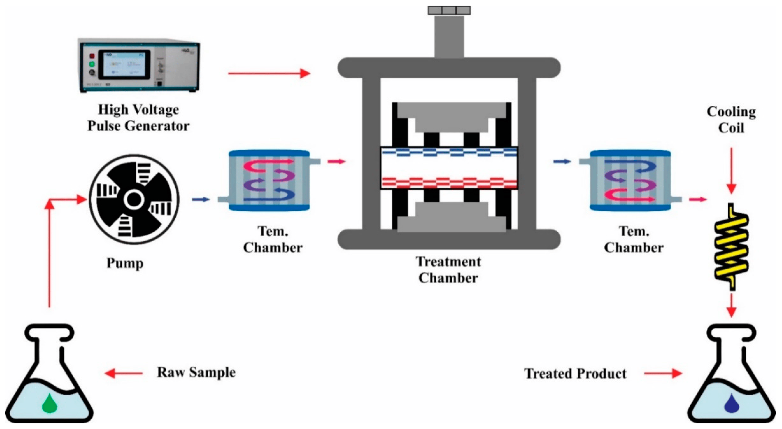
PEF IN PRODUCING SAFE FOOD
https://www.google.com/url?sa=i&url=https%3A%2F%2Fwww.mdpi.com%2F1420-3049%2F27%2F13%2F4031&psig=AOvVaw34szAQX5YIDCG3FhUP8r2C&ust=1685868205018000&source=images&cd=vfe&ved=0CBMQjhxqFwoTCPCL36_apv8CFQAAAAAdAAAAABAE

Slide 29
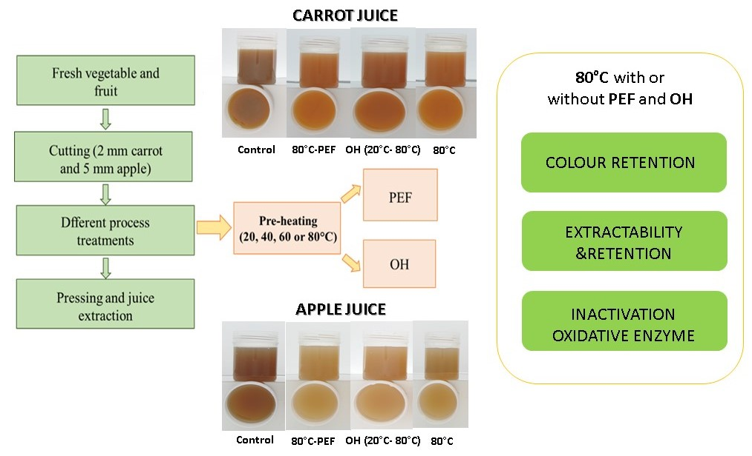
Treatment on apple and carrot juice by PEF

Slide 30
OTHER STERILIZATION TECHNIQUES
Other emerging sterilization methods include
cold plasma treatment
ultraviolet (UV) light technology
These which provide effective microbial control while maintaining the integrity of the food product.

Slide 31
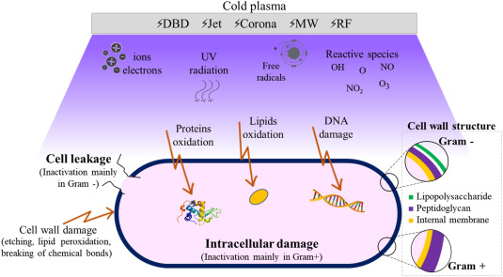
Use of Cold plasma for Aseptic Processing
https://www.google.com/url?sa=i&url=https%3A%2F%2Fwww.sciencedirect.com%2Fscience%2Farticle%2Fpii%2FS0260877421002740&psig=AOvVaw0uk58BtLYlUFDdxVzd96rV&ust=1685868355719000&source=images&cd=vfe&ved=0CBMQjhxqFwoTCJDgnPfapv8CFQAAAAAdAAAAABAR

Slide 32
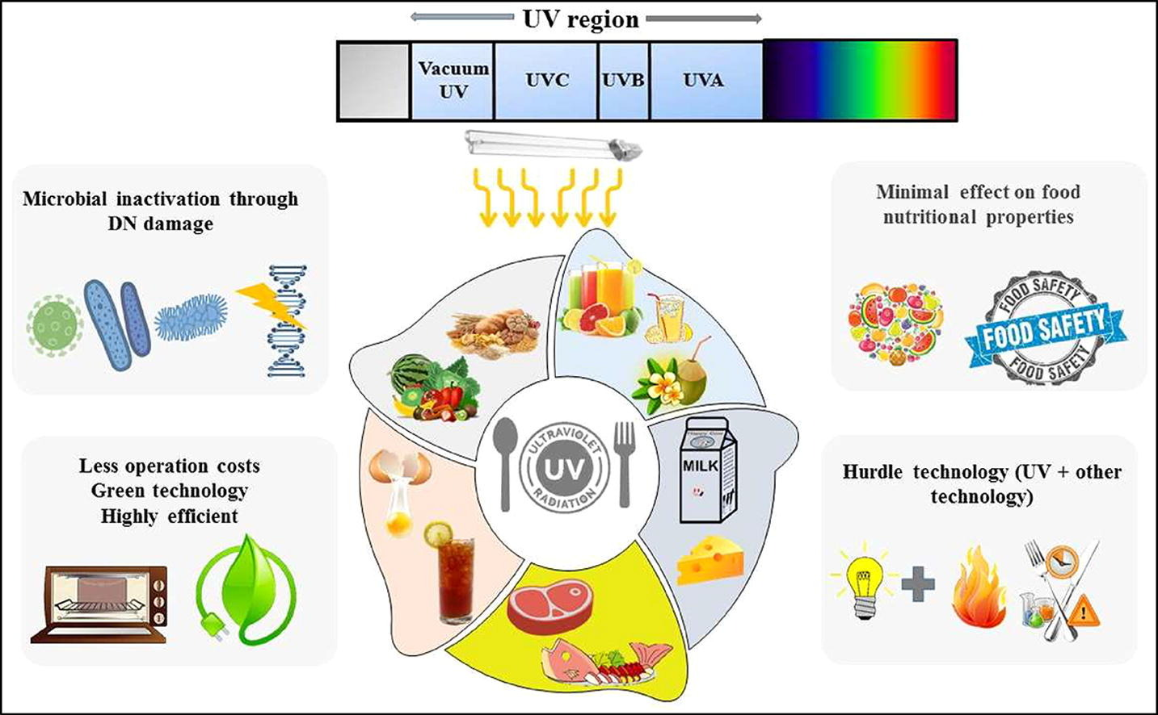
Use of UV light for Aseptic Processing
https://www.sciencedirect.com/science/article/abs/pii/S1385894720342005

Slide 33
Successful application of aseptic processing in various food industries

Slide 34
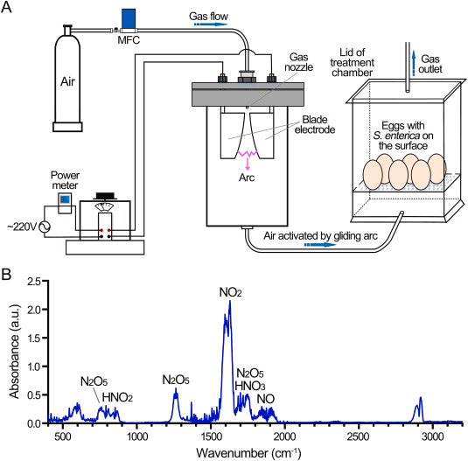
Aseptic inactivation of Salmonella on egg surfaces

Slide 35
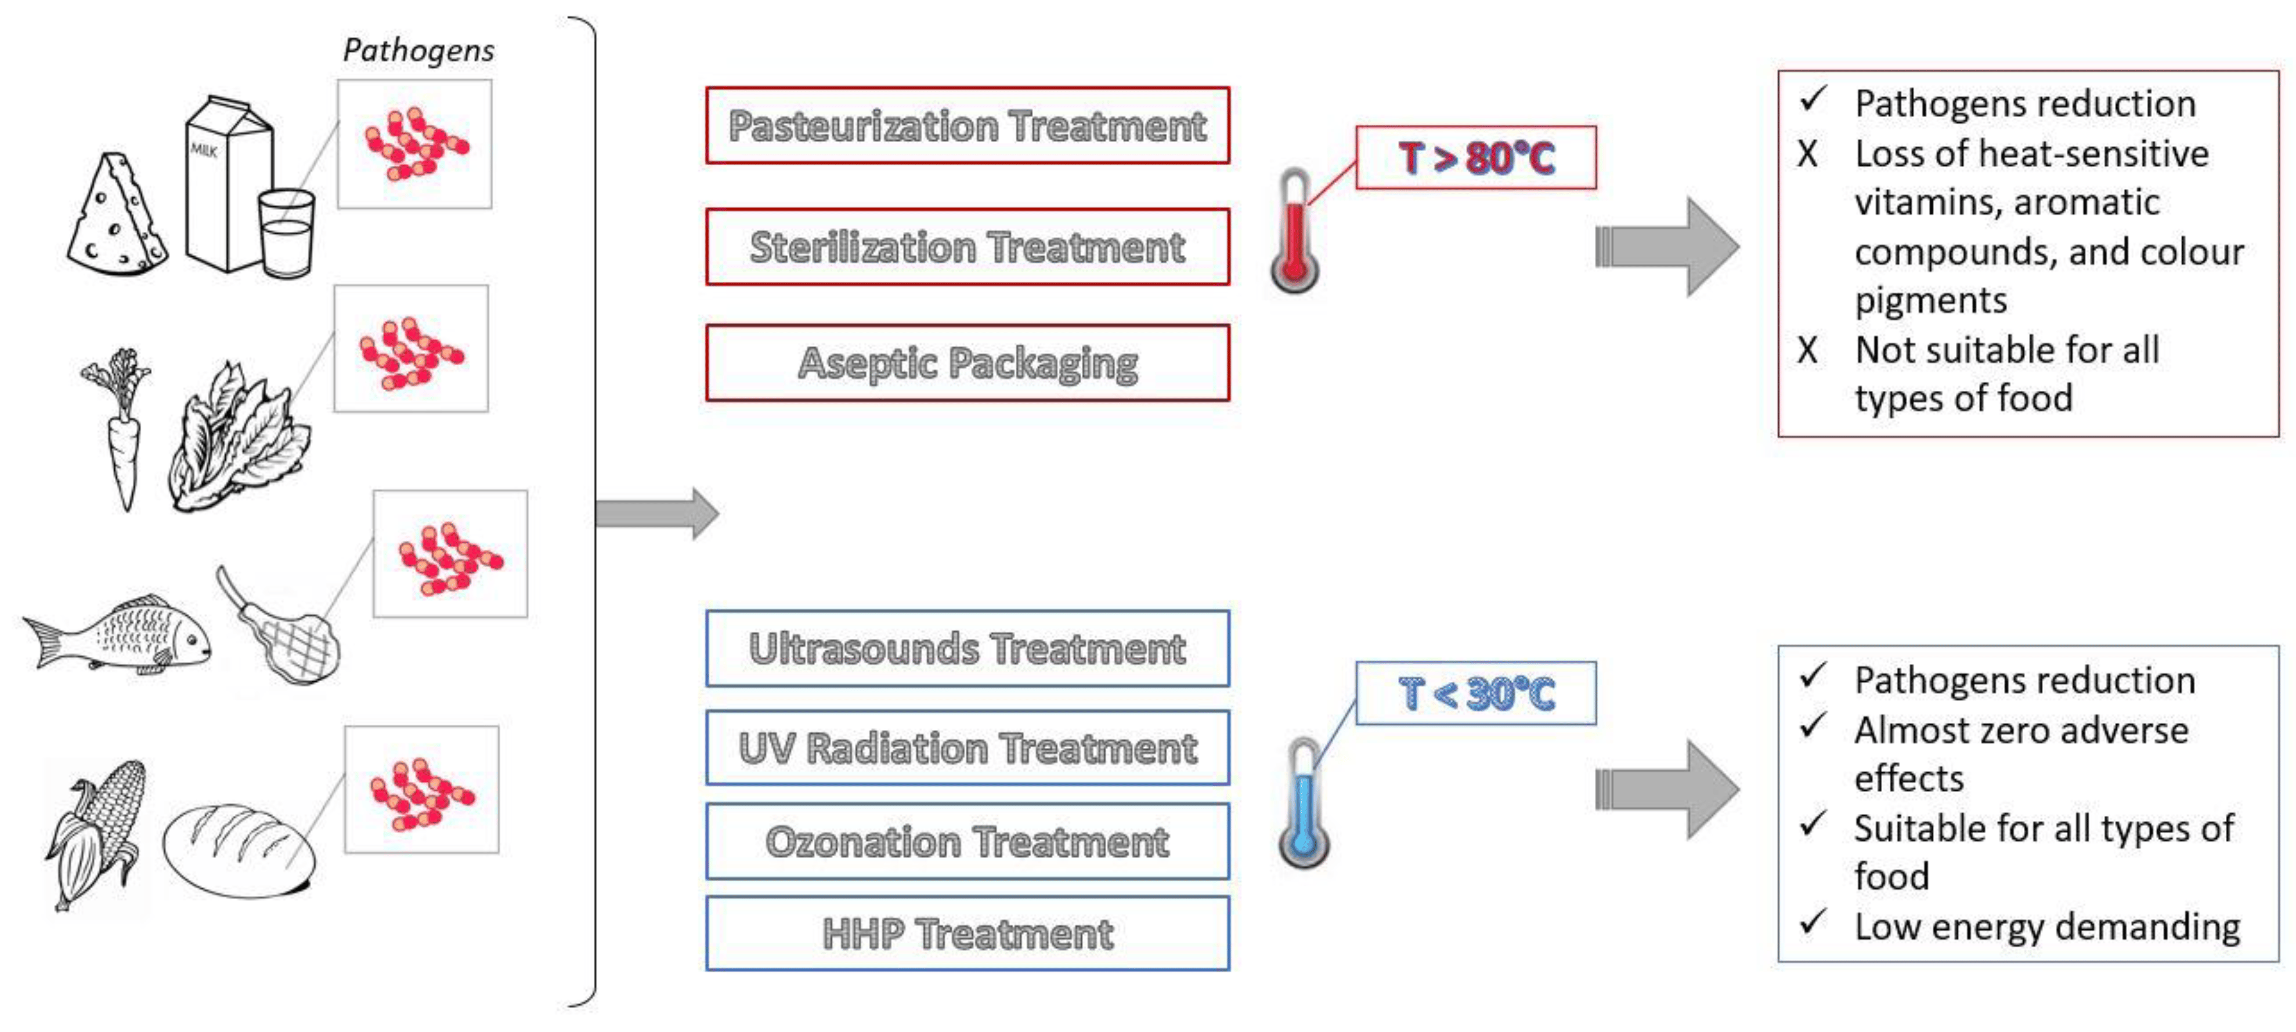
Aseptic processing of vegetables

Slide 36
ASEPTIC PROCESSING BY OHMIC HEATING AND EFFECT ON FOOD PRODUCTS
Author | Application | Experimental conditions | Food product | Conclusions
Gomes et al. (2018) | Blanching (peroxidase inactivation and color change) | 180 ± 1 V at 60 Hz for first 40 s followed by 163 ± 5 V; 80 °C | Tetsukabuto pumpkin | Shorter inactivation time for more than 90% peroxidase initial activity reduction in OH (2 min) compared to CH (4 min); no significant color change for both ohmic and conventional blanching
Soghani et al. (2018) | Blanching (mass transfer) | 90, 120, 150 V; 5, 10, 15 min; water + 0.1% NaCl | White mushroom | Mass loss increased with increased voltage and heating time; Mass gain by sample from 0.42% (150 V) to 9.52% (90 V) in 5 min; Mass loss by sample from 9.82% (90 V) to 34.05% (150 V) in 15 min
Bhat et al. (2017) | Blanching (total phenolic compound and color change) | 50 Hz; 220 V; 60, 70, 80, 90 °C; 1, 2, 3, 4, 5 min | Bottle gourd juice | Higher yield of TPC at 80 °C, 4 min blanching in OH (697 mg/100 mL) compared to CH (644 mg/100 mL) and unblanched sample (640 mg/100 mL); highest retention of the green color in OH
Mercali et al. (2014) | Blanching (ascorbic acid degradation and color changes) | 30 V; 10, 10², 10³, 10⁴, 10⁵ Hz; 85 °C; 0, 20, 40, 60, 80, 100, 120 min | Aerola pulp | Higher degradation and color changes with lower frequency; Similar degradation and color changes above 100 Hz ohmic treatment with CH
Guida et al. (2013) | Blanching (nutritional, bioactive compounds and quality parameters) | 24 V/cm; 80 °C | Artichoke heads | Shorter inactivation time of POD and PPO enzyme in OH (360 s) than CH (480 s); higher retention of proteins and polyphenols in OH—360 s (1.82 g/100 g and 482.32 mg/100 g, respectively) than CH – 480 s (0.8 g/100 g and 314.25 mg/100 g, respectively) during 90 days storage; natural color well preserved after OH while CH caused browning
Mercali et al. (2013) | Blanching (anthocyanin degradation) | 25 V; 75, 80, 85, 90 °C; 0, 15, 30, 45, 60, 75, 90 min | Aerola pulp | No significant difference between degradation mechanisms at 75 and 90 °C after 90 min treatment for OH (46% and 84%, respectively) and CH (43% and 80%, respectively)
Sarkis et al. (2013) | Blanching (anthocyanin degradation) | 160, 172, 200, 228, 240 V; 90 °C; 2 min | Blueberry pulp | Degradation increased with increased in voltage (5.7 to 14.7%)
Mercali et al. (2012) | Blanching (vitamin C and ascorbic acid degradation) | 120, 132, 160, 188, 200 V; 85 °C; 3 min | Aerola pulp | Degradation increased with increased in voltage (2 to 5.06% for vitamin C and 3.08 to 10.6% for ascorbic acid)

Slide 37
REGULATORY AUTHORITIES
Aseptic processing operations are governed by regulations produced by the Food and Drug Administration (FDA) and the United States Department of Agriculture (USDA) in the United States, Health Canada in Canada, The European Union in Europe and by Codex Alimentarius for most of the remainder of the world.
A key milestone in the commercialization of this technology was the FDA approval in 1981 of hydrogen peroxide as a sterilizing agent for the packaging material that comes in contact with food surfaces. Over the last 30 years, there have been a number of developments in specific areas of aseptic packaging such as filling, packaging itself, sterilization, and sealing

Slide 38
ADVANTAGES
Properties of aseptic packaging: a higher degree of safety, hygiene and nutrient retention in food. Preserving taste and freshness, which can be kept for months with no need for refrigeration or preservatives. Efficient (a filled package weight is 97% product and only 3% packaging material), using a small number of materials necessary to achieve a given function. A good example of resource efficiency is its light-weight (among the lightest packages available

Slide 39
FURTHER READING
https://www.ijtsrd.com/papers/ijtsrd22779.pdf
https://www.tetrapak.com/solutions/packaging
https://www.tetrapak.com/insights/handbooks/tetra-pak-dairy-processing-handbook
https://www.tetrapak.com/solutions/processing/main-technology-area/heatingsolutions
https://www.researchgate.net/publication/333695159_Aseptic_Packaging_-_A_Novel_Technology_to_the_Food_Industry
https://www.mdpi.com/1999-4923/15/6/1581
https://www.sciencedirect.com/science/article/pii/S0956713523000622?casa_token=hllj13u8lSgAAAAA:KTWCnBciWjbZk1-b8bpHXmtPTXKexQbd2Qs9aRMKbPJqvW3wU6RliXetogar9a9VMWVNznfumg4
https://www.sciencedirect.com/science/article/pii/S0956713523000622?casa_token=hllj13u8lSgAAAAA:KTWCnBciWjbZk1-b8bpHXmtPTXKexQbd2Qs9aRMKbPJqvW3wU6RliXetogar9a9VMWVNznfumg4

Slide 40
https://www.pharmtech.com/view/the-basics-of-aseptic-processing
https://www.sciencedirect.com/topics/agricultural-and-biological-sciences/aseptic-processing#:~:text=Aseptic%20processing%20is%20the%20processing,be%20stored%20at%20ambient%20conditions.
https://www.taylorfrancis.com/chapters/edit/10.1201/9781003158653-22/frontiers-research-development-jairus-david-pablo-coronel-josip-simunovic
https://www.mdpi.com/1999-4923/15/6/1581
https://www.mdpi.com/2227-9717/11/4/1272

Slide 41
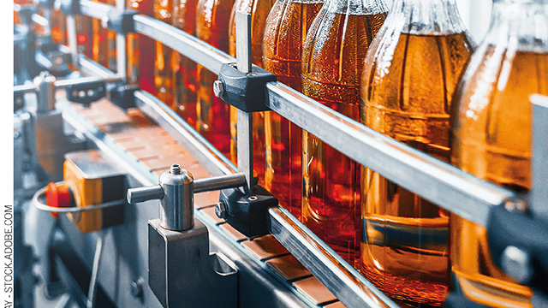
THANKYOU!

