Slide 1
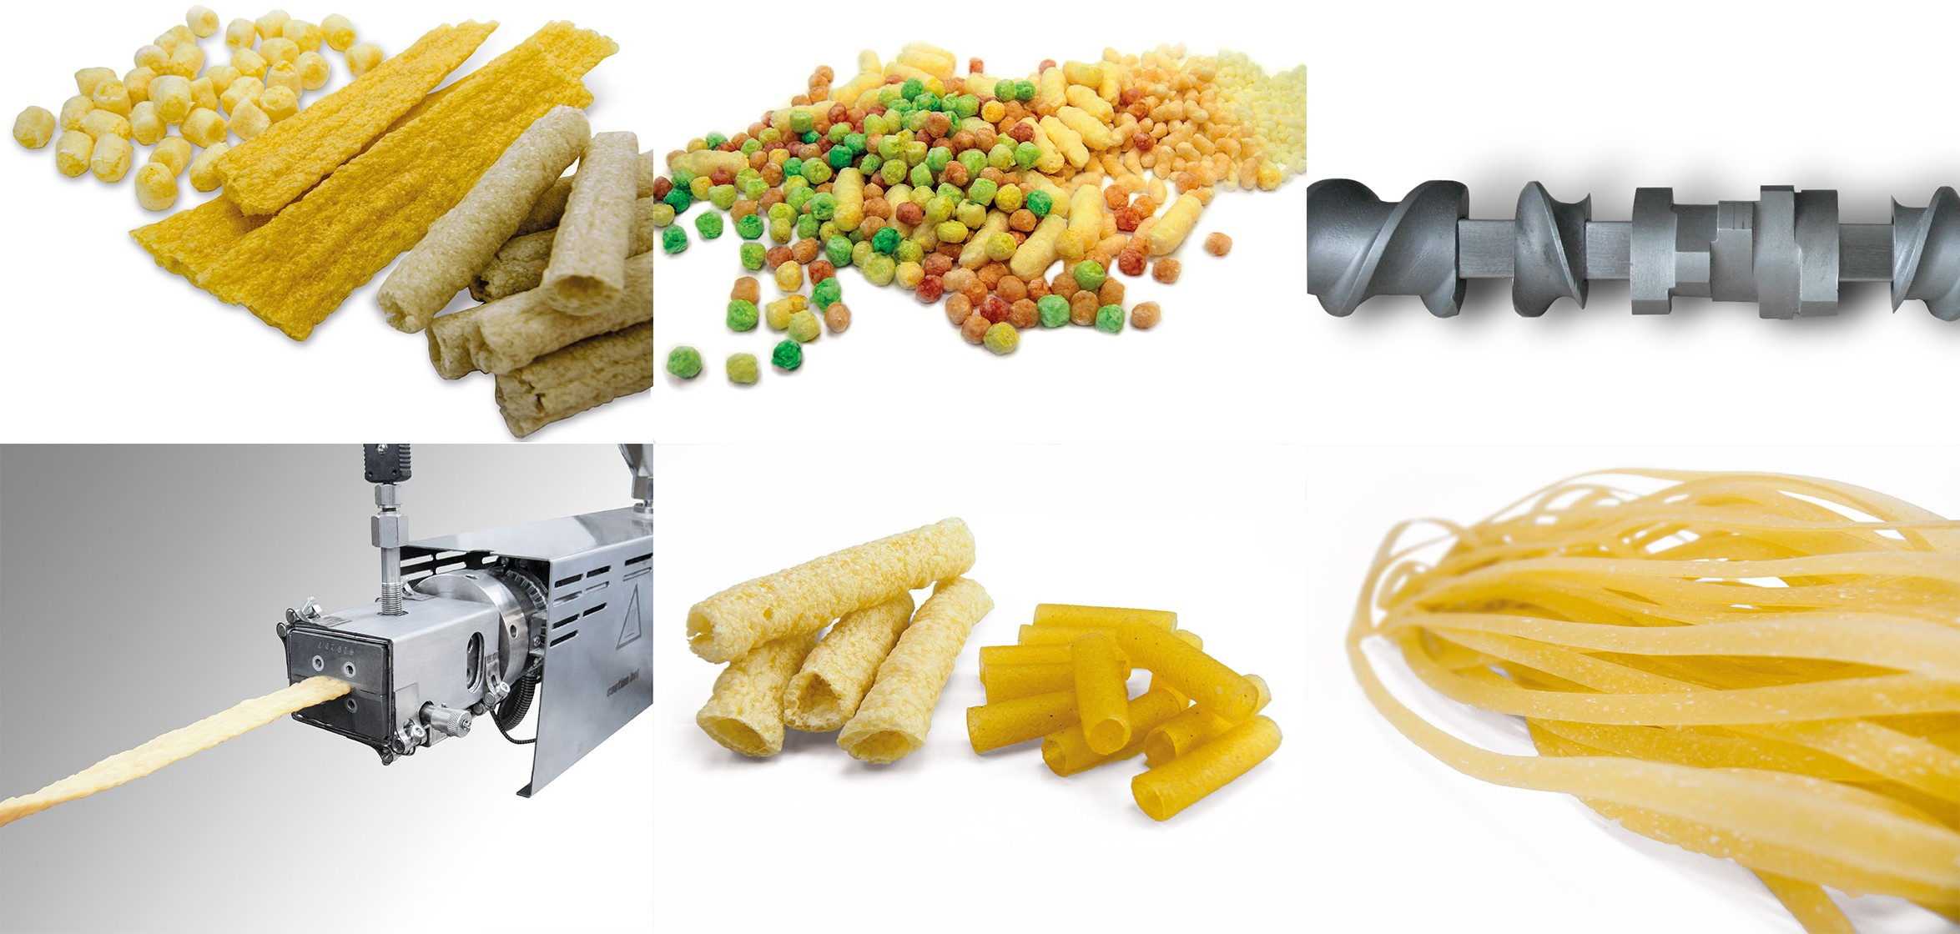
FOOD EXTRUSION PROCESSING: AN OVERVIEW

Slide 2
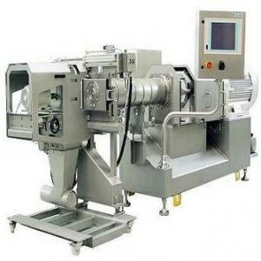
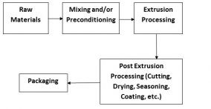
WSU EXTENSION | FOOD EXTRUSION PROCESSING: AN OVERVIEW
Food Extrusion Processing: An Overview
Summary
Extrusion processing is a commonly used processing technology in the food industry with a wide number of applications. It is a processing system that utilizes a single screw or a set of screws to force food materials through a small opening. While food is being forced through the extruder, foods are cooked by the high pressure, high shear, and high temperature environment created by the screws, encased in the barrel. Upon exiting, materials often puff due to the release of pressure and conversion of water into steam. The entire process is continuous and capable of happening in less than a minute. The most commonly used extruders in the food industry include single-screw and twin-screw systems, with twin-screw systems more widely used because of their flexibility. A brief overview of extrusion processing systems is provided in this publication, including applications of extrusion in the food industry, different parts of the extruder, and the concept of extrusion as a multiple input and multiple output processing system. This publication serves as an introduction to the understanding of food extrusion processing.
cereals, pellet products, pet foods, and pre-gelatinized flours, among others (Singh et al. 2007). It is a system that encompasses multiple unit operations such as mixing, kneading, cooking, forming, and cutting all into a single piece of equipment. This results in having a relatively simple process with high efficiency and low cost compared to other processing methods (Fellows 2009).
Introduction
Extrusion is defined as a system of pushing mixed ingredients out through a small opening, called a die, to form and to shape the materials (Launay and Lisch 1983). The formed products are then referred to as extrudates (Berk 2009). The first extruders for food processing were piston and ram-type extruders for processing meats and sausages (Harper 1981).
While still functional today, piston extruders have seen little development, but are still useful in specific applications. In the 1930s, pistons were replaced with a single screw to create a continuous process as opposed to the previous batch process. The single screws were applied to pasta production and revolutionized the food industry with the speed and functionality a screw extruder offered (Ainsworth 2011). Later in the 1960s, twin-screw extruders were established. The increased potential of a twin-screw system led to a diversification of options in food extrusion that expanded into a large variety of new snack and cereal products in the 1980s (Mercier et al. 1989).
Figure 1. A twin-screw extruder with the die cutter set up (with permission from Buhler, Inc.)
Figure 2 is a broad chart of what a food extrusion processing production line encompasses. The process begins with characterizing and receiving the raw ingredients. The raw ingredients used are crucial to the product consistency at the end of the processing line. The raw ingredients then undergo mixing and/or preconditioning, which can be done with the equipment such as ribbon blenders and preconditioners to ensure uniformity as they enter the extruder. However, mixing and preconditioning is optional for certain products.
Modern extruders now have incredible amounts of variability and functionality. Figure 1 shows a typical food extrusion system. Extruders are popular due to the creation of a rapid, continuous process that can be used in the food industry to make numerous food products such as snacks, breakfast
Figure 2. Flow chart of a typical extrusion processing line.

Slide 3
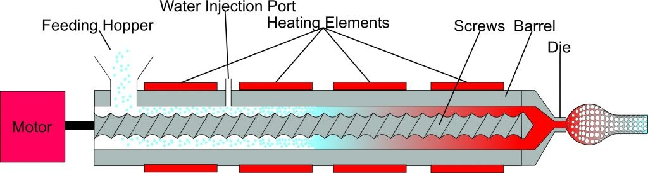
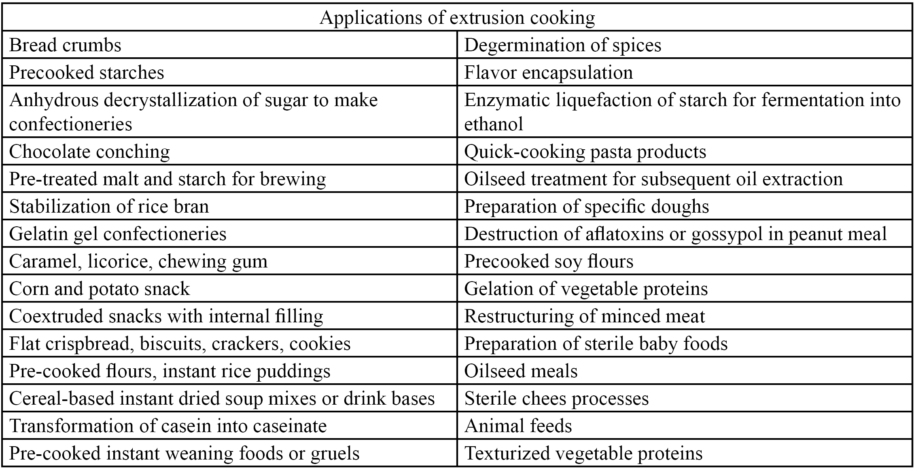
WSU EXTENSION | FOOD EXTRUSION PROCESSING: AN OVERVIEW
Extrusion processing then follows, which is the main cooking step where the raw ingredients are transformed into the cooked and formed products. Post-extrusion processing operations, such as cutting the extruded products into appropriate sizes, drying the products to the desired moisture, as well as seasoning or coating to provide the desired flavor and taste to the products before they go on to packaging. Along with these major sets of processing, there may be additional steps depending of the type of products being produced and their intended uses.
period of time. This helps to transform the ingredients from solid powders to a melt state inside of the extruder. The melted ingredients are then forced through a die at the end of the extruder into the atmosphere. The melt coming out of the extruder encounters a sudden drop in pressure, resulting in rapid expansion as well as a decrease in temperature, helping it to transform into a cooked product (Alvarez-Martinez et al.
1988). A schematic of the transformation can be seen in Figure
3. The final quality and texture of the extruded product depends on various factors, including the ingredient mixture and its properties, extrusion processing conditions, and post- processing conditions. Because of the great flexibility of extrusion processing, it has found very diverse applications in the food industry, some of which can be seen in Table 1.
Within the extrusion processing step, the food ingredients are subjected to high shear, temperature, and pressure for a short
Figure 3. A simple schematic of extrusion processing, showing the transformation of raw ingredient (such as grain flour or starch) to finished product.
Table 1. Applications of extrusion cooking.

Slide 4
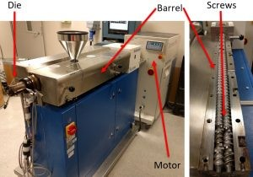
WSU EXTENSION | FOOD EXTRUSION PROCESSING: AN OVERVIEW
Extrusion processing is beneficial largely because of its applicability in various food processes, its flexibility, its reduced cost benefits, high production rate, and quality products compared to other ordinary food processes (Fellows 2009; Harper 1981; Riaz 2000).
be used for water or other liquid ingredients while added feeding ports may have additional powder ingredients being forced in through the side of the barrel so they experience less cooking by bypassing a large section of the extruder. The role of the screw(s) is to assist in imparting shear to the ingredient mixture and forcing the dough of the mixed ingredients out from the extruder through the die. The screws are also responsible for the buildup of pressure that occurs at the end of the extruder as well as added mixing of the ingredients. The die functions to hold the material in the screws, providing time for the screws to impart shear energy onto the sample. The die
also controls the final shape of the product and can be varied tremendously. The last essential part of the extruder is the motor, which provides the energy needed to rotate the screws (Figure 4).
Versatility
Extrusion can be utilized for plenty of different food products and easily be modified by changing control parameters to adjust for materials that are challenging or conditions that are unattainable with general food processing.
Reduced Cost
Extrusion processing has a lower cost range compared to other food processes. Its one-step, continuous system requires little labor, and the energy consumption of the extruder is relatively low.
Other optional parts may include a preconditioner, which can be used to pre-hydrate the ingredient mix and in some cases pre-cook the materials before feeding into the extruder. A
die cutter is also frequently used to help cut the final extrudates coming out of the die.
High Output
Owing to a continuous extrusion process, the extruder serves a high productivity system, which can provide higher efficiency for the food manufacturing process.
Product Quality
Extrusion can increase starch and protein digestibility by gelatinizing and denaturing, respectively. It also blocks and reduces contaminant microorganisms.
Extruder Parts
The major parts of an extruder include the feeder, barrel, screw(s), and die, although many more parts can be added for increased product versatility. The feeder is used for continuously feeding the mixture into the extruder at a constant rate to ensure consistency. Feeders often feed the material in either gravimetrically or volumetrically and it is possible to use more than one feeder at a time for different ingredients. The barrel encases the screw or a set of screws. Often, the barrel is jacketed for heating and for cooling. The heating can also be accomplished by providing electrical heating units on the barrel or by steam. The inner layer of barrels is often smooth in
twin-screw systems while it may be grooved or fluted in single- screw systems. The barrel may also have various injection ports or additional feeding ports along it. Injection ports may
Figure 4. Components of an extruder (CW Brabender 20mm TSE at the WSU Food Extrusion Laboratory).
Types of Extruders
The most common extruder types used in food processing are single-screw extruders and twin-screw extruders. A single- screw extruder consists of only one screw housed in the barrel that often has a fluted or grooved design. Additionally, the screw in a single-screw extruder is usually designed with a decreasing pitch to create compression. The amount of decreasing pitch is referred to as the compression ratio. A twin- screw extruder has a pair of screws that are either intermeshing or non-intermeshing. The set of screws in the twin-screw extruder can be either co-rotating or counter-rotating. Co- rotating is more frequently used as it can impart more

Slide 5
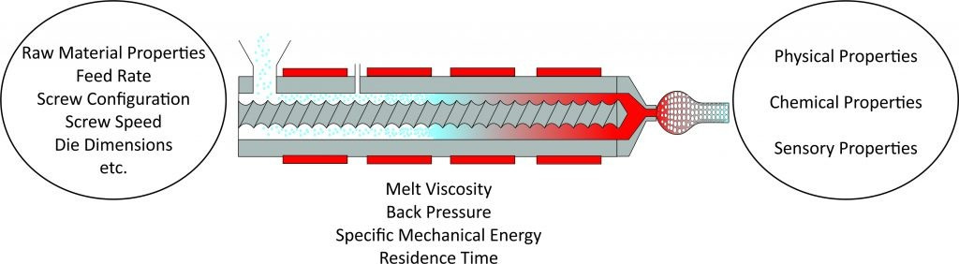
WSU EXTENSION | FOOD EXTRUSION PROCESSING: AN OVERVIEW
mechanical energy into the material than counter-rotating screws. The twin-screw extruder is more commonly used in the food industry because of its wide range of operating conditions and its ability to make wide range of food products,
even though it requires a higher maintenance cost than a single- screw extruder (1.5–2.0 times; Harper 1981; Heldman and Hartel 1997).
System Parameters
System parameters are the ones that the extruder operator does not have direct control over, but the operator can influence them by changing the independent parameters. The mean residence time, residence time distribution, back pressure, motor torque, and specific mechanical energy being applied to the material are the system parameters that can be measured. These impact the final product properties, but can only be modified indirectly through varying the independent parameters.
Twin-screw extruders have a wide flexibility for handling diverse ingredients and a higher production rate than single- screw extruders. Twin-screw extruders can be operated with a greater range of moisture content, which is a drawback for a single-screw extruder. The preconditioning systems can be used to expand the capabilities of both single- and twin-screw extruders. The twin-screw extruder has a higher efficiency in mixing, a self-wiping capability that can prevent residues from accumulating, and a heat transfer that is relatively faster and more uniform from the barrel to the ingredients (Ainsworth 2011; Berk 2009).
Product Properties
Product properties are parameters that help describe the final extruded product quality. This can include, physical properties (expansion ratio, density, etc.), chemical properties (water absorption and solubility, etc.) and sensory properties (crispness, crunchiness, texture, etc.).
Extrusion as MIMO System
Extrusion can be considered as a multiple input and multiple output (MIMO) system (Eerikäinen et al. 1994). Figure 5 demonstrates inputs and outputs associated with this concept. Various extrusion processing parameters can be broadly classified into three categories: (1) independent parameters (input parameters), (2) system parameters (dependent parameters) and (3) product properties (output parameters).
Describing extrusion processing with the MIMO system helps to control the extrusion process to manufacture food products consistently.
Direct-Expanded Food Products
The most common food products that are manufactured by direct expansion phenomenon include puffed snacks, breakfast cereals, and others. The majority of these direct-expanded products have a higher percentage of carbohydrates. The major source of these carbohydrates include cereal grains (such as corn, rice, and wheat), plant tubers (such as potato), and pulses (such as peas), among others (Aluwi et al. 2016; Harper, 1981; Kowalski et al. 2015).
Independent Parameters
Independent parameters are the parameters that the extruder operator has direct control over. These include the raw material (ingredient) properties and the extrusion operation parameters such as feed rate, barrel temperatures, screw configurations, screw speeds, die dimensions, and others. By modifying the independent parameters, the operator can achieve changes in the system parameters and final product properties.
Figure 5. Extrusion process as a MIMO system.

Slide 6
WSU EXTENSION | FOOD EXTRUSION PROCESSING: AN OVERVIEW
It is well researched that among the different biopolymers, starch expands the most in extrusion (Ganjyal and Hanna 2006). Proteins generally tend to inhibit expansion due to their inherent nature to denature and texturize during extrusion processing (Ganjyal et al. 2004). Fibers (specifically the insoluble fiber) are known to inhibit expansion as they do not go through phase change when subjected to heat and shear like the starches and proteins (Heldman and Hartel 1997; Kaisangsri et al. 2016).
Berk, Z. 2009. Chapter 15 – Extrusion. In Food Process Engineering and Technology, 333–350. San Diego: Academic Press.
Eerikäinen, T., Y.H. Zhu, and P. Linko. 1994. Neural Networks in Extrusion Process Identification and Control. Food Control 5(2): 111–119.
Fellows, P.J. 2009. 15 – Extrusion. In Food Processing Technology, 3rd ed., 456–477. Woodhead Publishing.
As the melt material exits the dies, the expansion process is initially caused by a sudden drop in pressure. This causes the liquid water in the melt to convert to steam. The steam then accumulates into small pockets and expands outward in all directions, causing products to expand radially and longitudinally from the die. After the initial expansion, the product continues to cool, resulting in a decrease in expansion, predominantly in the cells around the edge of the formed extrudate. Various extrusion conditions, as well as ingredients, can be used to process and change the type of structures being formed (Ganjyal and Hanna 2004; Wang et al. 2005). Direct- expanded products provide a great opportunity for the food industry to deliver nutritious and fun foods to consumers.
Ganjyal, G., N. Reddy, Y. Yang, and M. Hanna. 2004. Biodegradable Packaging Foams of Starch Acetate Blended with Corn Stalk Fibers. Journal of Applied Polymer Science 93(6): 2627–2633.
Ganjyal, G.M., and M.A. Hanna. 2004. Effects of Extruder Die Nozzle Dimensions on Expansion and Micrographic Characterization during Extrusion of Acetylated Starch. Starch- Stärke, 56(3?4): 108–117.
Ganjyal, G.M., and M.A. Hanna. 2006. Role of Blowing Agents in Expansion of High-Amylose Starch Acetate During Extrusion 1. Cereal Chemistry 83(6): 577–583.
Summary
Consumer demand for higher quality food products that have a great texture and high nutrient value is increasing. Extrusion processing has proven to be a very practical and economical processing tool to produce various food products that the consumers enjoy. With its ease and flexibility, extrusion has a great promise to continue to be a valuable processing technology for the food industry. As research continues in extrusion, more methods on how to utilize it effectively, and alter it further, will continue to drive the technology forward and expand the scope of possible products that can be produced.
Harper, J.M. 1981. Extrusion of Foods. CRC-Press.
Heldman, D.R., and R.W. Hartel. 1997. Food Extrusion. In Principles of Food Processing, 253–283, D.R. Heldman and
R.W. Hartel, eds. Springer US.
Kaisangsri, N., R.J. Kowalski, I. Wijesekara, O. Kerdchoechuen, N. Laohakunjit, and G.M. Ganjyal. 2016. Carrot Pomace Enhances the Expansion and Nutritional Quality of Corn Starch Extrudates. LWT – Food Science and Technology 68: 391–399.
Kowalski, R.J., C.F. Morris, and G.M. Ganjyal. 2015. Waxy Soft White Wheat: Extrusion Characteristics and Thermal and Rheological Properties. Cereal Chemistry Journal 92(2): 145–153.
References
Ainsworth, P. 2011. Extrusion. In Food Processing Handbook, 429–453. Wiley-VCH Verlag GmbH & Co. KGaA.
Launay, B., and J. Lisch. 1983. Twin-Screw Extrusion Cooking of Starches: Flow Behaviour of Starch Pastes, Expansion and Mechanical Properties of Extrudates.
Journal of Food Engineering 2(4): 259–280.
Aluwi, N.A., B.-J. Gu, G.S. Dhumal, I.G. Medina-Meza, K.M. Murphy, and G.M. Ganjyal. 2016. Impacts of Scarification and Degermination on the Expansion Characteristics of Select Quinoa Varieties during Extrusion Processing. Journal of Food Science.
Mercier, C., P. Linko, and J.M. Harper. 1989. Extrusion Cooking. American Association of Cereal Chemists.
Alvarez-Martinez, L., K. Kondury, and J. Harper. 1988. A General Model for Expansion of Extruded Products. Journal of Food Science 53(2): 609–615.
Riaz, M.N. 2000. Extruders in Food Applications. Technomic Pub. Co.

Slide 7
WSU EXTENSION | FOOD EXTRUSION PROCESSING: AN OVERVIEW
Singh, S., S. Gamlath, and L. Wakeling. 2007. Nutritional Aspects of Food Extrusion: A Review. International Journal of Food Science & Technology 42(8): 916–929.
Wang, L., G.M. Ganjyal, D.D. Jones, C.L. Weller, and M.A. Hanna. 2005. Modeling of Bubble Growth Dynamics and Nonisothermal Expansion in Starch-Based Foams during Extrusion. Advances in Polymer Technology 24(1): 29–45.

Slide 8

WSU EXTENSION | FOOD EXTRUSION PROCESSING: AN OVERVIEW
Copyright Washington State University
WSU Extension bulletins contain material written and produced for public distribution. Alternate formats of our educational materials are available upon request for persons with disabilities. Please contact Washington State University Extension for more information.
Issued by Washington State University Extension and the U.S. Department of Agriculture in furtherance of the Acts of May 8 and June 30, 1914. Extension programs and policies are consistent with federal and state laws and regulations on nondiscrimination regarding race, sex, religion, age, color, creed, and national or ethnic origin; physical, mental, or sensory disability; marital status or sexual orientation; and status as a Vietnam-era or disabled veteran. Evidence of noncompliance may be reported through your local WSU Extension office. Trade names have been used to simplify information; no endorsement is intended. Published November 2017.

