Slide 1
RESEARCH METHODS IN NUTRITION
HND 607
3(3-0)

Slide 2
What is Research??
Systematic and objective analysis and recording observations that may lead to development of theories, principles, generalizations, prediction and possible control of events
Collection of information about a particular subject
Systematic and scientific approach for determining relationship between variables

Slide 3
Research
Systematic
Controlled
Empirical
Critical Investigations
Presumed Relations
Observed Phenomenon

Slide 4
Sources of Knowledge
Custom and Tradition
Personal Experience
Reasoning
  Deductive
  General → Specific
  Inductive
  Specific → General
Scientific Inquiry

Slide 5
Types of Research
Experimental Research
Descriptive research
Ex-Post Facto research
Cross Sectional Research
Longitudinal Research
Action Research
Field Experiments
Qualitative Research
Quantitative research
Historical research

Slide 6

Experimental Research
Scientific research
Hypothesis manipulation by researcher
Controlled environment
Results are specific
Cause and effect of a hypothesis

Slide 7
Descriptive research
Describes the characteristics of the population or phenomenon under study
Focuses on “What” rather than “why”
Best approach for Descriptive research is survey
  Observation
  Case study
  Survey research
Conducted under natural environment
Helps in data collection
Provide base for decision making

Slide 8
Ex-Post Facto research
After the fact research
  Investigation starts after the fact has occurred
The majority of social science research where it is not possible to manipulate the characteristics of human particle is based on Ex-post facto research
  Things that can not be controlled physically or ethically e.g. to eyesight can not be changed to study its effect on motor skills

Slide 9
Cross Sectional Research
A cross-sectional study is defined as an observational research type that analyzes data of variables collected at one given point of time across a sample population. population or a pre-defined subset.
  Medical study looking at the prevalence of cancer amongst a certain population
Good for descriptive analysis
Does not help to Determine Cause

Slide 10
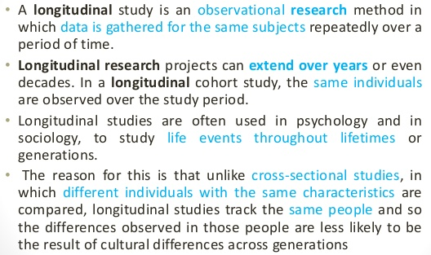
Longitudinal Research

Slide 11
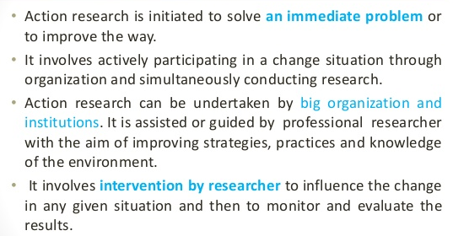
Action Research

Slide 12
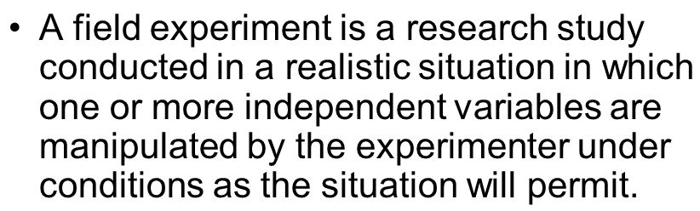
Field Experiment
Out comes are observed in natural environment as compared to laboratory environment
Chances of contamination are high

Slide 13
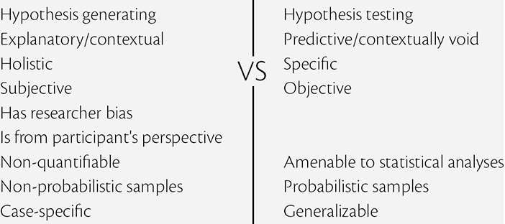
Qualitative and Quantitative research

Slide 14
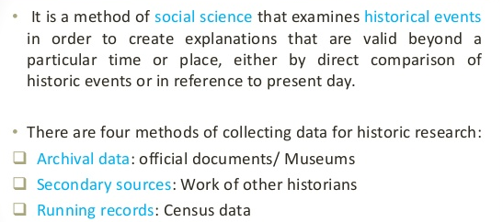
Historical research

Slide 15


