Slide 1
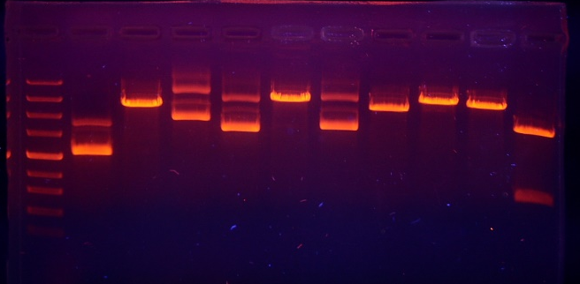
Working with DNA
Restriction enzyme and DDNA modification

Slide 2
A restriction enzyme is a protein isolated from bacteria that cleaves DNA sequences at sequence-specific sites, producing DNA fragments with a known sequence at each end. The use of restriction enzymes is critical to certain laboratory methods, including recombinant DNA technology and genetic engineering.
there are at least three thousand of them. Each one of these enzymes cuts a specific DNA sequence and doesn't discriminate as to where the DNA comes from — bacteria, fungi, mouse, or human, snip, snip, snip.

Slide 3
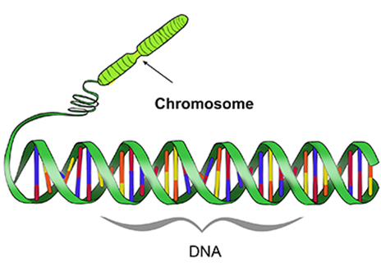
Restriction Enzymes
Learning intention
Success criteria
Describe the process of cutting DNA using restriction enzymes
recall that enzymes are proteins that catalyze specific chemical reactions under specific conditions
Recognise how restriction enzymes are used to make recombinant DNA.
Identify restriction sites in double-stranded DNA

Slide 4
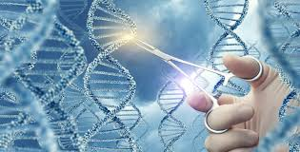
This is because…
DNA technologies are used in a range of industries; your body and your food are made of cells with DNA and protein.

Slide 5
Reminder: Enzymes
Enzymes are biological catalysts – found in all cells.
They are molecules (usually proteins) that speed up chemical reactions.
Enzymes have unique chemical structures that mean they only act on specific substrates
For a particular enzyme to work optimally, it must be under specific conditions (temperature, pH), otherwise its unique chemical structure will be disrupted.
Enzymes are critical for a range of cellular processes including digestion, DNA replication, protein synthesis.

Slide 6
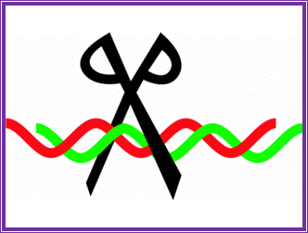
Restriction Enzymes - purposes
Researchers rely on restriction enzymes to assist with many processes in laboratories around the world:
1. Making recombinant DNA and appraising success
For research, medicine and agriculture
2. DNA profile analysis
For disease diagnosis, paternity/family relationship testing, and forensics

Slide 7
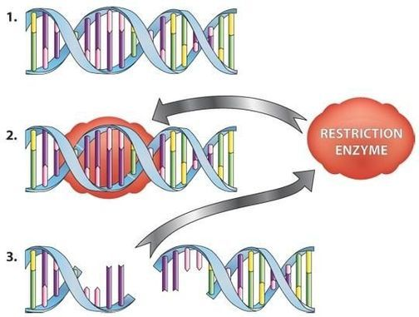
Restriction Enzymes
These enzymes were discovered in bacteria.
They help the bacteria destroy viral DNA.
(bacteria get viruses too!)
They cut between specific bases (letters) of the double stranded DNA molecule
The DNA is then in multiple pieces
The pieces are separated by gel electrophoresis for analysis
https://www.sciencelearn.org.nz/resources/2035-restriction-enzymes

Slide 8
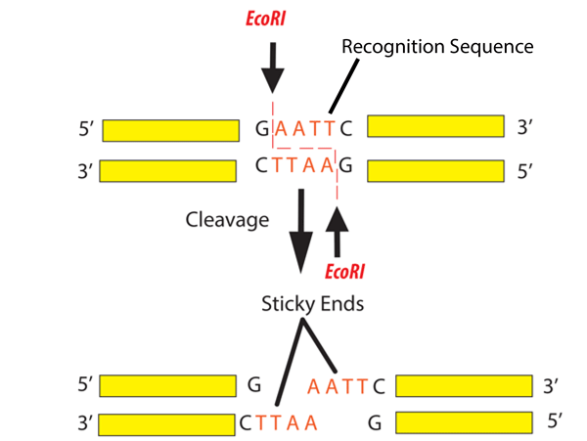
Restriction Enzymes Sites
Specific restriction enzymes cut at specific DNA sequences.
For example:
EcoRI is an enzyme that cuts at the following sequence: GAATTC
EcoRI was discovered in E. coli bacteria.
The resulting pieces of DNA are called “restriction fragments.”

Slide 9
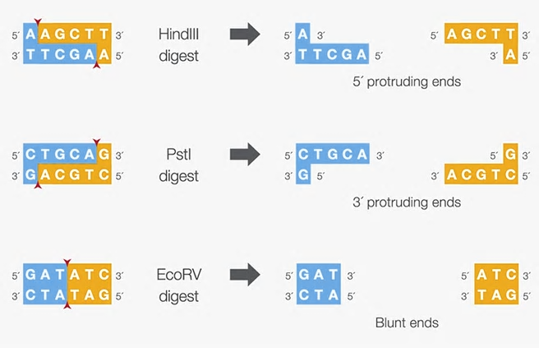
Many restriction enzymes
HindIII was discovered in H. influenza
PstI was discovered in P. stuartii
EcoRV was discovered in E. coli
Protruding ends are also called “sticky” ends. Why might these be useful?

Slide 10
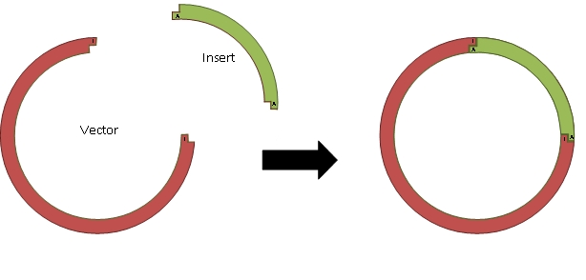
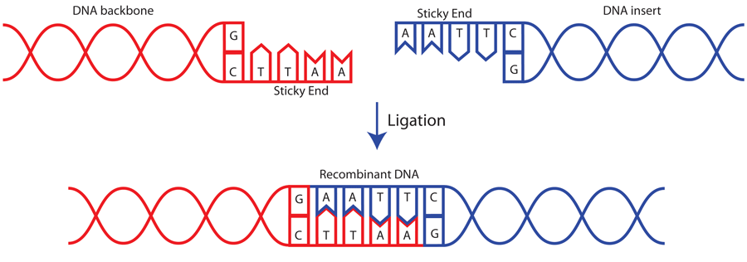
Restriction fragments: sticky ends
https://www.addgene.org/protocols/dna-ligation/
When you cut two separate molecules of DNA with the same restriction enzyme, the fragments will have matching sticky ends.
This is how recombinant DNA is created.
Purpose: making recombinant DNA
Notes:
Restriction enzymes are very useful because we can cut a plasmid vector with the same restriction enzyme as the source of our gene of interest. This allows us to then insert the gene of interest into the plasmid vector. Overlapping sticky ends form hydrogen bonds between complementary bases.

Slide 11
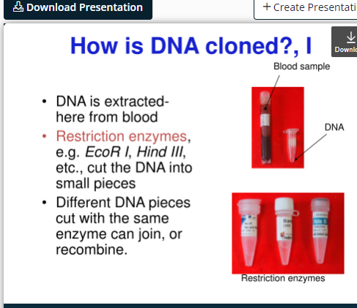

Slide 12
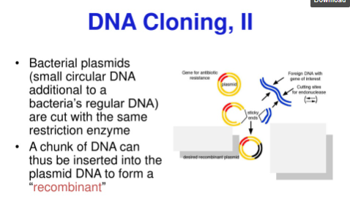

Slide 13
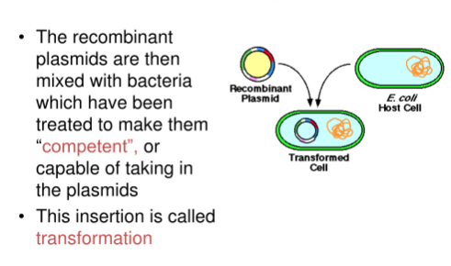

Slide 14
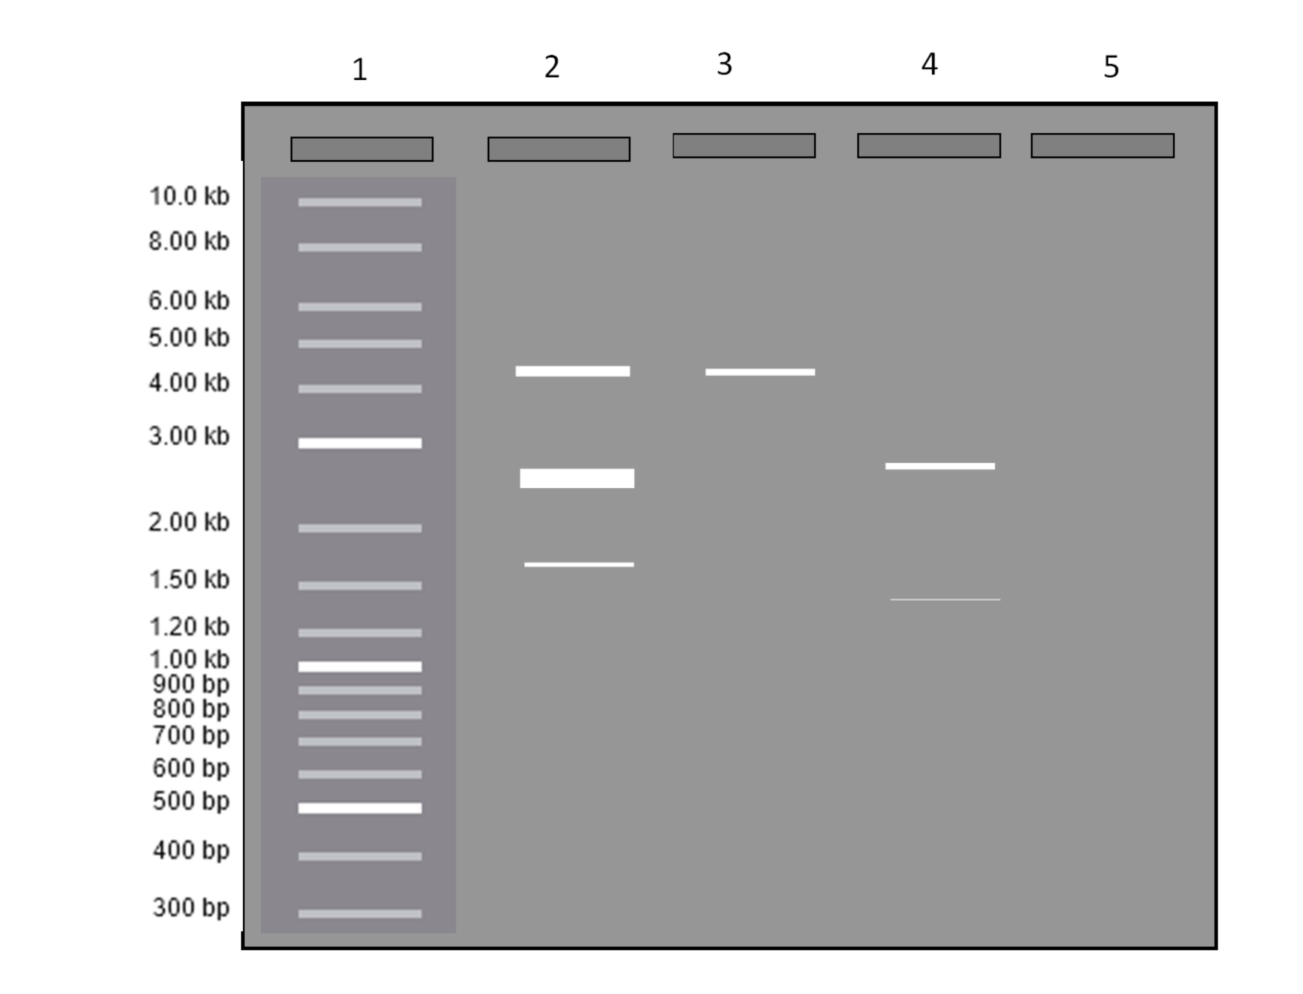
Booklet 3 Part A
Example sequence. Cut with EcoRI.
T C C A G C T G G A C G A A T T C T T C A G A T G A A T T C A A A
A G G T C G A C C T G C T T A A G A A G T C T A C T T A A G T T T
Number of fragments: 3
Size of each fragment: 12bp, 9bp, 4bp
1. Watch the video on restriction enzymes.
2. Complete part A of booklet 3

