Slide 1
Macro Nutrients
Dr. Asif Ahmad

Slide 2
Definition of Macronutrients
Definition of Macronutrients
Macronutrients are nutrients that your body needs in large amounts to function optimally. They provide the energy necessary for growth, metabolism, and other bodily functions. The three main types of macronutrients are carbohydrates, proteins, and fats

Slide 3
Types of Macro Nutrients
Types of Macronutrients
1. Carbohydrates
Function: Carbohydrates are the body’s primary source of energy. They are broken down into glucose, which fuels your brain and muscles.
Caloric Value: 4 calories per gram.
Sources:
  Whole grains (brown rice, oats, barley)
  Vegetables (potatoes, corn, peas)
  Fruits (bananas, apples, mangoes)
  Legumes (beans, lentils, chickpeas)
  Dairy products (milk, yogurt)

Slide 4
Proteins
Function: Proteins are essential for building and repairing tissues, making enzymes and hormones, and supporting immune function.
Caloric Value: 4 calories per gram.
Sources:
  Poultry (chicken, turkey)
  Eggs
  Red meat (beef, lamb, pork)
  Seafood (salmon, shrimp, cod)
  Dairy products (milk, cheese, yogurt)
  Plant-based sources (tofu, edamame, nuts, seeds)

Slide 5
Fats
Fats
Function: Fats provide a concentrated source of energy, support cell growth, protect organs, and help absorb certain vitamins.
Caloric Value: 9 calories per gram.
Sources:
  Healthy fats (avocados, nuts, seeds, olive oil)
  Fatty fish (salmon, mackerel)
  Dairy products (full-fat yogurt, cheese)
  Coconut products (coconut oil, fresh coconut)

Slide 6
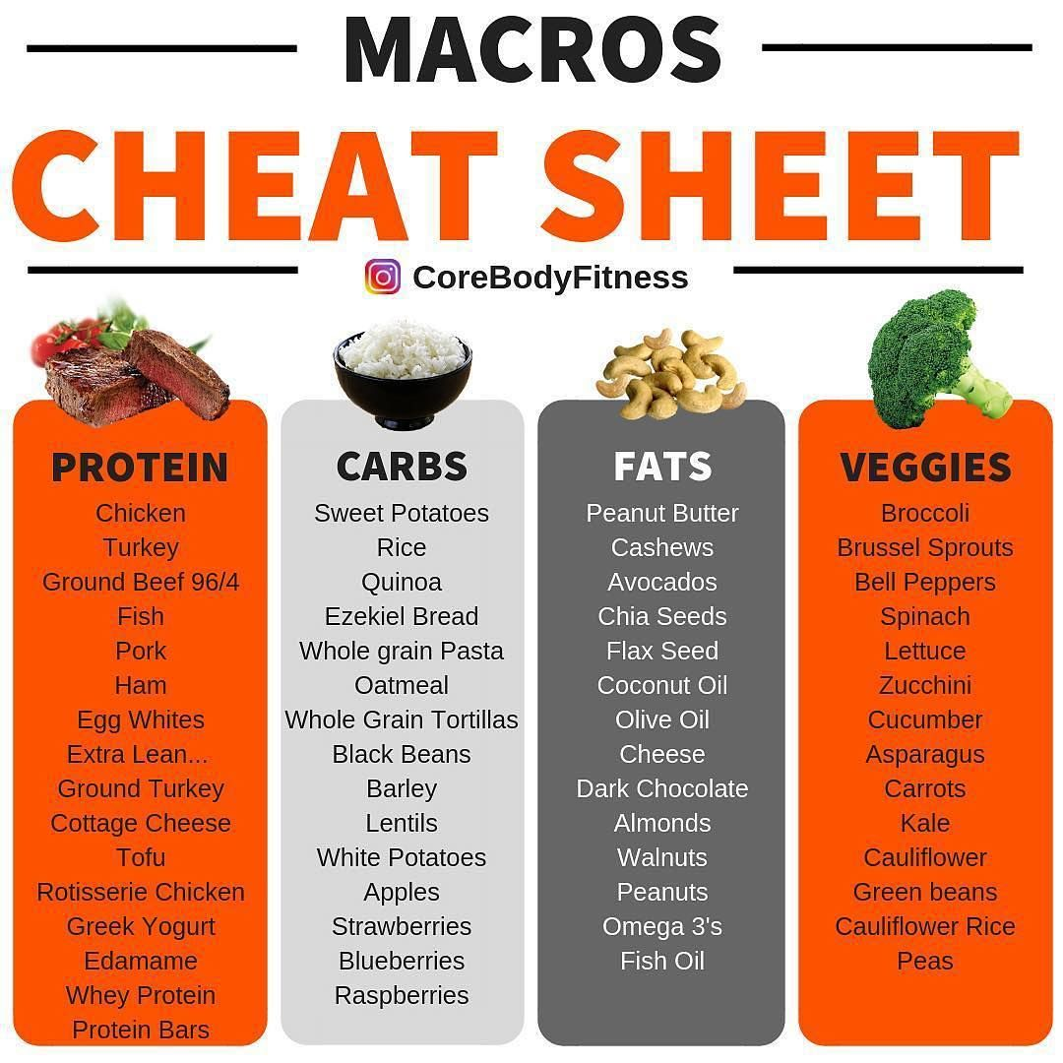
Macro Nutrients in Food

Slide 7
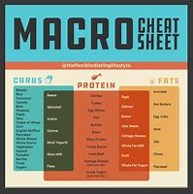
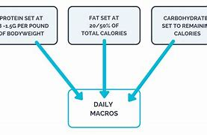

Slide 8
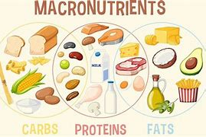
Mixed Nutrients

Slide 9
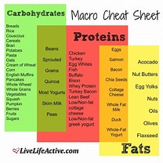
Macro Nutrients Cheat sheet

Slide 10
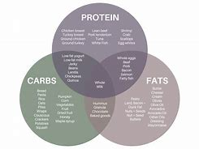

Slide 11
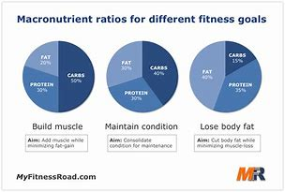

Slide 12
Proteins
1. Proteins
Function: Build and repair tissues, make enzymes and hormones.
Caloric Value: 4 calories per gram.
Sources:
  Animal-Based: Lean beef, chicken breast, turkey, fish (salmon, tuna), eggs, dairy (Greek yogurt, cottage cheese).
  Plant-Based: Lentils, chickpeas, beans, tofu, tempeh, quinoa, nuts, and seeds.

Slide 13
2. Carbohydrates
Function: Provide energy, especially for the brain and muscles during exercise.
Caloric Value: 4 calories per gram.
Sources:
  Simple Carbs: Fruits, honey, milk, sugar.
  Complex Carbs: Whole grains (oats, brown rice, quinoa), vegetables, legumes, starchy foods (potatoes, sweet potatoes).

Slide 14
3. Fats
Function: Store energy, protect organs, support cell growth, keep cholesterol and blood pressure under control.
Caloric Value: 9 calories per gram.
Sources:
  Healthy Fats: Avocado, nuts (almonds, walnuts), seeds (chia, flax), olive oil, fatty fish (salmon, mackerel).
  Saturated Fats: Butter, cheese, red meat, coconut oil.

Slide 15
Combination Foods
Protein & Carbs: Low-fat yogurt with fruit, oats with milk, beans with rice.
Protein & Fats: Eggs, salmon, nuts, and seeds.
Carbs & Fats: Avocado toast, nuts, and seeds.

Slide 16

Tips for Tracking Macros
Use a Food Scale: For accurate measurement.
Read Nutrition Labels: To understand the macronutrient content.
Use Apps: Like MyFitnessPal to track your intake.

Slide 17
Determine Your Total Daily Energy Expenditure (TDEE)
Step 1:
Step 1: Calculate Basal Metabolic Rate (BMR)
The BMR is the number of calories your body needs at rest. You can use the Mifflin-St Jeor Equation:
For Men:BMR=10×weight (kg)+6.25×height (cm)−5×age (years)+5
For Women:BMR=10×weight (kg)+6.25×height (cm)−5×age (years)−161

Slide 18
STEP 2
Step 2: Adjust for Activity Level
Multiply your BMR by an activity factor:
Sedentary (little or no exercise): BMR × 1.2
Lightly active (light exercise/sports 1-3 days/week): BMR × 1.375
Moderately active (moderate exercise/sports 3-5 days/week): BMR × 1.55
Very active (hard exercise/sports 6-7 days a week): BMR × 1.725
Super active (very hard exercise/physical job): BMR × 1.9

Slide 19
Understanding Your Macronutrient Ratios
2. Set Your Macronutrient Ratios
The typical macronutrient distribution ranges are:
Proteins: 10-35% of total calories
Carbohydrates: 45-65% of total calories
Fats: 20-35% of total calories

Slide 20
3. Calculate Macronutrient Needs
Using your TDEE and chosen macronutrient ratios, you can calculate the grams of each macronutrient you need per day.
Example Calculation
Let’s say your TDEE is 2500 calories, and you choose the following ratios:
Proteins: 30%
Carbohydrates: 50%
Fats: 20%

Slide 21
Calculations
Proteins:
  Calories from protein: ( 2500 \times 0.30 = 750 ) calories
  Grams of protein: ( \frac{750}{4} = 187.5 ) grams
Carbohydrates:
  Calories from carbs: ( 2500 \times 0.50 = 1250 ) calories
  Grams of carbs: ( \frac{1250}{4} = 312.5 ) grams
Fats:
  Calories from fats: ( 2500 \times 0.20 = 500 ) calories
  Grams of fats: ( \frac{500}{9} \approx 55.6 ) grams

Slide 22
Adjustments
4. Adjust Based on Goals
Weight Loss: Reduce your TDEE by 500-1000 calories/day for a safe weight loss of 0.5-1 kg per week.
Muscle Gain: Increase your TDEE by 250-500 calories/day.

Slide 23
Tools and Apps
Tools and Apps
MyFitnessPal: For tracking your food intake and macros.
Cronometer: For detailed nutrient tracking.

Slide 24
Home Task – Practice Exercise
Explore some Nutrition APPS For tracking your food intake and macros, work with these apps.
e.g.
MyFitnessPal: For tracking your food intake and macros.
Cronometer: For detailed nutrient tracking.
………

Slide 25
Importance of Macronutrients
Importance of Macronutrients
Each macronutrient plays a unique role in maintaining health and supporting bodily functions.
Suggested Reading: Follow these links:
A balanced intake of carbohydrates, proteins, and fats is crucial for overall well-being². (Macronutrients: Definition, importance, and food sources (medicalnewstoday.com))
Would you like more detailed information on any specific macronutrient or its sources? ¹: Healthline ²: Medical News Today
IIFYM, or “If It Fits Your Macros,” is a type of flexible dieting that helps people lose weight without feeling overly restricted. Rather than focusing on calories, IIFYM tracks macronutrients instead — namely protein, fat and carbohydrates. (www.healthline.com/nutrition/iifym-guide)

