Slide 1

CRABOHYDRATES, DIGESTION, ABSORPTION, METABOLISM OF CARBOHYDRTES- GLUCOSE HOMEOSTASIS
PROF.DR. ASIF AHMAD
IFNS- PMAS UAAR

Slide 2

INTRODUCTION
Carbohydrates are a primary energy source, classified into simple and complex forms.
During digestion, enzymes break down carbohydrates into glucose, which is absorbed into the bloodstream.
The body metabolizes glucose for energy or stores it as glycogen.
Glucose homeostasis is crucial for maintaining stable blood sugar levels, regulated by insulin (to lower blood sugar) and glucagon (to raise blood sugar).
Disruptions in this balance can lead to metabolic disorders like diabetes, highlighting the importance of proper carbohydrate digestion, absorption, and metabolism in overall health.
Notes:
© Copyright Showeet.com – Free PowerPoint Templates

Slide 3
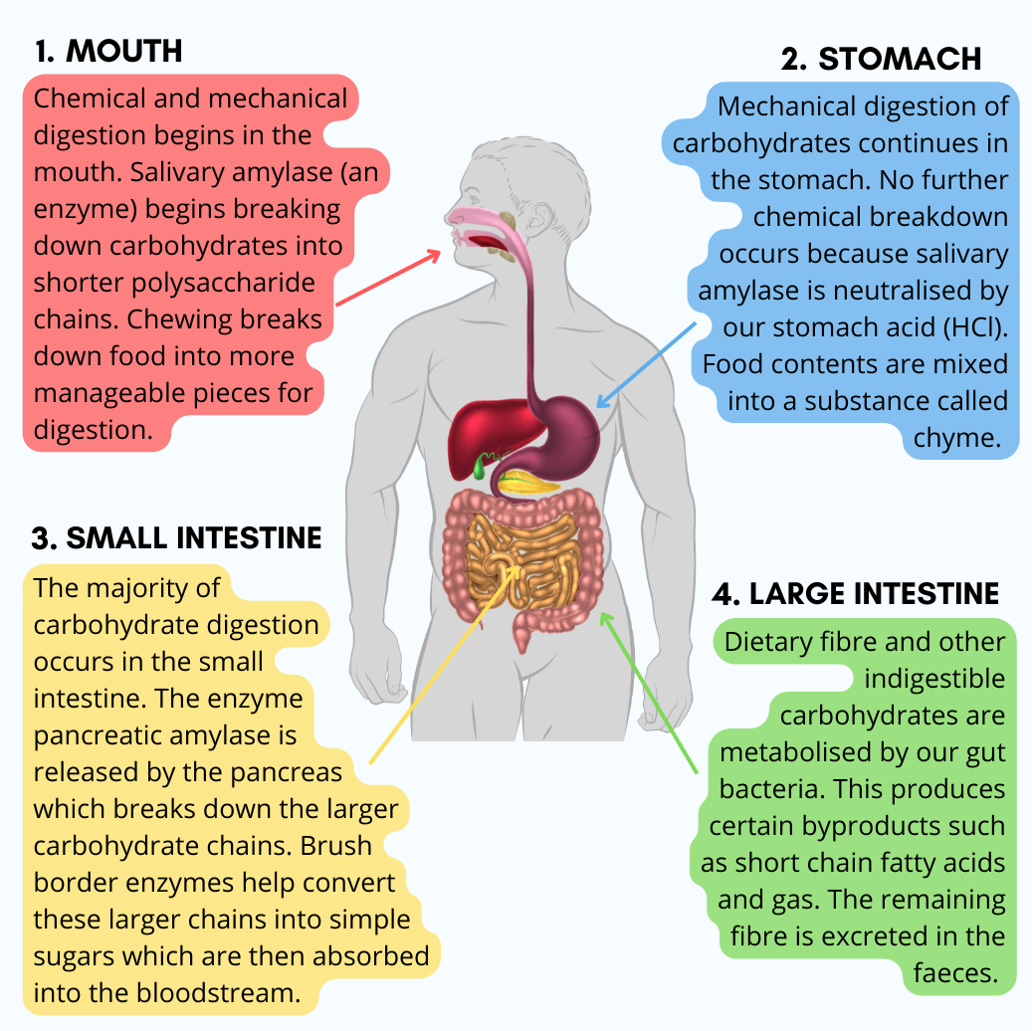
DIGESTION OF CARBOHYDRATES
Carbohydrate digestion begins in the mouth and continues through the stomach and small intestine:
Mouth: The process starts with salivary amylase, an enzyme that breaks down starches (complex carbohydrates) into smaller sugars (maltose).
Stomach: The acidic environment halts the action of salivary amylase, and no significant carbohydrate digestion occurs here.
Small Intestine: Most carbohydrate digestion takes place here:
  Pancreatic Amylase further breaks down starches into disaccharides (maltose, sucrose, lactose).
  Brush Border Enzymes in the small intestine (like maltase, sucrase, and lactase) split disaccharides into monosaccharides (glucose, fructose, and galactose), which can be absorbed into the bloodstream.
Absorption: The monosaccharides are absorbed through the villi into the blood, transported to the liver, and then distributed to cells for energy or stored as glycogen in the liver and muscles.
Notes:
© Copyright Showeet.com – Free PowerPoint Templates

Slide 4
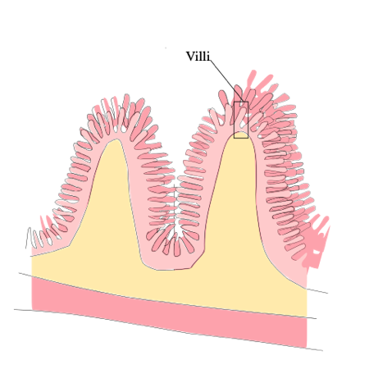
ABSORPTION OF CARBOHYDRATES
After carbohydrate digestion, the resulting monosaccharides (glucose, fructose, and galactose) are absorbed in the small intestine:
Absorption in the Small Intestine:
  Villi in the lining of the small intestine are lined with enterocytes (intestinal cells) that facilitate the absorption of monosaccharides into the bloodstream.
  Glucose and galactose are absorbed through active transport using a sodium-dependent glucose transporter (SGLT1), requiring energy.
  Fructose is absorbed through facilitated diffusion using a specific transporter called GLUT5.

Slide 5
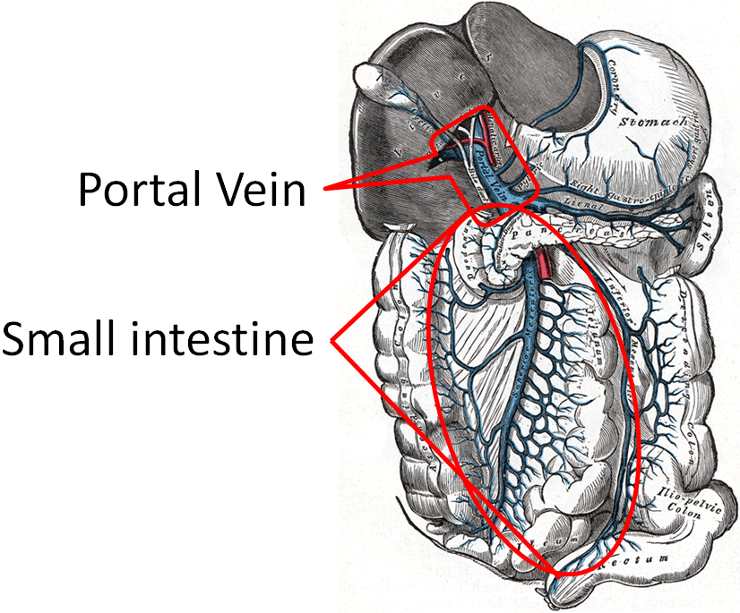
2. Transport to the Liver: Once absorbed, monosaccharides enter the bloodstream and travel to the liver via the portal vein.
  In the liver, glucose can either be used immediately for energy, converted to glycogen for storage, or released into the bloodstream to maintain blood sugar levels.
  Fructose and galactose are also converted into glucose or used for other metabolic processes.
3. Distribution: Glucose is then transported via the bloodstream to cells for energy production, particularly in muscles and the brain, where it is the primary energy source.

Slide 6
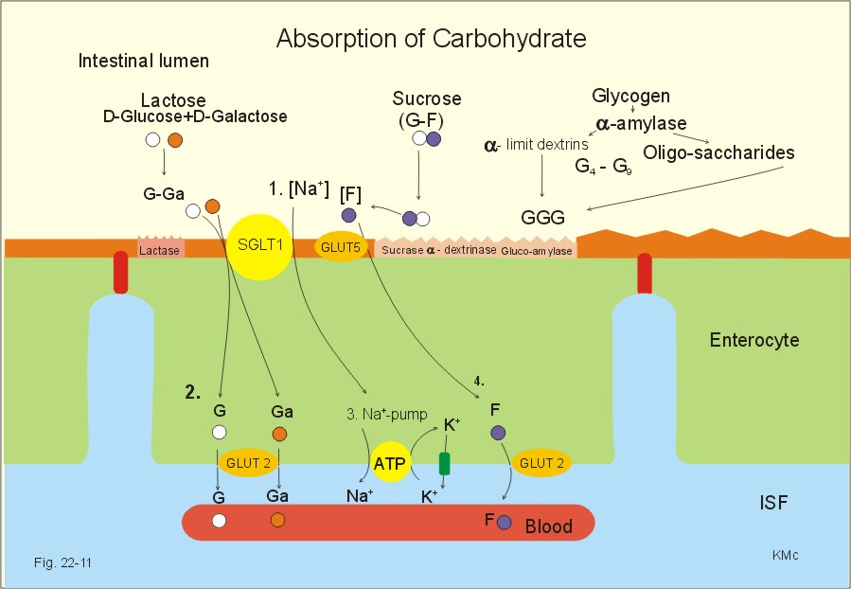
Carbohydrates like lactose, sucrose, and glycogen are broken down into glucose, galactose, and fructose by digestive enzymes. Glucose and galactose are absorbed into enterocytes via the SGLT1 transporter, using sodium ions, while fructose enters through GLUT5. Once inside the enterocyte, glucose and galactose move into the bloodstream via GLUT2, while fructose also uses GLUT2. The Na⁺-K⁺ pump helps maintain ion balance by pumping sodium out of the enterocyte.

Slide 7
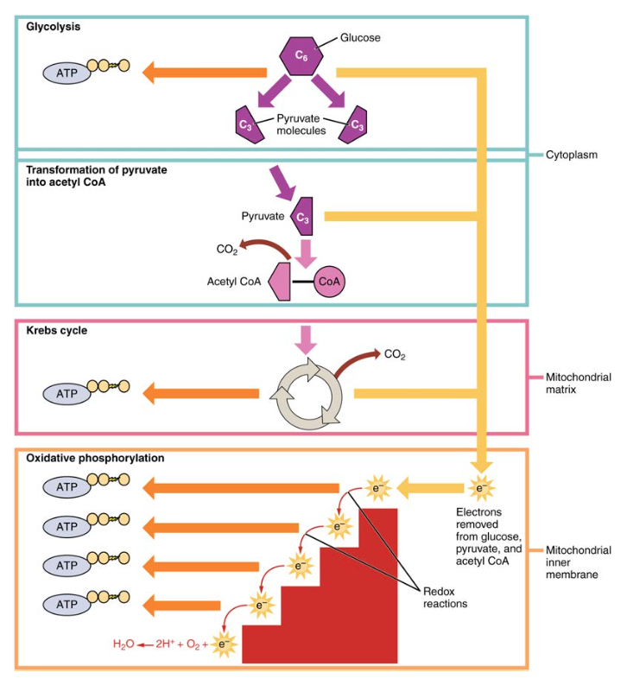
METABOLISM OF CARBOHYDRATES
Glycolysis:
  The process begins when glucose is taken into the cell.
  In the cytoplasm, glucose is broken down into pyruvate, producing ATP and NADH as energy carriers.
Pyruvate Decarboxylation:
  Pyruvate enters the mitochondria and is converted into acetyl-CoA.
  This step releases carbon dioxide and produces NADH.
Citric Acid Cycle (Krebs Cycle):
  Acetyl-CoA enters the citric acid cycle, where it combines with oxaloacetate to form citrate.
  Through a series of reactions, ATP, NADH, and FADH2 are produced.
  Carbon dioxide is released as a waste product.
Electron Transport Chain (ETC) and Oxidative Phosphorylation:
  NADH and FADH2 produced in glycolysis and the citric acid cycle donate electrons to the ETC.
  This process creates a proton gradient, driving the synthesis of ATP in the ATP synthase.
  Oxygen is the final electron acceptor, forming water as a byproduct.

Slide 8
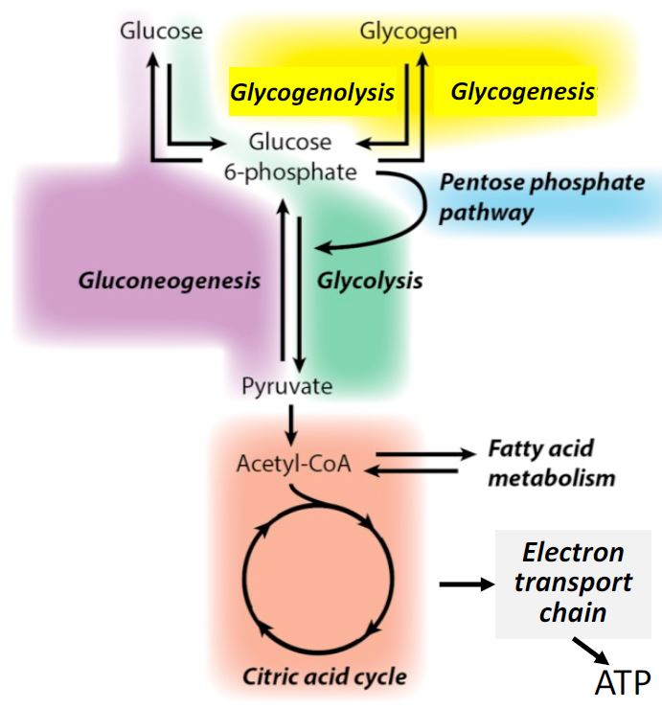
Glycogenesis:
  When glucose is abundant, it is stored as glycogen in the liver and muscles through a process called glycogenesis.
Glycogenolysis:
  When glucose levels are low, glycogen is broken down into glucose through glycogenolysis to maintain blood glucose levels.
Gluconeogenesis:
  In conditions like fasting, gluconeogenesis occurs, where non-carbohydrate precursors like amino acids are used to create glucose in the liver.
Lipogenesis:
  When glucose is in excess, it is converted into fatty acids and triglycerides through lipogenesis for long-term energy storage in adipose tissue.

Slide 9
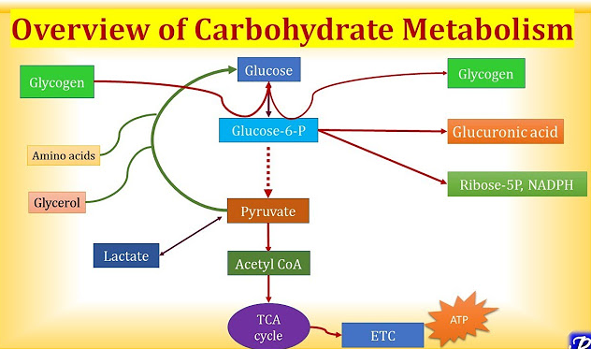

Slide 10
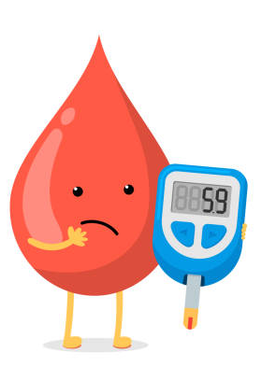
GLUCOSE HOMEOSTASIS
Glucose homeostasis refers to the maintenance of a stable concentration of glucose in the blood, ensuring that the body has a constant supply of energy.
Key Hormones Involved:
  Insulin: Secreted by the pancreas in response to high blood glucose levels. It promotes the uptake of glucose by cells, encouraging its storage as glycogen in the liver and muscles.
  Glucagon: Secreted by the pancreas when blood glucose levels are low. It stimulates the liver to break down glycogen (glycogenolysis) and release glucose into the blood.
  Cortisol and Epinephrine: These stress hormones help to raise blood glucose levels by promoting glycogen breakdown and gluconeogenesis.
  Growth Hormone: Stimulates gluconeogenesis and the release of glucose from the liver.

Slide 11
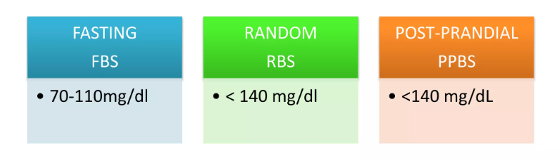
Regulation Mechanisms:
After a Meal (High Blood Glucose):
  Insulin secretion increases.
  Insulin promotes the uptake of glucose by cells and the conversion of glucose to glycogen (glycogenesis).
During Fasting (Low Blood Glucose):
  Glucagon secretion increases.
  Glucagon stimulates the liver to convert glycogen into glucose (glycogenolysis) and to produce glucose from non-carbohydrate sources (gluconeogenesis).
Maintaining Blood Glucose:
Blood glucose levels are generally maintained between 70-110 mg/dL in a healthy individual.
After eating, glucose levels rise, and insulin is released to lower them.
Between meals or during fasting, glucose levels fall, and glucagon helps to raise them.
Normal blood glucose level

Slide 12
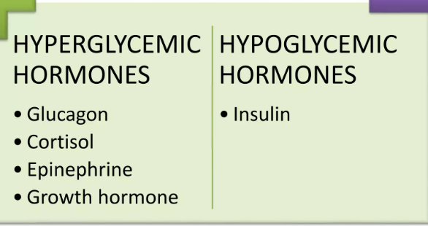
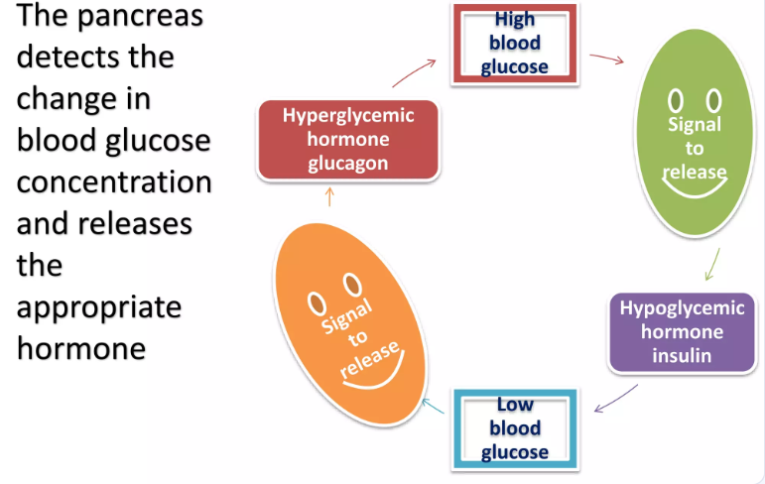
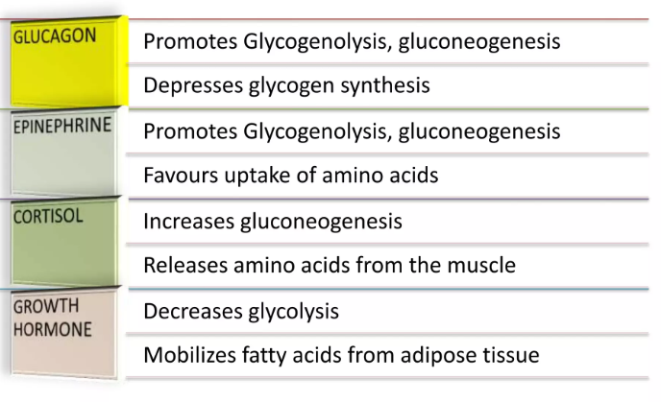
HORMONAL REGULATION

Slide 13
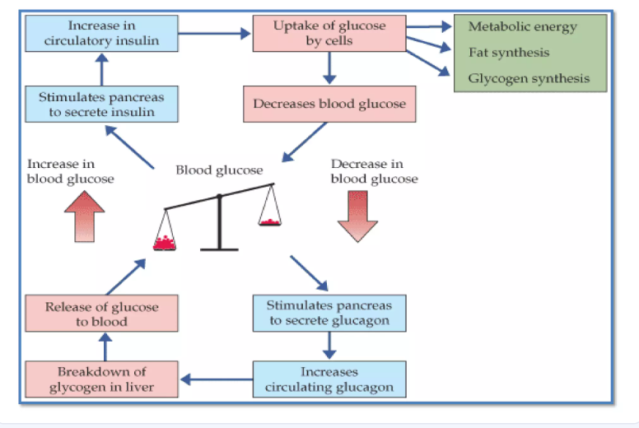
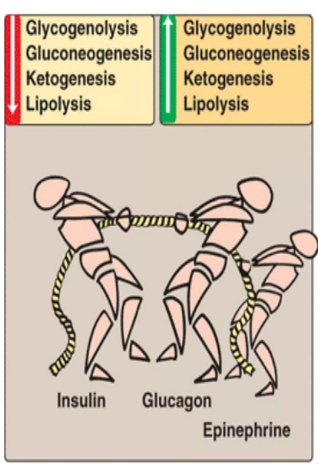
MAJOR ROLE OF INSULIN AND GLUCAGON

Slide 14
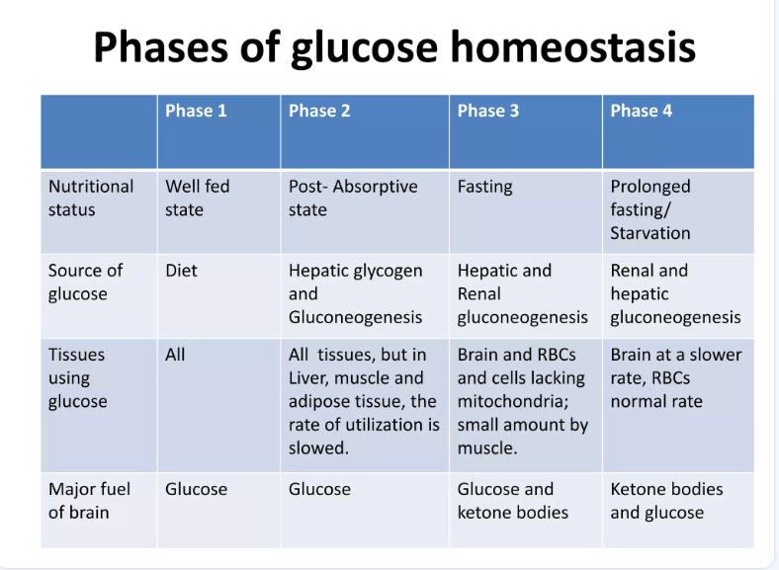
The phases of glucose homeostasis refer to the distinct stages that the body undergoes to maintain stable blood glucose levels in response to feeding, fasting, and other metabolic changes. These phases help to regulate blood sugar within a narrow range, ensuring a constant supply of energy to cells.

Slide 15
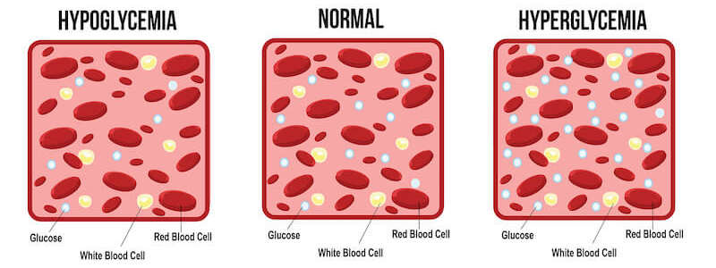
DISRUPTION IN GLUCOSE HOMEOSTASIS
Hypoglycemia: Low blood glucose levels, which can cause weakness, confusion, and if severe, unconsciousness.
Hyperglycemia: High blood glucose levels, commonly associated with conditions like diabetes mellitus.
  Type 1 diabetes: Insulin is not produced or is insufficient.
  Type 2 diabetes: The body becomes resistant to insulin, leading to impaired glucose regulation.

Slide 16
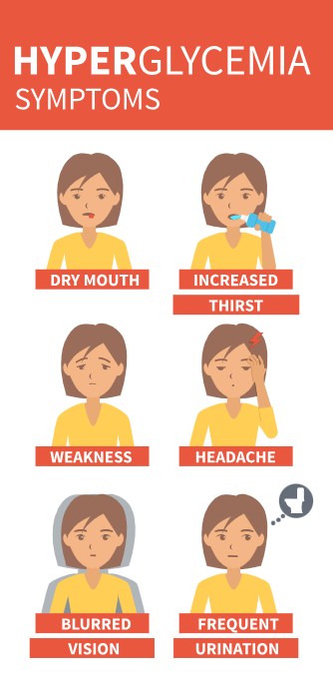
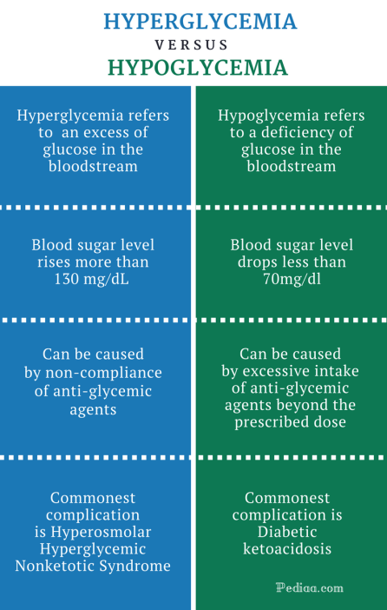
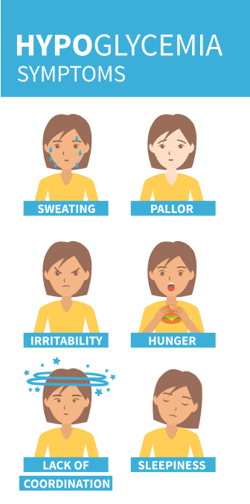

Slide 17
CARBOHYDRATES AND GLUCOSE LEVELS
Carbohydrates are broken down into glucose, which is the body’s main source of energy.
Impact on Blood Glucose:
The type and amount of carbohydrate consumed affect the rate and extent of blood glucose rise.
High-GI foods (e.g., white bread, sugary snacks) cause a quick spike in glucose levels.
Low-GI foods (e.g., whole grains, legumes) lead to a slower, more sustained increase in blood glucose.
Glucose Homeostasis:
The body regulates blood glucose through insulin (to lower glucose) and glucagon (to raise glucose), ensuring energy balance.
Long-Term Effects:
Consuming high-glycemic foods frequently can lead to insulin resistance and type 2 diabetes.
A balanced intake of low-glycemic carbohydrates supports better glucose control and metabolic health.

Slide 18

In conclusion, carbohydrates are essential macronutrients that provide energy through digestion, absorption, and metabolism. The digestive process breaks down carbohydrates into simple sugars like glucose, which are absorbed into the bloodstream.
Once in the bloodstream, glucose levels are tightly regulated through glucose homeostasis, involving processes like insulin secretion and glycogen storage during the absorptive phase, and glucagon-driven glucose release during fasting.
This dynamic system ensures that the body maintains stable blood sugar levels, supporting proper cellular function and overall energy balance. Understanding these processes highlights the critical role carbohydrates play in maintaining metabolic health.

