Slide 1
Supercritical Fluid extraction

Slide 2
SFE
Supercritical fluid extraction (SFE) is the process of separating one component (the extractant) from another (the matrix) using supercritical fluids as the extracting solvent. Extraction is usually from a solid matrix, but can also be from liquids. SFE can be used as a sample preparation step for analytical purposes, or on a larger scale to either strip unwanted material from a product (e.g. decaffeination) or collect a desired product (e.g. essential oils). These essential oils can include limonene and other straight solvents. Carbon dioxide (CO2) is the most used supercritical fluid, sometimes modified by co-solvents such as ethanol or methanol. Extraction conditions for supercritical carbon dioxide are above the critical temperature of 31 °C and critical pressure of 74 bar. Addition of modifiers may slightly alter this. The discussion below will mainly refer to extraction with CO2, except where specified.

Slide 3
Advantages: Selectivity
The properties of the supercritical fluid can be altered by varying the pressure and temperature, allowing selective extraction. For example, volatile oils can be extracted from a plant with low pressures (100 bar), whereas liquid extraction would also remove lipids. Lipids can be removed using pure CO₂ at higher pressures, and then phospholipids can be removed by adding ethanol to the solvent.^{[1]} The same principle can be used to extract polyphenols and unsaturated fatty acids separately from wine wastes

Slide 4
Speed
Extraction is a diffusion-based process, in which the solvent is required to diffuse into the matrix and the extracted material to diffuse out of the matrix into the solvent. Diffusivities are much faster in supercritical fluids than in liquids, and therefore extraction can occur faster. In addition, due to the lack of surface tension and negligible viscosities compared to liquids, the solvent can penetrate more into the matrix inaccessible to liquids. An extraction using an organic liquid may take several hours, whereas supercritical fluid extraction can be completed in 10 to 60 minutes

Slide 5
Procedure
The system must contain a pump for the CO₂, a pressure cell to contain the sample, a means of maintaining pressure in the system and a collecting vessel. The liquid is pumped to a heating zone, where it is heated to supercritical conditions. It then passes into the extraction vessel, where it rapidly diffuses into the solid matrix and dissolves the material to be extracted. The dissolved material is swept from the extraction cell into a separator at lower pressure, and the extracted material settles out. The CO₂ can then be cooled, re-compressed and recycled, or discharged to atmosphere.

Slide 6
Pumps
Carbon dioxide (CO₂) is usually pumped as a liquid, usually below 5 °C (41 °F) and a pressure of about 50 bar. The solvent is pumped as a liquid as it is then almost incompressible; if it were pumped as a supercritical fluid, much of the pump stroke would be "used up" in compressing the fluid, rather than pumping it. For small scale extractions (up to a few grams / minute), reciprocating CO₂ pumps or syringe pumps are often used. For larger scale extractions, diaphragm pumps are most common. The pump heads will usually require cooling, and the CO₂ will also be cooled before entering the pump.

Slide 7
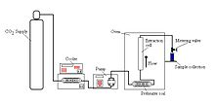

Slide 8
Pressure vessels
Pressure vessels can range from simple tubing to more sophisticated purpose built vessels with quick release fittings. The pressure requirement is at least 74 bar, and most extractions are conducted at under 350 bar. However, sometimes higher pressures will be needed, such as extraction of vegetable oils, where pressures of 800 bar are sometimes required for complete miscibility of the two phases.^{[4]}
The vessel must be equipped with a means of heating. It can be placed inside an oven for small vessels, or an oil or electrically heated jacket for larger vessels. Care must be taken if rubber seals are used on the vessel, as the supercritical carbon dioxide may dissolve in the rubber, causing swelling, and the rubber will rupture on depressurization

Slide 9
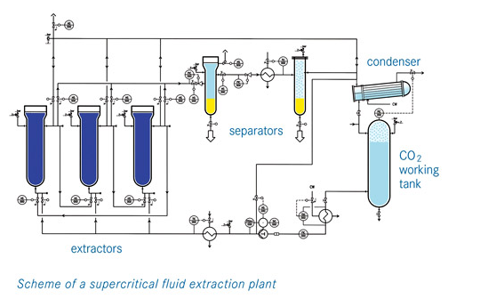
Flow Diagram

