Slide 1
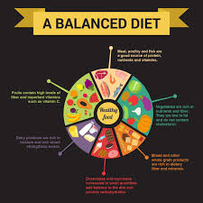
Factors Influencing Nutrient Needs
Age, Gender, Activity, Pregnancy, and Dietary Guidelines
Dr. Asif Ahmad

Slide 2
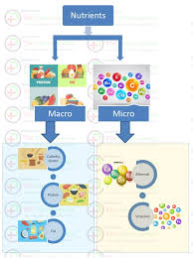
Introduction to Nutrient Needs
- Brief overview of why nutrient needs vary.
- Factors: Age, Gender, Physical Activity, Pregnancy, Environment, etc.

Slide 3
Overview of Dietary Guidelines
- What are dietary guidelines?
- How they are developed (based on population needs and scientific evidence).
- Graphic: Visual of food groups or a dietary pyramid.

Slide 4
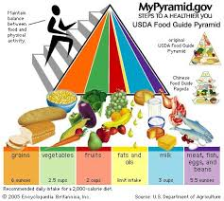
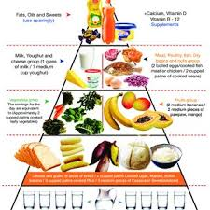
Food Pyramid

Slide 5
Age as a Factor
- Infancy and Childhood: Rapid growth and nutrient density.
- Adolescence: Higher needs for energy, calcium, iron, etc.
- Adulthood: Maintenance of health, energy, and metabolism.
- Older Adults: Decreased caloric needs but increased nutrient density.
- Image: Life stages with corresponding nutrient recommendations.

Slide 6
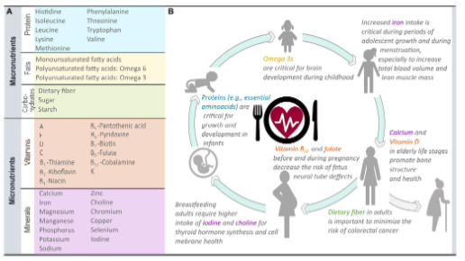
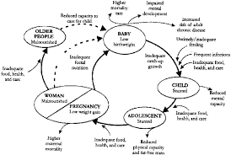
Diagram identifying key nutrients for physiological functioning from dietary sources. A All nutrients identified from dietary sources thatare required for proper human body functioning. B Examples on nutrient benefits for different human life stage

Slide 7
Gender and Nutrient Needs
- Differences in body composition and metabolism.
- Nutrient differences for men vs. women (iron, calcium, etc.).
- Special considerations: Menopause, hormonal differences.

Slide 8
Physical Activity and Nutrient Needs
- Energy expenditure in active individuals vs. sedentary.
- Macronutrients (carbs, proteins, fats) based on activity level.
- Importance of hydration and electrolytes.
- : Athlete vs. sedentary person with nutrient breakdown.

Slide 9
Pregnancy and Nutrient Need
- Key nutrients: Folate, Iron, Calcium, DHA, Protein.
- Dietary adjustments for pregnancy and lactation.
- Risks of malnutrition during pregnancy.
- Image: Pregnant woman with emphasis on key nutrients.

Slide 10
Environmental and Lifestyle Factors
- Climate, urbanization, access to food, socio-economic factors.
- Nutrient bioavailability and environmental pollutants.
-: City vs. rural environment or sustainable vs. processed food.

Slide 11
Health Status and Nutrient Needs
- Chronic diseases (diabetes, cardiovascular diseases, etc.).
- Immune system and nutrition.
- Impact of stress, medications, and illness on nutrient absorption.
- Graphic: Health conditions with corresponding nutritional considerations.

Slide 12

Body Composition and Metabolism
- Role of body composition (muscle mass vs. fat) in nutrient needs.
- Basal metabolic rate (BMR) and its influence.

