Slide 1
Non thermal food heating:
Ohmic Heating
Dr. Asif Ahmad

Slide 2
Content
Food preservation classification
What is ohmic heating?
Important benefits
Ohmic heating processing step
Applications
Advantages to ohmic systems
Disadvantages to Ohmic Systems
Summary

Slide 3
Food preservation methods
Thermal preservation
Non thermal preservation
Heating processing
Cold processing
Irradiation
Ohmic heating
Ozonation
High pressure processing

Slide 4
What is ohmic heating?
Ohmic heating is an advanced terminal processing method where in the food material which serves as an electrical resistor, is heated by passing electricity through Which result in rapid & uniform heating
Electrical resistance heating or joule heating or electro-heating
Ohmic heating is a thermal processing technology that uses electrical current to heat food products.
It is also known as Joule heating or electrical resistance heating.
Ohmic heating has gained popularity in the food industry due to its ability to provide rapid and uniform heating while preserving the quality and nutritional value of food products.

Slide 5
How Ohmic Heating Works
Ohmic heating works by passing an electrical current through the food product, which generates heat due to the resistance of the product to the current flow.
The heat generated is proportional to the electrical conductivity of the food product, which is influenced by factors such as moisture content, pH, and salt concentration.
Ohmic heating can be applied to a variety of food products, including liquids, suspensions, and solids.

Slide 7
History
The concept of ohmic heating of foods is not new
In the nineteenth century, several processes were patented that used electrical current for heating flowable materials
Within the past two decades, new and improved materials and designs for ohmic heating have become available. The Electricity Council of Great Britain has patented a continuous-flow ohmic heater and licensed the technology to APV Baker

Slide 8
Important benefits
Fast Processing
Homogeneous Treatment
Compactness of an Ohmic Installation

Slide 9
Ohmic heating processing step
Viscous food
Feed pump hopper
Electrodes

Slide 10
Tubular coolers
Holding tubes
Storage tanks

Slide 11

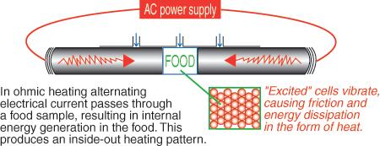

Slide 12
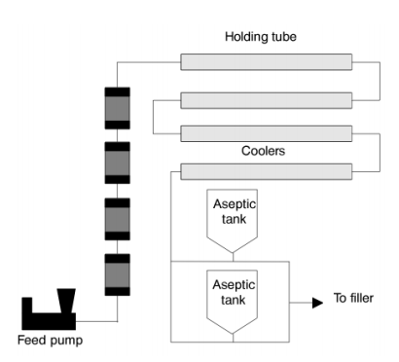

Slide 13

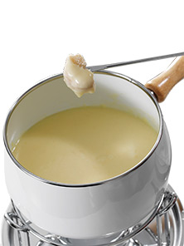
Applications
Sensitive Products egg products, processed fruits,
Fouling Products sauces, creams, cream cheese, viscous materials
Value-Added Products
Pasteurization: Ohmic heating can be used to pasteurize liquid foods such as fruit juices, milk, and liquid eggs.
Cooking: Ohmic heating can be used to cook solid foods such as meat, poultry, and vegetables.
Blending and emulsification: Ohmic heating can be used to blend and emulsify food products such as salad dressings and sauces.
Sterilization: Ohmic heating can be used to sterilize canned food products.

Slide 14
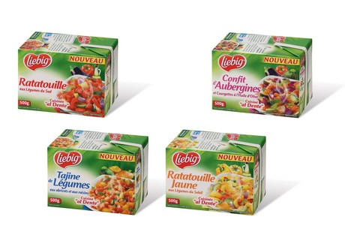
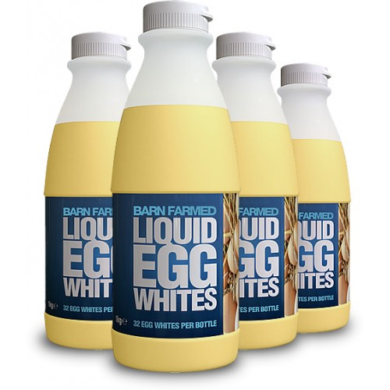
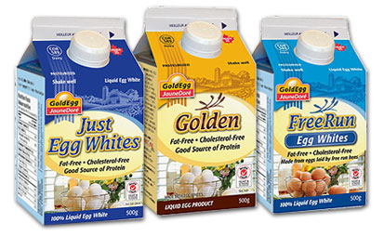
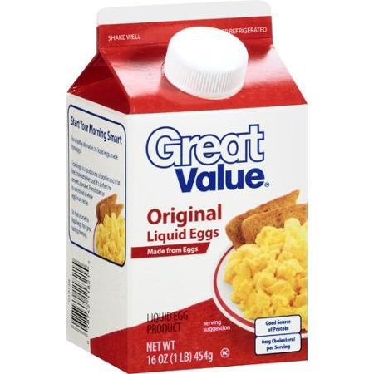
Ohmic processed commercial available products
.

Slide 15
Limitations
Equipment cost: Ohmic heating equipment can be expensive to purchase and maintain.
Electrical conductivity variability: The electrical conductivity of food products can vary depending on factors such as temperature, moisture content, and pH, which can affect the efficiency of ohmic heating.
Product consistency: Ohmic heating may not be suitable for food products that have a non-homogeneous consistency, as the electrical current may not distribute uniformly throughout the product.

Slide 16
Advantages
Heating food materials by internal heat generation
  Conventional heat transfer has limited dielectric penetration
  Heating takes place volumetrically and the product does not experience a large temperature gradient within itself as it heats

Slide 17
Advantages (Contd..)
Rapid and uniform heating: Ohmic heating can heat food products more rapidly and uniformly than conventional thermal processing methods such as steam heating or hot water immersion.
Improved quality: Ohmic heating can preserve the quality of food products by minimizing the exposure to high temperatures and reducing the risk of overcooking or undercooking.
Energy efficiency: Ohmic heating can be more energy-efficient than conventional thermal processing methods because it only heats the food product and not the surrounding environment.
Clean and hygienic: Ohmic heating is a clean and hygienic method of food processing because there is no direct contact between the food product and the heating source.

Slide 18
Advantages cont..
  Reducing risks of fouling on heat transfer surface and burning of the food products
  It results in minimal mechanical damage and better nutrients and vitamin retention.
  High energy efficiency because 90% of the electrical energy is converted into heat

Slide 19
Advantages cont.
Optimization of capital investment and product safety as a result of high solids loading capacity.
Ease of process control with instant switch-on and shut-down.

Slide 20
Advantages cont.
Reducing maintenance cost (no moving parts).
Ambient-temperature storage and distribution when combined with an aseptic filling system.
A quiet environmentally friendly system.

Slide 21
Disadvantages to Ohmic Systems
High installation cost
Can not apply for all the food
Increased electrical conductivity of food materials

Slide 22
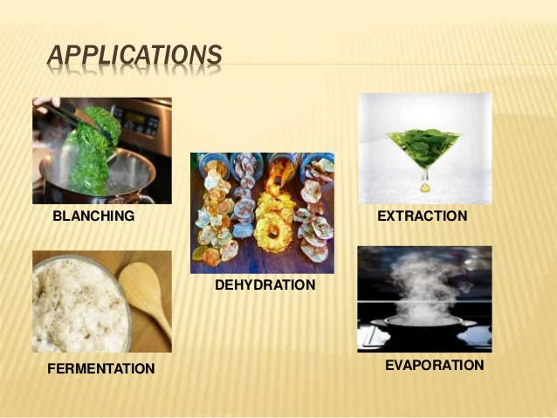
Summary
Ohmic heating is a promising technology for the food industry that offers several advantages over conventional thermal processing methods.
The technology has been successfully applied to a variety of food products, and ongoing research continues to explore its potential applications.
While there are some limitations to ohmic heating, its benefits make it an attractive option for food processors looking to improve their processing efficiency and product quality.

Slide 23
THANK YOU

Slide 24
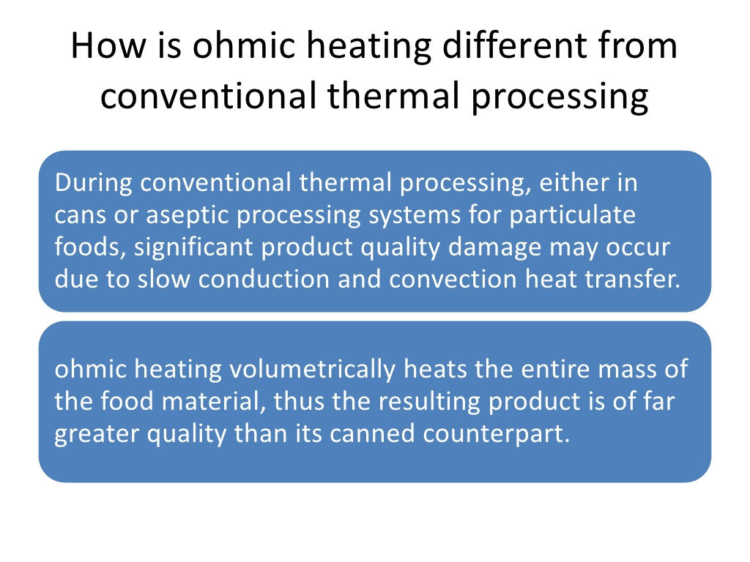

Slide 25
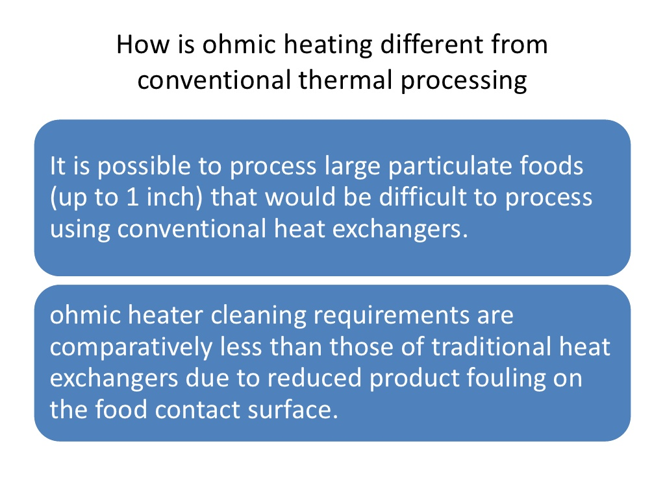

Slide 26
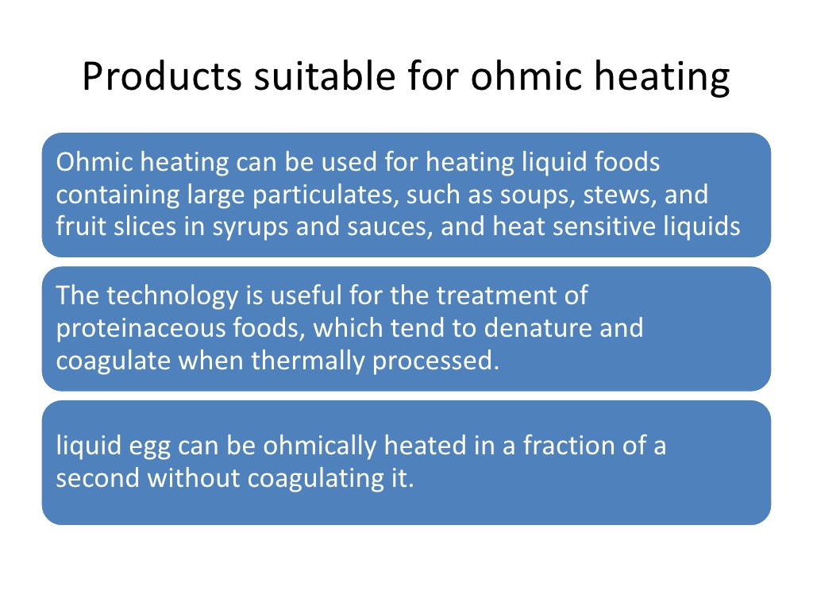

Slide 27
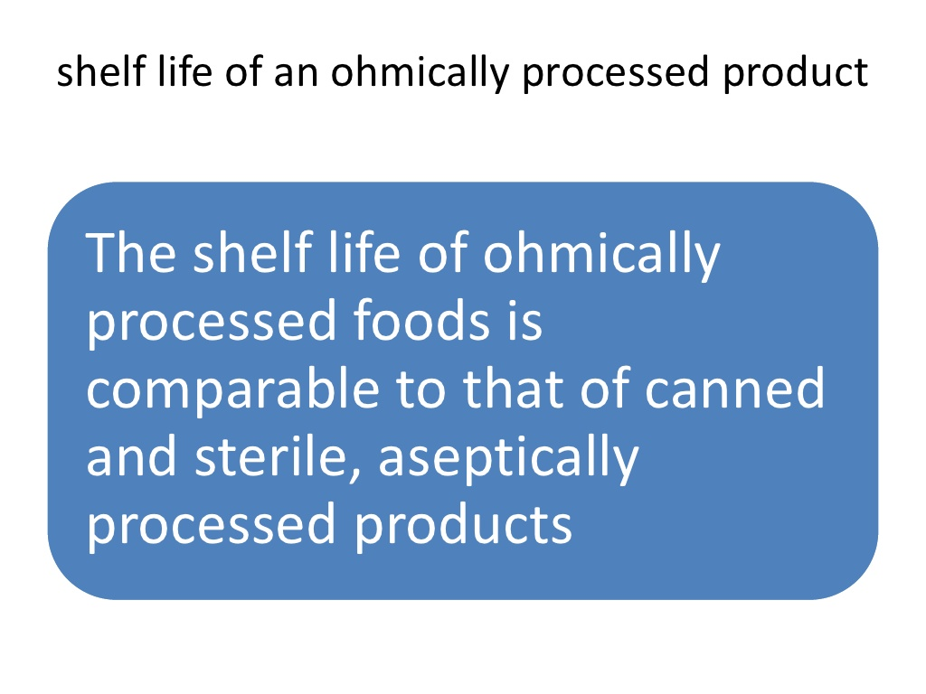

Slide 28
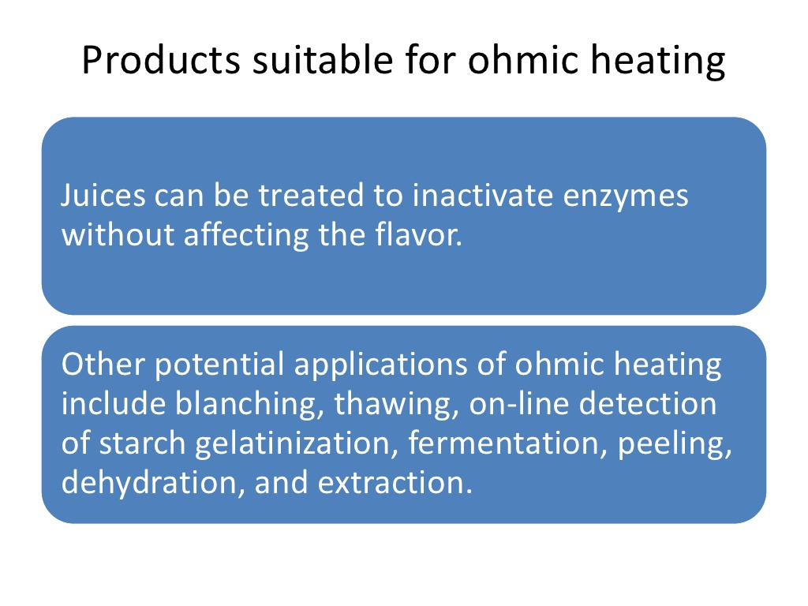

Slide 29
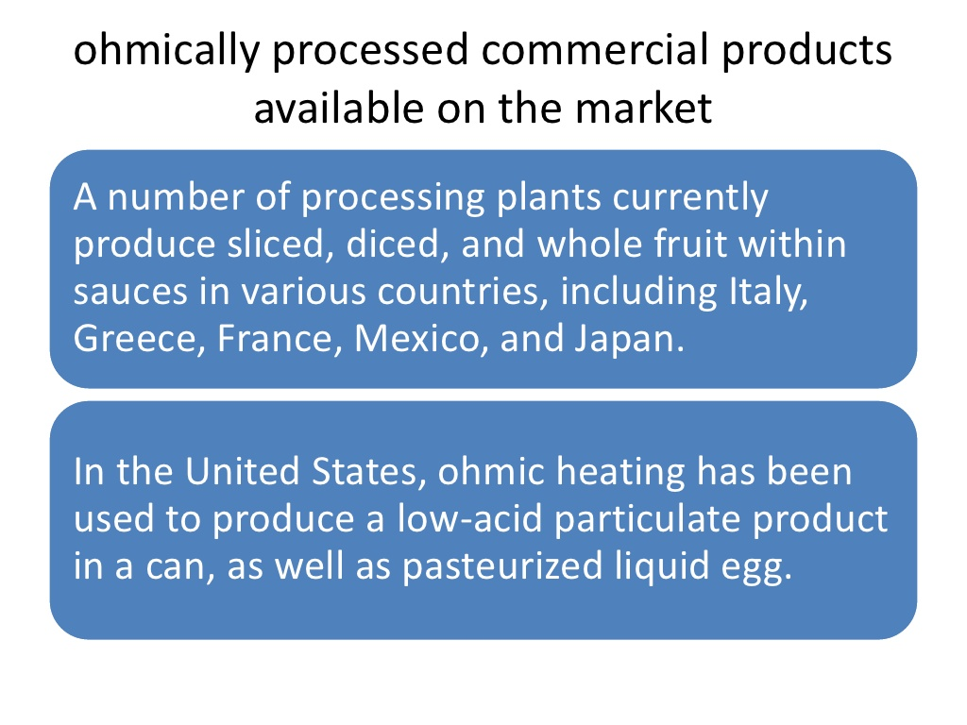

Slide 30
