Slide 1


CARBOHYDRATES METABOLISM DISORDERS: DIABETES MELLITUS, LACTOSE INTOLERANCE, METABOLIC SYNDROME
PROF. DR. ASIF AHMAD
IFNS- PMAS UAAR

Slide 2

INTRODUCTION
Carbohydrates: Primary energy source found in grains, fruits, vegetables, and dairy.
Health Role: Essential for brain function, energy production, and metabolic processes.
Disorders Linked to Carbohydrates:
Diabetes Mellitus: Blood glucose dysregulation.
Lactose Intolerance: Enzyme deficiency causing difficulty in digesting lactose.
Metabolic Syndrome: Cluster of conditions increasing heart disease and diabetes risk.
Highlights the need to understand digestion, absorption, and metabolism for disease management.

Slide 3
This table outlines how different patterns of carbohydrate consumption lead to specific health issues through distinct mechanisms
Medical Concern | Cause | Mechanism
Diabetes Mellitus | Excessive intake of high-GI carbohydrates | Rapid glucose spikes → Insulin overproduction → Insulin resistance → Hyperglycemia
Lactose Intolerance | Inability to digest lactose due to lactase enzyme deficiency | Undigested lactose ferments in the gut → Gas, bloating, diarrhea
Metabolic Syndrome | Overconsumption of refined carbs and sugars; obesity | Excess glucose converted to fat → Visceral fat, high triglycerides, and insulin resistance
Obesity | Persistent intake of more calories from carbohydrates than expended | Glucose stored as fat → Weight gain → Increased risk of metabolic diseases
Dental Caries | Frequent consumption of sugary foods | Sugar fuels bacterial growth in the mouth → Acid production → Tooth enamel erosion
Non-Alcoholic Fatty Liver Disease (NAFLD) | High intake of fructose and simple carbs | Excess carbs converted to fat in the liver → Liver fat accumulation → Inflammation and damage

Slide 4
DIABETES MELLITUS
Diabetes Mellitus is a chronic condition that occurs when the body is unable to properly regulate blood glucose (sugar) levels, leading to hyperglycemia (high blood sugar).
Insulin, a hormone produced by the pancreas, plays a crucial role in controlling glucose levels by helping cells absorb glucose for energy. In diabetes, either the body does not produce enough insulin or the cells become resistant to insulin, resulting in high glucose levels in the bloodstream.
Type 1 Diabetes
An autoimmune disorder where the immune system mistakenly attacks and destroys the insulin-producing beta cells in the pancreas.
The body produces little to no insulin, requiring individuals to take insulin externally (injections or pumps).
Most commonly diagnosed in children and young adults.
Type 2 Diabetes
Characterized by insulin resistance, where the body’s cells do not respond effectively to insulin. Over time, the pancreas may also produce less insulin.
Risk factors include obesity, sedentary lifestyle, and unhealthy diet.
It is more common in adults but is increasingly diagnosed in younger populations due to rising obesity rates.
Gestational Diabetes
A form of diabetes that develops during pregnancy, typically in the second or third trimester.
It can cause complications for both the mother and baby but often resolves after childbirth.
However, women who have had gestational diabetes are at higher risk of developing Type 2 diabetes later in life.

Slide 5
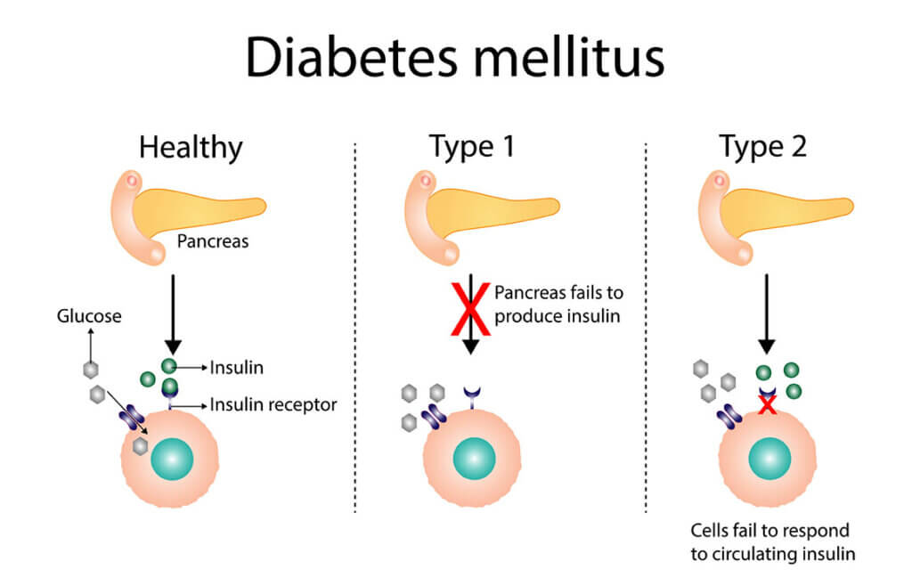

Symptoms:
Frequent urination, increased thirst, unexplained weight loss, fatigue.
Causes:
Genetic factors, obesity, poor diet, and lack of physical activity.
  In Type 1, an autoimmune response destroys insulin-producing cells.
  In Type 2, insulin resistance and inadequate insulin production by the pancreas.

Slide 6
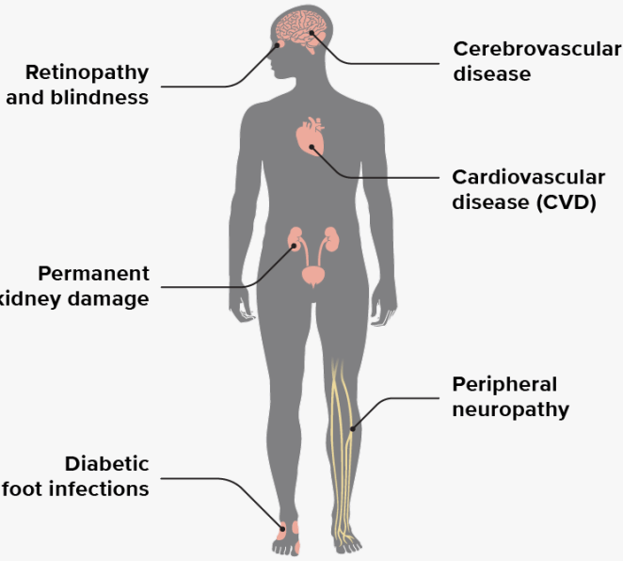
Complication | Description | Effects
Cardiovascular Disease | Increased risk of heart disease, stroke, and high blood pressure due to damage to blood vessels. | High blood pressure, heart attack, stroke, poor circulation, and potential heart failure.
Kidney Damage (Nephropathy) | Damage to the kidneys' blood vessels leading to impaired kidney function. | Protein in urine, kidney failure, need for dialysis or kidney transplant.
Nerve Damage (Neuropathy) | High blood sugar can damage nerves throughout the body. | Pain, numbness, tingling, and loss of sensation in the feet, hands, digestive issues, erectile dysfunction.
Eye Damage (Retinopathy) | Damage to the blood vessels in the retina, leading to vision problems. | Blurry vision, cataracts, glaucoma, and possibly blindness.
Poor Wound Healing | Impaired blood flow and immune response delay healing of wounds or infections. | Chronic infections, ulcers (especially in the feet), and amputation risks.
Increased Risk of Infections | High blood sugar weakens the immune system, making it harder to fight infections. | Frequent infections, especially urinary tract infections, skin infections, and respiratory infections.
Foot Problems | Due to nerve damage and poor circulation, minor foot injuries can lead to serious complications. | Ulcers, infections, gangrene, and possible amputation.
Cognitive Decline | High blood sugar levels may affect brain function and lead to cognitive decline. | Memory loss, difficulty concentrating, and possibly increasing the risk of dementia.
COMPLICATIONS OF DIABETES MELLITUS

Slide 7
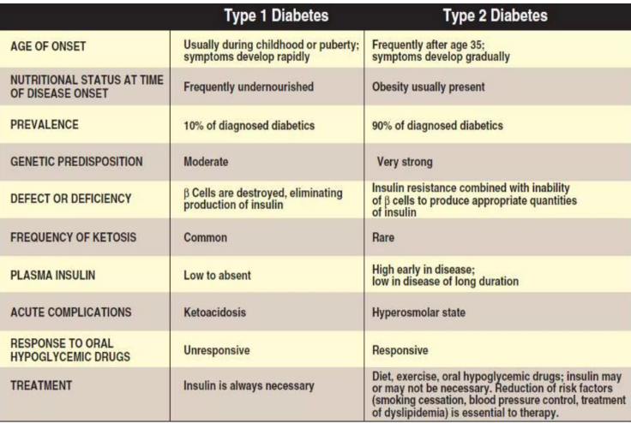

Slide 8
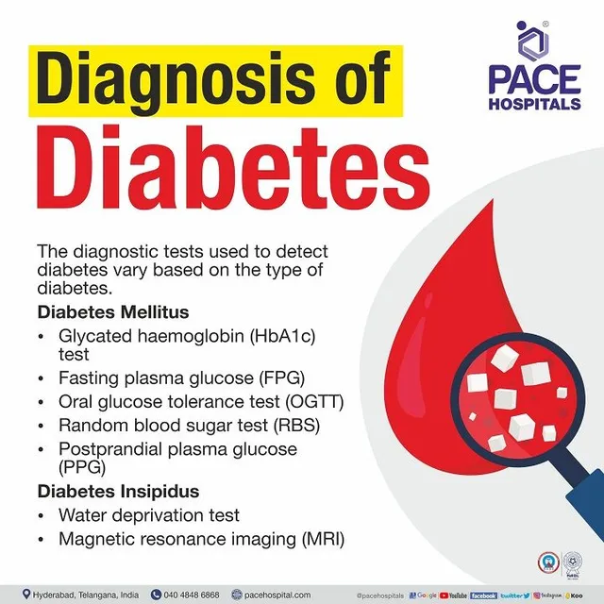
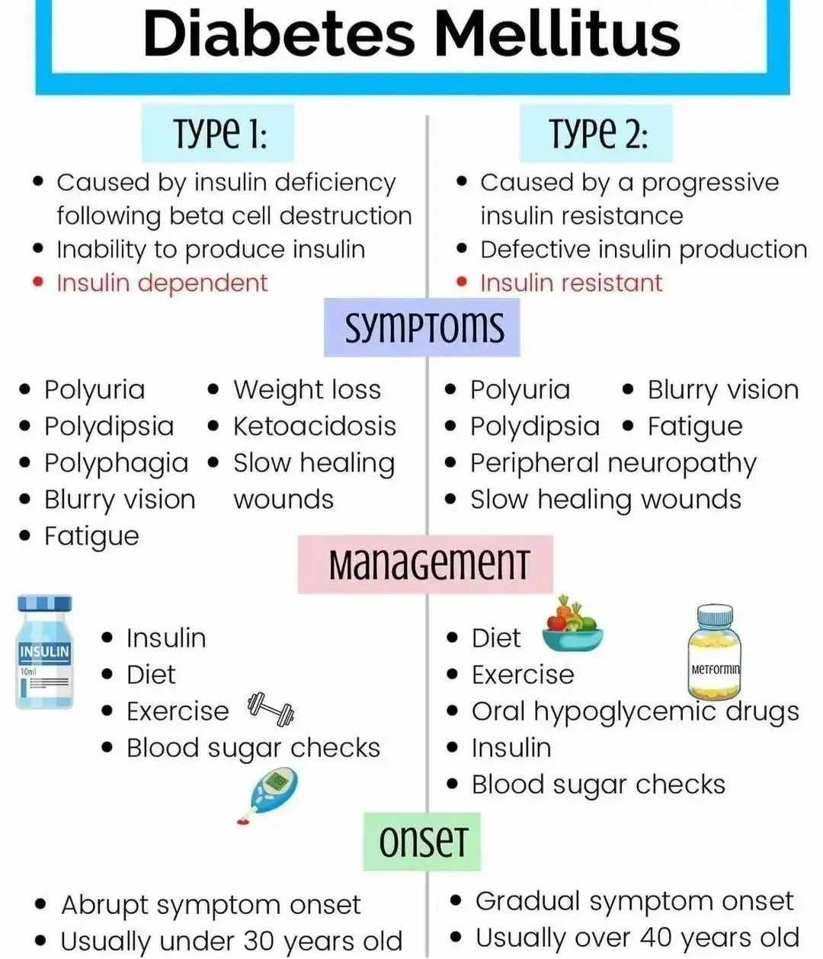

Slide 9
LACTOSE INTOLERANCE
Lactose intolerance is the inability to fully digest lactose, a sugar found in milk and dairy products.
This is due to a deficiency of lactase, the enzyme responsible for breaking down lactose into glucose and galactose for absorption in the small intestine.
Causes:
Primary Lactase Deficiency: The most common form, where lactase production decreases naturally with age.
Secondary Lactase Deficiency: Occurs after an illness or injury that damages the small intestine (e.g., viral infections, celiac disease).
Congenital Lactase Deficiency: A rare genetic condition where lactase is absent from birth.
Symptoms:
Bloating
Diarrhea
Stomach cramps
Gas
These symptoms occur after the consumption of dairy products containing lactose.

Slide 10



Slide 11
Diagnosis
Hydrogen Breath Test: Measures the amount of hydrogen in the breath after consuming lactose.
Lactose Tolerance Test: Measures blood glucose levels after consuming lactose.
Management
Lactose-free or Low-lactose Diet: Avoidance or reduction of lactose-containing foods.
Lactase Supplements: Available over-the-counter to aid in digestion of lactose.
Alternative Dairy Products: Consumption of dairy alternatives such as soy, almond, or oat milk.

Slide 12
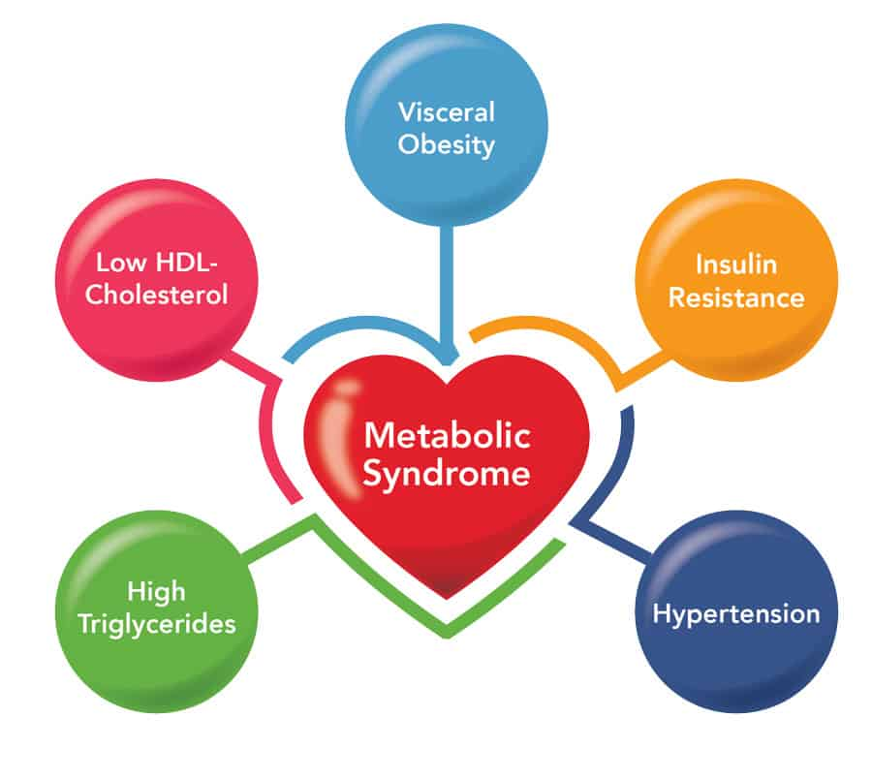
METABOLIC SYNDROME
Metabolic syndrome refers to a cluster of conditions that increase an individual’s risk of heart disease, stroke, and type 2 diabetes.
It is characterized by a combination of abdominal obesity, high blood pressure, high blood sugar, abnormal cholesterol levels, and insulin resistance.
RISK FACTORS
Genetics: Family history of diabetes, hypertension, and heart disease.
Lifestyle: Poor diet, physical inactivity, and excessive alcohol consumption.
Age: The risk increases with age.
Ethnicity: Higher prevalence in some ethnic groups, such as Hispanic, African American, and Asian populations.

Slide 13
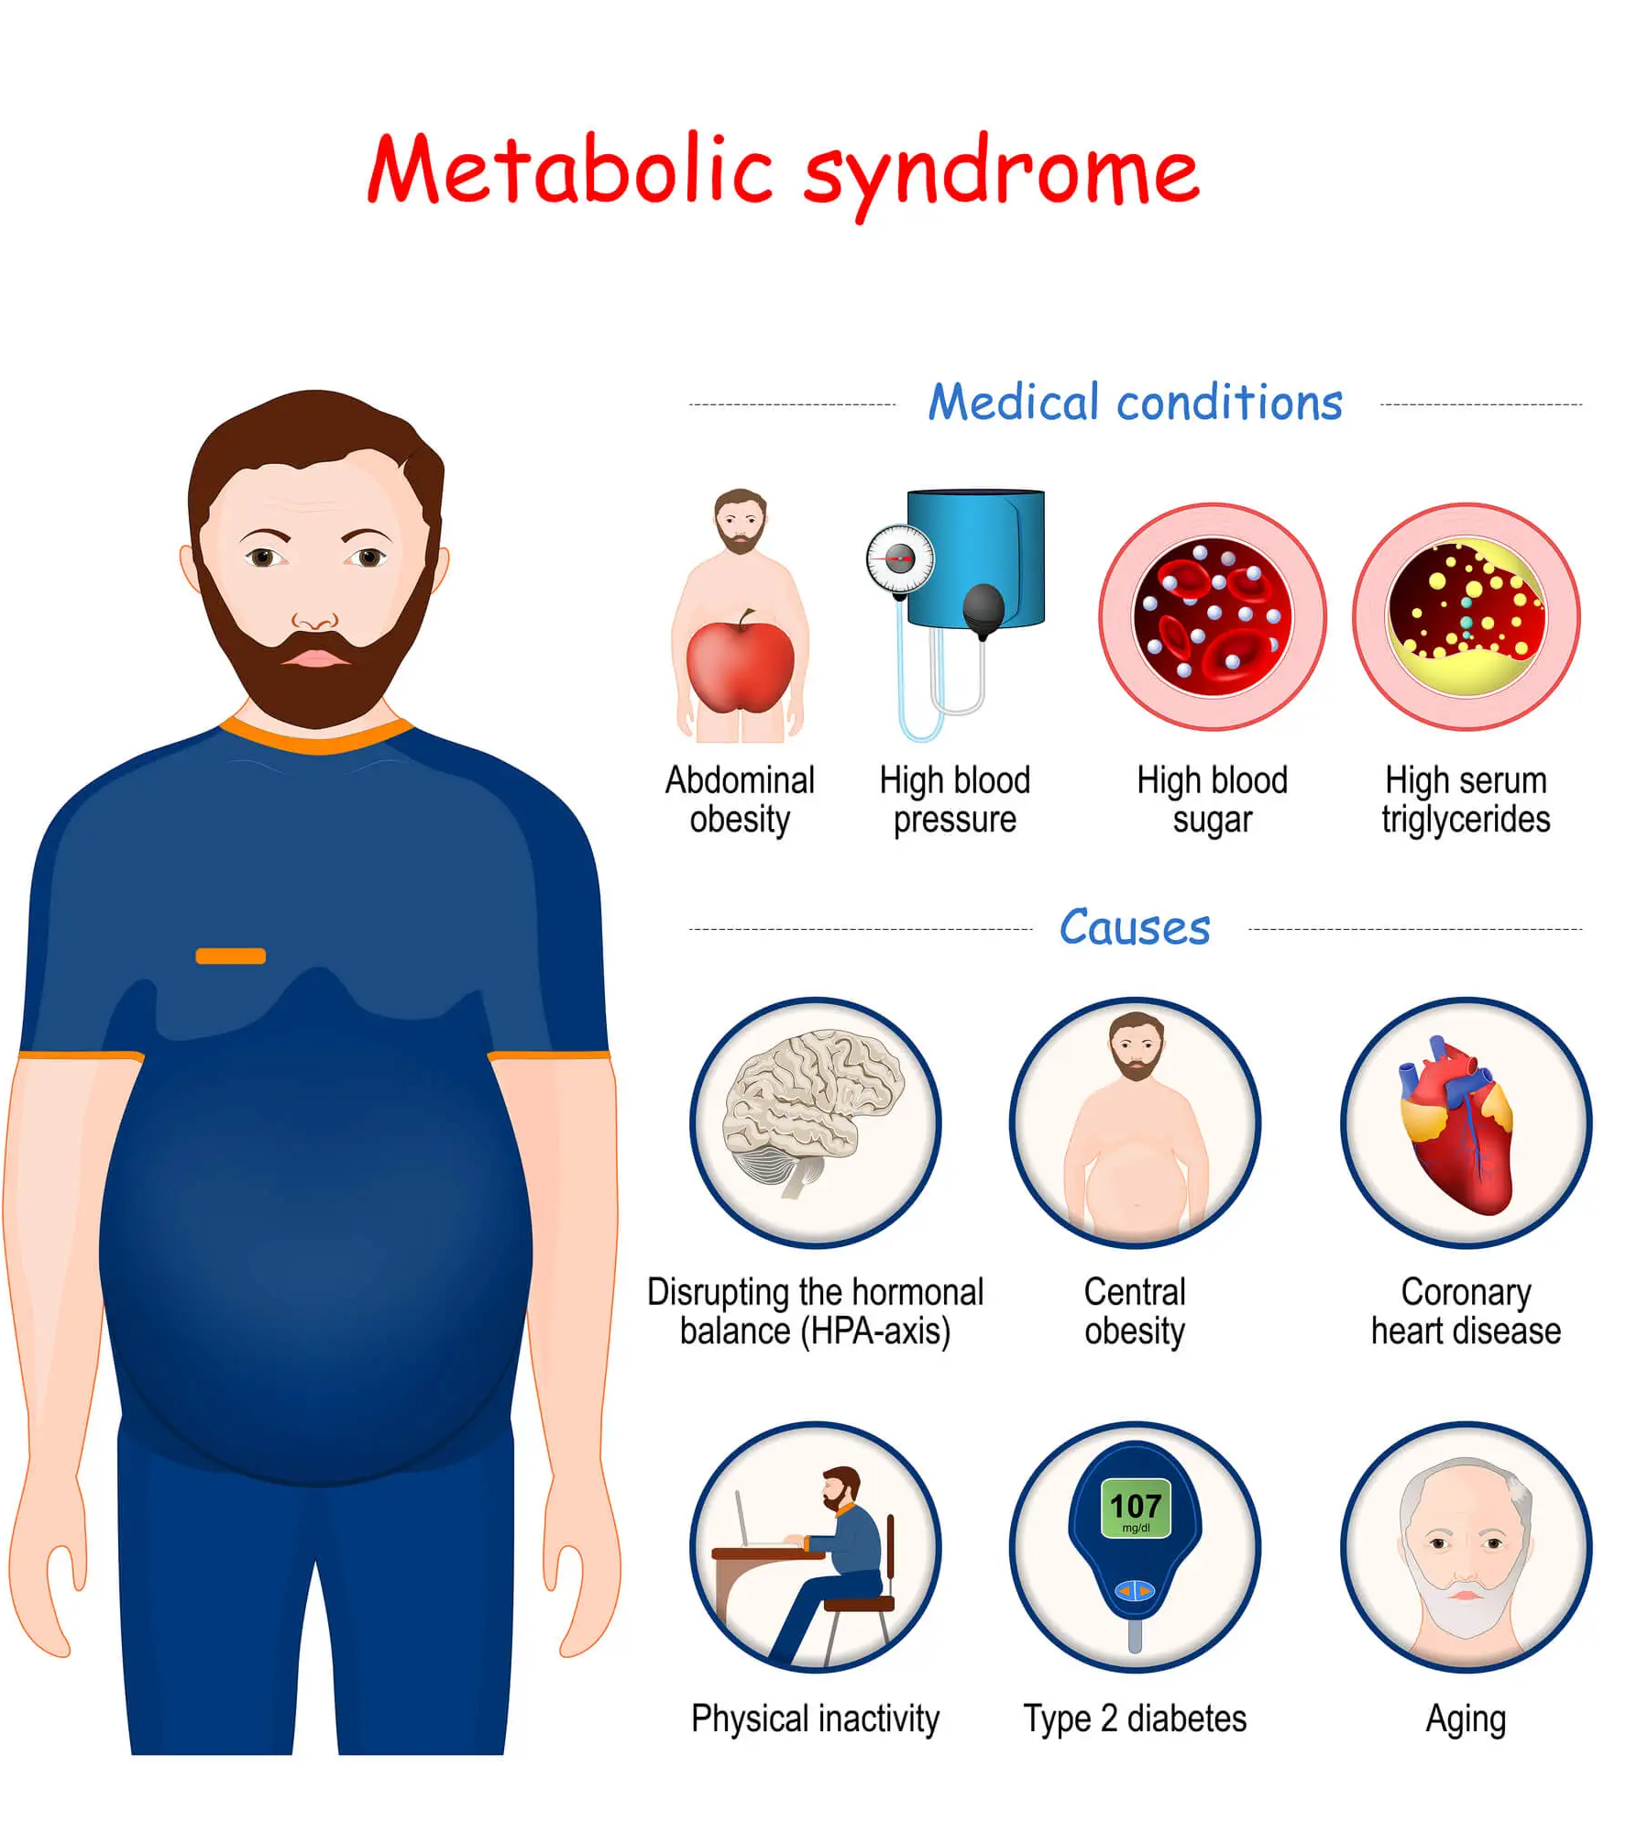
Key Components of Metabolic Syndrome:
Abdominal Obesity: Excess fat around the waistline, often measured by waist circumference.
Elevated Blood Pressure: A reading of 130/85 mmHg or higher is a common indicator.
High Fasting Blood Sugar: A level of 100 mg/dL or higher may suggest insulin resistance.
Abnormal Cholesterol Levels:
  High triglycerides (150 mg/dL or higher).
  Low HDL cholesterol (less than 40 mg/dL in men and 50 mg/dL in women).
Symptoms:
Many individuals with metabolic syndrome have no clear symptoms. However, abdominal fat (visceral fat) is often visible, and individuals may experience fatigue, high blood pressure, and dizziness.

Slide 14
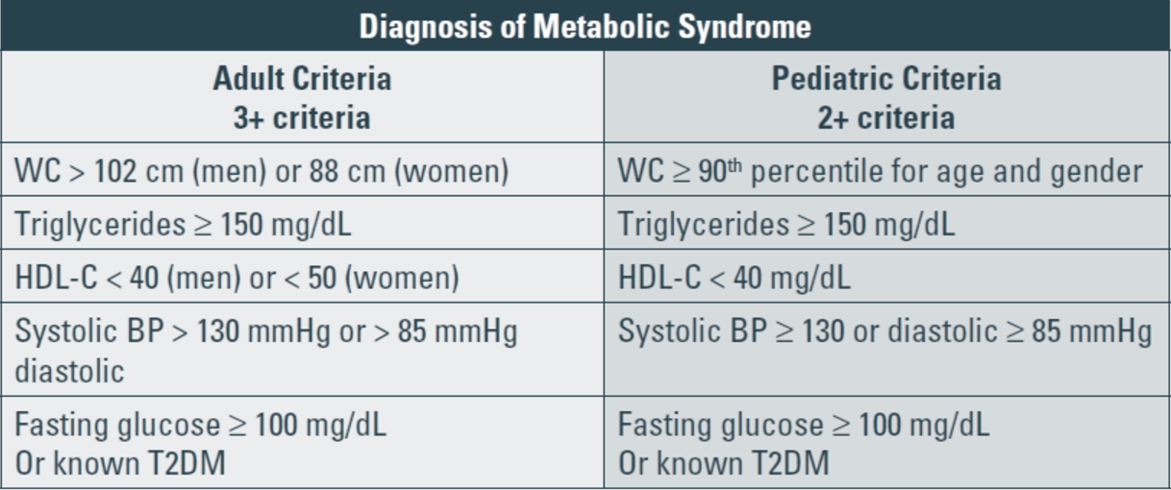
Diagnosis
Diagnosis is made when a person has at least three of the five risk factors associated with metabolic syndrome.
Management
Lifestyle Changes: Weight loss through a balanced diet and regular physical activity.
Medications: To control blood pressure, cholesterol levels, and blood sugar if necessary
.Monitoring: Regular monitoring of blood pressure, cholesterol, blood sugar, and waist circumference.

Slide 15
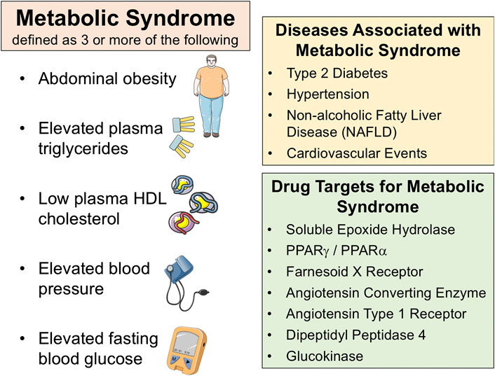

Slide 16
Comparison of Diabetes Mellitus, Lactose Intolerance, and Metabolic Syndrome
Aspect | Diabetes Mellitus | Lactose Intolerance | Metabolic Syndrome
Cause | Impaired insulin production or action; high carb intake | Lactase enzyme deficiency; inability to digest lactose | Excess refined carbs, obesity, sedentary lifestyle
Effect on Metabolism | Dysregulated glucose metabolism; chronic hyperglycemia | Lactose fermentation in gut → Bloating, diarrhea | Insulin resistance, lipid imbalance, increased fat storage
Symptoms | Frequent urination, fatigue, thirst, weight loss | Abdominal pain, gas, diarrhea | High blood pressure, obesity, high blood sugar
Long-term Complications | Nerve damage, kidney disease, cardiovascular disease | Nutrient malabsorption | Heart disease, diabetes, stroke
Prevention | Balanced diet, low-GI foods, physical activity | Lactose-free or low-lactose diet | Healthy eating, weight management, regular exercise
Treatment | Insulin therapy, oral medications, lifestyle modification | Lactase supplements, dietary adjustments | Treat individual components (e.g., hypertension, diabetes)

Slide 17

Carbohydrate metabolism disorders, including diabetes mellitus, lactose intolerance, and metabolic syndrome, highlight the critical role of balanced carbohydrate intake and efficient metabolic processes. These conditions arise from disruptions in digestion, absorption, or glucose regulation, leading to significant health impacts like insulin resistance, digestive discomfort, and increased cardiovascular risks. Understanding these disorders emphasizes the importance of dietary choices, lifestyle modifications, and early intervention in promoting metabolic health and preventing

