Slide 1
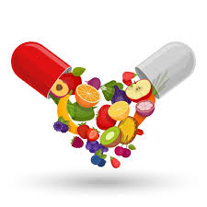
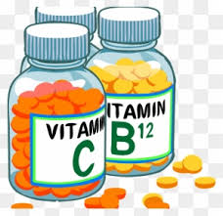
Coenzymes and Metabolism: Role of Water-Soluble Vitamins in Energy Production and Metabolic Pathways
PROF. DR. ASIF AHMAD
IFNS- PMAS UAAR

Slide 2
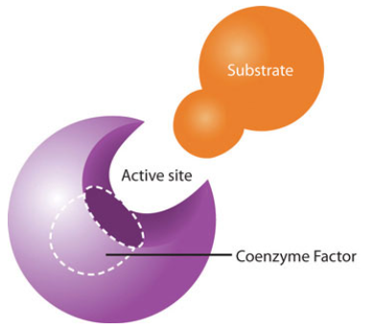
INTRODUCTION
While the macronutrients (carbohydrates, lipids, and proteins) and alcohol can be catabolized to release energy, vitamins play a different kind of role in energy metabolism
They are required as functional parts of enzymes involved in energy release and storage.
Vitamins that make up part of enzymes are referred to as coenzymes.
Coenzymes are required by enzymes to catalyze a specific reaction. They assist in converting a substrate to an end-product
Coenzymes are essential in catabolic pathways and play a role in many anabolic pathways too
Water-soluble vitamins, such as the B vitamins and vitamin C, function primarily as coenzymes in metabolic pathways, facilitating enzymatic reactions that are essential for energy production, nutrient metabolism, and the synthesis of important biomolecules.

Slide 3
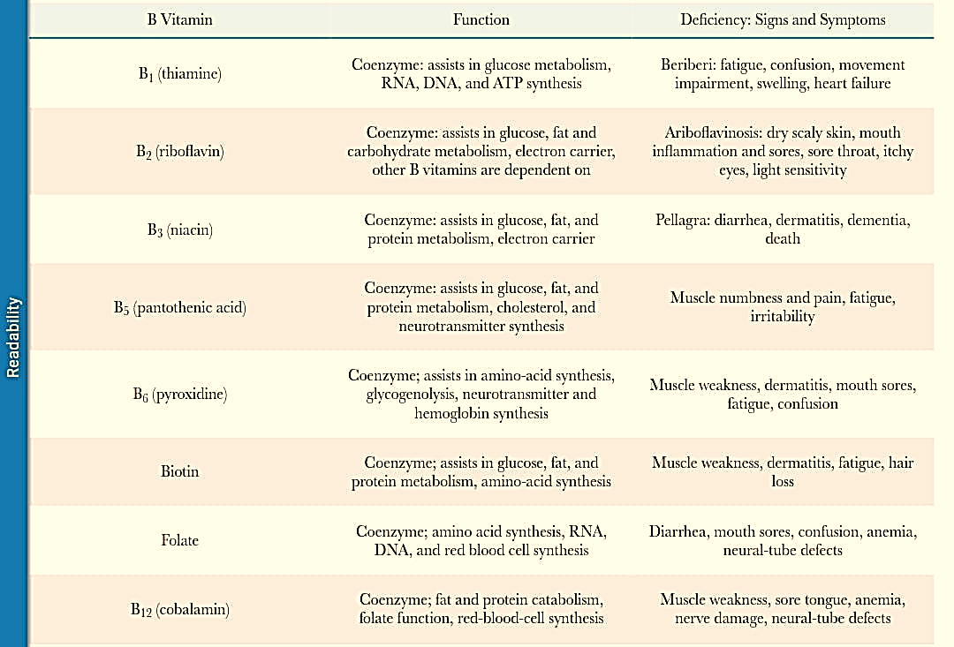
PROMINENT FUNCTIONS OF THE B VITAMINS IN METABOLISM AND THEIR DEFICIENCY SYNDROMES

Slide 4
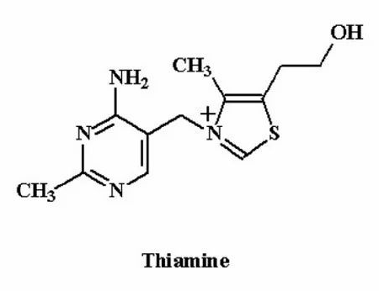
THIAMINE
Thiamine, also known as vitamin B1, plays a crucial role in energy production and various metabolic pathways.
Cofactor for Enzymes: Thiamine is converted into thiamine pyrophosphate (TPP), a coenzyme essential for several key enzymes in carbohydrate metabolism.
Energy Production: Through its involvement in the conversion of carbohydrates to energy, thiamine helps produce ATP, the primary energy currency of cells. Adequate thiamine levels are crucial for efficient energy metabolism, particularly in tissues with high energy demands, such as the brain and muscles.
Nerve Function: Thiamine is vital for maintaining proper nerve function. It helps synthesize neurotransmitters and is involved in the metabolism of glucose in nerve cells.
Overall Metabolism: Beyond carbohydrate metabolism, thiamine contributes to the metabolism of amino acids and lipids, making it essential for overall metabolic health.

Slide 5
Energy Production and Carbohydrate Metabolism
Amino Acid Metabolism
Thiamine, in its phosphorylated form as thiamine pyrophosphate (TPP or ThDP), acts as a coenzyme for several enzymes involved in energy metabolism.
Glycolysis and the Citric Acid Cycle: TPP is a cofactor for the pyruvate dehydrogenase complex, which converts pyruvate (derived from glucose) into acetyl-CoA, a key component of the citric acid cycle. This cycle is critical for the production of ATP, NADH, and FADH
Pentose Phosphate Pathway: TPP is necessary for the enzyme transketolase, which is involved in the pentose phosphate pathway. This pathway generates NADPH and ribose-5-phosphate, essential for nucleotide synthesis and various synthetic pathways
TPP is also crucial for the metabolism of certain amino acids too.
Branched-Chain Amino Acids: TPP is a cofactor for the branched-chain α-keto acid dehydrogenase complex, which decarboxylates the keto acids derived from leucine, isoleucine, and valine
Alpha-Keto Acids: TPP is involved in the decarboxylation of alpha-keto acids, such as α-ketoglutarate, through its role as a cofactor for α-ketoglutarate dehydrogenase

Slide 6
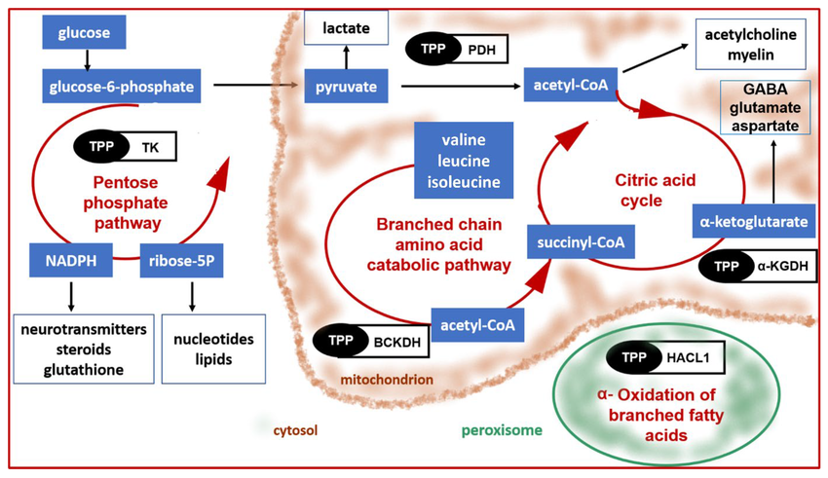

Slide 7
MODE OF ACTION
The mechanism of action of thiamine pyrophosphate (TPP) in enzymatic reactions, particularly in the decarboxylation of alpha-keto acids and the transketolase reaction, can be explained through the following steps:
Formation of the Ylide
TPP is deprotonated at the C2 position of its thiazolium ring, forming an ylide. This step is crucial because the ylide form of TPP is highly reactive1
Nucleophilic Attack
The carbanion of the TPP ylide nucleophilically attacks the carbonyl group of the substrate (e.g., pyruvate, alpha-ketoglutarate, or branched-chain keto acids). This forms a single bond between the TPP and the substrate
Bond Cleavage
The target bond on the substrate (usually a carbon-carbon bond connecting a carbonyl group to an adjacent reactive group like a carboxylic acid) is broken. The electrons from this bond are pushed towards the TPP, creating a double bond between the substrate carbon and the TPP carbon. This step also reduces the positive charge on the nitrogen atom in the thiazolium ring to a neutral form

Slide 8
Electron Rearrangement
It is essentially the reverse of the bond cleavage step, the electrons push back in the opposite direction. This forms a new bond between the substrate carbon and another atom. For example: In decarboxylases, this creates a new carbon-hydrogen bond, releasing CO2.
In transketolase, this attacks a new substrate molecule to form a new carbon-carbon bond1
Regeneration of TPP
The TPP-substrate bond is broken, reforming the TPP ylide and releasing the modified substrate. This step regenerates the active form of TPP, allowing it to participate in subsequent reactions
Stabilization of the Carbanion
The thiazolium ring of TPP, with its adjacent nitrogen and sulfur atoms, acts as an electron sink. This stabilizes the carbanion intermediate that forms during the decarboxylation reaction, making the reaction more favorable. The positive charge on the tetravalent nitrogen adjacent to the carbanion further stabilizes the negative charge, facilitating the reaction
Thiamine metabolism is tightly regulated, particularly through riboswitches that control the expression of genes involved in thiamine biosynthesis and salvage pathways. Thiamine is transported into cells by specific transporters, including those from the SLC19 family (SLC19A2 and SLC19A3

Slide 9
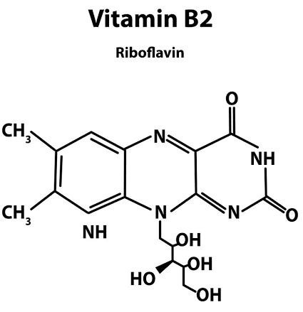
RIBOFLAVIN
Riboflavin, also known as Vitamin B2, plays a crucial role in energy production and various metabolic pathways, primarily through its active forms, flavin mononucleotide (FMN) and flavin adenine dinucleotide (FAD).
Riboflavin is absorbed from the gastrointestinal tract mainly through the riboflavin transporter 3 (RFVT3). It is then transported to the bloodstream by riboflavin transporters 1 and 2 (RFVT1 and RFVT2) and distributed to various tissues
Once absorbed, riboflavin is converted into its active forms
FMN: Formed by the action of riboflavin kinase (RFK), which phosphorylates riboflavin.
FAD: Formed by FAD synthase (FADS), which phosphorylates FMN

Slide 10
Role in Energy Metabolism
Riboflavin, through FMN and FAD, is essential for energy production in several ways:
Mitochondrial Electron Transport Chain
FAD is a component of Complex II (succinate dehydrogenase) of the mitochondrial electron transport chain, while FMN is part of Complex I (NADH dehydrogenase). These complexes are critical for the generation of ATP during cellular respiration
Mitochondrial Beta-Oxidation
FAD is necessary for the activity of enzymes involved in the beta-oxidation of fatty acids, such as acyl-CoA dehydrogenases and acyl-CoA oxidases. This process generates NADH and FADH2, which are used in the electron transport chain to produce ATP
Redox Reactions
FMN and FAD are key hydrogen carriers and participate in over 100 redox reactions involved in energy metabolism. They can be converted between their oxidized, half-reduced, and fully reduced forms, facilitating one- or two-electron transfers. This is crucial for the functioning of numerous flavoenzymes involved in various metabolic pathways

Slide 11
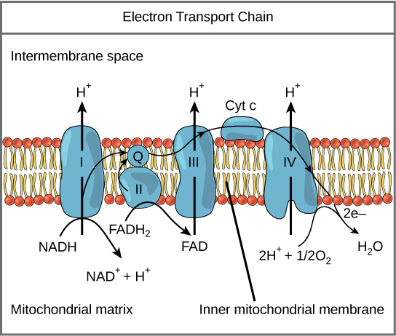
Metabolism of Carbohydrates, Proteins, and Fats
Carbohydrate Metabolism: FAD is involved in the glycolytic pathway and the citric acid cycle through its role in Complex II of the electron transport chain.
Protein Metabolism: FAD is necessary for the catabolism of certain amino acids, such as the conversion of tryptophan to niacin, and the metabolism of choline through choline dehydrogenase
Fat Metabolism: FAD is essential for the beta-oxidation of fatty acids and the synthesis of ether lipids in peroxisomes

Slide 12
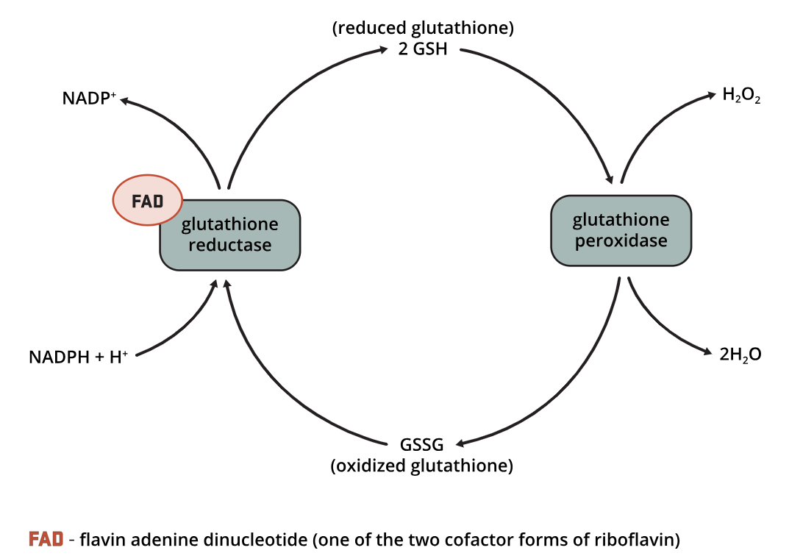
Other Metabolic Pathways
Pentose Phosphate Pathway
Although not directly involving FAD or FMN, riboflavin is crucial for overall cellular metabolism, and its deficiency can impact various pathways, including the pentose phosphate pathway indirectly.
Antioxidant Functions
FAD is required for the activity of glutathione reductase, an enzyme involved in the formation of the antioxidant glutathione
GLUTATHIONE REDOX CYCLE

Slide 13
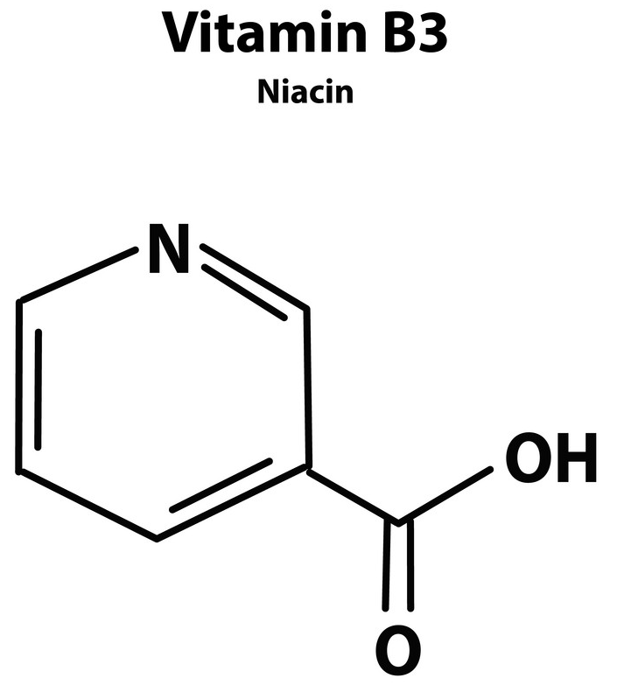
NIACIN
Niacin, also known as Vitamin B3, plays a crucial role in energy production and various metabolic pathways, primarily through its active forms, nicotinamide adenine dinucleotide (NAD) and nicotinamide adenine dinucleotide phosphate (NADP).Conversion to Active Forms
Niacin is converted into its metabolically active forms, NAD and NADP, in all tissues of the body. This conversion is essential for its biological functions
Role in Energy Production
Catabolic Reactions: NAD is primarily involved in catabolic reactions, such as those in glycolysis, the citric acid cycle, and the beta-oxidation of fatty acids. These reactions transfer the potential energy from carbohydrates, fats, and proteins to adenosine triphosphate (ATP), the cell's primary energy currency
Electron Transport Chain: NADH, the reduced form of NAD, is a key electron donor in the mitochondrial electron transport chain, which generates ATP through oxidative phosphorylation

Slide 14
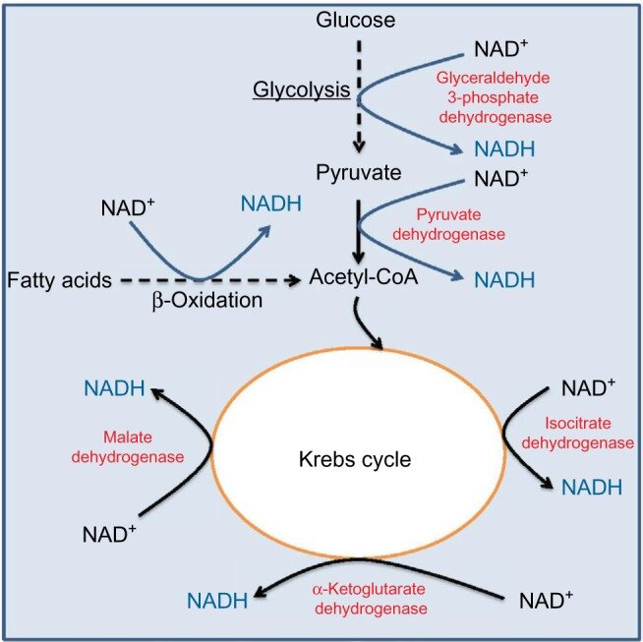
Metabolic Pathways
Glycolysis and Citric Acid Cycle: NAD is essential for enzymes involved in glycolysis and the citric acid cycle, ensuring the efficient breakdown of glucose and other substrates to produce ATP
Beta-Oxidation of Fatty Acids: NAD is required for the enzymes involved in the beta-oxidation of fatty acids, which generates acetyl-CoA and subsequently produces ATP through the citric acid cycle
Pentose Phosphate Pathway: Although NADP is the primary form used here, this pathway is crucial for generating NADPH, which is used in various anabolic reactions and antioxidant defenses

Slide 15
Redox Reactions
NAD/NADH Redox Couple: NAD and NADH participate in over 400 redox reactions, predominantly in catabolic metabolism. This redox couple is maintained in a highly oxidized state by the electron transport chain, facilitating the oxidation of substrates in various metabolic pathways
NADP/NADPH Redox Couple: NADP and NADPH are involved in about 30 reactions, largely in anabolic metabolism, such as the synthesis of cholesterol and fatty acids, and in antioxidant defense mechanisms. The NADP/NADPH redox couple is maintained in a highly reduced state mainly by the pentose phosphate pathway
Interdependence with Other Nutrients
The conversion of tryptophan to niacin via the kynurenine pathway depends on enzymes that require zinc, iron, riboflavin, and vitamin B6. Deficiencies in these nutrients can impair niacin production from tryptophan
Other Cellular Functions
Genome Integrity and Gene Expression: NAD is required for enzymes involved in the maintenance of genome integrity, such as poly(ADP-ribose) polymerase (PARP), and in the regulation of gene expression through sirtuin proteins
Cellular Communication and Antioxidant Functions: NAD-dependent enzymes are involved in cellular communication and antioxidant functions, protecting cells from oxidative stress

Slide 16
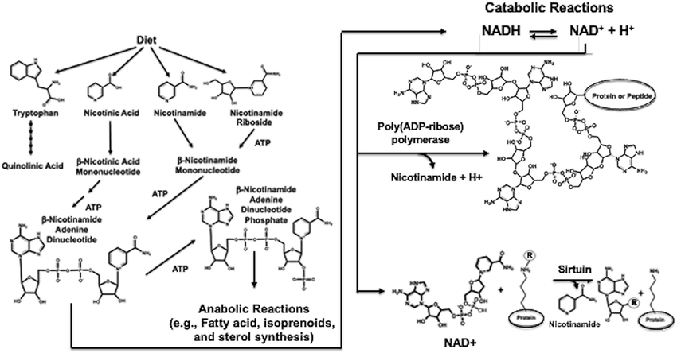

Slide 17
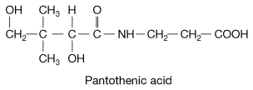
PANTOTHENIC ACID
Pantothenic acid, or Vitamin B5, plays a crucial role in various metabolic pathways, particularly in energy production and the synthesis and degradation of macromolecules.
Energy Production
Carbohydrate Metabolism: CoA is necessary for the conversion of pyruvate to acetyl-CoA, allowing it to enter the tricarboxylic acid (TCA) cycle, where it is used to produce ATP, NADH, and FADH23
Fatty Acid Metabolism: CoA is involved in the beta-oxidation of fatty acids, facilitating the breakdown of fats into acetyl-CoA, which then enters the TCA cycle to produce energy
Protein Metabolism: CoA participates in the catabolism of amino acids by facilitating the transfer of acyl groups, which is necessary for the complete breakdown of proteins
Acyl Carrier Protein (ACP)
Pantothenic acid is also a component of ACP, which is crucial for fatty acid synthesis.
ACP carries the growing fatty acid chain during the synthesis

Slide 18
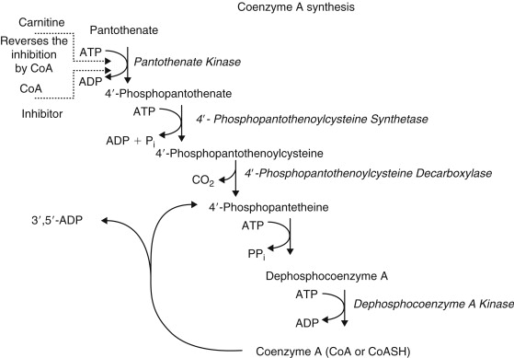
Synthesis of Coenzyme A (CoA)
Pantothenic acid is a precursor to CoA, which is essential for numerous biochemical reactions. CoA is synthesized through a five-step process involving pantothenic acid, cysteine, and ATP
CoA is vital for the transfer of acetyl and acyl groups, which is critical in the metabolism of carbohydrates, fats, and proteins.

Slide 19
General Metabolic Functions
Intermediary Metabolism: CoA is involved in hundreds of biochemical reactions, including cell growth, intermediary metabolism, and neurotransmitter synthesis4
Lipid Metabolism: Pantothenic acid, through CoA, plays a role in the synthesis and degradation of lipids. Derivatives like pantethine have been shown to lower triglycerides, LDL cholesterol, and total cholesterol, while increasing HDL cholesterol in clinical trials
Hormone Synthesis
Pantothenic acid is necessary for the synthesis of sex and stress-related hormones produced in the adrenal glands. This includes the production of cortisol, aldosterone, and sex hormones
Red Blood Cell Production
Pantothenic acid is involved in the production of red blood cells, which are essential for transporting oxygen throughout the body
Neurological Functions
The synthesis of acetylcholine, a neurotransmitter, depends on CoA derived from pantothenic acid. Deficiency in pantothenic acid can lead to impaired acetylcholine synthesis, resulting in neurological symptoms such as numbness, paresthesia, and muscle cramps

Slide 20
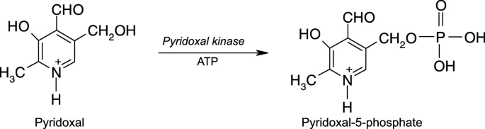
PYRIDOXINE
Vitamin B6, or pyridoxine, plays a crucial role in various metabolic pathways, particularly in energy production, amino acid metabolism, and the synthesis of several important biomolecules. Here are the key aspects of its role:
Energy Production
Glycogen Metabolism: Vitamin B6 is necessary for the conversion of stored glycogen to blood sugar (glucose). This process is essential for maintaining blood glucose levels and providing energy to the body
Citric Acid Cycle and Fatty Acid Metabolism: Pyridoxal 5'-phosphate (PLP), the biologically active form of vitamin B6, is involved in the metabolism of amino acids, which can be converted into intermediates that enter the citric acid cycle.
This cycle is critical for the production of ATP, NADH, and FADH. Additionally, PLP is involved in the breakdown of fatty acids through its role in various enzymatic reactions

Slide 21
Amino Acid Metabolism
Synthesis and Catabolism: Vitamin B6, through PLP, acts as a co-factor for over 140 biochemical reactions, many of which are related to amino acid biosynthesis and catabolism. PLP is essential for transamination, deamination, and decarboxylation reactions of amino acids
Non-Essential Amino Acid Synthesis: PLP is required for the synthesis of non-essential amino acids, which are crucial for protein synthesis and other metabolic processes
Neurotransmitter Synthesis
Neurotransmitter Production: Vitamin B6 is necessary for the synthesis of several neurotransmitters, including gamma-aminobutyric acid (GABA), dopamine, norepinephrine, serotonin, and epinephrine. These neurotransmitters play vital roles in neural function and communication
Red Blood Cell Formation and Iron Metabolism
Hemoglobin Synthesis: PLP is required for the synthesis of hemoglobin, a protein in red blood cells that carries oxygen throughout the body. A deficiency in vitamin B6 can lead to anemia, characterized by microcytic and hypochromic red blood cells

Slide 22
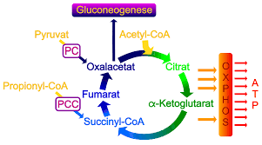
BIOTIN
Vitamin B7, or biotin, plays a crucial role in various metabolic pathways, particularly in energy production and the metabolism of carbohydrates, fats, and proteins.
Here are the key aspects of its role:
Carboxylation Reactions
Biotin acts as a coenzyme for several carboxylase enzymes, which are essential for carboxylation reactions. These enzymes include pyruvate carboxylase, propionyl-CoA carboxylase, beta-methylcrotonyl-CoA carboxylase, and acetyl-CoA carboxylase
Gluconeogenesis
Biotin is necessary for gluconeogenesis, the process of synthesizing glucose from non-carbohydrate sources such as amino acids and lactate. Pyruvate carboxylase, a biotin-dependent enzyme, initiates this process by converting pyruvate to oxaloacetate
Fatty Acid Synthesis
Biotin is involved in the synthesis of fatty acids through its role in acetyl-CoA carboxylase. This enzyme catalyzes the conversion of acetyl-CoA to malonyl-CoA, a critical step in the synthesis of fatty acids

Slide 23
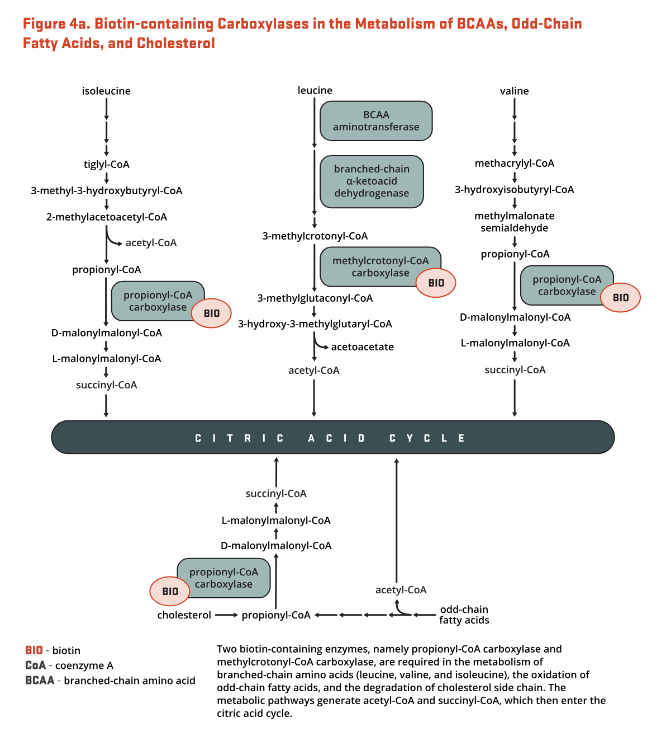
Amino Acid Metabolism
Biotin-containing enzymes are involved in the catabolism of several important amino acids, including leucine. For example, beta-methylcrotonyl-CoA carboxylase is necessary for the breakdown of leucine
Energy Production
By facilitating the metabolism of carbohydrates, fats, and proteins, biotin indirectly supports energy production. The breakdown of these macronutrients leads to the generation of ATP, NADH, and FADH2, which are crucial for cellular energy production
Metabolic Pathway Regulation
Biotin regulates the activity of carboxylase enzymes at both the posttranscriptional and transcriptional levels. For instance, biotinidase and holocarboxylase synthetase are involved in the recycling and activation of biotin, ensuring that biotin-dependent enzymes remain functional

Slide 24
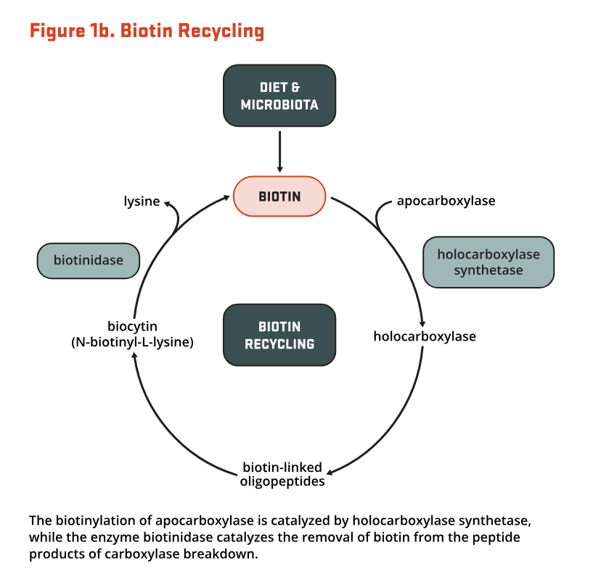
Recycling and Reutilization
Biotin is recycled within the body through the action of biotinidase, which cleaves biotin from biocytin (a biotinylated lysine residue) to release free biotin.
This free biotin can then be reutilized by holocarboxylase synthetase to activate carboxylase enzymes

Slide 25
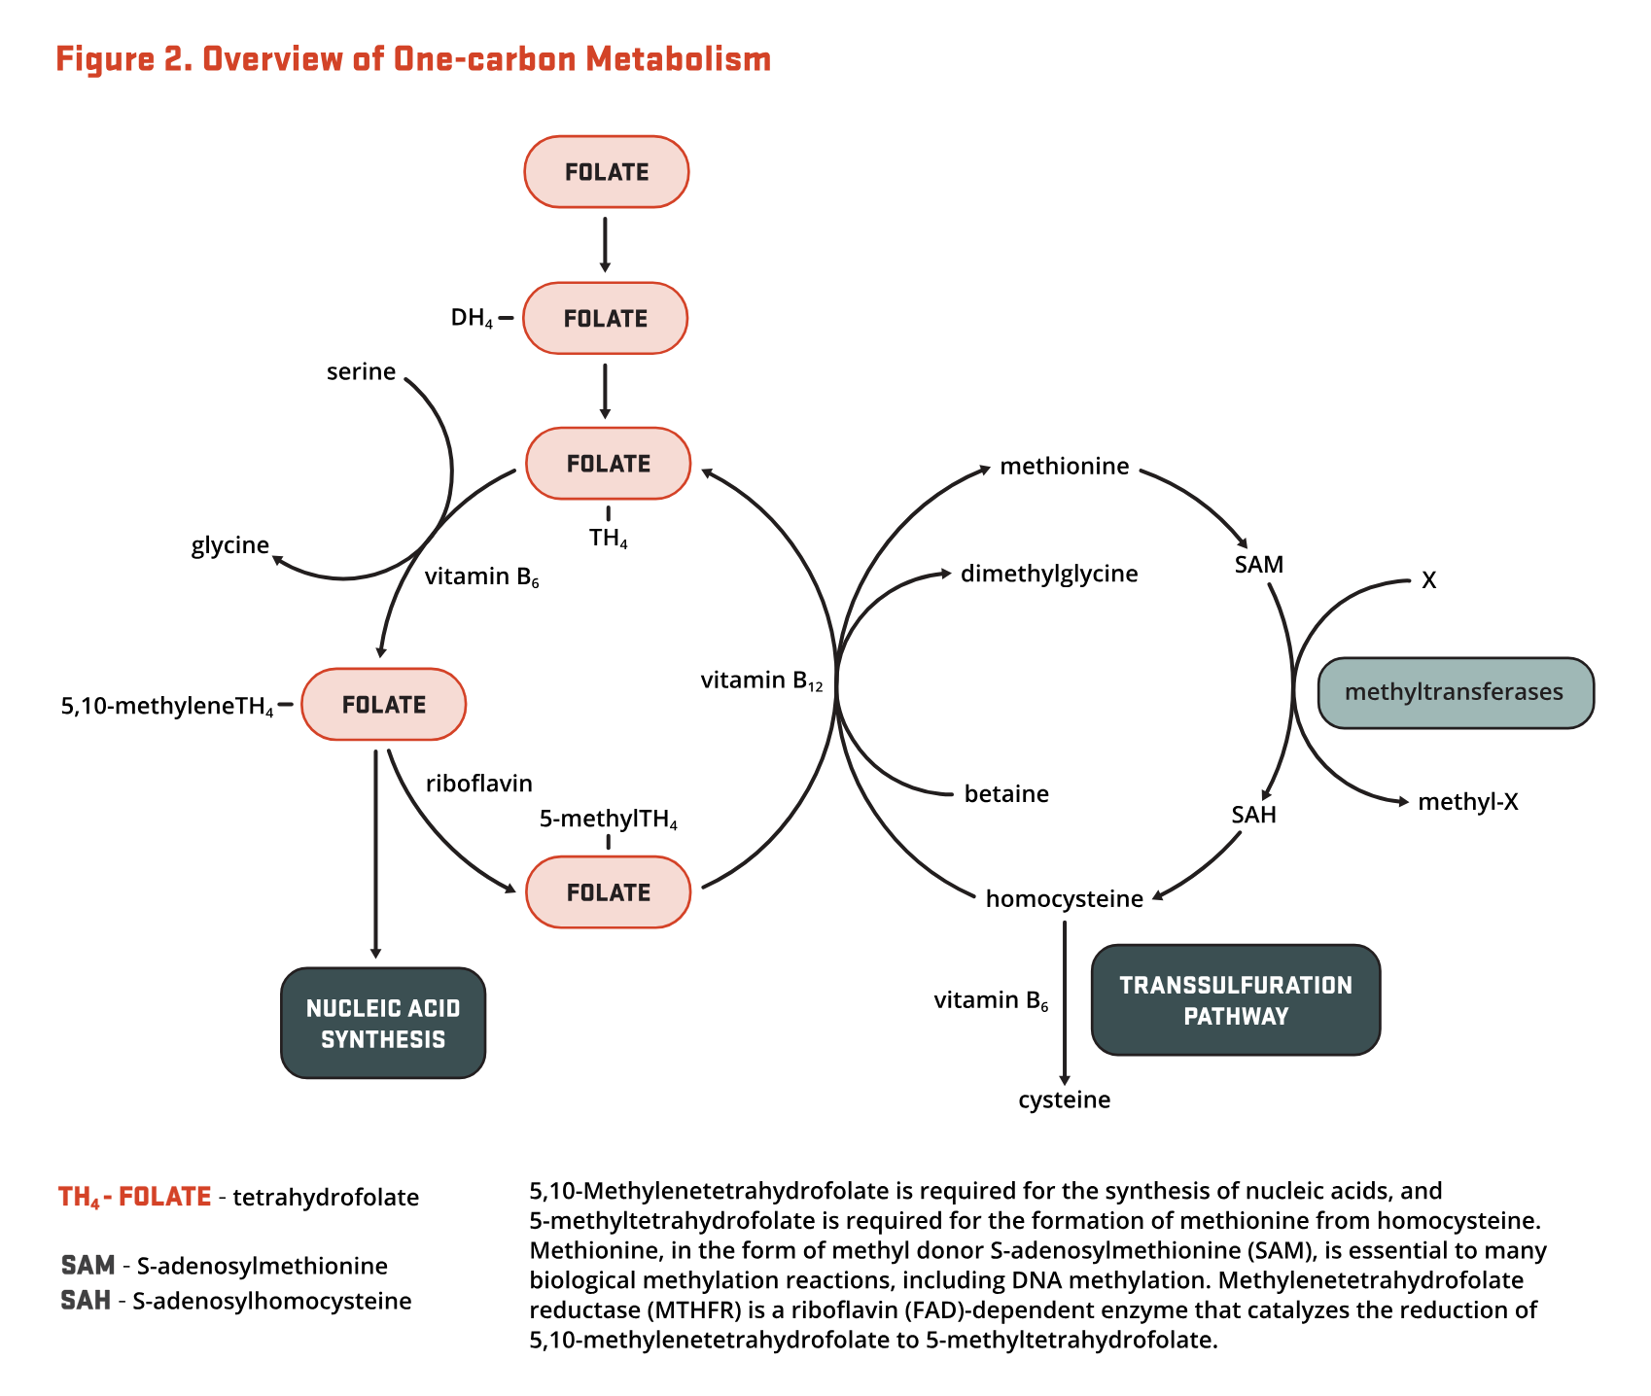
FOLATE
Vitamin B9, or folate, plays a critical role in various metabolic pathways, particularly in energy production, nucleotide synthesis, and the metabolism of amino acids and other biomolecules.
Here are the key aspects of its role:
One-Carbon Metabolism
Folate is essential for one-carbon metabolism, where it acts as a carrier of one-carbon units. These units are derived from amino acids such as serine, glycine, and the choline degradation products dimethylglycine and sarcosine.
The enzyme serine hydroxymethyltransferase (SHMT) converts serine to glycine, donating the one-carbon unit to tetrahydrofolate (THF) to form 5,10-methylene-THF

Slide 26
Amino Acid Metabolism
Folate is involved in the metabolism of several amino acids. For instance, the conversion of serine to glycine and the metabolism of histidine and tryptophan require folate-dependent one-carbon transfer reactions. These reactions are critical for the proper breakdown and synthesis of amino acids
Energy Production
Although folate is not directly involved in the primary energy-producing pathways like glycolysis or the citric acid cycle, it supports energy production indirectly. Folate is necessary for the synthesis of nucleotides, which are required for the replication of cells, including those involved in energy production. Additionally, folate metabolism influences the cellular redox state through the production and consumption of NADPH, which is essential for various metabolic processes, including those related to energy production
Redox Balance and NADPH Production
The folate pathway contributes to the cellular redox balance through the production and consumption of NADPH. In the mitochondria, the conversion of 5,10-methylene-THF to 5,10-methenyl-THF by MTHFD2 generates NAD(P)H, while in the cytosol, the reverse reaction catalyzed by MTHFD1 consumes NADPH. This balance is crucial for maintaining the cellular redox state and supporting various metabolic processes

Slide 27
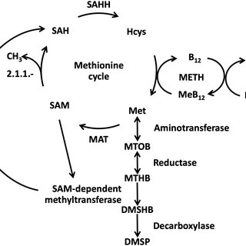
COBALAMIN
Vitamin B12, or cobalamin, plays a critical role in various metabolic pathways, particularly in energy production, amino acid metabolism, and the synthesis of nucleic acids.
Here are the key aspects of its role:
Energy Production Through Fatty Acid and Amino Acid Metabolism
Methylmalonyl-CoA Mutase: Vitamin B12, in its adenosylcobalamin (AdoB12) form, serves as a cofactor for the enzyme methylmalonyl-CoA mutase. This enzyme converts methylmalonyl-CoA to succinyl-CoA, a crucial step in the catabolism of fatty acids and certain amino acids. Succinyl-CoA then enters the citric acid cycle, contributing to the production of ATP, NADH, and FADH2
Methionine Synthesis and One-Carbon Metabolism
Methionine Synthase: Vitamin B12, in its methylcobalamin form, is a cofactor for methionine synthase. This enzyme catalyzes the conversion of homocysteine to methionine, using 5-methyltetrahydrofolate as a one-carbon donor. Methionine is essential for the synthesis of S-adenosylmethionine (SAMe), the primary methyl donor in cellular methylation reactions. This process is interconnected with folate metabolism and is vital for DNA synthesis, repair, and epigenetic modifications

Slide 28
Nucleotide Synthesis
Purine and Pyrimidine Synthesis: The one-carbon units generated in the methionine cycle, facilitated by vitamin B12, are also used in the synthesis of purines and thymidine monophosphate (dTMP). These nucleotides are essential for DNA and RNA synthesis, which are critical for cell division and energy production4
Myelin Synthesis and Neurological Function
Myelin Maintenance: Vitamin B12 is necessary for the synthesis and maintenance of myelin, the protective fatty layer around nerve axons. This is partly due to its role in the metabolism of fatty acids and the synthesis of phospholipids and sphingolipids, which are components of myelin. Deficiencies in vitamin B12 can lead to neurological symptoms such as numbness, weakness, and cognitive impairments
Red Blood Cell Formation
Erythropoiesis: Vitamin B12, along with folate, is essential for the synthesis of DNA in red blood cells. A deficiency in either vitamin can lead to megaloblastic anemia, characterized by large, immature red blood cells that are unable to function properly
Metabolic Pathway Regulation
Intersection with Folate Metabolism: Vitamin B12 metabolism is closely linked with folate metabolism. The methionine synthase reaction, which requires vitamin B12, also uses 5-methyltetrahydrofolate as a substrate. This intersection ensures that one-carbon units are properly distributed between different metabolic pathways, including those involved in energy production and nucleotide synthesis

Slide 29
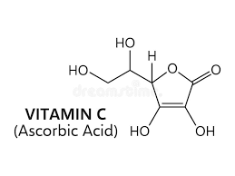
ASCORBIC ACID
Vitamin C, or ascorbic acid, plays several crucial roles in the body, although its direct involvement in energy production is more indirect than some other vitamins.
Here are the key aspects of its role in metabolic pathways and energy production:
Antioxidant Functions and Redox Balance
Vitamin C acts as a powerful antioxidant, helping to maintain the redox balance within cells. It can donate electrons to reduce oxidized molecules, such as reactive oxygen species (ROS), and in doing so, it is converted into the ascorbyl radical and then dehydroascorbic acid (DHA)
This antioxidant function is essential for protecting cellular components, including those involved in energy production, from oxidative damage

Slide 30
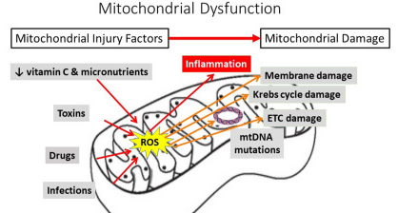
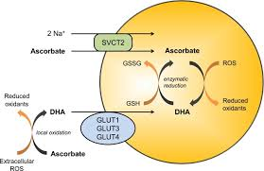
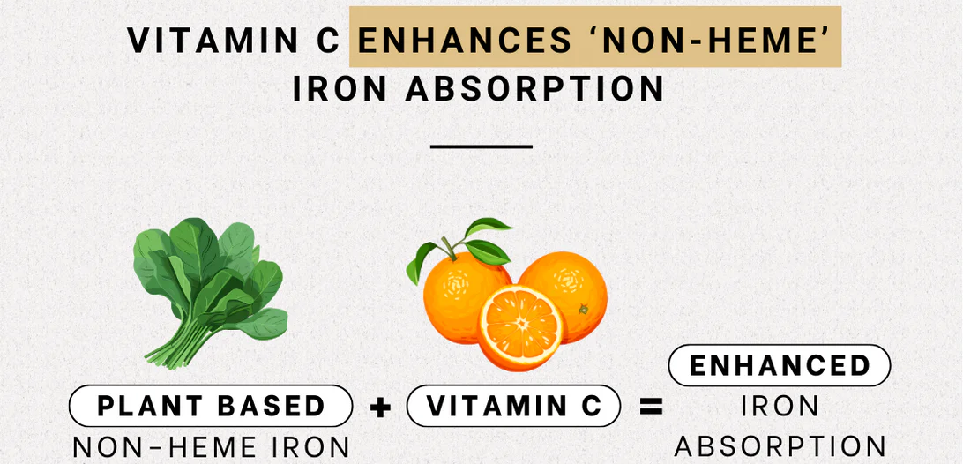
Energy Metabolism Support
Although vitamin C does not directly participate in the major energy-producing pathways like glycolysis, the citric acid cycle, or fatty acid oxidation, it supports these processes indirectly. For example, it helps maintain the integrity of mitochondria, the site of cellular respiration, by protecting against oxidative stress. Additionally, vitamin C is necessary for the synthesis of carnitine, which is involved in the transport of fatty acids into mitochondria for beta-oxidation
Regulation of Gene Expression and Cell Signaling
Vitamin C can influence gene expression and cell signaling pathways. For instance, it is required for the activity of certain transcription factors and can affect the epigenetic regulation of genes involved in metabolic processes. This regulatory role can indirectly impact energy metabolism by influencing the expression of genes related to energy production and utilization
Iron Absorption and Utilization
Vitamin C enhances the absorption of non-heme iron from plant-based foods by reducing ferric iron (Fe3+) to ferrous iron (Fe2+), which is more easily absorbed. Iron is essential for the production of hemoglobin and myoglobin, proteins that transport oxygen to cells, and for the functioning of various enzymes involved in energy production

Slide 31

In conclusion, water-soluble vitamins play a vital role as coenzymes in energy production and metabolic pathways, facilitating critical biochemical reactions that sustain life.
Their involvement in the conversion of macronutrients into usable energy underscores their importance in maintaining optimal health and metabolic function.
Deficiencies in these vitamins can lead to significant metabolic disruptions, impacting energy levels and overall well-being. Therefore, ensuring an adequate intake of water-soluble vitamins through a balanced diet is essential for supporting metabolic health.
By understanding the pivotal roles these vitamins play in metabolism, we can better appreciate their importance in our daily nutrition and health management strategies.

Slide 32
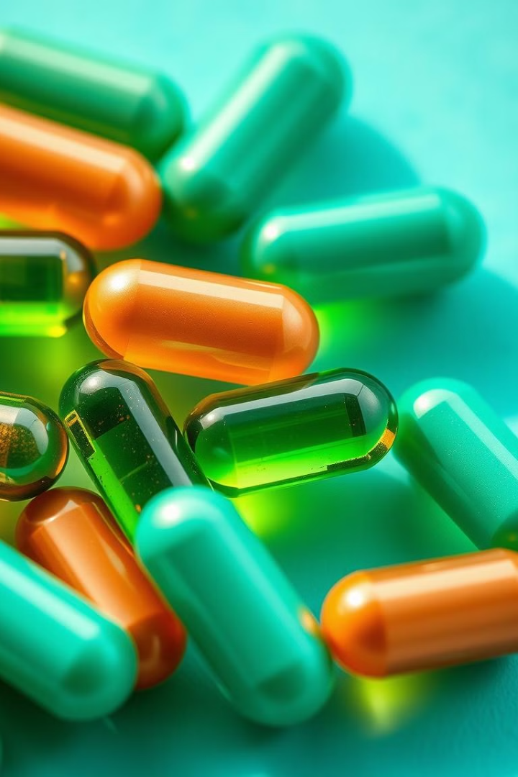

THANKS
Prof. Dr. Asif Ahmad, Director Institute of Food and Nutritional Sciences, PMAS-Arid Agriculture University Rawalpindi
asifahmad_1@yahoo.com

