Slide 1
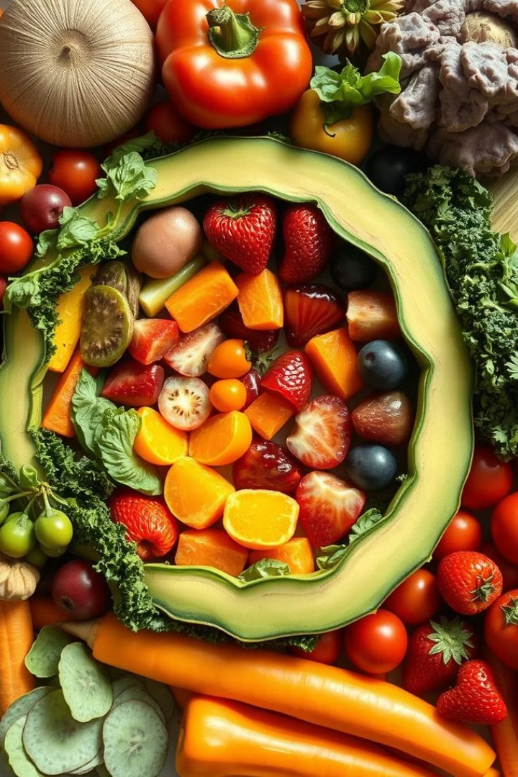
Water-Soluble Vitamin Deficiency
PROF. DR ASIF AHMAD
IFNS, PMAS UAAR

Slide 2
INTRODUCTION
Water-soluble vitamins include the B-complex vitamins and vitamin C. Unlike fat-soluble vitamins, these vitamins dissolve in water and are not stored in the body.
Water-soluble vitamins play crucial roles in various bodily functions, including energy metabolism, immune function, and the synthesis of neurotransmitters and red blood cells.
Deficiencies can arise from
  Poor dietary intake
  Malabsorption disorders (e.g., celiac disease)
  Increased physiological needs (e.g., pregnancy)
  Certain medications and chronic conditions
Long-term deficiencies can lead to serious health conditions, including scurvy (Vitamin C deficiency), beriberi (Thiamine deficiency), and pellagra (Niacin deficiency).
Ensuring a balanced diet rich in fruits, vegetables, whole grains, and lean proteins can help prevent deficiencies. In some cases, supplementation may be necessary.

Slide 3
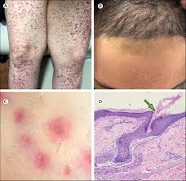
SCURVY
Scurvy is a disease caused by a significant lack of Vitamin C in your diet.
Scurvy most commonly affects babies, children and older adults who don’t get enough vitamin C in their diet.
Risk factors for developing the condition include:
  Not having access to fresh fruits or vegetables.
  Eating very little due to medical treatments that make you feel sick (such as chemotherapy) or an eating disorder (such as anorexia).
  Smoking, which reduces the amount of vitamin C your body absorbs from food.
  Having a drug or alcohol dependency that affects your diet.
  Having a poor diet during your pregnancy or while breastfeeding.
  Having a restrictive diet or food allergies.
  Other health conditions such as type 1 diabetes and inflammatory bowel disease.

Slide 4

BACKGROUND
Scurvy was the first discovered nutrition deficiency in 1746 by James Lind.
Lind was a surgeon on a British navy ship.
Frequently during voyages the sailors would develop scurvy for reasons that weren't understood at the time.
It was known that citrus fruits could cure or prevent scurvy, but it was believed this was due to their acidity.
Lind performed clinical trials comparing citrus juice to dilute sulfuric acid and vinegar and found that only citrus juice caused the sailors to recover.
As a result of the discovery, the British sailors became known as "Limeys" because they would drink this juice to prevent the development of the disease.

Slide 5
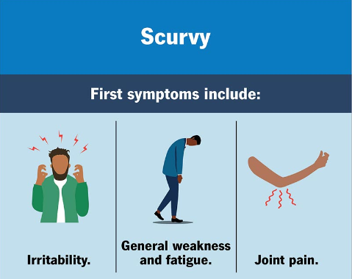
GENERAL SYMPTOMS
Scurvy symptoms may start to develop after a few months of not getting enough vitamin C in your diet.
The first symptoms may include general weakness, fatigue, irritability and joint pain.
In babies and children, symptoms of scurvy may include:
  Irritability.
  Pain when they move.
  No appetite.
  Failure to gain weight.
  Anemia.

Slide 6
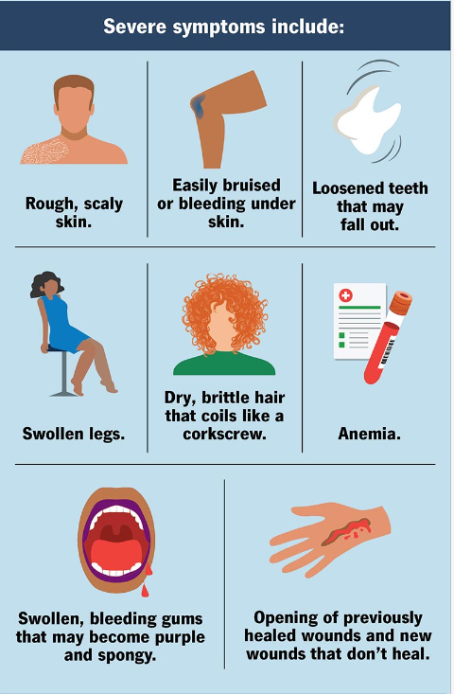
If left untreated, more severe symptoms may start to develop.
These may include:
  Anemia.
  Swollen, bleeding gums that may become purple and spongy.
  Loosened teeth that may fall out.
  Bleeding under your skin (skin hemorrhages).
  May develop a “scurvy rash” that shows up as red or blue spots on your skin.
  Easily bruised skin.
  Rough, scaly skin.
  Swollen legs.
  Opening of previously healed wounds and new wounds that don’t heal.
  Dry, brittle hair that coils like a corkscrew.

Slide 7
COMMON CAUSES
A severe lack of Vitamin C in your diet for at least three months can cause scurvy.
Reasons for this deficiency include not eating enough fresh fruits and vegetables. Also, cooking destroys some of the vitamin C found in food.
Certain conditions increase your body’s vitamin C requirement. You need more vitamin C and risk deficiency if you don’t get enough while experiencing the following conditions:
  Pregnancy
  Breastfeeding
  Disorders that cause high fevers
  Overactive thyroid gland (hyperthyroidism)
  Chronic diarrhea
  Recent surgery.
  Burns
  Tobacco usage.

Slide 8
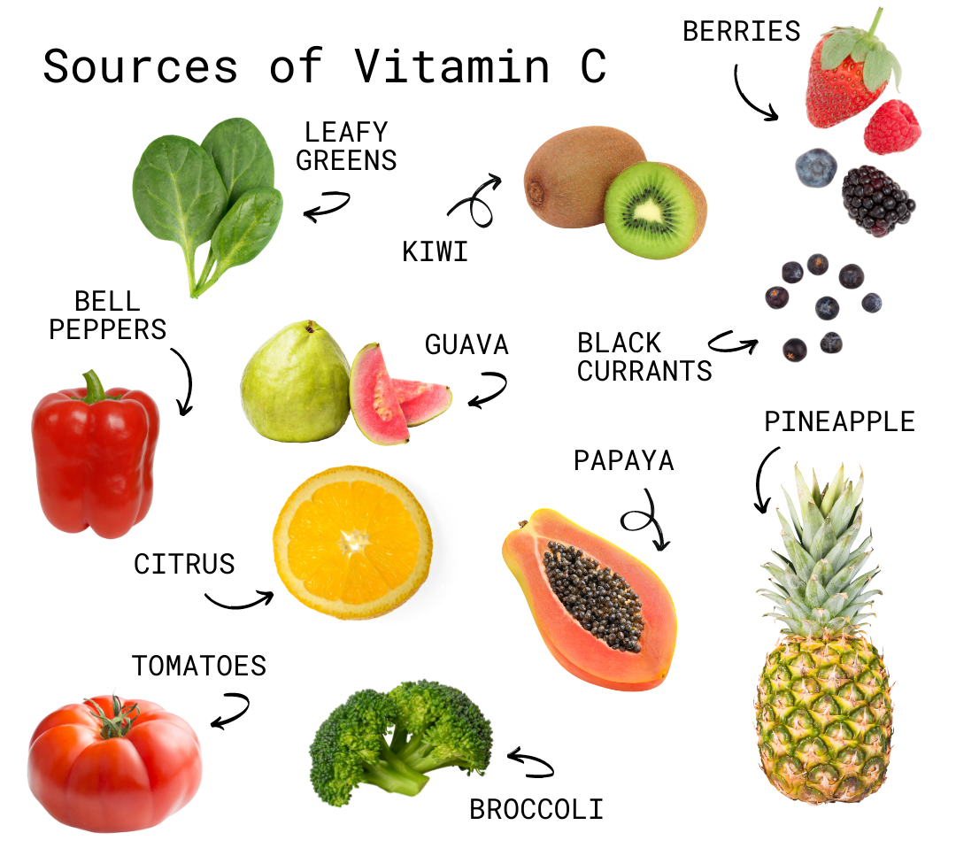
TREATMENT
Scurvy treatment is essential to avoid further complications.
The condition is easily treatable by consuming more vitamin C.
Maintaining a nutritious diet that includes one to two times your daily recommended amount of vitamin C.
Adding fresh fruits and vegetables to every meal.
Dietary Sources of Vitamin C
  Citrus fruits (oranges, lemons)
  Kiwi, strawberries
  Bell peppers, broccoli, spinach
Vitamin C Supplements
  Tablets, chewable, powders for severe cases
  Children with scurvy can take a supplement of up to 300 milligrams (mg)
  Adults can take between 500 mg and 1000 mg.
Dietary Changes
  Encourage balanced diet with fruits and vegetables
Monitoring and Follow-Up
Regular health check-ups to assess recovery
Blood tests to monitor Vitamin C levels

Slide 9
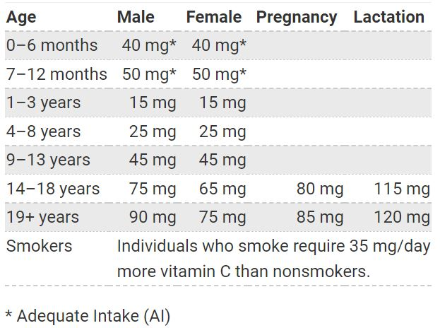

RECOMMENDED DIETARY ALLOWANCE
The amount of vitamin C you need every day depends on your age and other factors.
The average daily recommended amounts of vitamin C are given in the table
If you smoke, you should add 35 milligrams to the above values to get your total daily recommended amount

Slide 10

CASE STUDIES
Patient Profile: A 45-year-old male presents with fatigue, swollen gums, and joint pain. His diet is poor, and he has a history of alcohol use.
Diagnosis: Clinical examination reveals scurvy symptoms such as petechiae and bruising. Serum Vitamin C levels confirm deficiency.
Prognosis: With treatment, including Vitamin C supplementation and dietary changes, the patient is expected to recover fully within weeks.
Treatment and Intervention: Initiated with 1,000 mg of oral Vitamin C daily, alongside dietary counseling to increase intake of fruits and vegetables. Follow-up is scheduled to monitor improvement.
Patient Profile: A 30-year-old female presents with weakness, anemia, and mood changes. She follows a vegan diet and reports limited fruit intake.
Diagnosis: Anemia indicators are noted during assessment. Laboratory tests show low serum Vitamin C levels and altered iron studies.
Prognosis: Improvement is anticipated with appropriate interventions, though there is a risk of chronic deficiency if dietary changes are not maintained.
Treatment and Intervention: Prescribed 500 mg of Vitamin C daily, with dietary recommendations to include fortified foods. Nutrition counseling is provided to ensure a balanced intake. Follow-up is planned to evaluate recovery.

Slide 11
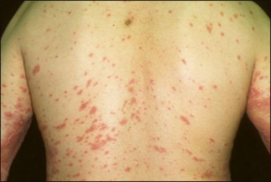
BERIBERI
Beriberi is a disease caused by vitamin B1 deficiency, also known as thiamine deficiency.
It occurs most often in people with a diet that consists mostly of white rice or highly refined carbohydrates.
There are two types of beriberi:
  Wet beriberi
  Dry beriberi
Wet beriberi affects the heart and circulatory system.
In extreme cases, wet beriberi can cause heart failure
Dry beriberi damages the nerves and can lead to decreased muscle strength and eventually muscle paralysis
Beriberi can be life threatening if it isn’t treated.

Slide 12
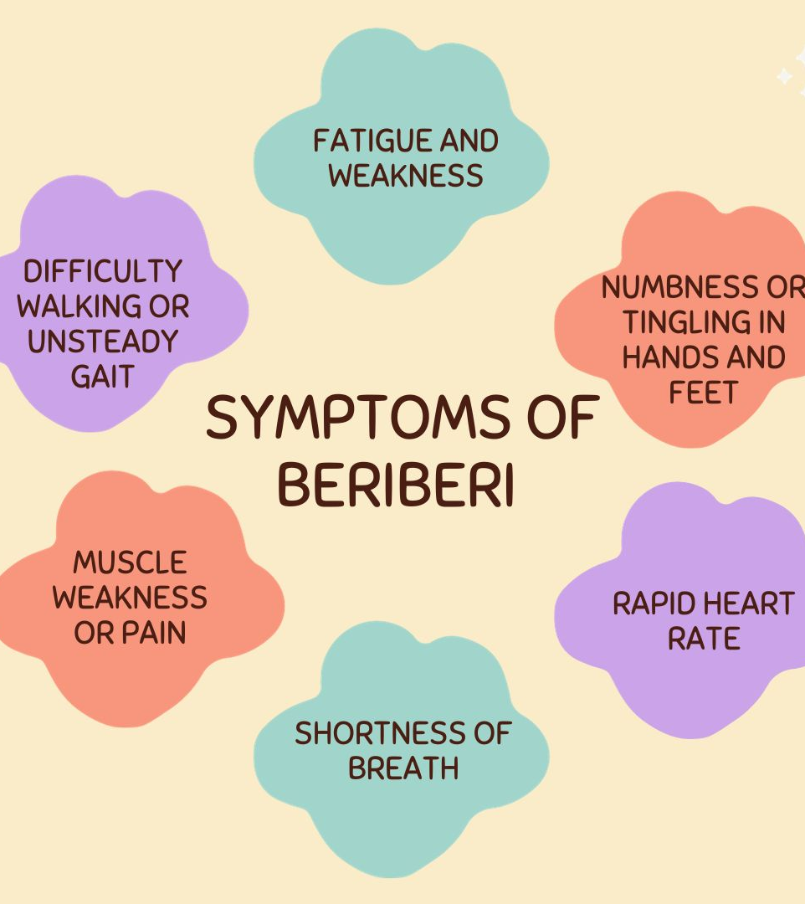
SYMPTOMS
The symptoms of beriberi vary depending on the type.
Wet beriberi symptoms include:
  shortness of breath during physical activity
  waking up short of breath
  rapid heart rate
  swollen lower legs
Dry beriberi symptoms include:
  decreased muscle function, particularly in both lower legs
  tingling or loss of feeling in the feet and hands on both sides
  pain
  mental confusion
  difficulty speaking
  vomiting
  involuntary eye movement
  paralysis

Slide 13
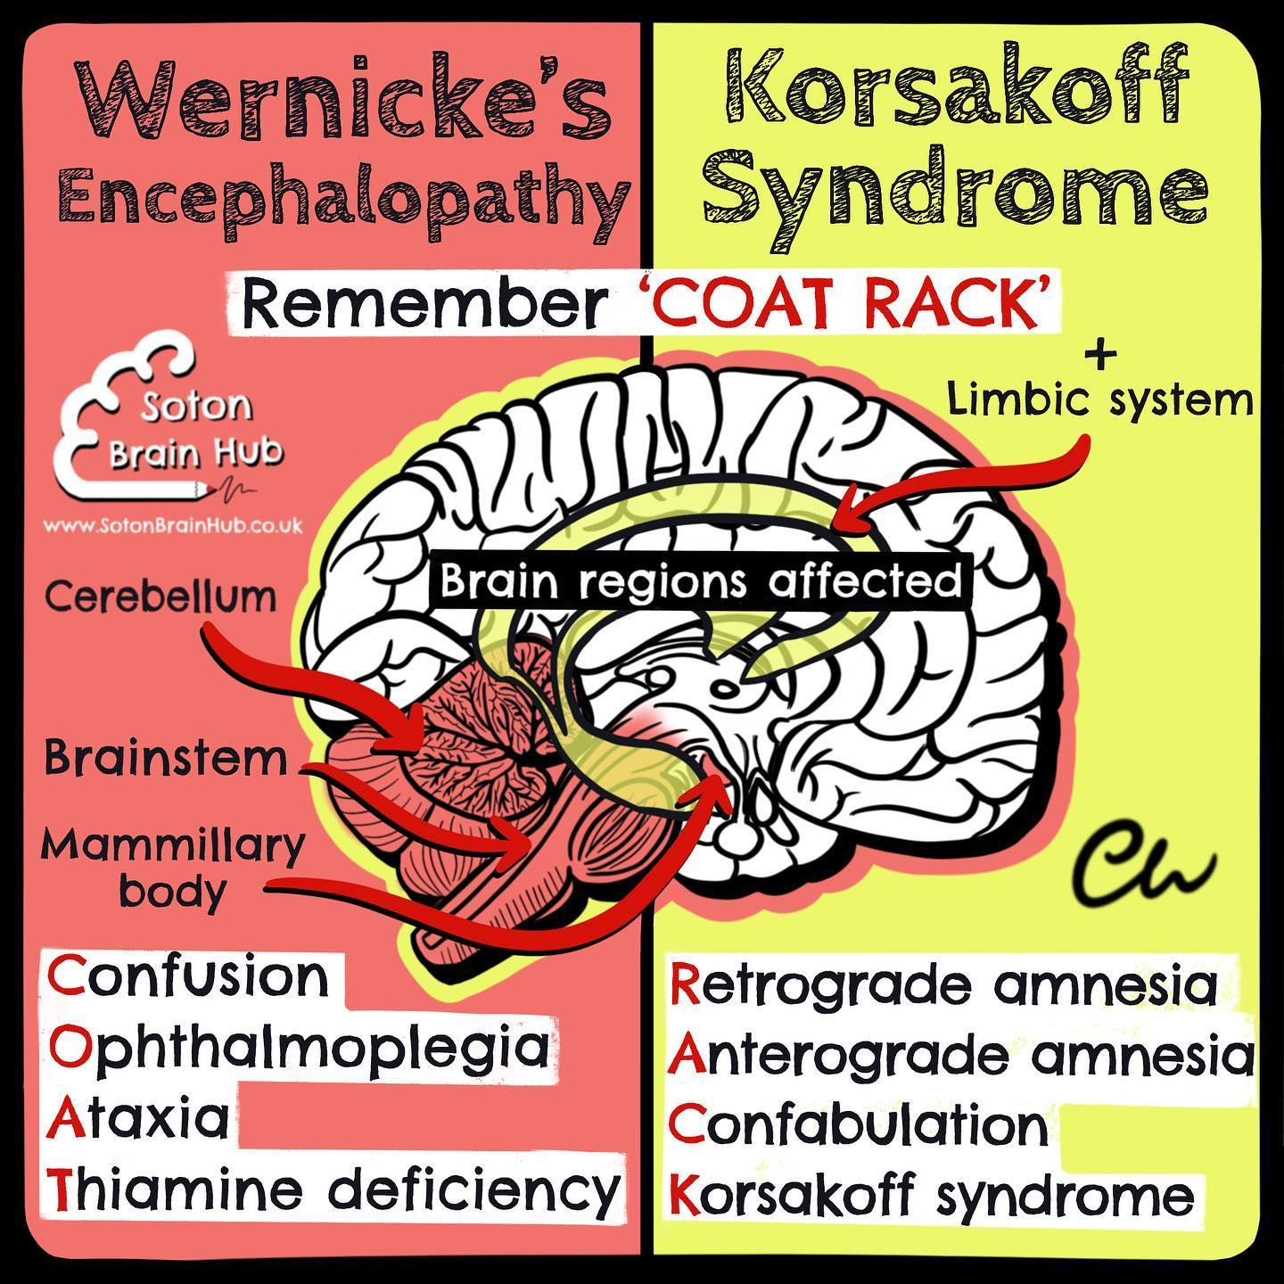
In extreme cases, beriberi is associated with Wernicke-Korsakoff syndrome.
Wernicke encephalopathy and Korsakoff syndrome are two forms of brain damage caused by thiamine deficiency.
Wernicke encephalopathy damages regions of the brain called the thalamus and hypothalamus.
This condition can cause:
  confusion
  memory loss
  loss of muscle coordination
  visual problems such as rapid eye movement and double vision
Korsakoff syndrome is the result of permanent damage to the region of the brain where memories form.
It can cause:
  loss of memory
  inability to form new memories
  hallucinations

Slide 14
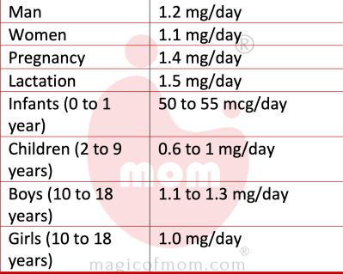
CAUSES AND RISK FACTORS
The main cause of beriberi is a diet low in thiamine. The disease is very rare in regions with access to vitamin-enriched foods, such as certain breakfast cereals and breads.
Other factors may cause thiamine deficiency, as well.
These include:
  alcohol misuse, which can make it hard for your body to absorb and store thiamine
  genetic beriberi, a rare condition that prevents the body from absorbing thiamine
  hyperthyroidism (overactive thyroid gland)
  extreme nausea and vomiting in pregnancy
  AIDS
  prolonged diarrhea or use of diuretics (medication that makes you urinate more)
  undergoing kidney dialysis
  diabetes
Breastfeeding mothers need daily thiamine in their diet. Infants drinking breast milk or formula low in thiamine are at risk for thiamine deficiency.
Thiamine deficiency is also more common in cancer patients. Restrictive diets, eating disorders, and inflammatory bowel disease can also cause thiamine deficiency.
RECOMMENDED DIETARY ALLOWANCE

Slide 15

PREVENTION AND TREATMENT
To prevent beriberi, eat a nutrient-dense, balanced diet that includes foods rich in thiamine. These include:
  Beans and legumes
  Seeds
  Meat
  Whole grains
  Nuts
  Dairy
  Certain vegetables, such as asparagus, acorn squash, Brussels sprouts, spinach.
  Breakfast cereals that are enriched with thiamine
Cooking or processing any of the foods listed above decreases their thiamine content.
Limiting alcohol consumption helps reduce your risk of developing beriberi.
Beriberi is easily treated with thiamine supplements.
For severe cases, a healthcare professional will administer intravenous thiamine.
Your progress will be monitored with follow-up blood tests to see how well your body is absorbing the vitamin.

Slide 16
CASE STUDIES
Patient Profile: A 25-year-old female presents with complaints of numbness in her extremities, difficulty walking, and confusion. She reports a diet low in thiamine-rich foods due to adherence to a strict vegetarian diet.
Diagnosis: Clinical signs indicate dry Beri Beri, characterized by muscle wasting and peripheral neuropathy. Laboratory tests confirm low thiamine levels.
Prognosis: The patient is expected to improve with appropriate treatment, but chronic deficiency may lead to long-term neurological damage if dietary changes are not made.
Treatment and Intervention: Prescribed oral thiamine supplementation (150 mg/day) along with dietary modifications to include legumes, nuts, and fortified foods. Nutrition education sessions are scheduled to ensure a well-rounded intake. Follow-up is arranged to assess neurological recovery and dietary adherence.
Patient Profile: A 50-year-old male presents with symptoms of severe fatigue, muscle weakness, and peripheral neuropathy. He has a history of alcoholism and a diet primarily consisting of polished rice.
Diagnosis: Clinical evaluation reveals classic signs of wet Beri Beri, including edema and tachycardia. Thiamine (Vitamin B1) levels are confirmed to be low through laboratory tests.
Prognosis: With prompt treatment, including thiamine supplementation, the patient is expected to show significant improvement within days. However, if untreated, the condition may lead to severe cardiovascular complications.
Treatment and Intervention: Initiated with intravenous thiamine (100 mg daily) for the first few days, followed by oral thiamine supplementation (300 mg/day). Dietary counseling is provided to encourage a balanced diet rich in whole grains and proteins. Follow-up appointments are scheduled to monitor recovery.

Slide 17
PELLAGRA
Pellagra is a systemic disease caused by a severe deficiency of niacin (vitamin B3). It is a form of malnutrition — specifically, micronutrient undernutrition.
Niacin is crucial to cell functioning throughout your body, and the lack of it shows up in symptoms throughout your body, including your skin, mouth, bowels and brain.
If left untreated, pellagra can cause lasting damage to your nervous system and even death.
Primary pellagra is caused by a lack of niacin in your diet. It usually occurs in poor and food-limited populations.
Secondary pellagra can occur when your body is unable to absorb the niacin you eat.
Niacin is found in many food sources, and most people who eat a balanced diet get enough of it.
Primary pellagra from inadequate dietary intake is still a significant problem in impoverished and food-limited populations.
In the industrialized world, niacin deficiency is more likely to occur from secondary causes from health conditions or substances that prevent your body from absorbing or using niacin.

Slide 18

history
First described in the early 18th century in Spain.
Initially thought to be a skin disease.
Widespread in the southern United States in the early 1900s.
Linked to diets low in niacin and high in corn.
Dr. Joseph Goldberger conducted research identifying diet as the cause.
Advocated for the inclusion of meat, dairy, and vegetables in diets.
Niacin (Vitamin B3) identified as a critical nutrient in the 1930s.
Goldberger’s work contributed to understanding and preventing Pellagra.
Public health measures included fortification of foods with niacin.
Education on nutrition helped prevent outbreaks.
Rare in developed countries, still a concern in some developing regions.

Slide 19
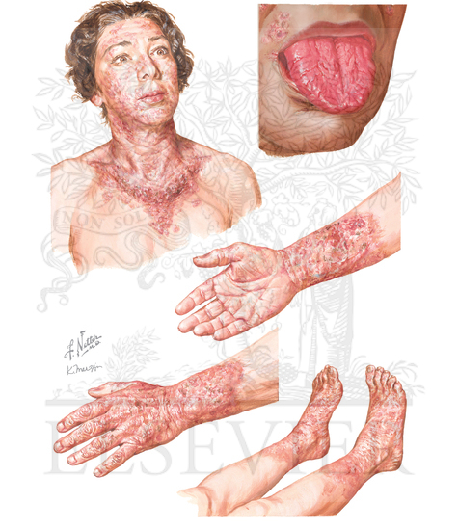
SYMPTOMS
Chronic diarrhea, sometimes bloody.
Abdominal pain and indigestion.
Loss of appetite, nausea and vomiting.
Itchy or painful skin rashes.
Mouth sores and a red, swollen tongue.
Fatigue, weakness and malaise.
Mood changes, depression.
Neurological symptoms such as tremors or numbness and tingling in the hands and feet.
Delirium and dementia.

Slide 20
CAUSES
The primary cause of pellagra is an inadequate diet. You can get your vitamin B3 from a wide range of foods, but people who don’t have enough food choices may lack certain nutrients.
You can also get pellagra from secondary causes, meaning other health conditions that prevent your body from absorbing or using niacin. Some of these include:
Gastrointestinal diseases that cause malabsorption, such as inflammatory bowel disease or cirrhosis of the liver.
Heavy alcohol use can induce pellagra by way of organ damage, causing malabsorption and general malnutrition.
Bariatric surgery can damage the intestinal mucosa, leading to various micronutrient deficiencies, including pellagra.
Iron deficiency anemia
Hartnup disease. This genetic disorder prevents your body from absorbing amino acids, which are necessary to produce vitamins from food.
Carcinoid syndrome, This syndrome is characterized by active tumor cells that depress niacin production.
Certain drugs can disrupt your body’s niacin metabolism process, particularly antispasmodic and chemotherapy drugs.
HIV infection depletes niacin in your body.

Slide 21
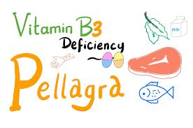
TREATMENT
A well-balanced diet is the simplest way to ensure adequate nutrition.
When food choices are limited, enriched foods and dietary supplements can help.
A B-complex vitamin supplement provides enough niacin for most healthy adults.
The best food sources of niacin are:
  Beef liver.
  Beets.
  Brewer's yeast.
  Enriched bread and cereals.
If you have a chronic health condition that predisposes you to pellagra, you may need to discuss long-term prevention with your healthcare provider. This may involve diet, supplements or changes to your medications.
  Oily fish, such as salmon
  Peanuts.
  Potato.
  Poultry.
  Rice.

Slide 22
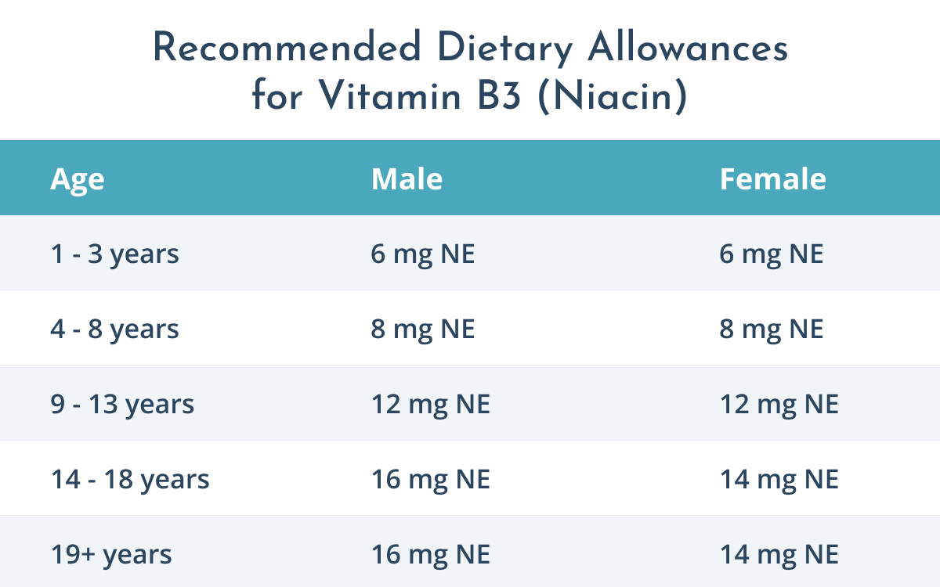

Slide 23
CASE STUDIES
Patient Profile: A 45-year-old male presents with symptoms of dermatitis, diarrhea, and dementia. He has a history of a corn-based diet with limited variety and low protein intake.
Diagnosis: Clinical evaluation reveals characteristic signs of Pellagra, including a photosensitive rash. Laboratory tests confirm low levels of niacin (Vitamin B3) and its metabolites.
Prognosis: With appropriate treatment, including niacin supplementation, the patient is expected to show significant improvement within weeks. Untreated, Pellagra can lead to severe complications and is potentially fatal.
Treatment and Intervention: Initiated with niacin supplementation (100 mg three times daily). Dietary counseling is provided to increase intake of niacin-rich foods such as meat, fish, legumes, and fortified grains. Follow-up appointments are scheduled to monitor recovery and dietary changes.
Patient Profile: A 7-year-old girl presents with symptoms of a scaly rash on her face and arms, irritability, and digestive issues. Her family reports a diet predominantly consisting of cornmeal and limited protein sources.
Diagnosis: Clinical examination reveals signs of Pellagra, including dermatitis and gastrointestinal symptoms. Laboratory tests indicate low niacin levels.
Prognosis: With early intervention, the child is expected to recover fully, but untreated Pellagra may lead to developmental issues and serious health complications.
Treatment and Intervention: Prescribed niacin supplementation (50 mg daily) and dietary modifications to include more diverse sources of niacin, such as dairy, eggs, and lean meats. Nutrition education for the family is provided to promote a balanced diet. Follow-up is arranged to assess improvement and dietary adherence.

Slide 24
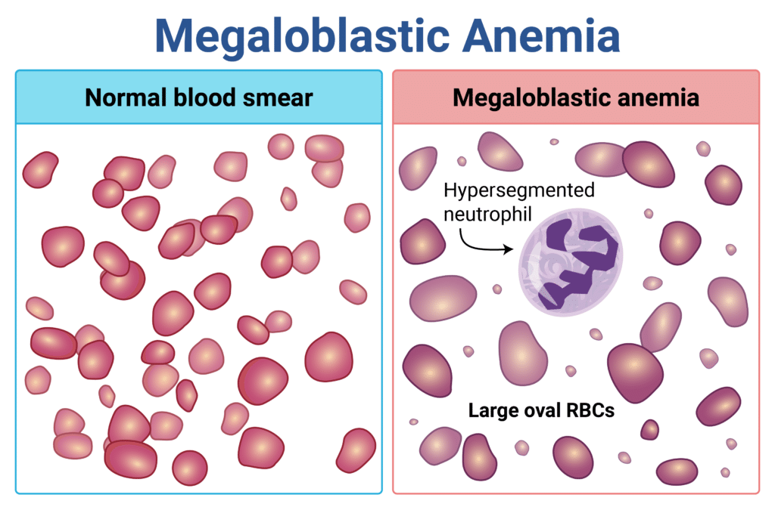
Megaloblastic anemia
Megaloblastic anemia is a form of macrocytic anemia.
Macrocytic anemia is a blood disorder that causes your bone marrow to make abnormally large red blood cells.
It’s also a type of vitamin deficiency anemia.
This condition happens when you don’t get enough vitamin B12 and/or vitamin B9 (folate). Healthcare providers treat megaloblastic anemia with vitamin B12 and vitamin B9 supplements.
Megaloblastic anemia is caused in part by vitamin B12 deficiency.
Left untreated, vitamin B12 deficiency can cause neurological issues, including memory loss, problems with balance and paresthesia, which is a sense of tingling or prickling in your arms and legs.

Slide 25
CAUSES
Megaloblastic anemia happens when you don’t have enough vitamin B12 or vitamin B9 to make sure your bone marrow develops enough healthy red blood cells to carry oxygen throughout your body.
Some people develop vitamin B12 deficiency because they have conditions or have had medical treatments that affect their ability to absorb vitamin B12. Those conditions include
Pernicious anemia: This autoimmune disorder keeps your body from absorbing vitamin B12.
Gastrectomy: This surgery removes part of your stomach, which may affect vitamin B12 absorption.
Zollinger-Ellison syndrome: This rare condition keeps your body from absorbing vitamin B12.
Blind loop syndrome: Blind loop syndrome happens when food you’ve digested stops moving through your intestines, causing bacteria overgrowth that uses up vitamin B12.
Fish tapeworm infestation: You can get a tapeworm infection or infestation by eating infected fish that was undercooked. Tapeworms feed on vitamin B12.
Pancreatic insufficiency: This condition affects your pancreas’ ability to make enough digestive enzymes to break down food, which means you may not get all the nutrients you need, including enough vitamin B12 or vitamin B9.
People may develop vitamin B9 (folate) deficiency if their daily diet doesn’t include green vegetables, fruits, meat and liver or foods that are enriched with folic acid. Other causes may include:
Digestive system diseases: Your digestive system doesn’t absorb folic acid well if you have a disease such as Crohn’s disease or celiac disease.
Excessive alcohol use: People who drink large amounts of alcohol sometimes substitute alcohol for food. As a result, they don’t get enough folate.
Overcooking your fruits and vegetables: When you overcook produce, the heat can destroy naturally occurring folate.
Hemolytic anemia: A blood disorder that occurs when your red blood cells are broken down and your bone marrow can’t replace red blood cells fast enough.
Certain medications: Some antiseizure drugs and ulcerative colitis drugs interfere with the proper absorption of folate.
Dialysis: Sometimes, people receiving dialysis for kidney failure have poor appetites, which affects how much vitamin B12 they receive from food.

Slide 26
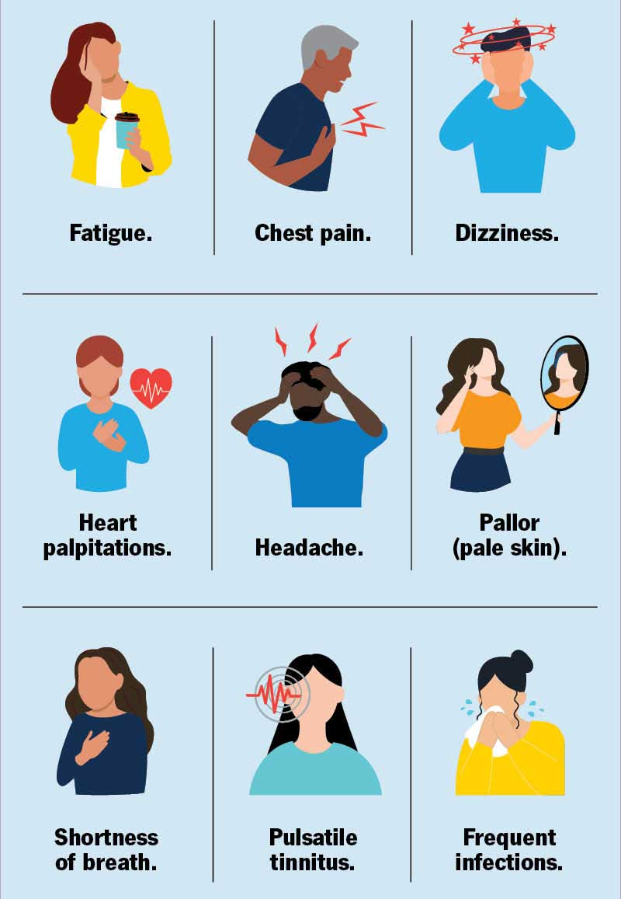
SIGNS AND SYMPTOMS
Megaloblastic anemia symptoms are similar to symptoms of other types of anemia:
Fatigue: This is feeling too tired to complete daily activities.
Weakness: You may feel as if you don’t have enough muscle strength to get around easily or manage daily activities.
Pallor: Your skin is more pale than usual.
Shortness of breath (dyspnea): You may feel as if you can’t catch your breath or take a deep breath.
Feeling light-headed or woozy: Feeling as if you may faint.
Vitamin B12 deficiency sometimes affects your nerves, causing symptoms like tingling sensations, loss of sensation or muscle weakness.

Slide 27
PREVENTION AND TREATMENT
There are several ways to reduce your risk:
Try to eat a balanced diet that emphasizes foods containing vitamin B12 and vitamin B9.
Drink alcohol in moderation. Regular alcohol consumption may affect your digestive system and keep your body from absorbing vitamin B12.
Foods with vitamin B12
Animal food products: Red meat, fish, poultry, eggs, milk and other dairy products all contain vitamin B12.
Fortified foods: Fortified foods are foods that have certain vitamins and nutrients added to them that they don’t naturally have. Fortified foods include certain breakfast cereals, nutritional yeast, plant milk and certain bread. Be sure to check the food label (nutritional facts) to confirm the food is fortified with vitamin B12.
Foods with vitamin B9
Fruits and Vegetables: Dark green leafy vegetables, peas, beans and legumes, Citrus fruits.
Animal food products: Liver, seafood, meat and poultry.
Eggs and dairy.
Fortified foods: Certain breads, flour, pasta, rice and cereal contain folic acid. Be sure to check the food label (nutritional facts) to confirm the food is fortified with vitamin B9.

Slide 28
CASE STUDIES
Patient Profile: A 22-year-old female college student presents with fatigue, weakness, and occasional tingling in her hands. She follows a strict vegan diet and reports limited intake of fortified foods.
Diagnosis: Clinical evaluation reveals signs of anemia and neurological symptoms. CBC shows macrocytic anemia with elevated MCV. Serum vitamin B12 levels are low, confirming megaloblastic anemia due to vitamin B12 deficiency.
Prognosis: The patient is expected to improve with treatment, but without dietary changes, there is a risk of persistent neurological complications.
Treatment and Intervention: Prescribed oral vitamin B12 supplementation (1,000 mcg daily) and dietary counseling to incorporate fortified plant-based foods and other sources of B12. Follow-up is arranged to assess improvement in symptoms and dietary adherence.
Patient Profile: A 60-year-old female presents with fatigue, pallor, and shortness of breath. She has a history of gastrointestinal issues, including chronic atrophic gastritis.
Diagnosis: Clinical examination shows signs of anemia, including an enlarged spleen. Complete blood count (CBC) reveals macrocytic anemia with a high mean corpuscular volume (MCV). Serum vitamin B12 and folate levels are low, confirming megaloblastic anemia.
Prognosis: With prompt treatment, the patient is expected to show significant improvement in symptoms and hematological parameters within weeks. If untreated, complications may include neurological issues due to prolonged B12 deficiency.
Treatment and Intervention: Initiated with vitamin B12 injections (1,000 mcg intramuscularly once a week for four weeks) and oral folate supplementation (1 mg daily). Dietary counseling is provided to increase intake of B12-rich foods such as meats, dairy, and fortified cereals. Follow-up appointments are scheduled to monitor hematological recovery.

Slide 29
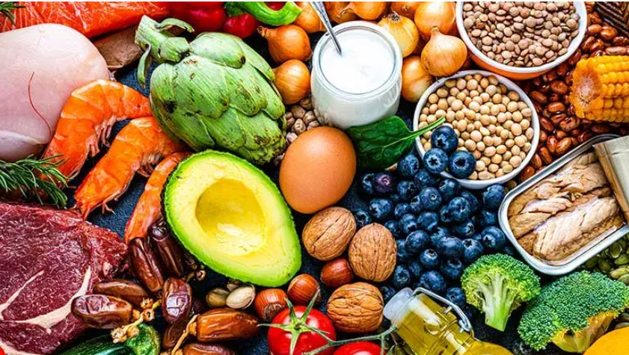
CONSLUSION
In conclusion, water-soluble vitamin deficiencies pose significant health risks that can lead to various complications, including fatigue, anemia, and skin issues.
These vitamins are essential for critical bodily functions, and their absence can severely impact overall well-being. Preventing deficiencies through a balanced diet rich in fruits, vegetables, whole grains, and protein is vital, particularly for vulnerable populations.
Early diagnosis and appropriate supplementation are crucial for reversing deficiencies and safeguarding health. By increasing awareness and understanding of the importance of water-soluble vitamins, we can empower individuals to make informed dietary choices that support long-term health.

Slide 30


THANKS
Prof. Dr. Asif Ahmad, Director Institute of Food and Nutritional Sciences, PMAS-Arid Agriculture University Rawalpindi
asifahmad_1@yahoo.com

