Slide 1
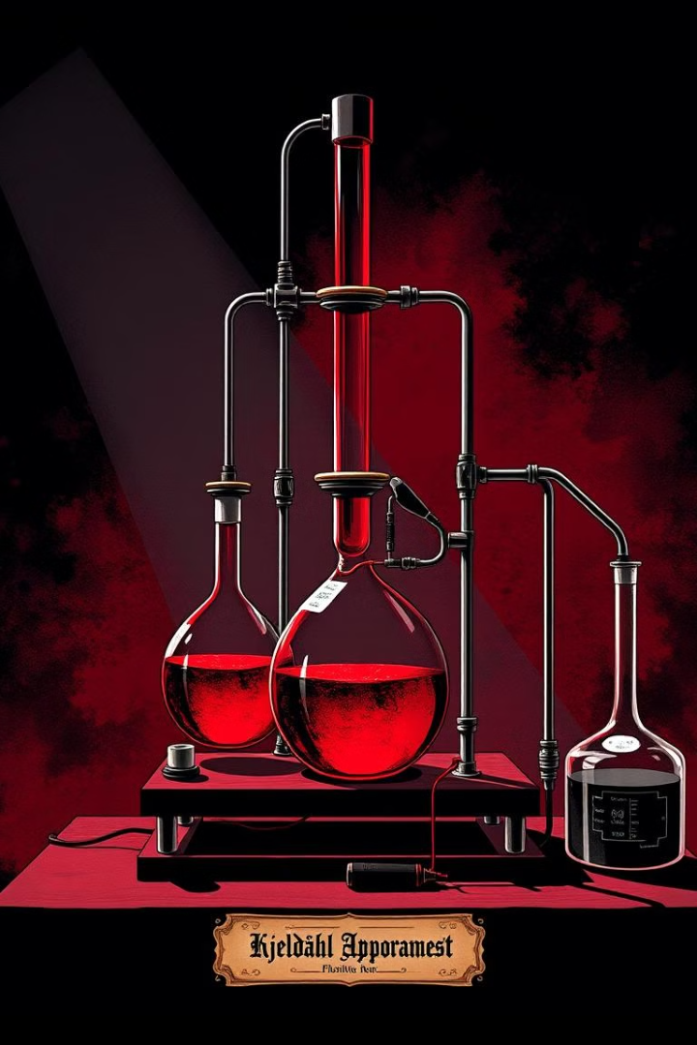

Advanced Theory of the Kjeldahl Method: Optimization Techniques
The Kjeldahl method is a widely used technique for determining the nitrogen content of various samples, including food, agricultural products, and environmental samples.
Prof. Dr. Asif Ahmad
Director (Institute of Food & Nutritional Sciences)
AA

Slide 2
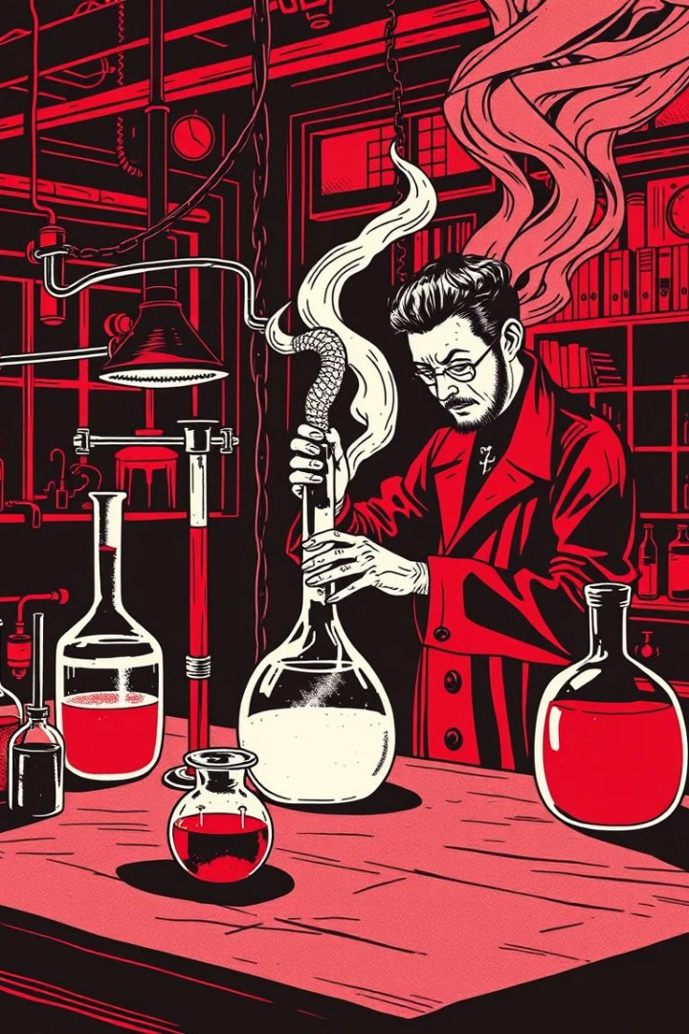
Introducing Kjeldahl method and Historical advancement
1
Early 19th Century
The method was developed by Johan Kjeldahl in 1883, initially for analyzing the nitrogen content of proteins in food.
2
20th Century
The Kjeldahl method was refined and standardized by several scientists, leading to its widespread adoption in various fields.
3
21st Century
Automation and semi-automation of the Kjeldahl method have been introduced, leading to increased efficiency and accuracy.

Slide 3
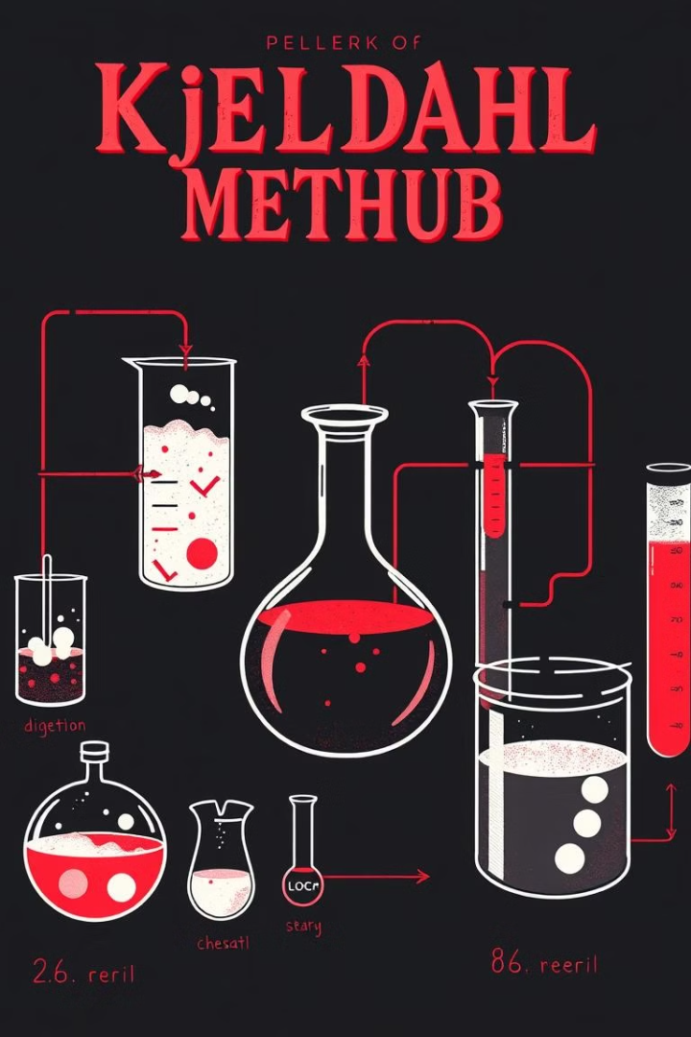



Principles of nitrogen determination: Digestion, Distillation and Titration stages
Digestion
Organic nitrogen is converted to ammonia by heating with concentrated sulfuric acid, a catalyst (e.g., mercury, copper, or selenium), and potassium sulfate.
Distillation
Ammonia is distilled from the sample by adding a strong base, usually sodium hydroxide, and then collected in a solution of a weak acid (e.g., boric acid).
Titration
The ammonia collected is then titrated with a standard solution of an acid (e.g., hydrochloric acid) to determine the amount of nitrogen present.

Slide 4
Factors affecting Kjeldahl analysis
Sample Composition
Reagent Purity
Temperature & Time
The presence of certain compounds, like nitrates or nitrites, can interfere with the analysis.
Impurities in reagents can lead to inaccurate results. Using high-quality reagents is crucial.
Digestion and distillation times, as well as reaction temperatures, must be strictly controlled for reliable results.

Slide 5
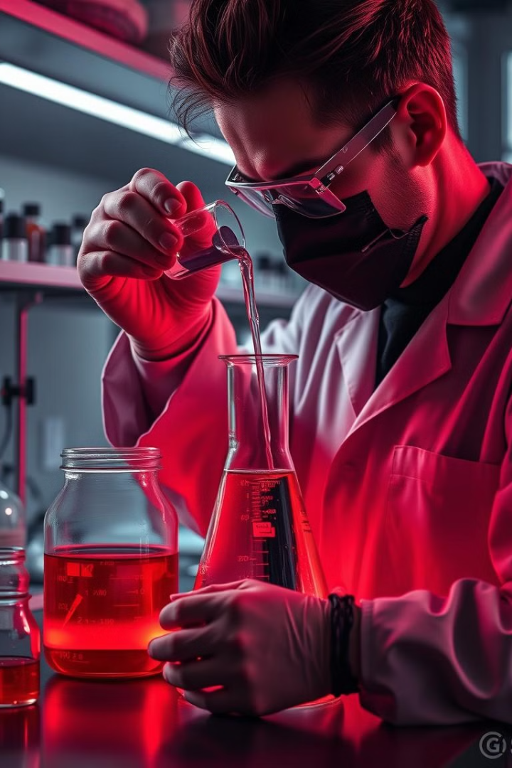
Sample preparation and digestion
1
Homogenization
2
Weighing
Samples are thoroughly mixed to ensure a representative portion is taken for analysis.
The sample is weighed accurately and transferred to the digestion flask.
3
Digestion
4
Clear Solution
The sample is heated with concentrated sulfuric acid, a catalyst, and potassium sulfate to convert organic nitrogen to ammonia.
The digestion process is complete when the solution is clear, indicating that the organic matter has been broken down.

Slide 6
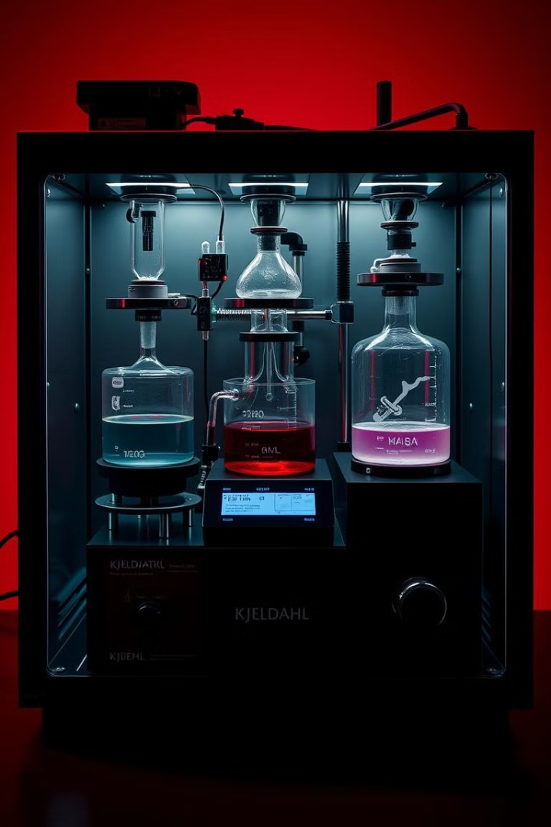




Automation and semi-automation
Increased Efficiency
Improved Accuracy
Automated systems can significantly reduce the time and labor required for Kjeldahl analysis.
Automated systems can provide more consistent results by reducing human error.
Data Collection
Higher Throughput
Automated systems can automatically record and store data, making it easier to track results and analyze trends.
Automated systems can handle a larger number of samples in a shorter amount of time.

Slide 7
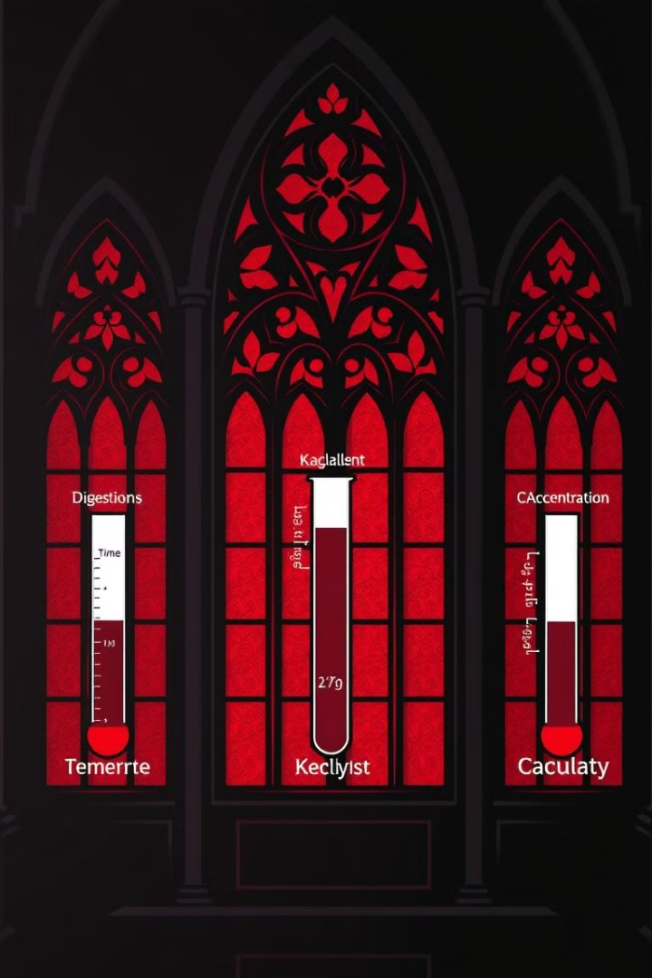
Optimized parameters:
Catalyst Selection
Reagent Concentration
Different catalysts have varying effects on digestion efficiency and can affect the accuracy of the analysis.
Optimizing the concentrations of sulfuric acid, potassium sulfate, and other reagents is crucial for efficient digestion.
Digestion Time & Temperature
Longer digestion times and higher temperatures can lead to greater nitrogen recovery, but must be balanced to prevent loss of ammonia.

Slide 8
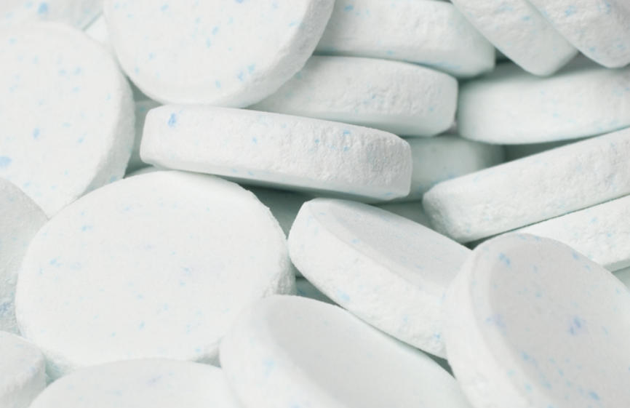
Optimization of reagents and Catalysts
Reagent Concentration
Catalyst Selection
Mercury was long used as the best catalyst but is today not used because of environmental and health concerns. Selenium and copper are the catalysts of choice, though for certain applications with titanium has found some usage. Today selenium or copper are used as catalysts in more than 90% of the Kjeldahl digestions being performed all over the world.
Speed of the digestion can be improved by catalysts. Potassium sulfate is added in order to increase the boiling point of sulfuric acid and catalysts accelerate oxidation and make the digestion complete. Using catalyst allows an increase of temperature to 420ºC, reducing digestion time to around one hour
Digestion Time & Temperature
Most laboratories use premixed Kjeldahl catalyst tablets to save time and reduce the risk for errors. A typical tablet contains 97-99% salt and 1-3% catalyst or mixture of catalyst.

Slide 9
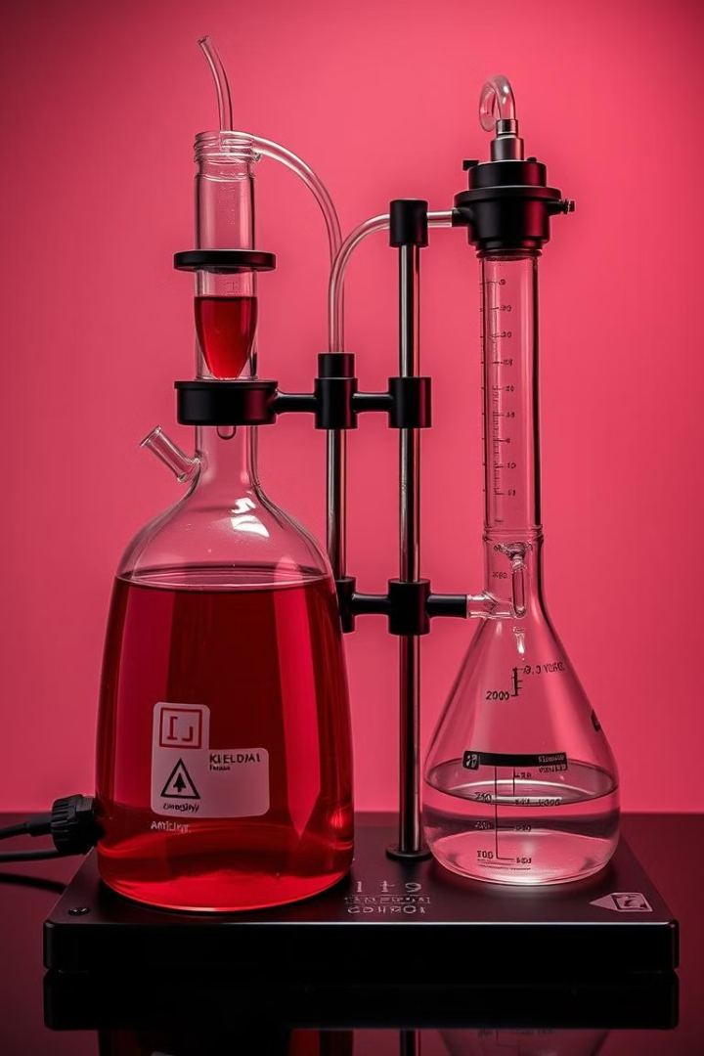
Calculations
Digestion and Distillation
The ammonia is distilled from the digested sample using a strong base.
Titration
The ammonia collected in the receiving flask is titrated with a standard solution of an acid.
Calculation
The amount of nitrogen in the sample is calculated based on the volume of acid used in the titration, according to a specific formula.
NH3 has an equivalent mass of 17g/eq. And one equivalent weight of NH3 contains 14 grams of nitrogen. Consequently, the following formula can be used to calculate the nitrogen percentage:
Nitrogen estimation using the Kjeldahl technique equals 1.4V× NW, where W equals the sample’s weight (in grams).
V = Acid used in titration (in ml)
N = normality of standard acid

Slide 10
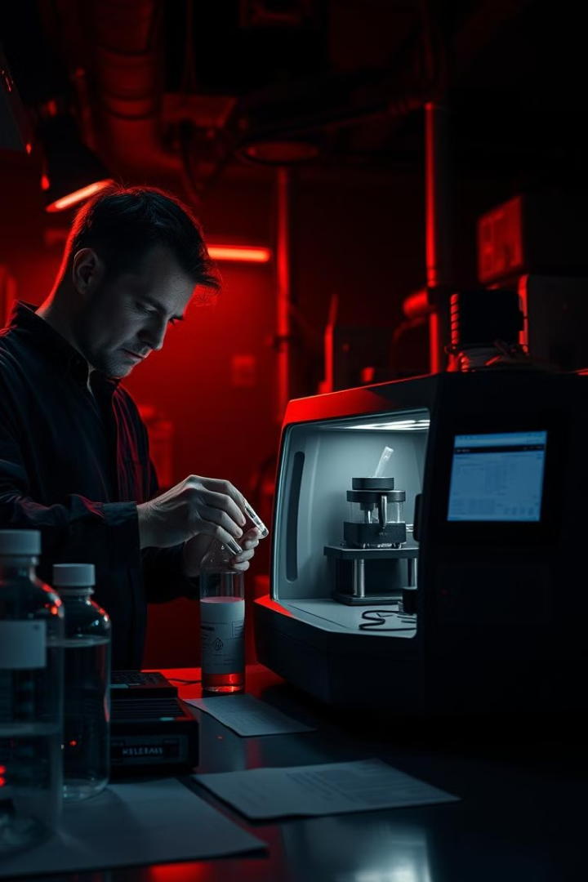
Validation and quality assurance
1
Reference Materials
2
Standard Operating Procedures (SOPs)
Certified reference materials (CRMs) are used to verify the accuracy and precision of the method.
SOPs ensure consistency and reproducibility of the analysis, minimizing variation between operators and analyses.
3
Regular Calibration
4
Statistical Analysis
Calibration of the instruments and reagents is performed regularly to maintain accuracy and reliability.
Statistical methods are used to assess the accuracy, precision, and repeatability of the results.

Slide 11

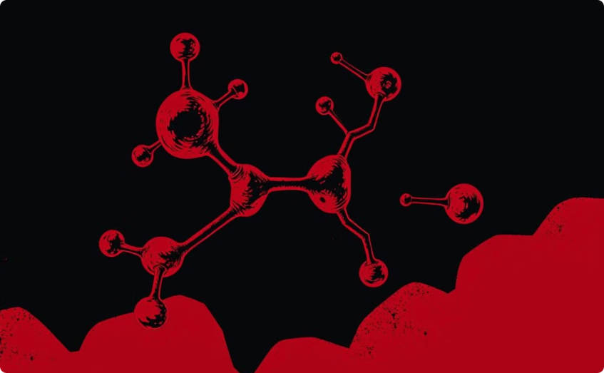
Applications(Food and Agriculture) and limitations
Food and Agriculture
Protein Content Analysis
The Kjeldahl method is widely used to determine the protein content of various food and agricultural products, which is crucial for nutritional labeling and quality control.
The Kjeldahl method provides a reliable measurement of the total nitrogen content, which is directly related to the protein content in most samples.

Slide 12
chemistry during Digestion, Distillation and Titration
Chemical Reactions during
digestion
Chemical Reaction in Distillation
1
During digestion, organic material is hydrolyzed in the presence of sulfuric acid, converting nitrogen into ammonium sulfate for quantification.
2
The particular process is a combination of boiling and condensation. An excess of base is added to the formed solution to convert the ammonium sulfate solution to NH3 gas..
3
Titration
To finally quantify the nitrogen present in the sample, the obtained product from the previous process is titrated in order to give the final required results.
Digestion:
Organic (C, H, N) + H₂SO₄ → digest Cu²⁺ + (NH₄)₂SO₄
Distillation:
(NH₄)₂SO₄ + 2NaOH → Na₂SO₄ + 2H₂O + 2NH₃ And, NH₃ + HCl → NH₄Cl
Titration:
B(OH)₂ + H₂O + Na₂CO₃ → NaHCO₃ + CO₂ + H₂O

Slide 13
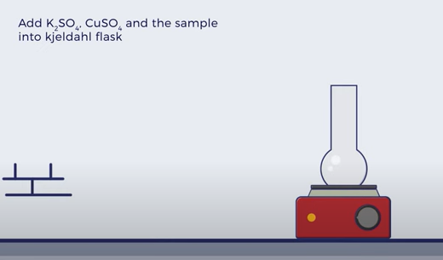
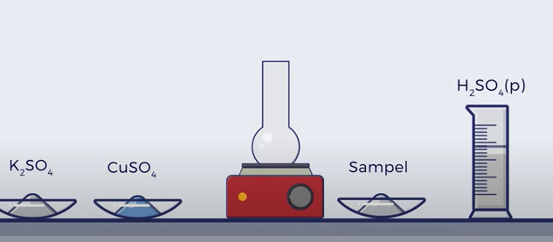
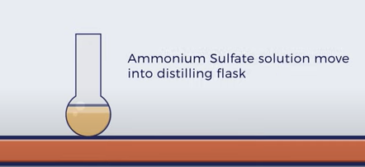
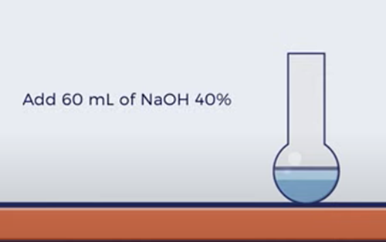
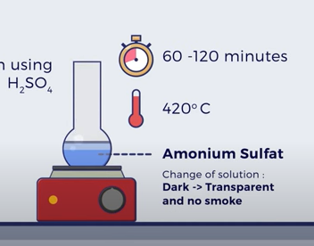
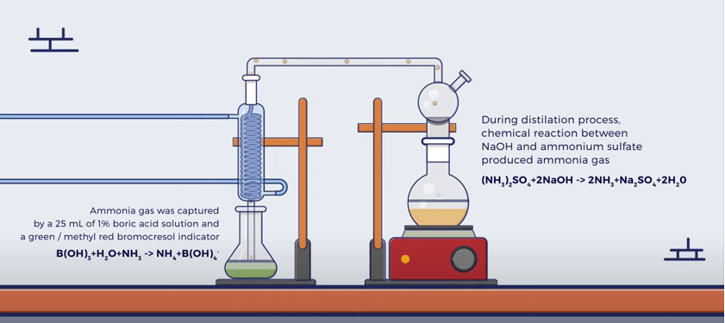
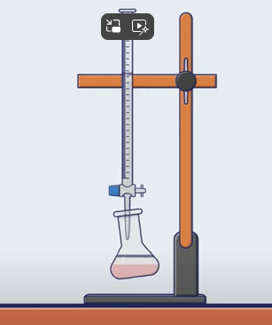

Slide 14
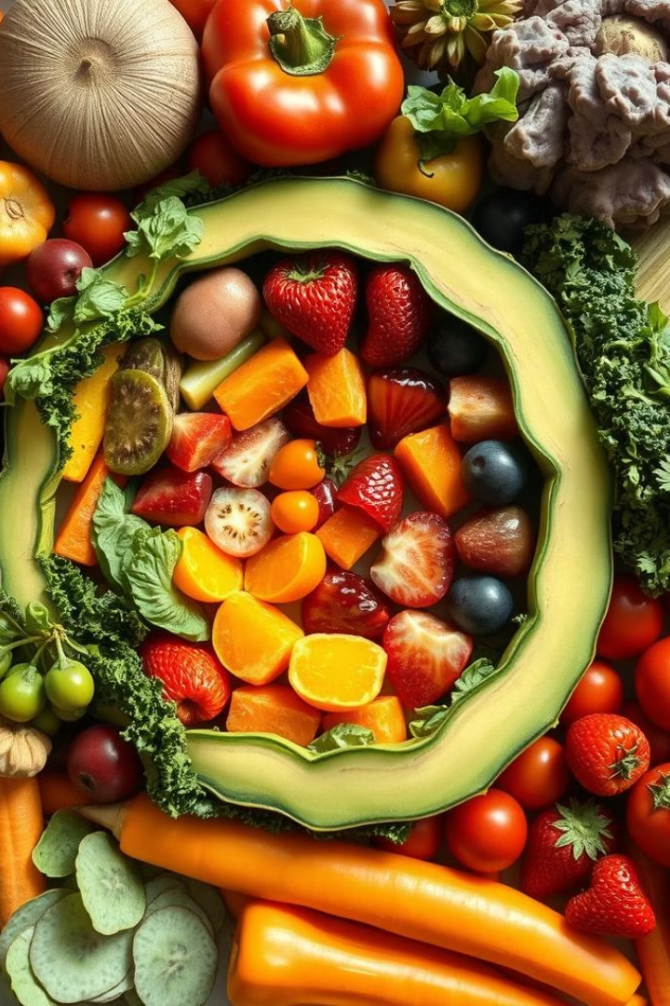
THANKS
Prof. Dr. Asif Ahmad, Director Institute of Food and Nutritional Sciences, PMAS-Arid Agriculture University Rawalpindi
asifahmad@uaar.edu.pk
Weblink: https://shorturl.at/nmsO0

Slide 15
