Slide 1
Metabolic Pathways
Dr. Asif Ahmad

Slide 2
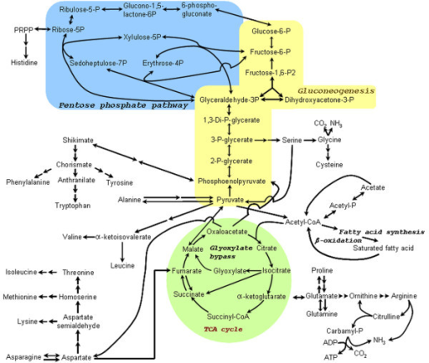

Slide 3
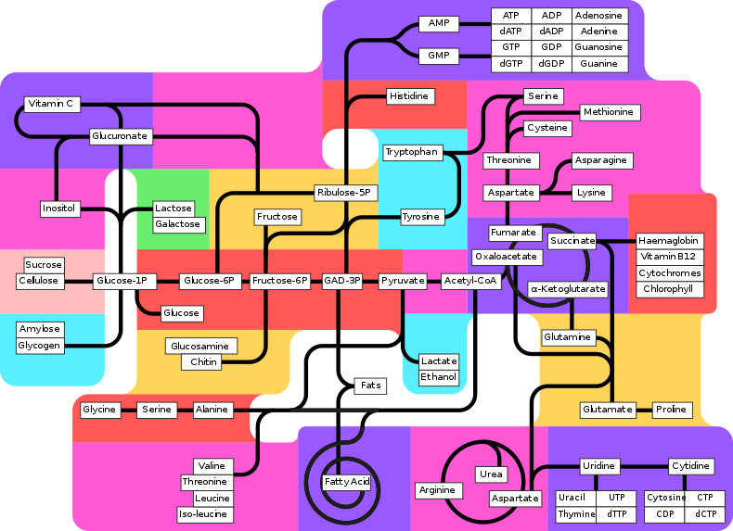

Slide 4
