Slide 1

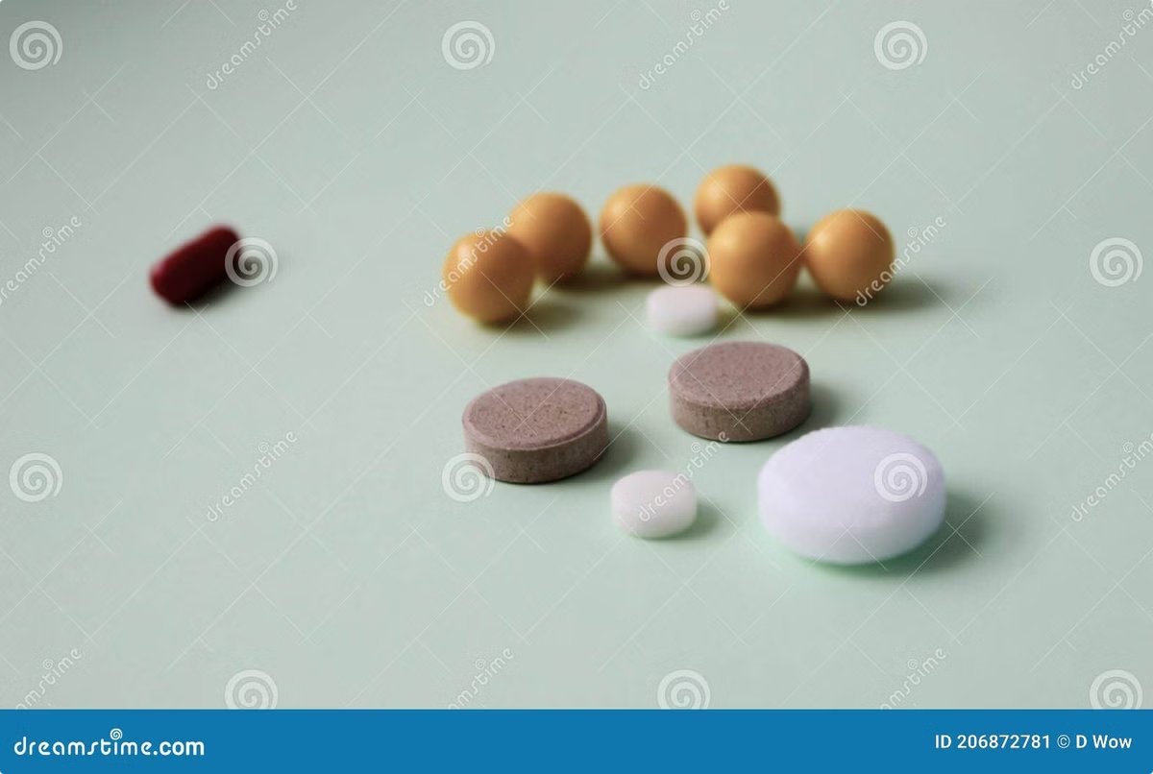

Water-Soluble Vitamins (Part 3)
This section delves into the chemical structures and coenzyme functions of key water-soluble vitamins. We will explore the crucial roles of Vitamin B5, B6, B7, B9, and B12 in various metabolic processes.
AA
by Asif Ahmad

Slide 2

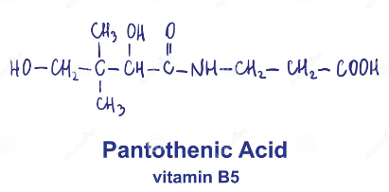
Chemistry and structure of Vitamin B5 (Pantothenic Acid)
Pantothenic Acid
Structure
It's a water-soluble vitamin, also known as Vitamin B5. It's essential for many metabolic processes, including the synthesis of Coenzyme A.
The pantothenic acid molecule is composed of a pantoic acid moiety and a beta-alanine moiety. This structure allows it to participate in a wide range of biochemical reactions.
Coenzyme A
It's a key component of Coenzyme A, which plays a vital role in energy production, carbohydrate metabolism, and fatty acid synthesis.

Slide 3
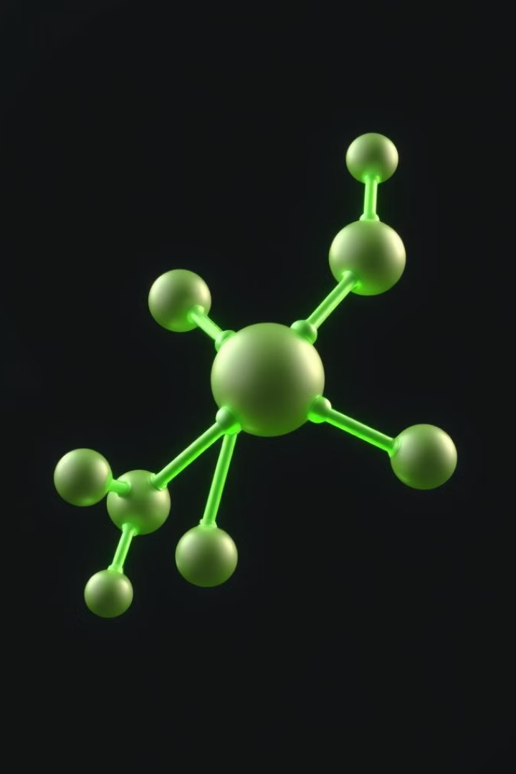
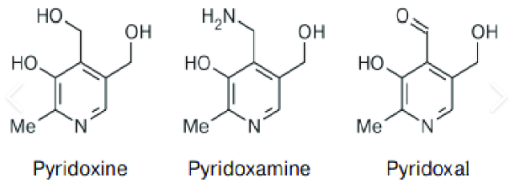
Chemistry and structure of Vitamin B6 (Pyridoxine)
1
Pyridoxine
2
Structure
It's a water-soluble vitamin, also known as Vitamin B6. It plays a crucial role in protein metabolism, neurotransmitter synthesis, and red blood cell formation.
The pyridoxine molecule consists of a pyridine ring with a hydroxymethyl group at the 4-position, a hydroxyl group at the 5-position, and a methyl group at the 2-position.
3
Coenzyme Forms
Pyridoxine is converted into its active coenzyme forms, pyridoxal phosphate (PLP) and pyridoxamine phosphate (PMP), which are essential for various metabolic processes.

Slide 4
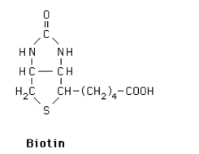

Vitamin B7 (Biotin) - Chemistry, Structure and Coenzyme Roles
1
Biotin
It's a water-soluble vitamin, also known as Vitamin B7. It's essential for various metabolic processes, including carbohydrate metabolism, fatty acid synthesis, and amino acid metabolism.
2
Structure
The biotin molecule has a unique structure, consisting of a ureido ring attached to a valeric acid side chain, with a sulfur atom linking the two components.
3
Coenzyme Role
It serves as a coenzyme in carboxylase enzymes, which are involved in reactions that add carbon dioxide to molecules.

Slide 5
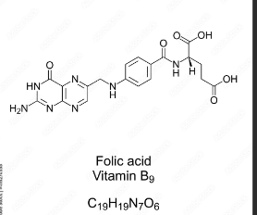
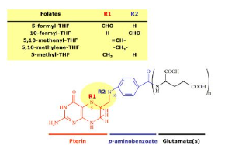
Vitamin B9 (Folate) - Chemistry, Structure and Coenzyme Functions
Structure
Coenzyme Forms
The folate molecule consists of a pteridine ring, a para-aminobenzoic acid (PABA) moiety, and one or more glutamate residues.
Folate is converted into its active coenzyme forms, such as tetrahydrofolate (THF), which play crucial roles in one-carbon metabolism.

Slide 6
Vitamin B12 (Cobalamin) - Chemistry, Structure and Coenzyme Roles
Structure
Coenzyme Forms
Importance
The cobalamin molecule has a complex structure, consisting of a corrin ring, a cobalt atom, a nucleotide, and a propanolamine group.
Cobalamin is converted into its active coenzyme forms, such as methylcobalamin and 5'-deoxyadenosylcobalamin, which are essential for DNA synthesis, cell division, and nerve function.
Vitamin B12 is crucial for the production of red blood cells and the maintenance of a healthy nervous system.

Slide 7





Coenzyme Functions of Water-Soluble Vitamins, explain through Pictures
Tetrahydrofolate (THF)
It's essential for one-carbon metabolism, involved in DNA synthesis, amino acid metabolism, and red blood cell formation.
Pyridoxal Phosphate (PLP)
It's a coenzyme for aminotransferases, decarboxylases, and other enzymes involved in protein metabolism, neurotransmitter synthesis, and glycogen metabolism.
Coenzyme A (CoA)
It plays a vital role in energy production through the citric acid cycle, fatty acid metabolism, and other metabolic pathways.
Biotin
It's a coenzyme for carboxylases, enzymes that catalyze the addition of carbon dioxide to molecules.
Cobalamin (B12)
It's essential for the synthesis of myelin, a fatty substance that insulates nerve fibers. B12 deficiency can lead to nerve damage.

Slide 8


Deficiency Issues with Vitamins B5, B6, B7, B9, B12
Vitamin
Deficiency
Symptoms
B5
Pantothenic Acid Deficiency
Fatigue, weakness, tingling sensations, digestive problems
B6
Pyridoxine Deficiency
Anemia, nerve damage, seizures, skin problems, depression
B7
Biotin Deficiency
Skin rash, hair loss, fatigue, depression, muscle pain
B9
Folate Deficiency
Anemia, fatigue, neural tube defects in babies, heart disease
B12
Cobalamin Deficiency
Anemia, fatigue, nerve damage, memory problems, depression

Slide 9





Symptoms and Health Impacts of Vitamin Deficiencies
Fatigue and Weakness
Headaches and Migraines
Deficiencies can lead to decreased energy production, impacting physical and mental function.
Vitamin deficiencies can disrupt neurotransmitter production and function, leading to headaches and migraines.
Cognitive Decline and Depression
Heart Health Issues
Vitamin B9 deficiency can increase the risk of heart disease, while B12 deficiency can lead to anemia and heart palpitations.
Some deficiencies can affect brain function, leading to memory issues, concentration problems, and even depression.

Slide 10

Dietary Sources and Supplementation of Water-Soluble Vitamins
1
Dietary Sources
2
Supplementation
3
Importance of Balance
Water-soluble vitamins are readily available in a variety of fruits, vegetables, and whole grains.
Supplements can be helpful in cases of deficiency or inadequate dietary intake. Consult with a healthcare professional for appropriate supplementation.
Maintaining a balanced diet rich in fruits, vegetables, and whole grains is essential for optimal health and well-being.

Slide 11
Further Reading
B Vitamins: Types, Benefits and Side Effects
Vitamin B complex: Structure, coenzyme forms and Biological roles - Online Biology Notes

Slide 12


THANKS
Prof. Dr. Asif Ahmad, Director Institute of Food and Nutritional Sciences, PMAS-Arid Agriculture University Rawalpindi
asifahmad_1@yahoo.com

