Slide 1
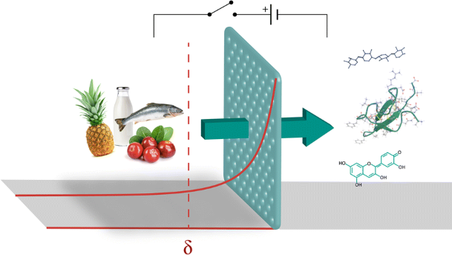
MEMBRANE PROCESSING TECHNOLOGY
DR. ASIF AHMAD
FT 722

Slide 2
MEMBRANE PROCESSING TECHNOLOGY
Among the wide range of the available separation processes, membrane technology is defined as abroad term that contains several separation processes on molecular level i.e., membrane separation usually applied on10 µm size molecules. It is among the vital fields of food science
A set of specialized equipment is used for a particular membrane process that enable it to show its typical separation characteristics as well as, make it suitable for specific desired single or multiple applications. Water industry (drinking water + wastewater processing + water desalination)has the largest commercial market for membranes worldwide. In last 20-25 years, the market volume of different membranes has increased about€800–850 million in food industries and the same is now stands as the second largest commercial market for membrane on global basis

Slide 3
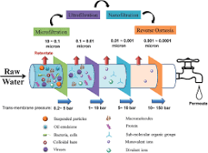
DIFFERENT TYPES OF MEMBRANES
Membrane separation is performed above the atmospheric pressure (that varies with particular membrane process) in a closed system so, these processes are known as pressure-driven membrane processes.
Four membrane processes (in their ascending pore diameter) are
Reverse osmosis (RO)
Nanofiltration (NF)
Ultrafiltration (UF)
Microfiltration (MF)
Electrodialysis
UF systems as well as UF membranes have the maximum share (35%) in global membranes market followed by the share of MF systems and membranes (33%) and NF/RO systems and membranes (30%). Membrane contactors (MC), Electrodialysis (ED) and Pervaporation (PV) are the other membrane processes but contribute only for 2% share in total membranes market

Slide 4
Classical Membranes, Their Types and Design:
Membranes are semi-permeable barriers, used to separate two phases, which restrict the transport of various substances in permeate and retentate streams in a specific way i.e., based on particle size, shape, electric charge etc.
The separation efficiency of a particular membrane is usually affected by different processing factors like feed composition, pH, temperature, pressure, feed flow as well as interactions between feed component and membrane surface

Slide 5
Membrane Processing in Food Processing
Availability of few food materials in naturally pure form underlines the importance of different separation and purification processes in transforming food or food substances into safe and direct consumable form.
For selected applications, membrane processing is superior to other conventional methods owing to its inherent advances such as low energy consumption, fewer and mild processing steps, greater separation efficiency, improved final product quality, eco-friendly and ‘cleaner’ processing i.e., better quality products at lowest cost with highest environment protection through minimum/low waste generation.
Now a days, these processes have been become an integral part of different industries like functional food and nutraceuticals industry, agricultural, dairy and food and bio-product industries

Slide 6
1. REVERSE OSMOSIS
Reverse osmosis is a membrane process widely used in water purification process. It is a concentration process. It is used to remove and lessen the number of undesirable molecules, ions, larger sized molecules from drinking water. This process is also used in desalinating sea water to drinking water and landfill leachate purification.
This process concentrates on the concentration of solvent and not solute. This method can also be named as forced osmosis. But in case of reverse osmosis process, the solvent is forced to move from a lower solvent concentration to a higher solvent concentration through a selectively permeable membrane under the influence of an external pressure and this external pressure should be higher than that of osmotic pressure. The membrane pore size is usually very small due to which only water is mostly able to pass through them. The membrane used can be a single membrane or a composite membrane.
This process is usually carried out at temperatures ranging from 40-80 ᵒC at 700 psig and 100 MW cutoffs. The most widely used membrane is cellulose acetate.

Slide 7
APPLICATIONS IN FOOD INDUSTRY
The food company utilize their reverse osmosis water for three different purposes:
Food production
Food production equipment
Cooling towers
The application of reverse osmosis in the food industry is a clear example where it is widely used; from concentrates of egg whites, fruit juices and gelatins, to removal of bacteria and brine in meat or alcohol removal from spirits.

Slide 8
ADVANTAGES AND LIMITATIONS
Examples: fruit juice concentration, dairy product desalination
Advantages: high solute concentration, energy efficiency
Limitations: fouling, potential loss of volatile compounds

Slide 9
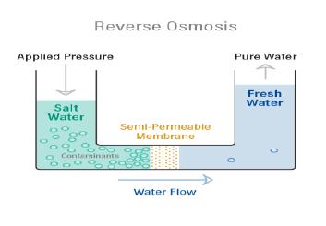
FIGURE

Slide 10
2. ULTRA FILTRATION
It is a separation and filtration process. In this process the membrane pore size is larger than compared to RO allowing some selected solute particles to move across the membrane along with water.
This process is used in dairy industry in ultrafiltration of skim milk. It allows minerals and lactose to pass through and retains proteins and fats. It also uses external pressure to carry out the filtration process. The membrane used here is generally polysulfone membranes.
This process is carried out at a temperature ranging from 50-70 ᵒC at 40 psig and 10,000 MW cutoffs. Diafiltration is an advanced type of ultrafiltration.

Slide 11
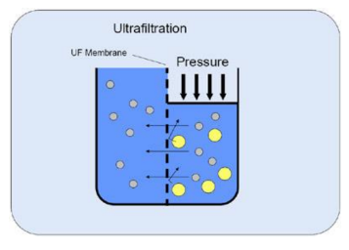
FIGURE

Slide 12
APPLICATIONS IN FOOD INDUSTRY
Applications: concentration, fractionation, and protein separation
In the dairy industry, ultrafiltration is used for a wide range of applications such as protein standardization of cheese milk, fresh cheese production, protein concentration, and decalcification of permeates, as well as lactose reduction of milk.
Examples: milk concentration, whey protein fractionation
Food UF applications include concentration of proteins (enzymes, milk proteins, egg whites), starch, and pectin; clarification/stabilization of fruit juices and wine (removal of haze components); removal of cellular debris and bacteria from beer; removal of polysaccharides, proteins, and colloidal impurities in sugar refining; and sterile filtration of biologicals (removal of bacteria and viruses).

Slide 13
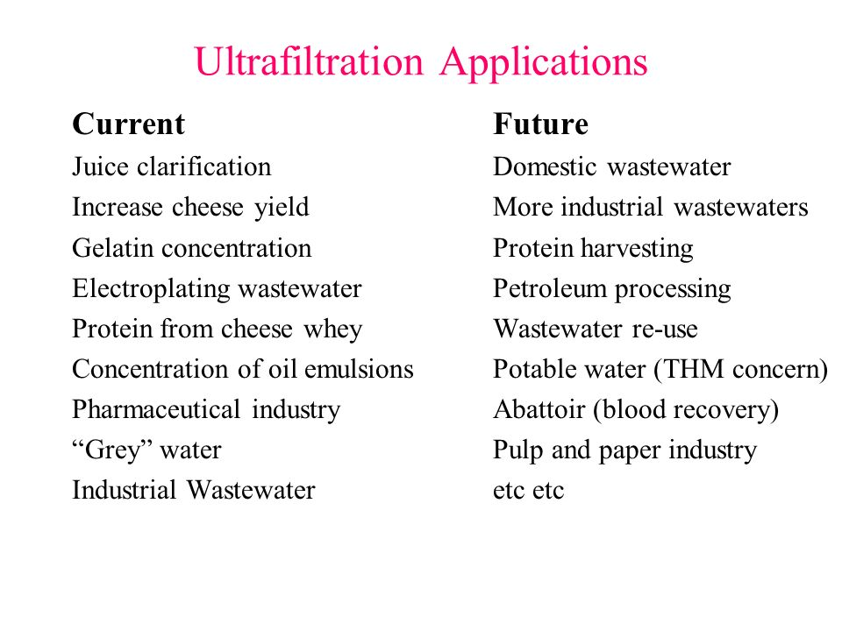
CURRENT AND FUTURE PROSPECTS

Slide 14
ADVANTAGES AND LIMITATIONS
Advantages: selective removal of macromolecules, improved texture and stability
Limitations: fouling, limited removal of smaller solutes

Slide 15
3. MICROFILTRATION
Microfiltration is a process of separating large molecules as well as microbes from the liquid. It can be done with combining ultrafiltration process prior to microfiltration in order to remove suspended particles and carry out the process efficiently.
It is used in secondary wastewater effluent treatment, cold sterilization, dairy processing, and petroleum refining, clarification, separation and purification process.

Slide 16
Microfiltration in Food Processing and Preservation
Applications: clarification, particulate removal, and sterilization
MF is used in the dairy industry for making low-heat sterile milk.
Microfiltration in particular can be used to remove large solids and process gluten.
Beverage sterilization – Microfiltration can be used in place of heat to remove microbes and suspended solids found during the sterilization of beverages.
Examples: juice clarification, beer filtration

Slide 17
A. Milk industry
The removal of bacteria and spores from milk to extend its shelf-life by MF is an alternative way to ultra-pasteurization. In this approach, the organoleptic and chemical properties of the milk are unaltered.
The first commercial system of this so- called Bactocatch was developed by Alfa Laval and marketed by Tetra Pak under the name Tetra Al cross-Bactocatch. In this process, the raw milk is separated into skim milk and cream. The resulting skim milk is micro filtered using ceramic membranes with a pore size of 1.4 µm at constant Trans membrane pressure (TMP).
Thus, the retentate contains nearly all the bacteria and spores, while the bacterial concentration in permeate is less than 0.5 % of the original value in milk. The retentate is then mixed with a standardized quantity of cream. Subsequently, this mix is subjected to a conventional high heat treatment at 130 °C for 4 s and reintroduced into the permeate, and the mixture is then pasteurized. Since less than 10 % of the milk is heat treated at the high temperature, the sensory quality of the milk is significantly improved.
MF for the removal of bacteria and spores can be further applied in the production of other dairy products. In the production of cheese, the use of low bacterial milk improves also the keeping quality of cheese due to the removal of spores, thus eliminating the need of additives (e.g., nitrate). While in the production of whey protein concentrates (WPC) and isolates (WPI), this MF concept is used to remove bacteria and spores giving a high-quality product.

Slide 18
B. Beverage industry
In the classical beer production process as an alternate, reverse osmosis is used for beer de-alcoholisation prior to its clarification by microfiltration before pasteurization and bottling MF now successfully employed for beer clarification i.e., for removal of yeasts, microorganisms and for haze without adversely affecting its sensorial attributes

Slide 19
Advantages
Advantages include retention of flavor and nutrients, extended shelf life

Slide 20
Limitations
Limitations include potential fouling, limited removal of dissolved compounds
The factor that limits microfiltration and other membrane process is fouling.
Fouling is the accumulation of separated particles that accumulate over the semi-permeable membrane with time, which causes less efficient separation. To resolve this factor, either the semi-permeable membrane should be replaced with a new one or treat the semi-permeable membrane with some chemicals to remove the built up layer and reuse the membrane.

Slide 21
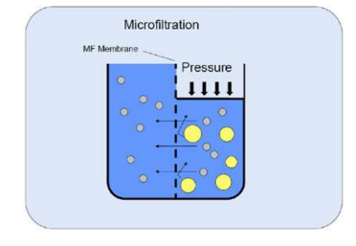
FIGURE

Slide 22
4. NANOFILTRATION
Nanofiltration (NF) is a pressure-driven membrane operation with separation characteristics between those of reverse osmosis and ultrafiltration widely used for several applications such as water softening and wastewater treatment.
With the increased demand for products with greater nutritional value and environmentally friendly processing procedures, NF has become a reliable and techno-economically attractive operation in the food processing industry for the fractionation, concentration, and purification of different products and byproducts.

Slide 23
Definition
Nanofiltration (NF) is a pressure driven membrane process applied in the area between the separation capabilities of reverse osmosis (RO) membranes and ultrafiltration (UF) membranes, that is, in the separation of ions from solutes such as small molecules of sugars. Nanofiltration is often used where the divalent ions (Ca, Mg and ions of plating industry) have to be removed

Slide 24
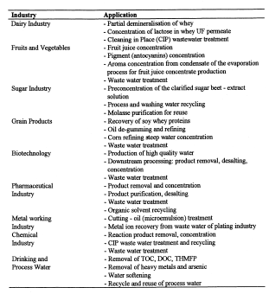
APPLICATIONS IN FOOD INDUSTRY

Slide 25
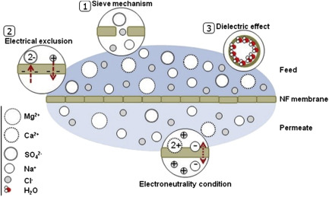
Nanofiltration process

Slide 26
APPLICATIONS OF NANOFILTRATION IN FOOD INDUSTRY
Applications: color and flavor removal, desalination
NF finds its applications in concentrating, fractionating and/or purifying various edible products from the dilute streams thereby enhancing process efficiency to a great extent. It can significantly reduce levels of dissolved solids, colors, organics, hardness, turbidity, divalent and multivalent ions and facilitate the required desalting of permeate streams.
Food-processing industries dealing with fruit-juice, beverage, dairy, sugar, lactic acid, and vegetable oils successfully employ NF in a myriad of applications. It is also used in wastewater treatment, recovery of value-added components and solvents from food waste, deacidification and nutritional enrichments of certain food products.
Examples: sugar decolorization, wine and juice deacidification

Slide 27
ADVANTAGES AND LIMITATIONS
Advantages include low thermal damage to the product, higher aroma retention, lower energy consumption, and low maintenance costs.
It ensures selective removal of divalent ions, improved product quality
Limitations: limited retention of monovalent ions, fouling

Slide 28
5. ELECTRODIALYSIS
Electrodialysis is a membrane technology that is used increasingly in the food sector to concentrate, purify, or modify the properties of foods.
Electrodialysis can be performed in a dilution-concentration mode (conventional electrodialysis) when anion exchange and cation exchange membranes are used, or for pH modification when bipolar membranes are used (electrodialysis with bipolar membranes).

Slide 29
ADVANTAGES
Advantages of the technology include a modular design, product purification with no dilution, efficiency, pH variation and adjustment with no addition of external solutions, and the lack of requirements for additional thermal treatment.

Slide 30
APPLICATIONS IN FOOD INDUSTRY
Today, the most important use of conventional electrodialysis is the desalination of brackish water for the production of potable water. However, other applications are gaining increasing importance including large-scale industrial installations in the food industry, whey and molasses demineralization, tartaric stabilization of wine, and deacidification of fruit juices).
Electrodialysis using bipolar membranes is also used at the industrial scale to produce organic acid.
Other applications currently under development that have potential for future industrial applications include the production of plant protein isolates, production of acid caseinates, fractionation of whey proteins, regeneration of wastewater resulting from food processing, and separation of peptides using an ultrafiltration–electrodialysis integrated process.

Slide 31
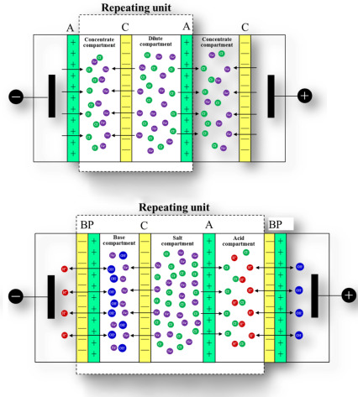
FIGURE

Slide 32
Membrane Materials and Configurations for Food Processing
Membrane materials suitable for food applications
Polymeric membranes (e.g., polyamide, polyethersulfone)
Ceramic membranes
B. Membrane configurations in food processing
Spiral-wound membranes
Hollow fiber membranes

Slide 33
Benefits and Challenges of Membrane Processing in Food Industry
Benefits
Preservation of sensory and nutritional attributes
Extended shelf life and improved food safety
Reduction in the use of additives and thermal processing
B. Challenges
Fouling and membrane fouling mitigation strategies
Process optimization for desired selectivity
Cost considerations and scalability

Slide 34
Case Studies and Examples
Membrane processing in dairy industry (e.g., milk fractionation, whey processing)
Membrane applications in fruit and vegetable processing (e.g., juice clarification, concentration)
Membrane technologies in wine and beverage industry (e.g., deacidification, color removal)

Slide 35
Future Trends and Innovations
Advances in membrane materials for improved selectivity and performance
Integration of membrane processes with other technologies (e.g., high-pressure processing)
Application of membrane technologies in emerging areas (e.g., plant-based proteins)
Sustainability considerations and waste reduction in membrane processes

