Slide 1

BIOFORTIFICATION
FT-722
DR. ASIF AHMAD

Slide 2
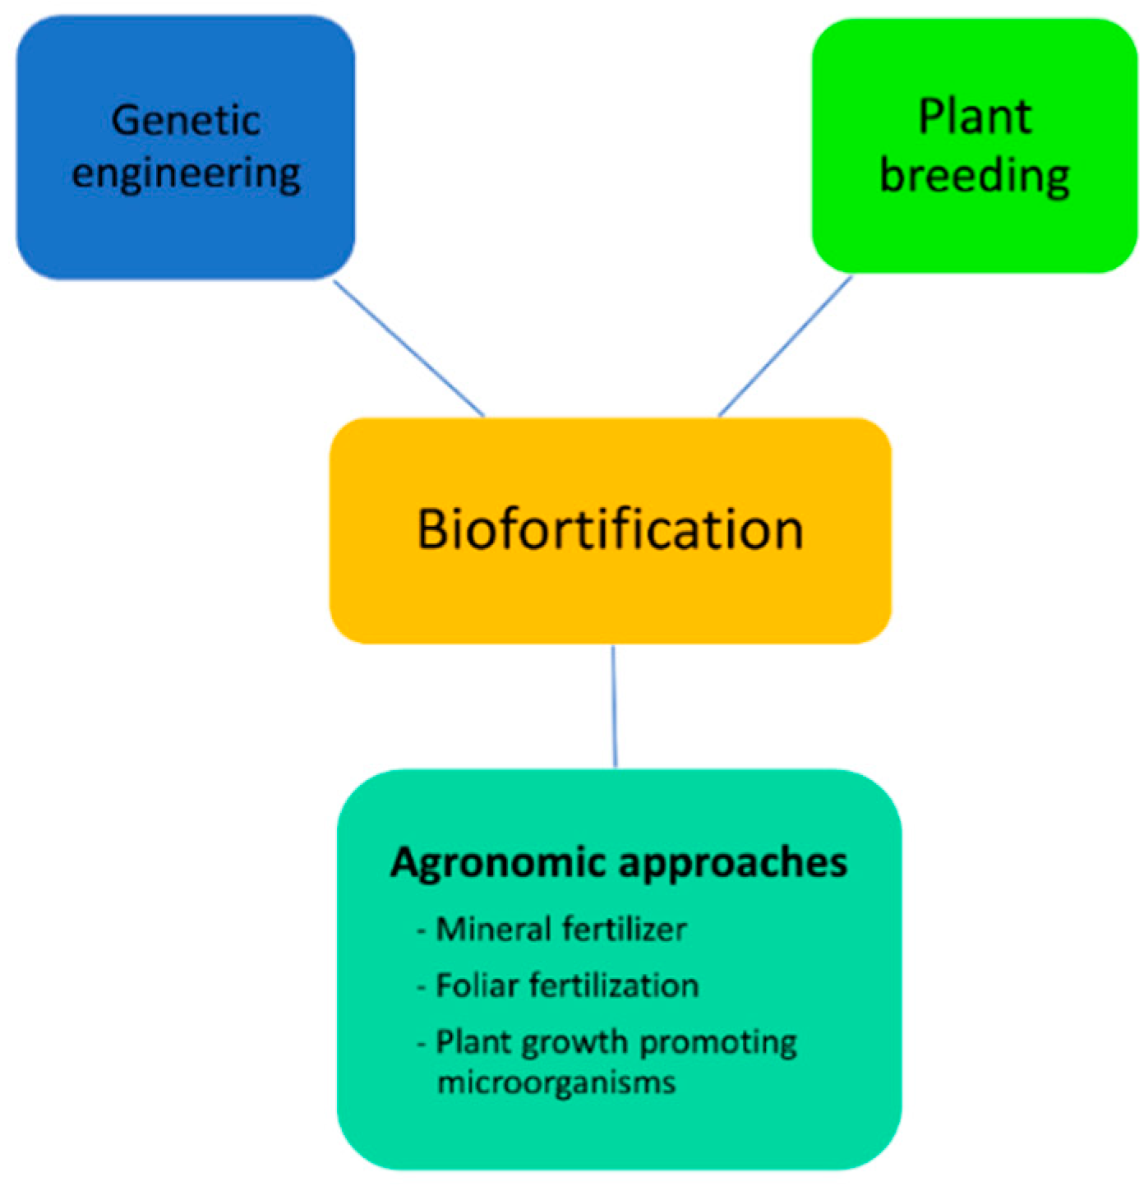
WHAT IS BIOFORTIFICATION?
Biofortification is the process of increasing the nutritional value of crops through breeding, genetic engineering, or agronomic practices. The goal of biofortification is to improve the nutrient content of staple crops such as rice, wheat, and maize, which are consumed by billions of people around the world, particularly in developing countries.
Biofortification can increase the levels of essential micronutrients, such as vitamin A, iron, and zinc, in crops, improving the health and wellbeing of populations who rely on these crops as their primary source of food. This has the potential to address malnutrition and its associated health problems in vulnerable populations, particularly women and children.
Biofortified crops can be developed using traditional breeding techniques or genetic engineering. Agronomic practices such as fertilization and irrigation can also be used to enhance nutrient uptake in crops. Biofortification requires careful consideration of the nutritional needs of target populations, the specific crop varieties to be used, and the cultural and socio-economic context in which the crops will be grown and consumed.

Slide 3

Biofortification was initially designed to overcome the drawbacks and deficiencies of supplementation. Therefore, a modern weapon against mineral deficiency involved transferring the genes directly in elite genotypes.
Transgenic crops employed the genetic engineering tools for genotype improvement in focused metabolic pathways of the plant to improve and modify carbohydrates, fats, proteins, minerals, vitamins, and other secondary metabolites.
These transgenes targeted redistribution of micronutrients between tissues, enhanced the efficiency of a biochemical pathway, increased bioavailability, reduced anti-nutrient absorption and multigene transfer (corn with a high concentration of beta-carotene, ascorbate, and folate in a multivitamin plant) with the reconstruction of selected pathways (field of system biology).
With the advent of various “Omics” technologies, different CRISPR-based gene-editing tools including CRISPR-Cas9/13 and transcription activator-like effector nucleases (TALENs) as well as availability of sequence genome of multiple species opened new horizons for crop biofortification.
Because of the above-mentioned facts, we have exploited the potential of new breeding techniques (NBTs), i.e., genetic engineering, RNAi, and gene editing for the development of nutritionally enriched crops to combat malnutrition.

Slide 4
Malnutrition—A Hidden Hunger
Malnutrition is an emerging threat in an ever-increasing population around the globe. The world population is expected to rise to 8.3 billion in 2030 against the present-day 7.8 billion. According to UNFAO, 792.5 million people around the globe suffer from malnutrition with more victims in the developing world. Most people in developing countries either face hunger or receive nutrient-poor food. The global death rate due to hunger piles up to 24,000 people per day. About one-third of the population is suffering from “hidden hunger.”
They lack either one or all of the essential micro- or macronutrients, like Zn, Fe, selenium, iodine, folic acid, lysine, vitamin A, vitamin B12, vitamin C, vitamin D, and others, in their. These vitamins and nutrients are inevitable for the growth, development, and proper functioning of the human body.
Deficiency of these micronutrients for a short period does not cause much harm but their shortage for a long time may cause many diseases like anemia (Fe deficiency), beriberi (Vitamin B deficiency), pellagra (niacin deficiency), rickets (vitamin D deficiency), and scurvy (vitamin C deficiency) or be fatal.
Approximately 25% of the world's population suffers from anemia and Fe deficiency is its leading cause (50–60% affected).
Beriberi is responsible for 50% of the deaths of children in the last centry in rice-consuming regions around the globe. Rickets is a very serious threat to many communities around the globe, i.e., China has 3%, Bangladesh 13%, Magnolia 25.6%, India 13%, and the Middle East 10% population affected by this disease. These facts highlight the importance of biofortification of crops to deliver healthy diets to the world's population to overcome these issues.

Slide 5
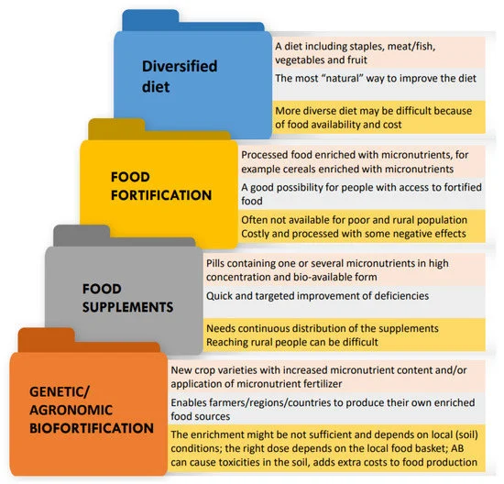
WAYS TO COMBAT MALNUTIRTION:

Slide 6
Recent trends in biofortification include:
1. Multiple nutrient biofortification: Instead of focusing on a single nutrient, crops are being developed that are high in multiple nutrients such as iron, zinc, and vitamin A.
2. Biofortification of staple crops: Biofortification is being applied to staple crops such as rice, wheat, and maize, which are consumed in large quantities by people in low-income countries.
3. Genetic engineering for biofortification: Genetic engineering techniques are being used to enhance the nutritional content of crops.
4. Participatory plant breeding: Farmers are being involved in the development of biofortified crops to ensure that the crops meet their needs and preferences.
Examples of biofortified crops include:
1. Golden Rice: This is a genetically modified rice that contains high levels of beta-carotene, which the body can convert into vitamin A.
2. Iron-biofortified beans: Bean varieties are being developed that have higher levels of iron than traditional varieties.
3. Zinc-biofortified wheat: Wheat varieties are being developed that have higher levels of zinc than traditional varieties.
4. Biofortified cassava: Cassava varieties are being developed that have higher levels of vitamin A and other nutrients than traditional varieties.

Slide 7
The major growing factor towards biofortification market is the heaving demand for nutritional food and increasing investments in agrigenomics.
The prime factor driving the demand for biofortification is the rising demand for high nutritional content foods.
Furthermore, the various private agriculture research institutes, government authorities and agri-based firms are investing in public health program to provide biofortified crops to the undernourished people is also heightening the overall demand for biofortification market over the forecast period of 2021 to 2028.
Moreover, the strong advancements in the agricultural sector, rising implementation of biofortification in crops such as beans, wheat, sweet potato, rice, corn and pearl millet also serves as foremost drivers for increasing the demand for biofortification market at a global level.
In addition, the improvement of the nutritional content of yields such as tomato, banana, sorghum, and barley is also lifting the growth of the biofortification market.
Likewise, biofortification is less expensive, and the expenses of cultivating biofortified foods are small also it progress the micronutrient proportions in staple foods and reduces the micronutrient deficiencies in the population which is highly impacting the growth of the market.

Slide 8

Biofortification market is expected to grow at a compound annual rate of 36.8% in the forecast period 2021 to 2028.

Slide 9
Global Biofortification Market Scope and Market Size
Biofortification market is segmented on the basis of crop type, target nutrients, gene pool and technique. The growth among segments helps you analyze niche pockets of growth and strategies to approach the market and determine your core application areas and the difference in your target markets.
CLASSIFICATION:
On the basis of crop type, the biofortification market has been segmented into sweet potato, cassava, rice, corn, wheat, beans, pearl millet and others
Based on target nutrients, the biofortification market has been segmented into iron, zinc, vitamins, amino acid and others.
Biofortification market has also been segmented into on the basis of gene pool into primary, secondary and tertiary.
The technique segment of the biofortification market has been segmented into conventional plant breeding, agronomy and genetic technology.

Slide 10
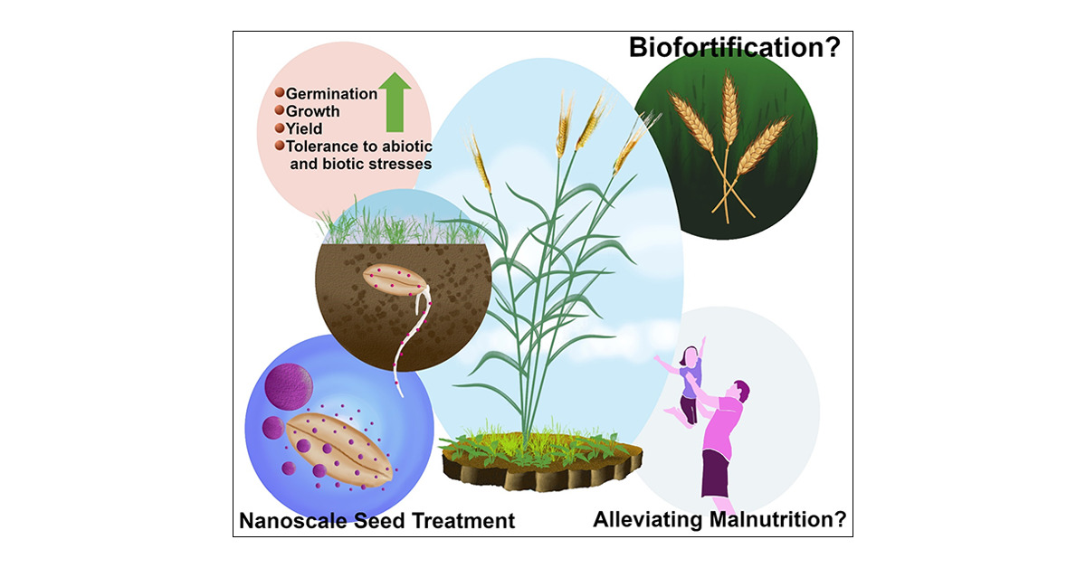
Advantages of Biofortification
Biofortification has several advantages, including:
• Improving the health and well-being of people who rely on staple crops rich in a few nutrients
• Reducing micronutrient deficiencies and related diseases
• Helping to achieve global food security by fortifying crops that people already grow and eat.
• Decreasing poverty and malnutrition as biofortification provides an affordable and sustainable solution

Slide 11
Zinc Biofortification
Zinc is a vital mineral required for normal growth and development in humans. Zinc deficiency is common in many countries, particularly in developing countries.
In recent years, significant progress has been made in developing zinc-biofortified crops. For example, zinc-biofortified wheat developed through conventional breeding processes, is now being adapted for use in several countries including India, Pakistan, Ethiopia, and Bangladesh.
Transgenic Approaches for Improvement of Zinc Content in Plants
Recent advancements in plant biotechnology enables us to better understand plant metabolisms, which has made it possible to increase micronutrients contents, such as zinc (Zn), iron (Fe), and vitamin A, in staple foods to combat mineral malnutrition.
Zinc deficiency is common worldwide and is associated with various health conditions. Genetic engineering can be used in different ways to improve zinc content in staple foods, like the introduction of the specific coding sequencing that codes for zinc-binding protein, overexpression of zinc-storage protein, and/or enhanced expression of specific proteins that are responsible for zinc uptake into plants.
Moreover, zinc bioavailability can be increased by introducing a protein that helps to decrease the antinutrient content.

Slide 12
WAYS TO ENHANCE ZINC ABSORPTION:
Decreasing the amount of phytic acid:
Phytic acid (also term as phytate) is an inhibitor and antinutrient compound that chelates minerals (Zn and Fe) that decrease their bioavailability, and hence is the leading cause of mineral malnutrition worldwide.
Phytic acid makes insoluble complexes when combining with metal ions, especially Zn and Fe, in the gastrointestinal tract that may not be absorbed or digested in humans because of the lack of intestinal phytase enzyme.
Phytate can also make complexes with endogenously secreted minerals, e.g., Zn, by reducing their reabsorption into the body. It is best to decrease the content of phytic acid in edible parts of staple crops to increase the absorption of minerals to combat mineral malnutrition.
Studies have shown that reducing the content of phytate in the diet is strongly related to increased zinc and iron absorption. In phytase, wheat transgenic lines show an increment of 4–115% in bioavailable zinc (Abid et al., 2017).

Slide 13
APPROACHES FOR IMPROVEMENT OF IODINE CONTENT IN PLANTS
The addition of iodine in table salt is a common strategy to prevent iodine deficiency (Gonzali et al., 2017); however, biofortification of crops with iodine is a more promising strategy to combat mineral malnutrition, as it is more sustainable and cost-effective as compared to other fortification techniques (Garg et al., 2018).
In the last few decades, scientists successfully fortified staple crops with several micronutrients, such as iron, zinc (Abid et al., 2017), and folate.
However, to date, no reports of biofortification of iodine in crops using recombinant DNA technology have been published. This is because of the poorly characterized physiology of iodine in plants. According to some hypotheses, iodine fluxes across the cell membrane of root cells via anion channels and putative H+/halides transporters.
However, such transporters have not yet been molecularly identified. In contrast, the iodine volatilization from over ground parts of plants, such as the root and leaf, are much better characterized in different species. Halide ion methyltransferase (HMT) and halide/thiol methyltransferase (HTMT) activity are found to be responsible for iodine volatilization. The only study which employed molecular approaches to enhance the iodine concertation was on transgenic Arabidopsis. In this study, the human sodium-iodide symporter (hNIS) gene of thyroid glands had overexpressed under the CaMV 35S promoter, thus enhanced uptake of iodine was observed.
In addition, the HOL-1 gene that encodes for HMT enzyme (cause iodine volatilization) was knocked out and a substantial reduction in volatilization in transgenic plant as compared to wild-type was observed.

Slide 14
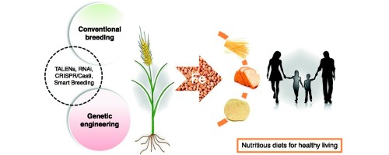
IRON BIOFORTIFICATION
Iron deficiency is a major public health problem in many developing countries. Iron-biofortified crops have been developed using conventional breeding techniques. Iron-biofortified beans and pearl millet are being evaluated for their effectiveness in combating iron deficiency in several countries.

Slide 15
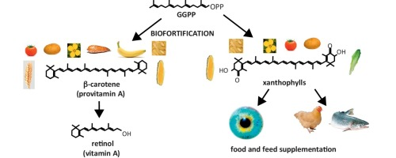
VITAMIN A BIOFORTIFICATION
Vitamin A is a critical nutrient for immune function, vision, and fetal development. Vitamin-A deficiency is widespread in many countries, particularly in Sub-Saharan Africa and Southeast Asia.
Recent advances in biofortification have resulted in the development of new varieties of crops with higher levels of vitamin A. Vitamin-A biofortified crops include sweet potato, maize, cassava, and rice.

Slide 16
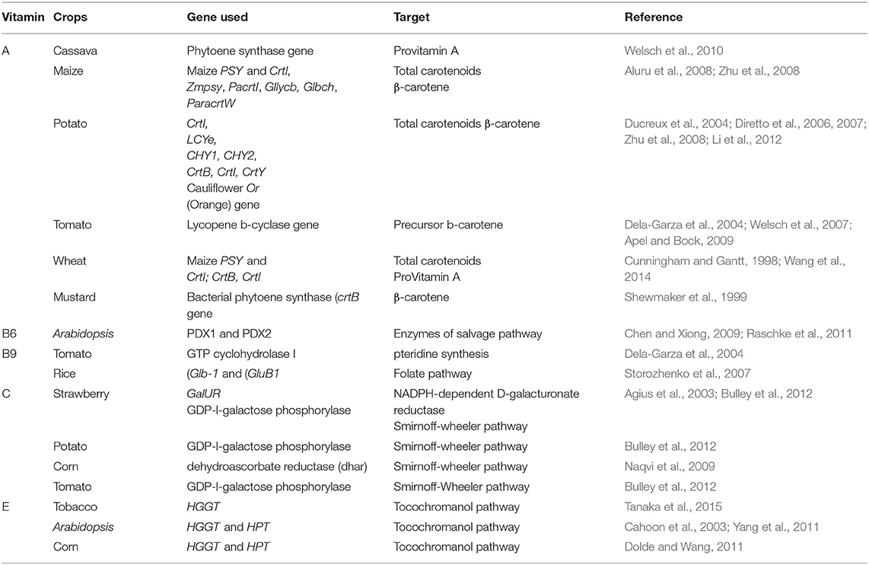

Slide 17
BIOFORITIFCATION IN CEREALS:
The commonly cultivated cereal crops include rice, wheat, maize, sorghum, barley, millets, and oats. Rice is reportedly deficient in Fe, Zn, and pro-vitamin A, which is a leading cause of hidden hunger in rice-eating areas around the globe and causes anemia, night blindness, and loss of vision
Wheat needs biofortification for effective provision of zinc, iron, selenium, grain yellow pigment contents (GYPC), pro-vitamin A, grain anthocyanins, and essential amino acids, similarly some anti-nutrient compounds, i.e., phytic acid, are present in excessive quantities which needs to be checked
Maize is found deficient in vitamin E (tocopherol, tocotrienol) along with persuasive antioxidants, vitamin C, vitamin A, anti-nutrient components, and quality protein
There is a need to enhance tryptophan and lysine content to increase nutritional quality of vital zein proteins. The opaque-2 (o2) mutant form in maize has the potential to increase tryptophan and lysine contents. Varieties possessing o2 allele have relatively high lysine and tryptophan contents as compared to wild typed varieties.
Micronutrients, i.e., zinc, iron, health-supporting γ-linolenic acid, polyunsaturated fatty acids, and stearidonic acid (STA), are also reportedly deficient in barley. Barley seeds have a phytase gene (HvPAPhy a) that is responsible for enhanced phytase action. This increased phytase activity improves zinc and iron bioavailability. Due to overexpression of cellulose synthase-like gene (HvClF), β glucans content increases. These are the dietary fibers involved mainly in the reduction of type II diabetes and cardiovascular disease
Sorghum is also reported to be deficient in iron and zinc along with iodine, selenium, magnesium, and calcium

Slide 18
BIOFORITIFCATION IN PULSES:
About 1,000 pulses are known to humans but only 20 of them are cultivated for human consumption including cowpea (Vigna unguiculata), pigeon pea (Cajanus cajan L.), chickpea (Cicer arietinum L.), urban (Vigna mungo L.), mung bean (Vigna radiata L.), French bean (Phaseolus vulgaris), lentil (Lens culinaris Medik), horse gram (Macrotyloma uniflorum), soybeans (Glycine max), moth bean (Vigna aconitifolia), Lathyrus (Lathyrus sativus L.), field pea (Pisum sativum L.), etc. Pulses are deficient in iron and zinc contents like the majority of cereals
These are also deficient in selenium, dietary fibers, and sulfur-containing amino acids including cysteine and methionine.
Although pulses are rich in proteins and micronutrients, there are some anti-nutrients as well which restricts the bioavailability of proteins and nutrients, e.g., lectins, phytic acid, saponins, lathyrogens, protease inhibitors, α-amylase inhibitors, and tannins, restrict the absorption of iron, zinc, calcium, magnesium, and other essential nutrients
There is a need to understand the metabolic pathway involved in the synthesis of these compounds and the disruption of key genes involved for their reduced production.

Slide 19
ANTINUTRIENTS IN PULSES:
As we are talking about the removal of anti-nutrient compounds from cereals and pulses, we must also consider their vital functions in plant development as discussed below.
Lectins: are a diverse family of plant proteins found in almost all organisms including animals, microorganisms, and plants, which restricts the bioavailability of iron and zinc. There are over 500 members of lectins in plants that are produced in response to biotic stresses, i.e., disease, insect, molds, and fungi attack and serve as the first defense line
Oxalates: or oxalic acid, are substances that can form insoluble salts with sodium, potassium, magnesium, iron, and calcium and restricts their bioavailability. These are produced in all photosynthetic organisms for calcium regulation, detoxification of heavy metals, and plant protection
Phytate: phytic acid or myo-inositol hexaphosphate (IP6) is another plant-derived anti-nutrient compound that restricts the bioavailability of iron and zinc. It usually serves as a storage house for plant phosphates, antioxidants for germinating seeds, and energy sources. These are usually produced during seed germination and serve as a source of 50–60% phosphorus during germination
Tannins: are a class of high molecular weight polyphenols that are found in the plant kingdom and serve as anti-nutrients by chelating iron, zinc, and copper. There are two classes of tannins, i.e., hydrolyzable tannins and condensed tannins. Condensed tannins are found abundantly in plants and play a role in plant defense as an antioxidant, anti-carcinogenic, immunomodulatory, detoxifying, and cardio-protective activities
Given the important metabolic activities of anti-nutrient compounds, there is a need to tradeoff between their desirable and undesirable functions before their silencing or knocking out

Slide 20
BIOFORTIFICATION IN PEARL MILLET
Pearl millet (Pennisetum glaucum L., R. Br.) is a major warm-season cereal grown in the arid and semi-arid tropical regions of Asia and Africa and is used as food and fodder. It is a staple food for millions of people in Africa and Asia and contains higher levels of micronutrients such as Zn and Fe than wheat and rice.
Variation in Fe concentration (35–116 mg kg−1), Zn (21–80 mg kg−1), and protein (6–18%) were reported in 281 advanced breeding lines bred at ICRISAT by [72]. Pearl millet has also been shown to exhibit great genetic variation (30–140 mg kg−1 Fe and 20–90 mg kg−1 Zn) which can be used to breed new cultivars that have high contents of Zn and Fe and are high yielding.
Pujar et al. found highly significant and positive correlations between general performance and Fe/Zn density in pearl millet populations. Incorporation of parental lines with a high degree of average heterosis could prove to be beneficial in breeding programs with a focus to enhance Fe/Zn in pearl millet
The high iron and zinc pearl millet varieties AIMP92901 and ICMR312 have been developed.
In India, open pollinated pearl millet varieties (Dhanashakti) and hybrids (ICMH 1202, ICMH 1203, and ICMH 1301) with high concentrations of iron (70–75 mg kg−1) and zinc (35–40 mg kg−1) have been introduced

Slide 21
BIOFORITIFIED POTATO:
Potato (Solanum tuberosum) is an important vegetable and a good source of energy and calories for people of all ages. As it is being used globally, it has great potential to improve human nutrition through various biofortification strategies. Using transgenic techniques, the beta-carotene contents of potato have been enhanced by adding the PSY gene
Field experiments were conducted to enhance Zn content in potato tubers by foliar application of Zn fertilizers which increased tuber Zn content significantly. It was also observed that zinc sulfate and zinc oxide were more productive than zinc nitrate for foliar applications targeted at enhanced Zn concentrations and improved yield
Similarly, it was shown that the selenium (Se) concentration in potato tubers was enhanced by foliar application of selenite and selenate
The Se content of potato tuber also improved by foliar application of Se with humic acid. In addition, potato is also a good source of antioxidants for human health. Additionally, the contribution of potatoes as a source of antioxidants and nutritive properties was related to the natural variation of red and purple pigments in cultivated potato germplasm. Thus, breeders are paying serious attention to the breeding of these variants
In summary, potatoes have considerable genetic diversity for micronutrient concentration that can be utilized for conventional breeding of varieties with enhanced Fe and Zn concentrations for human nutrition

Slide 22
BIOFORTIFICATION OF COMMON BEANS
The common bean (Phaseolus vulgaris) is an essential grain legume, consumed by humans in all parts of the world. It is an annual herbaceous plant and its dry grains are edible. The beans are a rich source of amino acids, i.e., threonine, valine, leucine, isoleucine, and lysine, but its nutritive value is insufficient due to low concentrations of the essential amino acids methionine and cysteine.
However, the methionine concentration in beans can be enhanced through expression of methionine-rich storage albumin protein from seeds of the Brazil nut
Common beans also have a potential for Zn biofortification through foliar application of Zn fertilizer
It has been reported that in common beans N, P, K, Mn, Cu, and Zn concentrations can be enhanced by the administration of organic and chemical fertilizers
Furthermore, it has been shown that in common beans the Fe concentration can be enhanced by 60–80% and Zn concentration by around 50%, using different strategies. High genetic diversity in common beans has been discovered for Fe and Zn concentration and genes have been reported in navy bean that are related to Zn accumulation
Generally, staple crops are poor sources of dietary folates but legumes and particularly beans were shown to be a good source of dietary folates
Thus, biofortification of common beans with minerals and amino acids can play a significant role to uplift the nutritional status of resource poor people of developing countries and promising work is in progress.

Slide 23

EMERGING TECHNOLOGIES FOR BIOFORTIFICATION

Slide 24
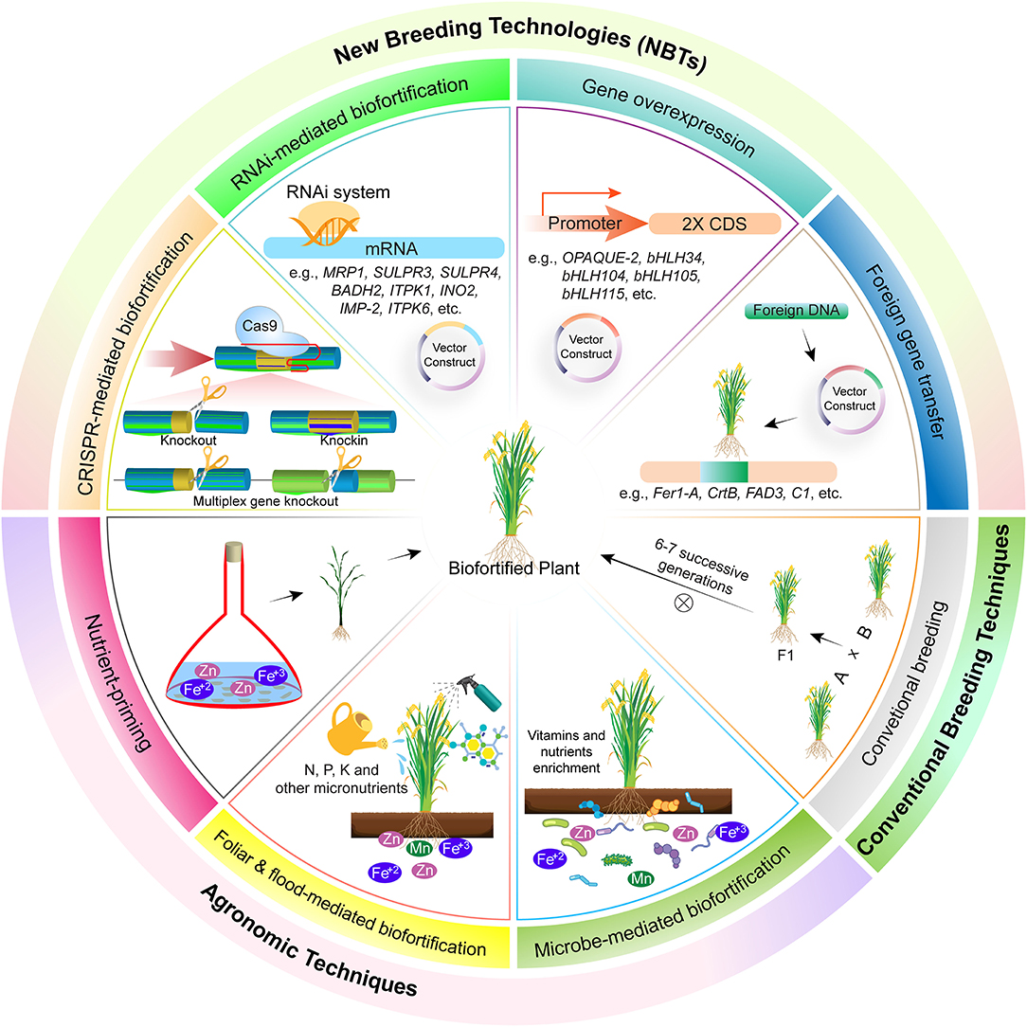

Slide 25
Here are some emerging techniques for biofortification:
1. Genetic engineering: Through genetic engineering, scientists can modify the DNA of plants to increase their nutrient content. For example, scientists can modify the genes responsible for producing iron in rice plants to increase their iron content.
2. Agronomic practices: By improving agronomic practices, such as crop rotation, soil management, and fertilizer application, farmers can enhance the nutrient content of crops.
3. Micronutrient-enhanced fertilizers: Scientists are developing fertilizers that contain micronutrients such as zinc, iron, and selenium, which can be absorbed by plants and increase their nutrient content.
4. Biofortification through food processing: Scientists are exploring ways to enhance the nutrient content of foods during processing. For example, fortifying flour with iron and folic acid can help reduce the prevalence of anemia in populations that rely on wheat-based diets.
5. Breeding programs: Plant breeders can develop new crop varieties that are more nutritious. For example, they can cross two different varieties of plants to create a new variety with higher levels of certain nutrients.

Slide 26
1. RNA Interference
RNAi is a sequence-specific gene regulation process driven by a double-stranded RNA (dsRNA) molecule, which results in inhibition of either transcription or translation of a particular gene. Since its discovery, RNAi has opened a new vista for crop improvement. It is a precise, stable, efficient, and better tool than antisense technology. RNAi provides a platform for the incorporation of biotic and abiotic stress tolerance and delivery of quality food through biofortification and bio-elimination. It is widely used for nutritional quality enhancement of crops and removal of food allergens and contaminants. The following sections cover some examples of the use of RNAi for the biofortification of cereals and pulses.
Phytic acid (PA) is considered a major anti-nutrient in cereals and pulses due to its ability to chelate micronutrients and restrict the bioavailability of important nutrients. RNAi was employed to disrupt an important gene [inositol pentakisphosphate kinase (TaIPK1)] of the PA biosynthesis pathway in wheat. The resultant homozygous transgenic lines of wheat at the T4 stage show reduced expression of TaIPK1, reduced PA accumulation (26–58%), and increased grain phosphate, zinc, and iron contents
Carotenoid contents have high nutritional value being precursors of pro-vitamin A. In rice, carotenoid contents were enhanced by RNAi-based disruption of carotenoid-cleavage dioxygenases (CCDs) genes which degrade carotenoids. Three genes, i.e., OsCCD1, OsCCD4a, and OsCCD4b, were disrupted using RNAi. Resultantly an increase in carotenoid production was observed in mutants, i.e., OsCCD1-RNAi (1.4-fold), OsCCD4a-RNAi (1.6-fold), and OsCCD4b-RNAi (1.3-fold) as compared to wild types

Slide 27
Lysine is the main limiting essential amino acid in rice, which serves as a source of energy and nutrition. Two enzymes, i.e., aspartate kinase (AK) and dihydrodipicolinate synthase (DHDPS), are liming factors for lysine and are extremely sensitive to a feedback mechanism. RNAi-based repression of AK and DHDPS enzymes was carried out in rice and resultantly 6.6- and 21.7-fold more lysine was accumulated in mutant lines, respectively. When both mutations were combined in one genotype, the lysine level was 58.5-fold more in wild types
Maize endosperm is deficient in pro-vitamin A and β-carotene leading to vitamin A deficiency in masses. However, other carotenoids, i.e., zeaxanthin which is produced from β-carotene via a two-step hydroxylation reaction, are found in sufficient quantity which may be stopped to increase β-carotene content in maize endosperm. Considering the abovesaid phenomena two maize genes ZmBCH1 and ZmBCH2 involved in hydroxylation reaction were knocked out using RNAi to enhance β-carotene in maize endosperm.
Mutants for ZmBCH2 genes showed a significant increase in β-carotene contents in maize grain indicating that this gene has a key role in conversion of β-carotene to other carotenoids. Due to the presence of γ-kafirin, sorghum was considered less digestible and through suppression of γ-kafirin 1A, γ-kafirin1, 2, and γ-kafirin through RNAi silencing its digestibility was improved

Slide 28
2. Genome Editing
Sequence-specific nucleases (SSNs) are used in plant genome editing (GE) for stably inherited and targeted gene modification in the desired crop to produce transgene-free plants. Various types of SSNs, i.e., TALENs, ZFNs, and CRISPR-Cas system are used for plant genome editing
Genome editing through CRISPR involves Cas9/13, RNA-guided DNA endonucleases guided by a short guided RNA (sgRNA) resulting in a complex at the target site for targeted gene editing
Genome editing was exploited less for biofortification of cereals and pulses; however, some highlighted examples are discussed below.

Slide 29
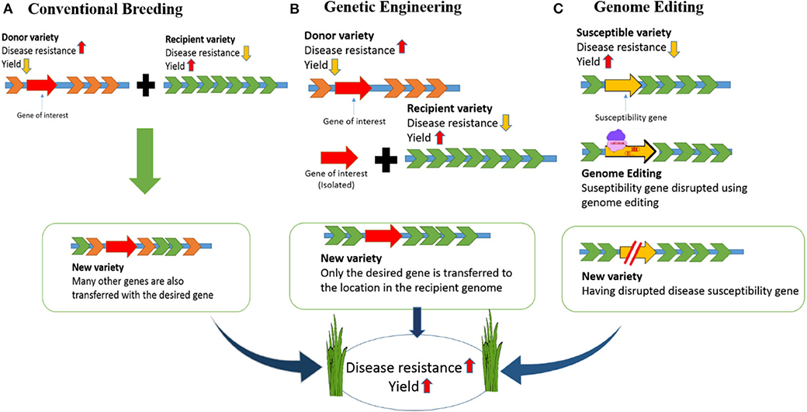

Slide 30
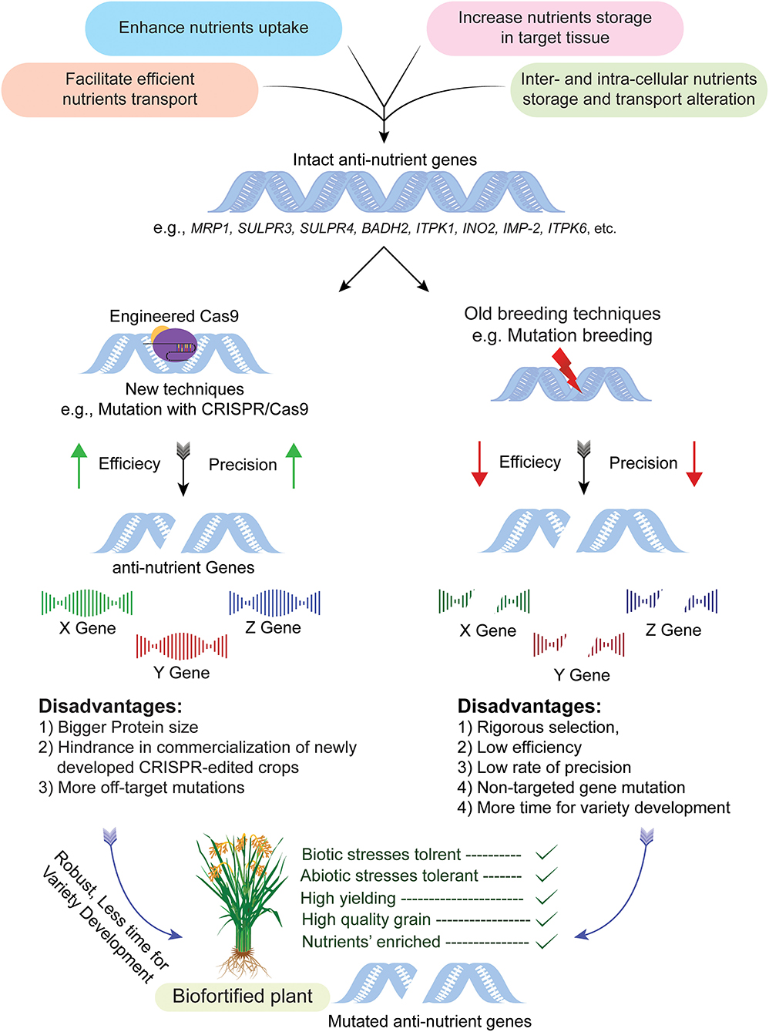

Slide 31
3. AGRONOMIC BIOFORTIFICATION
For hundreds of years, mineral fertilizers have been applied to plants or soil to facilitate
the increased nutrients of crop plants. Based on a similar principle, the agronomic biofortification approach has been used to enrich cereal grains with minerals
It is commonly believed that the application of mineral nutrients from external sources advances their concentration in developing grains as well as improving soluble and mobilizable mineral elements in the soil. In developing nations, particularly in Africa and Asia, agronomic biofortification is the fastest and easiest method to supply food grains with Zn, Fe, or additional essential micronutrients for the human body
Agronomic biofortification, like supplements and fortification, is probably best used in a specific situation or in conjunction with other strategies. It is used as a foliar application when minerals cannot be easily translocated to edible tissues
This approach has been adopted worldwide due to it straightforwardness and timeliness. Pre-harvest agricultural practices that increase the nutritional value of food are supported by following such approaches This method incorporates the use of organic manures, synthetic fertilizers, and biofertilizers, as well as seed priming via soil or foliar application

Slide 32
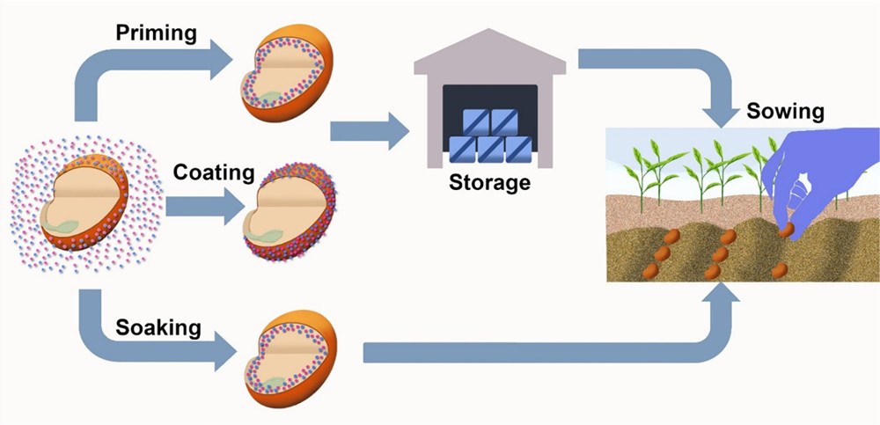
4. SEED PRIMING :
Seed priming is another method of biofortification, in which the seeds are soaked in nutrient-rich solutions before planting.
Crops are typically seed-primed to improve germination, seedling establishment, and robust root systems and yield
It is a low-cost and simple method for increasing nutrient availability for farmers
According to Praharaj et al. the Zn concentration in wheat grains improved significantly after the seeds were primed with different concentrations of a zinc sulfate heptahydrate solution.

Slide 33
5. MICRONUTRIENT FERTILIZERS:
The micronutrient fertilizers Zn, Mn, B, Fe, Cu, and Mo are the six most essential for increasing productivity in wheat farming
Though they account for a smaller amount, their importance in promoting the yield and yield parameters should not be ignored. Their contributions to plant nutrition and soil productivity render them more significant. Moreover, micronutrient fertilizers not only play pivotal roles in plant nutrition, the better development of grains, the improvement of physiological traits and yield parameters, and in ameliorating nutrient deficiency in wheat, but humans and animals also require them for their well-being
One of the leading causes of the high prevalence of micronutrient deficiencies in human populations is the insufficient quantities and low bioavailability of micronutrients in plant-based diets. Typically, there is a spatial overlap between human populations’ vitamin inadequacies and those of micronutrients in cultivated soils
This suggests a close relationship between the population’s health and the micronutrient status of plants. However, there is generally less concern regarding micronutrients in relation to production sustainability and the nutritional quality of food crops compared to other plant mineral requirements.

Slide 34
According to researchers, the application of micronutrient fertilizers such as (Fe + Zn) in combination with N and K is the best option for achieving a higher grain yield and quality of wheat Notwithstanding the frequent and acceptable application of NPK fertilizer, ensuring the average growth of high-yielding grain varieties is challenging due to the minimal, inappropriate, or lack of inclusion of micronutrient fertilizers in wheat production.
The authors stated that widely fluidizer-responsive varieties expressed their full yield potential when trace elements of (Zn, Fe, B) micronutrient fertilizers were applied together with NPK fertilizers, which meaningfully improved the wheat yield compared to the controls when applied singly or in a mixture with other fertilizer elements. Meanwhile, the Researchers also noted a positive interaction between fertilizer treatments and the physiological stages of wheat growth when micronutrient fertilizer was combined with macronutrient fertilizer. The use of micronutrient fertilizers (Boron, Copper) positively affected the wheat parameters and increased the grain yield considerably

Slide 35
ENHANCING THE ABSORPTION OF MICRONUTIENTS:
Insertion of iron-binding protein gene
The first transgenic approach involves the insertion of an iron-binding protein gene (lactoferrin) under the control of an endosperm specific promoter to achieve Fe accumulation in the seed which is consumed by humans. For this purpose, plants or crops that store iron in their seeds are targeted. Rice is one such example where many attempts have been made to increase its grain iron content. Rice is favorable for many reasons, such as its low allergenic properties and the absence of toxic compounds that interfere with the expression (Suzuki et al., 2003). Researchers were successful in expressing human lactoferrin in dehusked rice using a strong endosperm specific promoter. It resulted in an increase of 120% in iron content which was suitable for supplementing infants; however, it was still not enough to meet the daily requirements of adults as one molecule of lactoferrin binds to only two ferric ions (Suzuki et al., 2001).
As an alternative, ferritin gene was expressed in rice. Ferritin is known to bind 4,500 ferric ions per molecule (Theil et al., 1997). Iron in the ferritin form is good for human absorption as in the human intestine it is not inhibited by iron absorption inhibitors such as phytate (Theil, 2011). In transgenic rice, a 2 to 3-fold increase in iron content has been achieved by expressing soybean ferritin under the control of rice seed-storage protein glutelin promoter, GluB-1 (Goto and Yoshihara, 2001). Iron in soybean ferritin is reported to be readily absorbed by the human gut (Lonnerdal, 2003). Some studies reported an increase in iron content of rice plants: a 2-fold increase in dehusked rice using rice glutelin promoter (Lucca et al., 2001) and a 3.7-fold increase in Indica cv. IR68144 seeds (Vasconcelos et al., 2003). In addition to rice, ferritin and human lactoferrin genes are reported to increase Fe content in maize grains (Drakakaki et al., 2005), tomato fruits, potato tubers, and lettuce leaves (Goto and Yoshihara, 2001). A factor affecting ferritin over-expression leading to iron accumulation might be soil composition (Vansuyt et al., 2000). Endosperm-specific expression of wheat and soybean ferritin in wheat led to a 1.5 and 1.9-fold increase in iron content, respectively (Borg et al., 2012; Xiaoyan et al., 2012).

Slide 36
INSERTION OF AN IRON-CHELATOR GENE
Nicotianamine (NA) is known to chelate iron and plays a key role in Fe homeostasis and assimilation. The Ferritin gene co-expressed with the nicotianamine synthase (NAS) gene in rice is reported to show a 6-fold increase in Fe content, which is higher when compared to the single gene approach
In another study, a 7-fold increase in Fe content in transgenic rice seeds was observed by expressing NAS, OsNAS3. Anemic mice fed with these transgenic rice seeds for 4 weeks recovered from iron deficiencies and anemia, while no change was observed in mice fed with non-transgenic rice seeds. Transgenic rice containing HvNAS1 over-expressed by OsActin1 promoter/35S promoter showed a 5- to 10-fold increase in endogenous NA levels in the shoots and seeds, leading to 3-fold higher increase in Fe concentration in the T1 seeds
Similarly, transgenic tobacco over-expressing nicotianamine synthase (AtNAS1) showed increased Fe levels).
An increase in iron has also been reported in biofortified pearl millet, an amount 2-folds higher than in most modern wheat varieties. An increase in iron absorption by 5–10% in around 35 million people consuming biofortified pearl millet has been reported

Slide 37
Over-expression of already present proteins for iron-binding and accumulation
Leghemoglobin is an example of a protein that is already present in plants and binds to iron in the form of heme, a form that is not affected by anti-nutrients and can make iron readily available for human consumption
There is a need to create methods through which the gene for leghemoglobin synthesis would be expressed in edible plant parts. A study on potato tubers expressing the soybean leghemoglobin gene resulted in poor growth of tubers, proving this to be a difficult task
INSERTION OF TRANSPORTER GENE
The amount of iron that accumulates in seeds is dependent on how much of it is absorbed by the plant and transported to the required plant part
Mineral ions need to pass through the root-soil interface, accumulate in the apoplasm so that these ions are sufficiently collected, and finally transported to the required edible plant parts
In plants, the P_{1B}-type heavy metal ATPases (HMA) family are important transporters of transition metal ions and are diverse in metal specificity, subcellular localization, and tissue distribution HMAs are divided into two subgroups on the basis of metal specificity: a zinc (Zn)/lead (Pb)/cadmium (Cd) group and sliver (Ag)/copper (Cu) group. Functional studies have demonstrated that P_{1B}-ATPases control the root-shoot transportation of Zn
In rice, OsHMA1 plays an important role in Zn transportation as its expression is highly upregulated in shoot tissues under Zn deficiency. On the other hand, overexpression of OsHMA3 decreased the concentration of Cd in shoots and grains while increasing the accumulation in roots.

Slide 38
Micronutrients also play pivotal roles in chlorophyll and nucleic acid formation, protein synthesis, metabolism, and several enzymatic activities of photosynthesis, as well as respiration
Ziaeian and Malakouti reported that when micronutrient fertilizers are applied to wheat, the total uptake of Zn, Cu, Fe, and Mn in the grain and flag leaves was significantly increased.
Other findings demonstrated that micronutrient fertilizers such as (Fe, Cu, Zn, B, Mn, and Mo) are required for the critical development of plants. Research has shown that small amounts of foliar-applied micronutrients (singly or combined with other essential elements) can increase the yield and its components, thus enhancing wheat growth and quality

Slide 39
A. Impact of Biofortified Crop Cultivars in the Alleviation of Human Malnutrition
Biofortified crops are nutritionally dense in comparison with non-biofortified crops, with assumptions of similar micronutrient bioavailability and retention after cooking, processing, and storage, so the consumption of biofortified staple crops improves the total micronutrient intake. Currently, over 20 million people have included biofortified food crops in their diets across the world.
The deployment and consumption of biofortified varieties has demonstrated positive effects on human health and wellbeing. However, the assessment of biofortified crops’ impact on humans is tedious, as it is difficult to measure their effects in controlled conditions, but there are several studies attempting to study their effect on human health. The consumption of Fe-enriched biofortified crops like rice has increased the Fe stores in potentially pregnant women in the Philippines
Fe-biofortified pearl millet has enhanced the Fe level in Indian school children, overcoming Fe deficiency and Fe-biofortified beans have improved the Fe stores in Rwanda women
It was assessed that the interpretation of the pro-vitamin A effect was more difficult, as the pro-vitamin A carotenoids are first engrossed by the body and then converted into vitamin A’s active form as per the body’s need.
A few case studies were conducted to analyze the effect of the consumption of pro-vitamin A biofortified sweet potatoes, which overcame the vitamin A deficiency in Mozambique, South Africa and Uganda, while in Bangladesh, a base experiment showed an increased pro-vitamin A concentration but no increment in vitamin A’s status. Consumption of pro-vitamin A-enriched yellow cassava increased the vitamin A status and pro-vitamin A concentrations in Kenyan school children

Slide 40
B. Cost-Effectiveness and Monetizing Benefits of Biofortification
Through biofortification, the majority of the world’s population is dependent on a single staple food and cannot afford a diverse diet to fulfill all nutrient requirements. Hence, through biofortification, basic food crops like wheat, rice, maize, and beans are enriched with deficient micronutrients.
It mainly targets the rural population, where food production and consumption will stay in the community, on the farm, or locally, and unlike commercial fortified food, there is no need to purchase the product repeatedly. Thus, developing and disseminating biofortified varieties requires only a one-time investment.
The evidence of biofortified crops’ impact on public health has shown their benefits and positive effects on different populations of human groups, studied by conducting trial under controlled settings. In addition to the health benefits, it is also equally important to consider how biofortification is economically efficient, as it is a long-term process that includes huge research and developmental activities. The assessment of the cost-effectiveness of biofortification is a tedious task, as it varies with the type of biofortification
attempted in different crops and countries
The Disability-Adjusted Life Years (DALYs) framework is mainly used to determine the cost-effectiveness by considering both mortality and morbidity results in a single analysis.
The benefits are quantified using the number of DALYs saved and the costs per DALY saved to provide a constant way of ranking different interventions. However, the DALYs framework used to assess the cost-effectiveness is very data-intensive, and the calculations are based on many assumptions, which generate a certain level of uncertainty in the assessment.

Slide 41
C. Decrease in Micronutrient Burden:
Several studies have shown that biofortification leads to a decrease in the burden of micronutrient deficiency
Furthermore, it has to decipher how much the biofortification process costs to achieve these reductions in burden. For crop biofortification, there are
initial costs for basic breeding and research activities to develop the micronutrient-enriched biofortified lines, followed by marginal costs for testing, adaptive breeding, maintenance breeding, dissemination, and extension activities.
According to the World Bank Report for 1993, any public health interventions costing less than USD 150 per DALY saved are highly cost-effective

Slide 42
CHALLENGES FACED BY BIOFORTIFICATION
Several challenges have been encountered in the process of making biofortification a reality.
These include:
• Consumer Acceptance
• High Cost of Production
• Limited Collaboration
• Cross-Hybridization
• Regulatory Barriers
• Intellectual Property Rights

Slide 43
THANKYOU

