Slide 1
Introduction to Nutrition Metabolism
Prof. Dr. Asif Ahmad

Slide 2
Metabolic Pathways
Overview of metabolism pathways
- Catabolism - Anabolism
- Bioenergetics
- Important metabolic pathways
- Catabolism:
- Glucose catabolism
- aerobic pathway
- anaerobic pathway
- Hydrocarbon
- Nitrogen compounds
- Anabolism:
- Photosynthesis
- Biosynthesis

Slide 3
Metabolic processes
Catabolic = Breakdown:
  generation of energy and reducing power from complex molecules
    produces small molecules (CO₂, NH₃) for use and as waste products
Anabolic = Biosynthesis:
  construction of large molecules to serve as cellular components such as
    amino acids for proteins, nucleic acids, fats and cholesterol
    usually consumes energy

Slide 4
Inputs (cellular nutrients)
Carbon source
  sugars
    glucose, sucrose, fructose, maltose
    polymers of glucose: cellulose, cellobiose
Nitrogen
  amino acids and ammonia
Energy extraction:
  oxidized input → reduced product
  reduced input → oxidized product

Slide 5
Products of anaerobic metabolism of pyruvate
Succinate
Lactate
Acetyl CoA
Acetate
Malate
Oxaloacetate
Pyruvate
Ethanol
Acetaldehyde
Acetoacetyl CoA
Acetolactate
Formate
CO₂
Acetoin
Butanol
H₂
Butyrate
Butylene glycol

Slide 6
Conversion Efficiency: Food to Usable Energy
40% used to make
high energy phosphate
bonds
60% “lost” (?) as
heat

Slide 7
Energy needs
Measurement of Energy Intake
Metabolic Energy Yields

Slide 8
Energy Out: Basal Metabolism
Largest daily energy output
Definition: “the sum total of minimal activity of all tissue cells of the body under steady state conditions”
Men estimate: lbs body weight X 11
Women estimate: lbs body weight X 10
affected by
  Muscle > Fat Male > Female
  Young > Old
  Temperature: body and environment

Slide 9
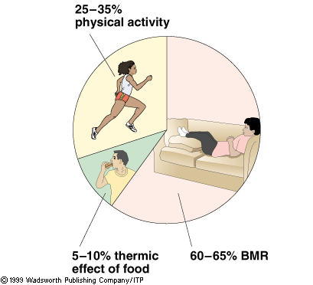
BMR > Activity > Dietary Thermogenesis

Slide 10
Factors affecting BMR
1) Body Size & Composition
  ↑Lean tissue ↑BMR
  Body weight ↑wt ↑lean tissue (but also ↑fat)
2) Age:
  ↑age ↓Lean tissue
3) Sex: Men ↑lean
4) Activity: Exercise ↑lean tissue

Slide 11
Factors affecting BMR
5) Growth ↑BMR
  Children, pregnancy
6) Fasting/starvation: ↓BMR
7) Fever/stress ↑BMR
8) Smoking/caffeine: ↑BMR

Slide 12
Energy Balance
Sources of fuel for energy
  Input from diet: carbs, fat, prot, alcohol
  Stored energy: glycogen, fat, muscle
Energy outgo from:
  Basal metabolism
  Physical activity
  “Dietary thermogenesis”

Slide 13
Energy Balance
Energy In = Energy Out
  Weight Maintenance
Energy In > Energy Out
  Weight Gain
Energy In < Energy Out
  Weight Loss

Slide 14
Basal Metabolic Rate
BMR = number of calories would need daily simply to stay alive if were totally inactive, in bed, awake for 16 hours & slept for 8 hours
Harris-Benedict Equation:
Women: 661+(4.38 x weight in pounds)+(4.38 x height in inches)-(4.7 x age)=BMR
Men: 67+(6.24 x weight in pounds)+(12.7 x height in inches)- (6.9 x age)=BMR

Slide 15
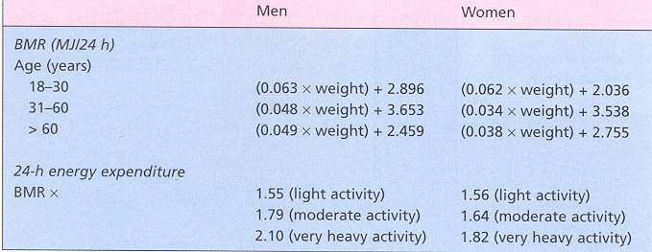
James & Schofield

Slide 16
Coenzymes
Capture energetic electrons from glucose during its catabolism
  coenzymes reduced
    gains energy (electron)
    charge reduced (electrons have negative charge)
NAD⁺ (nicotinamide adenine dinucleotide)
  derived from niacin (B vitamin)
  NAD⁺ + H⁻ + H⁺ → NADH + H⁺
FAD (flavin adenine dinucleotide)
  derived from riboflavin
  FAD + H⁻ + H⁺ → FADH₂

Slide 17
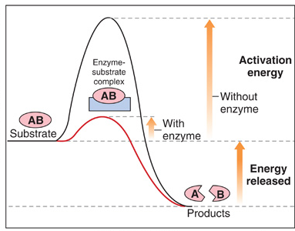
Enzyme Catalysis: Activation Energy
Acid-catalysed reaction
Enzyme-catalysed reaction

Slide 18
Activation Energy
  Activation energy
    Energy needed to allow the reactants to form products
    Necessary for a chemical reaction to proceed
    Activation energy is needed even for breakdown reaction to get them going
Activation
Energy
Z
X + Y
Energy Level
Time
In the laboratory, we heat the reactants in order to provide
activation energy for a chemical reaction
Inside the cell, a different mechanism is required as heating up
the reactants is not possible
Lower the energy required for the reaction

Slide 19
Cellular Reactions Either Use or Liberate Energy
Catabolic/Breakdown Reactions release energy
  Molecules become more disorganized or less structured
X Y
+ +
Z
Anabolic/Buildup Reactions absorb energy
  Molecules become more ordered and complex
  ATP needed to power endothermic reactions
A B
+ + ATP
C

Slide 20
Both Breakdown and Buildup Reactions Have Activation Energies
Breakdown Reactions Release Energy: Exergonic/exothermic
Z
X + Y
Activation
Energy
X Y
+ +
Energy Level
Z
Time
Buildup Reactions Absorb or Require Energy: Endergonic/endothermic
A B
C
+ + ATP
C
Activation
Energy
Energy Level
A+ B
Time

Slide 21
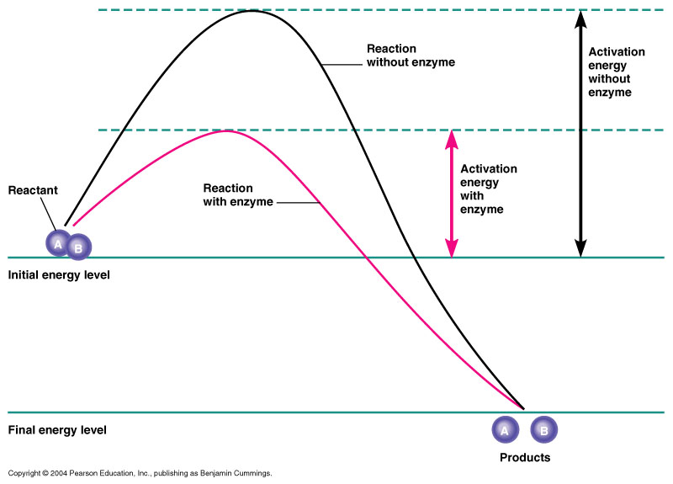
Enzymes Are Biological Catalysts
Figure 5.2

Slide 22
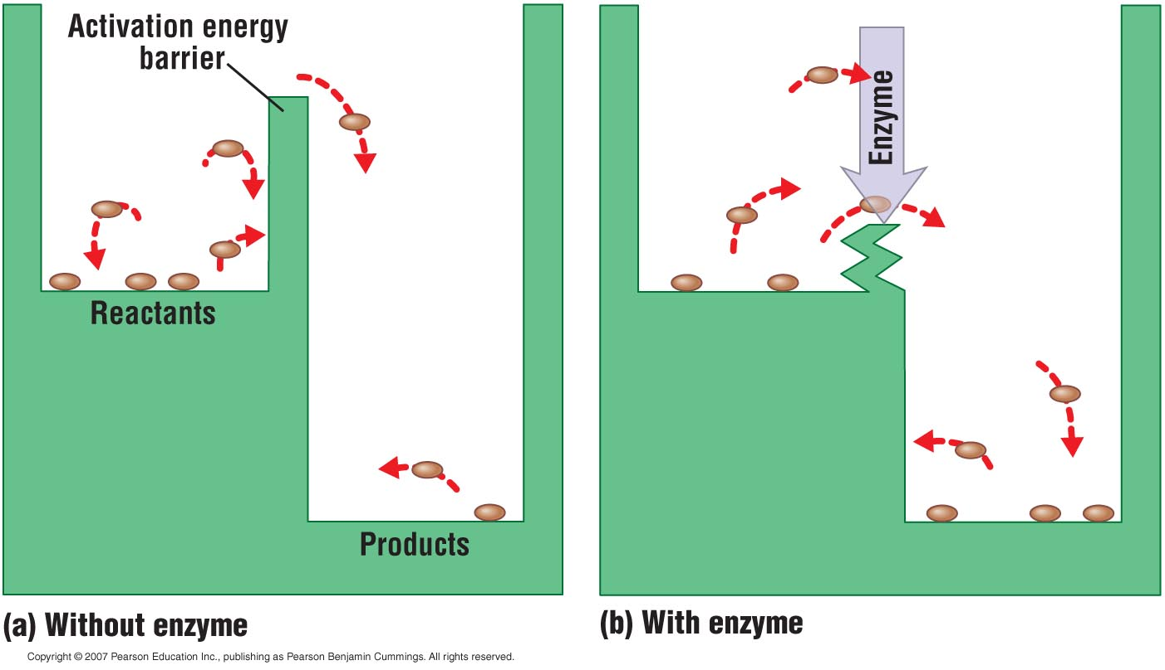
Enzymes Lower Activation Energy and Speed Up Reactions
Figure 5.8

Slide 23
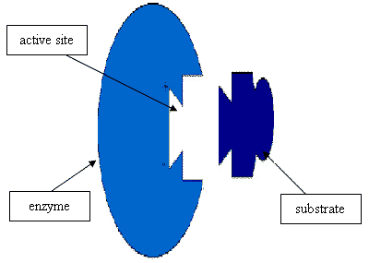
Enzyme Substrate Complex
One part of the enzyme is called the active site, which complexes with the substrate.
Fit together like “key and lock”. Induced Fit Model means that it undergoes slight change for optimum fit.
Every reaction requires
its specific enzyme

Slide 24
Factors Affecting Enzymatic Speed
Substrate Concentration: Enzyme activity increases as concentration increases. When all active sites filled, max rate, cannot increase any more
Temperature and pH:
Higher temperature increases enzyme activity. KMT, higher collision between enzyme and substrate. Too hot becomes denatured.
At optimal pH the reaction is highest. Extreme conditions of pH also denatures the enzyme
Enzyme Concentration: If there are too many enzymes present they can get in the way. Only certain enzymes work for certain substrates.
Enzyme Inhibition: when an active enzyme is prevented from combining with its substrate, eg. poisons.

Slide 25
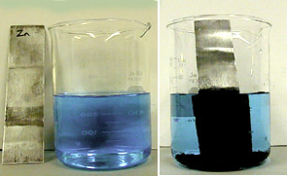
Oxidation-Reduction
Oxidation – the loss of electrons
Reduction – gain of electrons
Example: Na + Cl → NaCl
sodium has been oxidized, chlorine has been reduced
When oxidation and reduction go hand in hand it is called a redox reaction
This is an example of a spontaneous redox reaction. When zinc metal is placed in a solution of copper sulfate, the copper is reduced and appears as a black coating on the zinc.

Slide 26
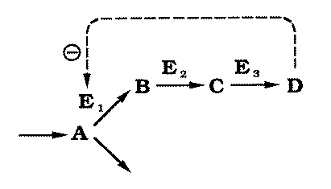
Metabolic Pathways & Enzymes
Reactions in cells occur usually because they are part of a metabolic pathway, series of linked reactions.
Enzyme is a protein molecule that functions as an organic catalyst to speed chemical reaction
Reactants in enzymatic reaction are called substrates for that enzyme

Slide 27
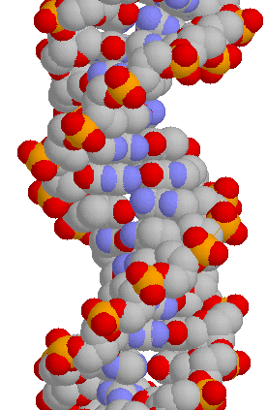
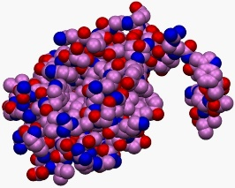
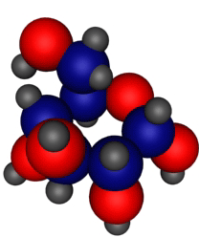
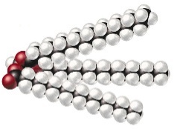
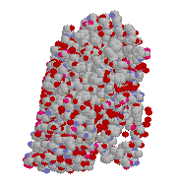
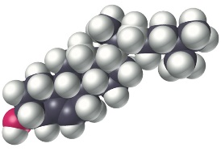
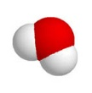

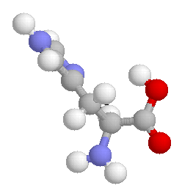
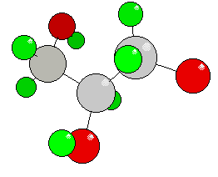
Metabolism: Breakdown of Food Fuels Construction of Biomolecules
Food molecules (high energy)
Complex biomolecules (high energy)
Breakdown
(Catabolism)
Energy from chemical bonds → Usable cellular energy (ATP)
Construction/ Synthesis (Anabolism)
Waste molecules (low energy)
Simple molecules (low energy)

Slide 28
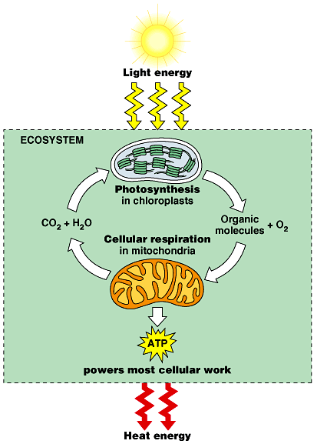
Photosynthesis and cellular respiration permit a Flow of Energy from the sun through all living things
Photosynthesis:
energy + carbon dioxcide + water → glucose + oxygen
Chloroplasts capture solar energy and convert it into ATP
Cellular Respiration:
Glucose + oxygen → carbon dioxcide + water + energy
When ATP is used up as an energy source, all useable energy is converted into heat

Slide 29
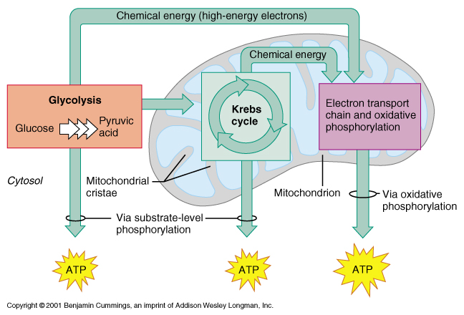

Slide 31
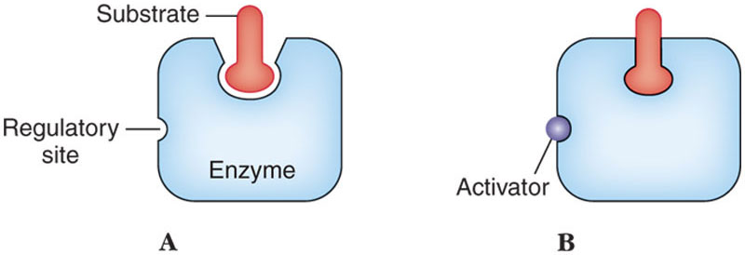
Regulating Cellular Respiration
Enzyme activity is controlled by presence or absence of metabolites that cause conformational changes in enzymes.
  Improves or decreases effectiveness as catalyst.

Slide 34
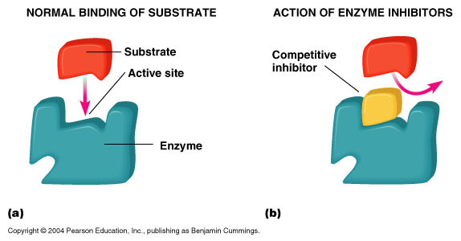
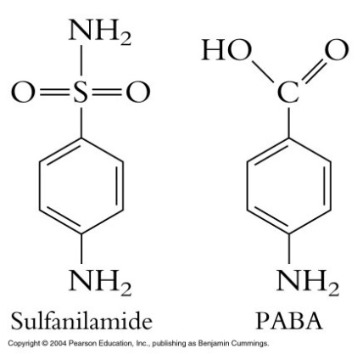
Factors Influencing Enzyme Activity
Competitive inhibition
Figure 5.7a, b

Slide 35
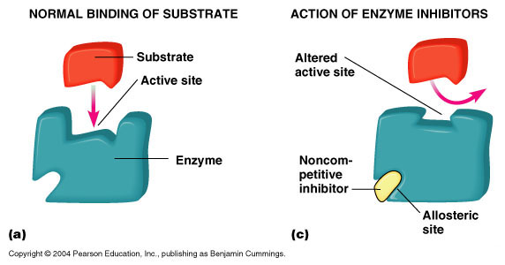
Factors Influencing Enzyme Activity
Noncompetitive inhibition
ATP, pyruvate, end amino acid
Figure 5.7a, c

Slide 36
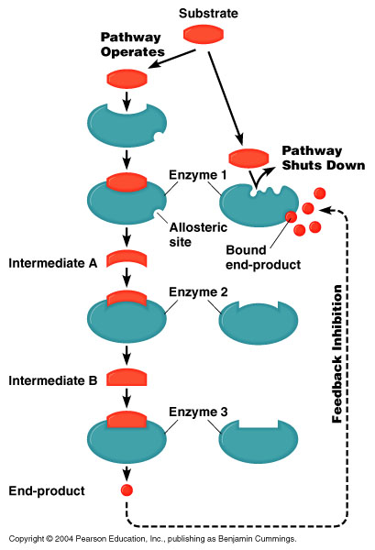
Factors Influencing Enzyme Activity
Feedback inhibition

Slide 37
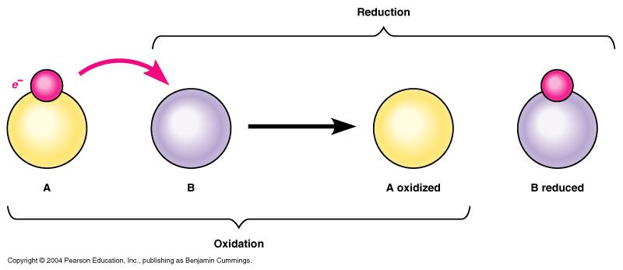
Oxidation-Reduction
Oxidation is the removal of electrons.
Reduction is the gain of electrons.
Redox reaction is an oxidation reaction paired with a reduction reaction.
OIL RIG: Oxidation is loss of e-, reduction is gain of e-
Figure 5.9

Slide 38
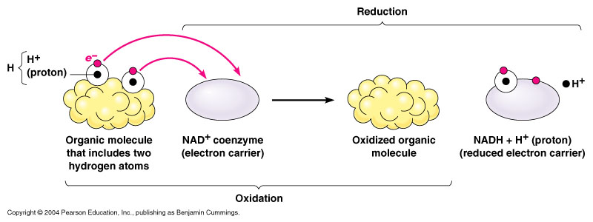
Oxidation-Reduction
In biological systems, the electrons are often associated with hydrogen atoms. Biological oxidations are often dehydrogenations.
Or FAD⁺ FADH₂
Sugars, amino acids, fatty acids
Figure 5.10

Slide 39
