Slide 1
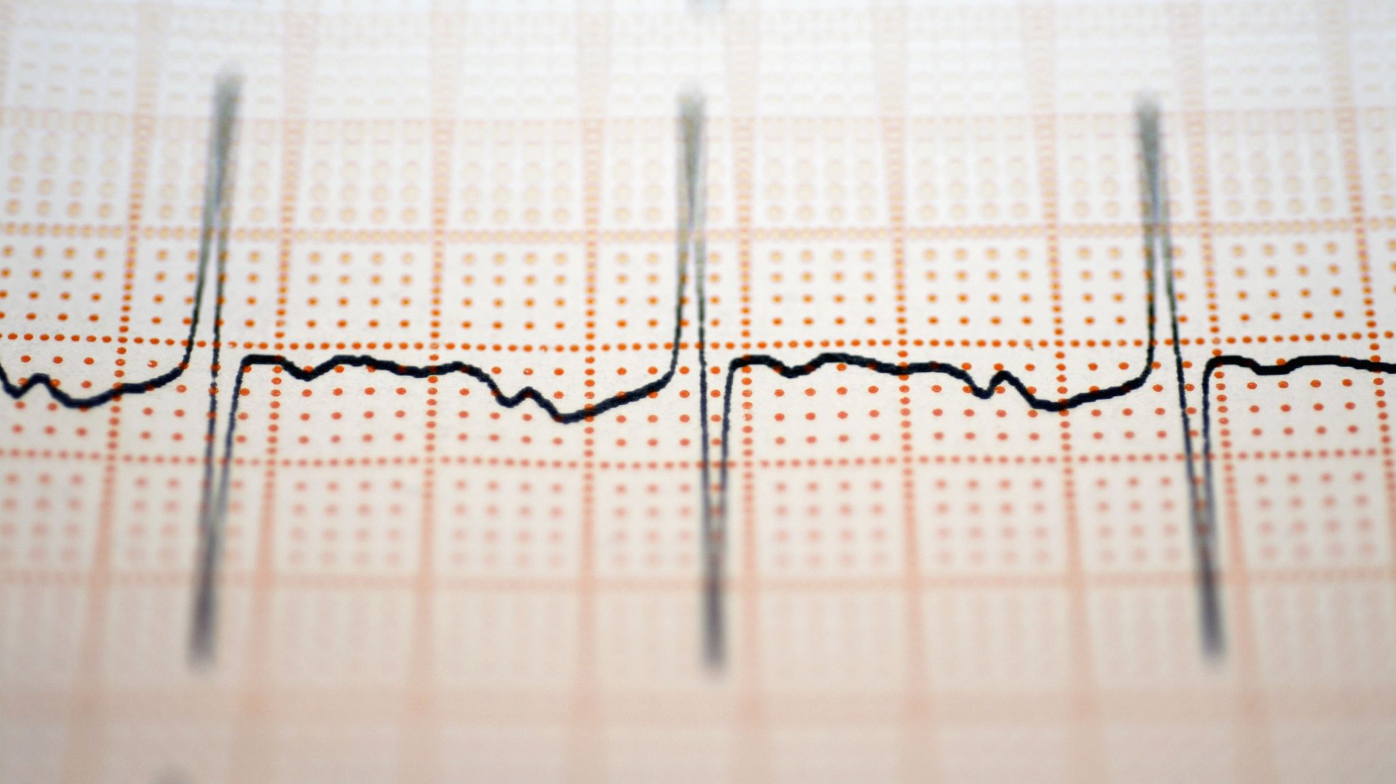
CAPILLARY ELECTROPHORESIS
DR ASIF AHMAD
FT 722

Slide 2
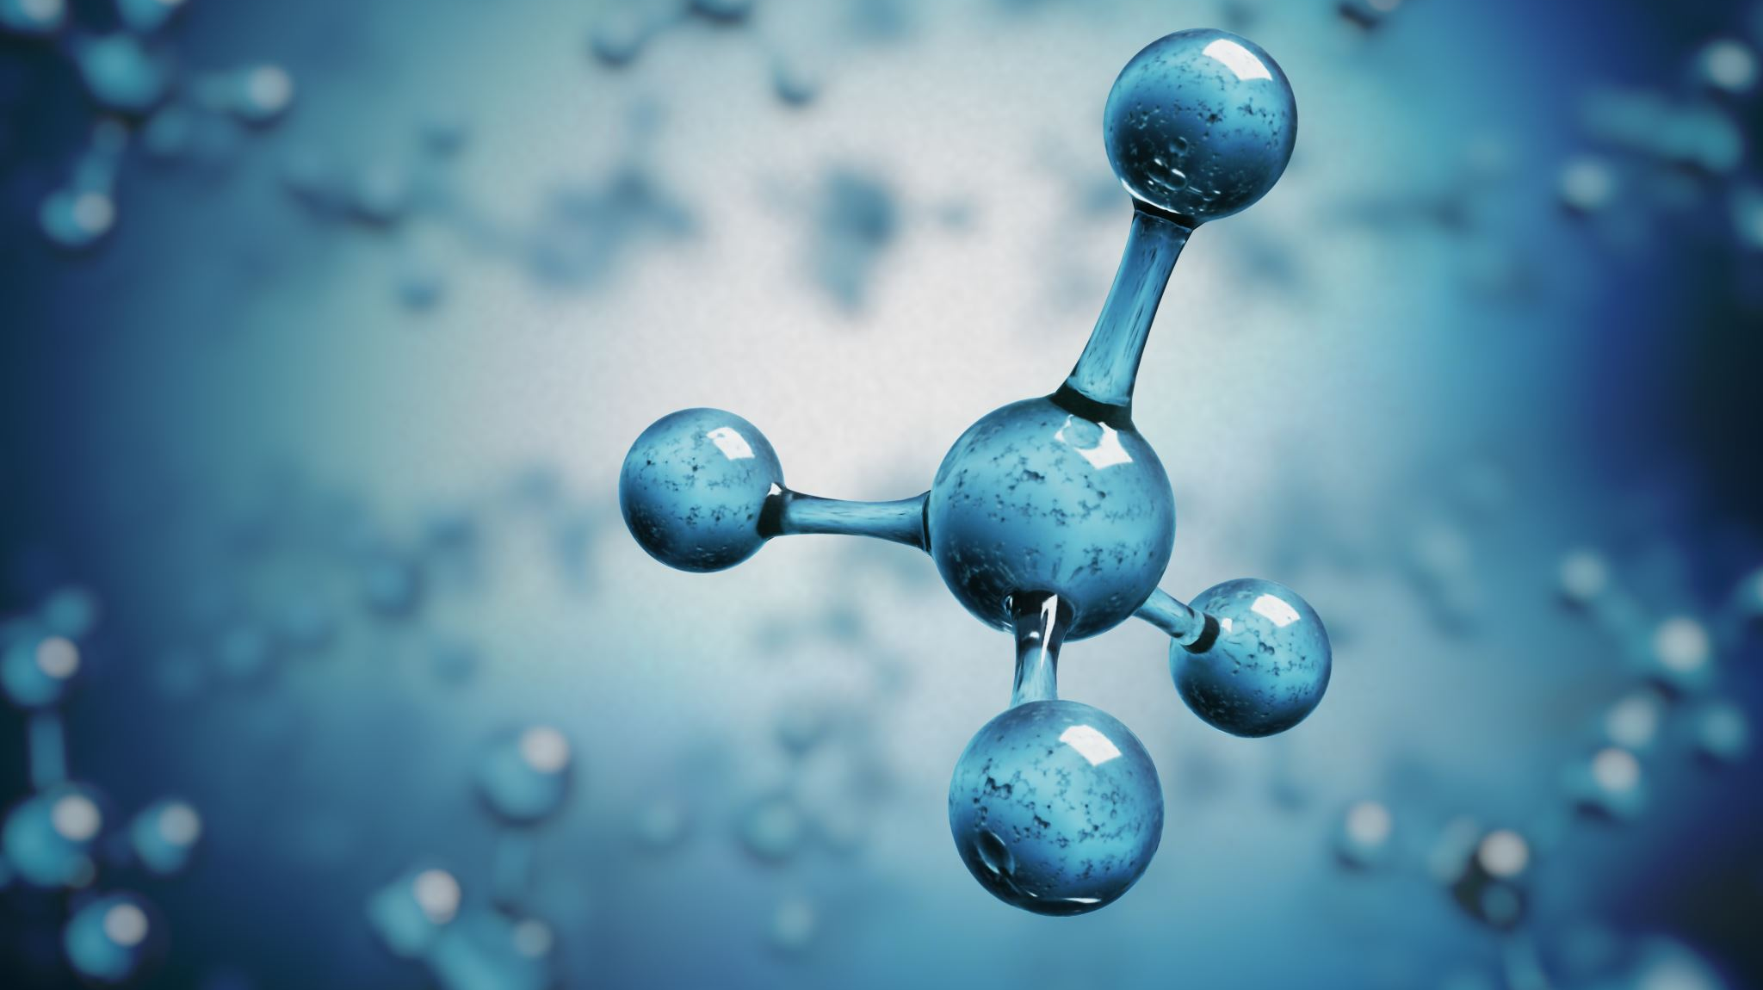
Capillary Electrophoresis (CE)
Capillary electrophoresis is an analytical technique that separates ions based on their electrophoretic mobility with the use of an applied voltage. The electrophoretic mobility is dependent upon the charge of the molecule, the viscosity, and the atom's radius.
In capillary electrophoresis, a high-voltage electric field is applied across the capillary filled with an electrolyte solution. The analyte mixture, which can consist of various biomolecules such as proteins, nucleic acids, carbohydrates, and small ions, is injected into the capillary. The applied electric field causes the charged analytes to migrate through the capillary at different rates based on their charge-to-size ratio.

Slide 3
Capillary electrophoresis (CE) is a separation technique that uses an electric field to separate charged molecules in a capillary. CE is a powerful analytical tool that can be used to identify and quantify a wide variety of compounds in food samples.

Slide 4
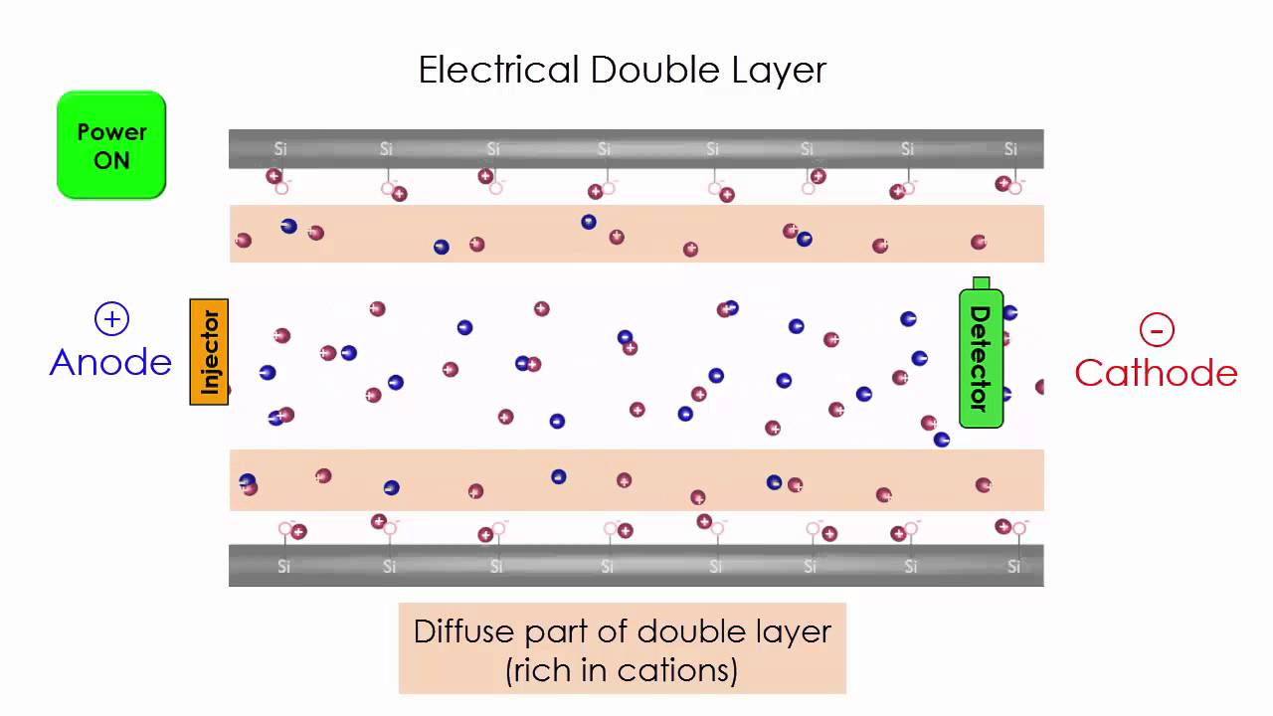
Capillary Electrophoresis
Capillary electrophoresis (CE) is a separation technique that uses an electric field to separate charged molecules in a capillary. CE is a powerful analytical tool that can be used to identify and quantify a wide variety of compounds in food samples.

Slide 5
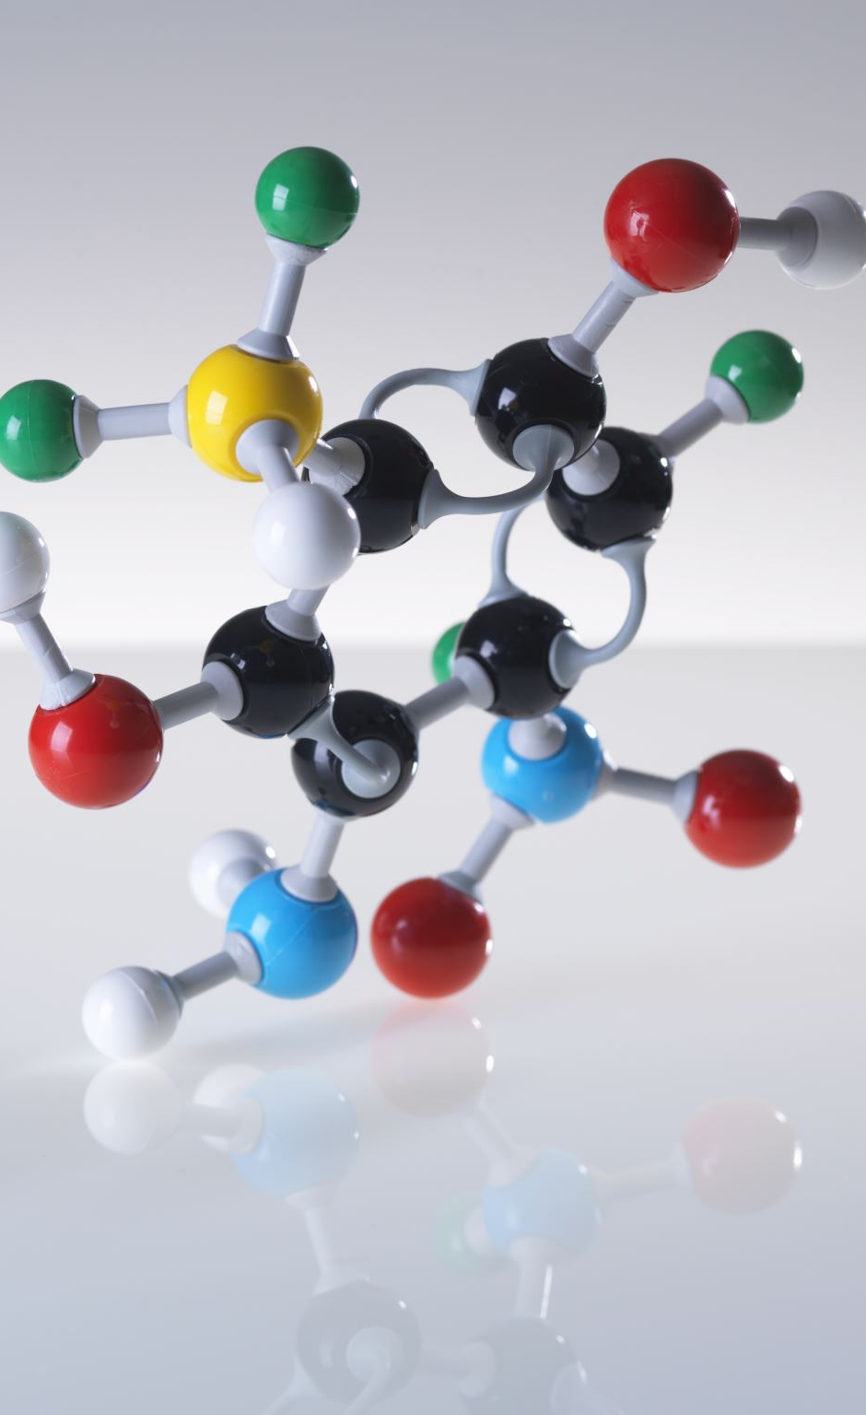
Working
The separation in CE is governed by different mechanisms, including electrophoretic mobility, electroosmotic flow, and molecular diffusion. Electrophoretic mobility refers to the movement of charged analytes in response to the electric field, while electroosmotic flow describes the movement of the buffer solution caused by the electric field. Molecular diffusion, on the other hand, is the random movement of analyte molecules due to thermal energy.
The separation is typically monitored by a detector located at the end of the capillary. Common detection methods used in CE include UV-Vis absorbance, fluorescence, and mass spectrometry. By analyzing the time and peak area or height of the separated analytes, one can determine their concentrations and other characteristics.

Slide 6
Working of CE
A capillary electrophoresis instrument consists of a capillary, a high-voltage power supply, and a detector. The capillary is a small, fused-silica tube that is filled with a buffer solution. The buffer solution is used to maintain a constant pH and ionic strength throughout the capillary.
The sample is injected into the capillary at one end. When an electric field is applied, the charged molecules in the sample will migrate towards the oppositely charged electrode. The molecules will migrate at different speeds, depending on their size, charge, and shape.
The detector is used to measure the concentration of the separated molecules. The most common type of detector for CE is a UV/Vis detector, which measures the amount of light that is absorbed by the molecules.

Slide 7
Contd….
The working principle of CE is based on the difference in electrophoretic mobility of the molecules. The electrophoretic mobility of a molecule is determined by its charge, size, and shape. The greater the charge and the smaller the size and shape of the molecule, the faster it will migrate in the electric field.
A capillary electrophoresis instrument consists of a capillary, a high-voltage power supply, and a detector. The capillary is a small, fused-silica tube that is filled with a buffer solution. The buffer solution is used to maintain a constant pH and ionic strength throughout the capillary.
The sample is injected into the capillary at one end. When an electric field is applied, the charged molecules in the sample will migrate towards the oppositely charged electrode. The molecules will migrate at different speeds, depending on their electrophoretic mobility.
The detector is used to measure the concentration of the separated molecules. The most common type of detector for CE is a UV/Vis detector, which measures the amount of light that is absorbed by the molecules.
The following are the steps involved in capillary electrophoresis:
The capillary is filled with a buffer solution.
The sample is injected into the capillary.
An electric field is applied to the capillary.
The molecules in the sample migrate towards the oppositely charged electrode.
The detector measures the concentration of the separated molecules.

Slide 8
Application of CE in Food sector
CE can be used to analyze a wide variety of compounds in food samples, including:
Carbohydrates
Amino acids
Proteins
Nucleic acids
Food additives
Pesticides
Pathogens

Slide 9
Advantages of CE
CE has several advantages over other analytical techniques, including:
High separation efficiency
Fast analysis time
Small sample size
Low cost

Slide 10
Limitation of CE
CE also has some disadvantages, including:
Complex sample preparation
Difficult to interpret results
Limited availability of trained personnel

Slide 11

Clinical Electrophoresis

Slide 12
Principles of Electrophoresis
The main principle behind capillary electrophoresis is that the ions or charged particles move towards the opposite pole under the influence of an electric current and separate from each other based on their sizes when certain filters are placed in the path of their movement.
It works such that the existence of charge separation between the surface of a particle and the fluid immediately surrounding it. An applied electric field acts on the resulting charge density, causing the particle to migrate and the fluid around the particle to flow.

Slide 13
Principles
Electrophoretic mobility and charge-to-size
The electrophoretic mobility is dependent upon the charge of the molecule, the viscosity, and the atom's radius. The rate at which the particle moves is directly proportional to the applied electric field--the greater the field strength, the faster the mobility.
Electroosmotic flow and molecular diffusion
The electroosmotic flow (EOF) is caused by applying high-voltage to an electrolyte-filled capillary. This flow occurs when the buffer running through the silica capillary has a pH greater than 3 and the SiOH groups lose a proton to become SiO⁻ ions. The capillary wall then has a negative charge, which develops a double layer of cations attracted to it. The inner cation layer is stationary, while the outer layer is free to move along the capillary. The applied electric field causes the free cations to move toward the cathode creating a powerful bulk flow.

Slide 14
Key factors influencing CE separation
Gel composition and strength (weight percentage of polymer)
Electric field strength.
Temperature.
Protein size, shape, and charge — which are in turn affected by. Buffer pH, ion type, and concentration. Addition of detergents or reducing agents.

Slide 15
Applications in Food industry
Food Quality Control
Detection and quantification of contaminants (pesticides, mycotoxins, heavy metals)
Analysis of food additives, preservatives, and sweeteners
CE can be used to assess the quality and safety of food products. It can detect and quantify contaminants, such as pesticides, mycotoxins, and heavy metals, which can affect food safety. CE is also employed to analyze food additives, preservatives, and sweeteners to ensure compliance with regulatory standards.

Slide 16
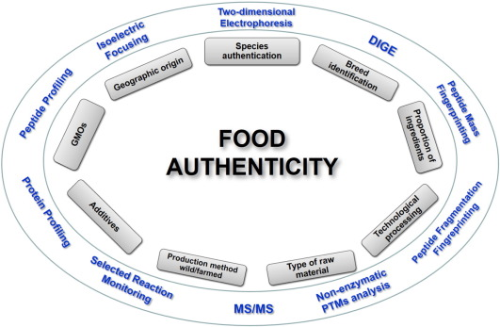
2. Food Authentication
CE can help in verifying the authenticity and origin of food products. By analyzing specific compounds or markers, CE can identify fraudulent activities, such as adulteration, mislabeling, or substitution of ingredients in food products.

Slide 17
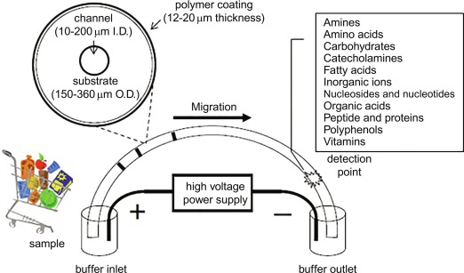
3. Nutrition Analysis
CE can determine and quantify various nutrients and components in food, including vitamins, amino acids, carbohydrates, and organic acids. This information is essential for assessing the nutritional content and labeling of food products.

Slide 18
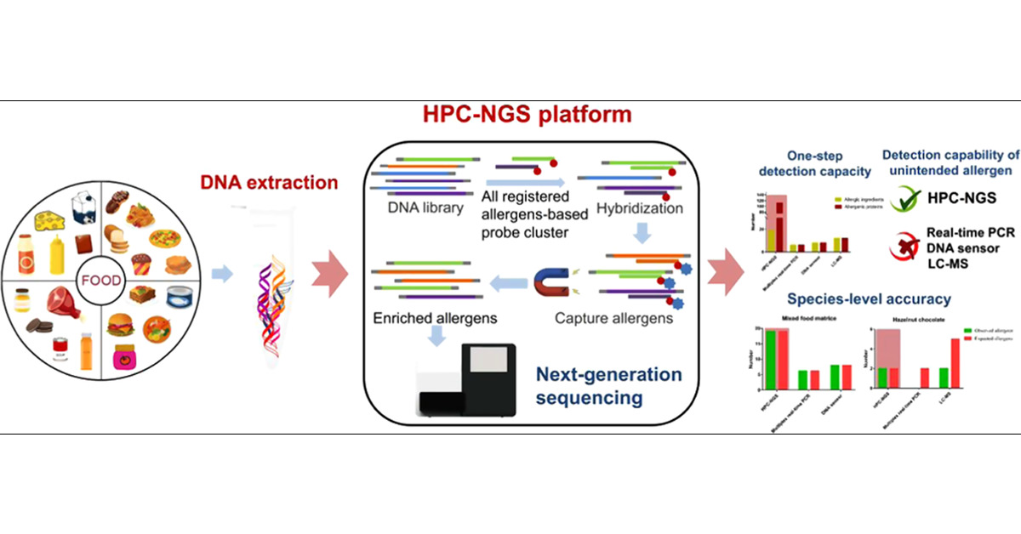
4. Allergen Detection
CE can be employed to detect and quantify allergenic proteins in food samples. It is particularly useful for identifying allergens that may be present in trace amounts and could cause severe allergic reactions in sensitive individuals.

Slide 19
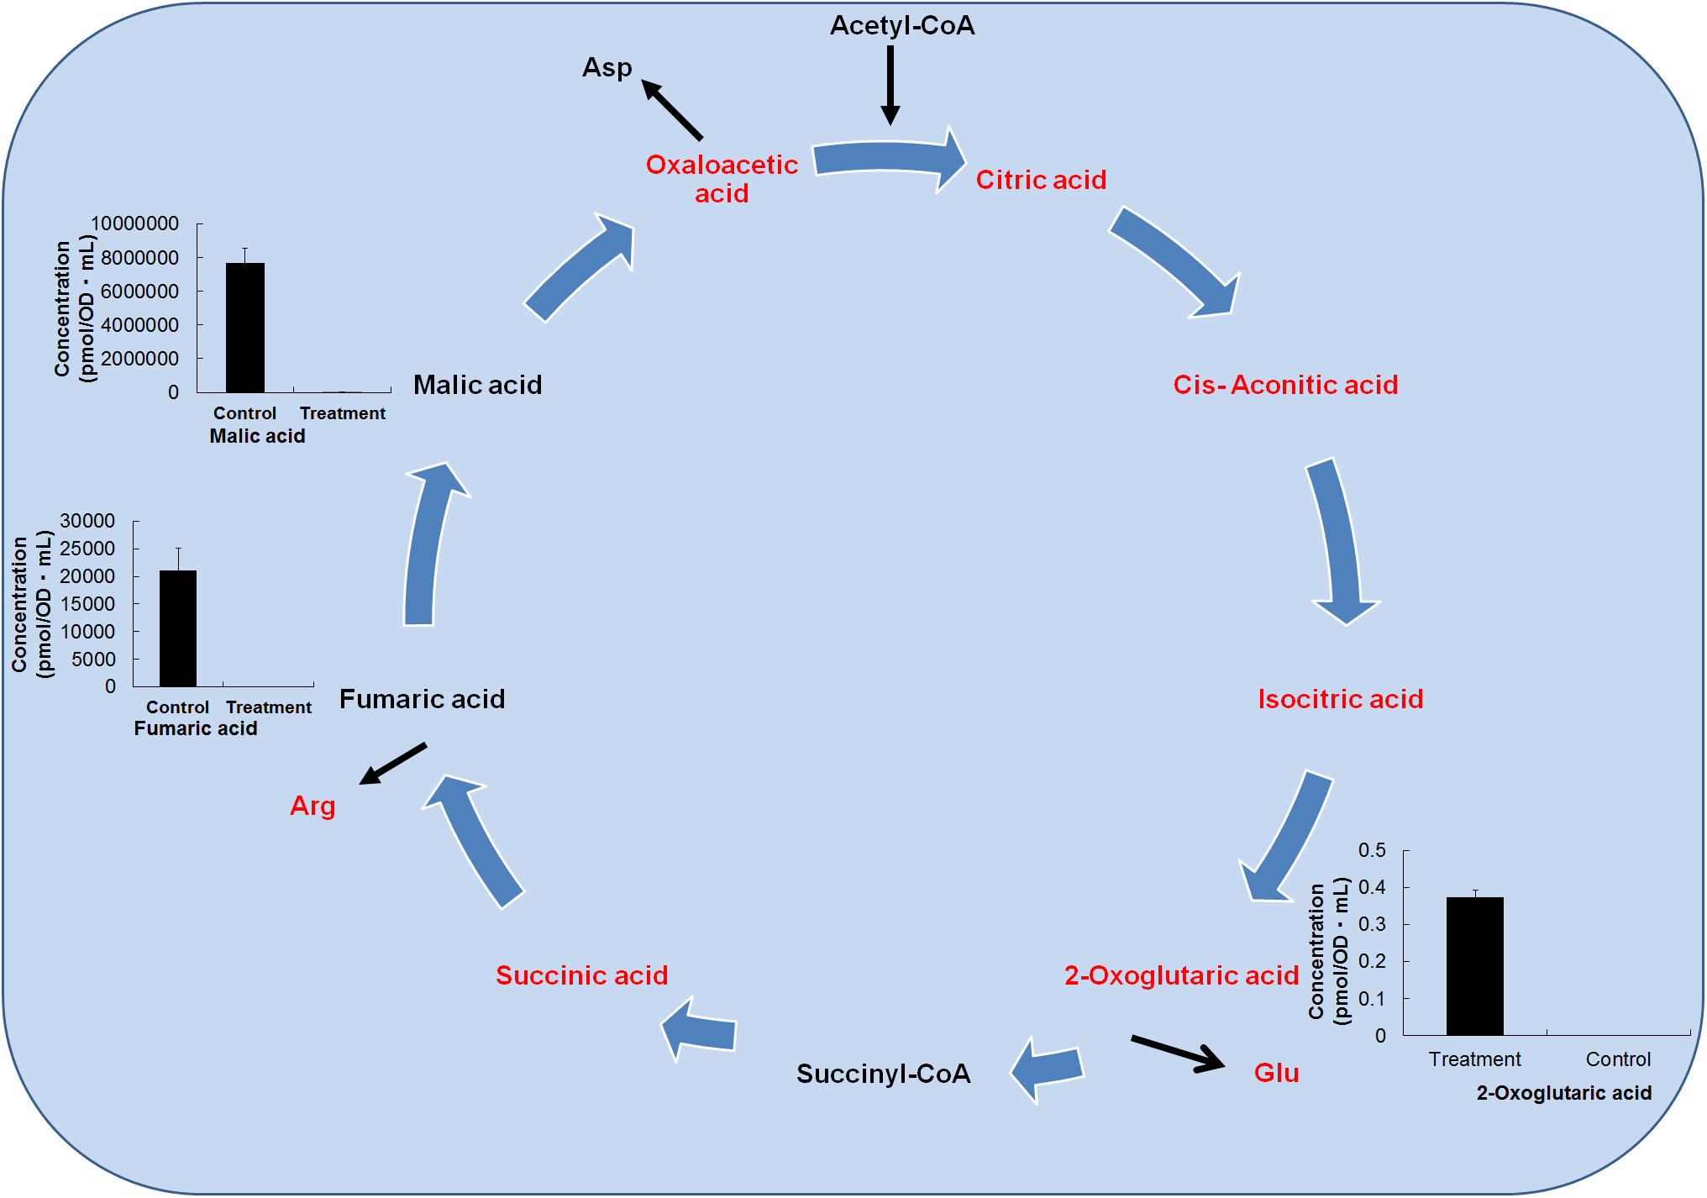
5 Food Fermentation Monitoring
CE can monitor the progress of fermentation processes in the food industry. It can assess the production of organic acids, sugars, alcohols, and other metabolites, providing insights into the fermentation kinetics and the quality of the final product.

Slide 20
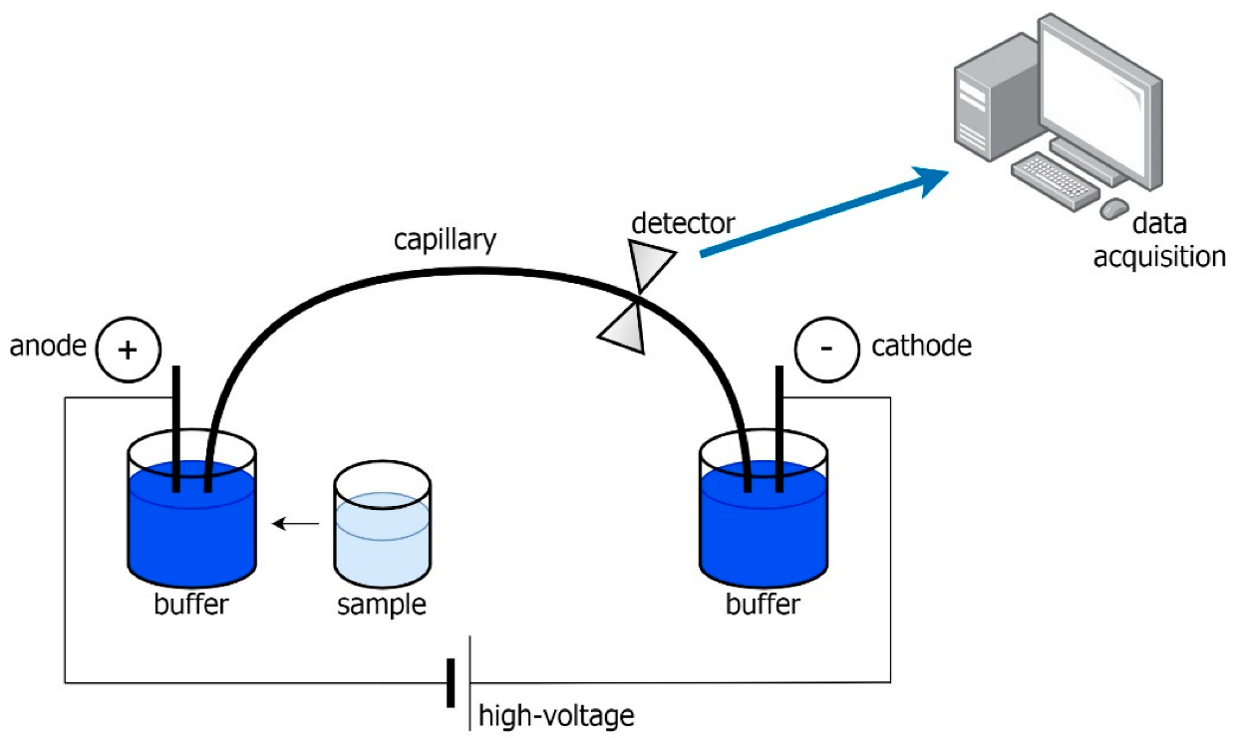
6. Flavor Analysis
CE can help identify and quantify flavor compounds present in food and beverages. By separating and analyzing volatile compounds responsible for aroma and taste, CE assists in flavor profiling and quality control of food products.

Slide 21
7. Food Contaminant Analysis
CE can be used to detect and quantify various contaminants in food samples, such as food dyes, mycotoxins, veterinary drug residues, and environmental pollutants. This aids in ensuring food safety and compliance with regulatory standards.

Slide 22
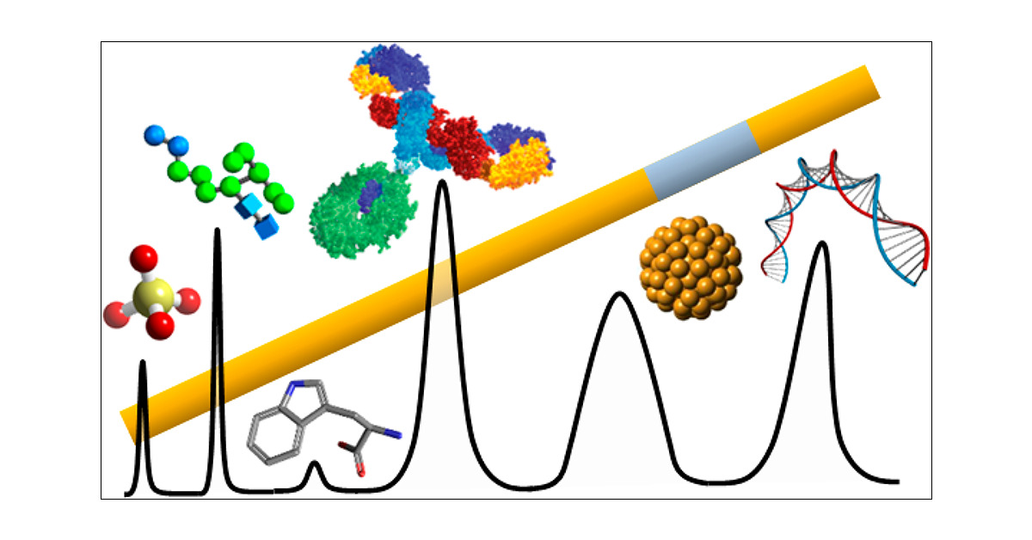
Recent Advances and Trends in Capillary Electrophoresis
Capillary electrophoresis in industry is used to analyse products such as; food additives, herbicide, animal nutrition, and detergents. In particular, CZE is used to separate and identify the small molecules existing in these types of samples.

Slide 23
Advantages
Capillary electrophoresis offers several advantages over traditional gel electrophoresis, including higher separation efficiency, faster analysis times, lower sample and reagent consumption, and compatibility with small sample volumes. It finds applications in various fields such as pharmaceutical analysis, environmental analysis, forensic science, biotechnology, and DNA sequencing, among others.
Overall, capillary electrophoresis is a versatile and powerful technique for the separation and analysis of charged molecules, providing valuable insights into the composition and characteristics of complex mixtures.

Slide 24

THANKYOU

