Slide 1
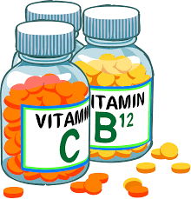
Clinical Manifestations of Water-Soluble Vitamin Deficiencies: Diagnosis and Treatment Strategies
PROF. DR. ASIF AHAMD
IFNS- PMAS UAAR

Slide 2
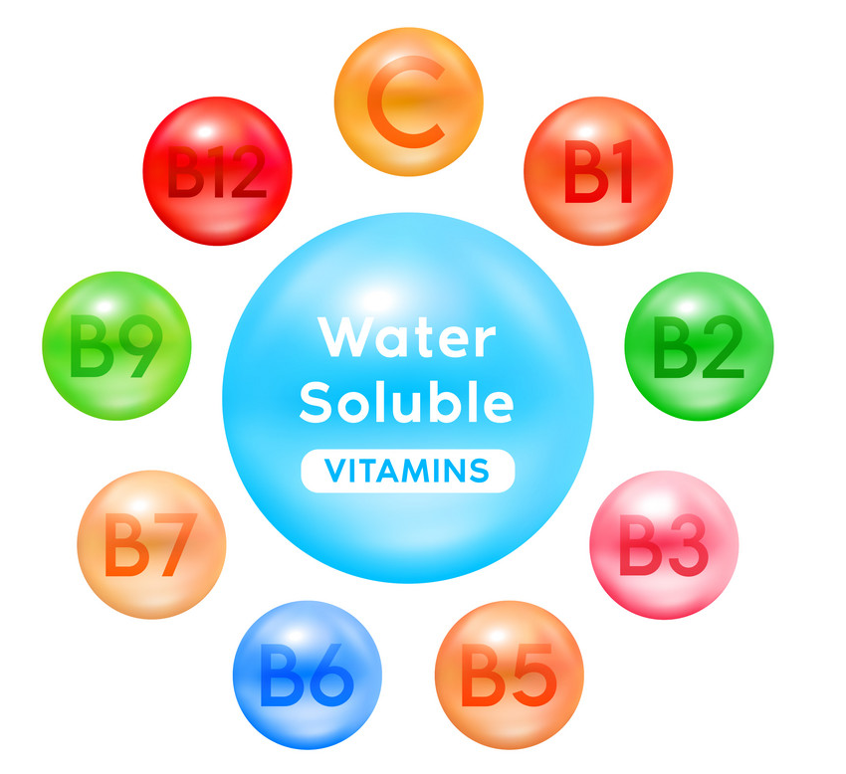
INTRODUCTION
Water-soluble vitamins include B-complex vitamins and vitamin C, essential for various metabolic processes and overall health.
These vitamins play critical roles in energy metabolism, red blood cell formation, and neurological function.
Common in populations with poor dietary habits, malabsorption disorders, or increased physiological demands (e.g., pregnancy).
Deficiencies can lead to a range of health issues, including:
  Anemia (e.g., B12 and folate deficiency)
  Neurological disorders (e.g., thiamine and B6 deficiency)
  Skin issues (e.g., riboflavin and niacin deficiency)
Diagnosis: Involves a combination of clinical evaluation, dietary assessment, and laboratory tests to determine specific vitamin deficiencies.
Treatment Strategies: May include:
  Dietary modifications to increase intake of vitamin-rich foods
  Supplementation as needed
  Management of underlying health conditions affecting absorption

Slide 3
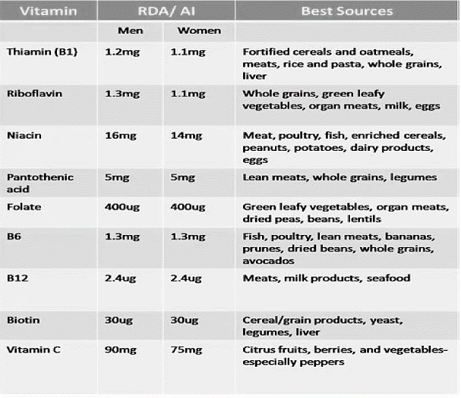
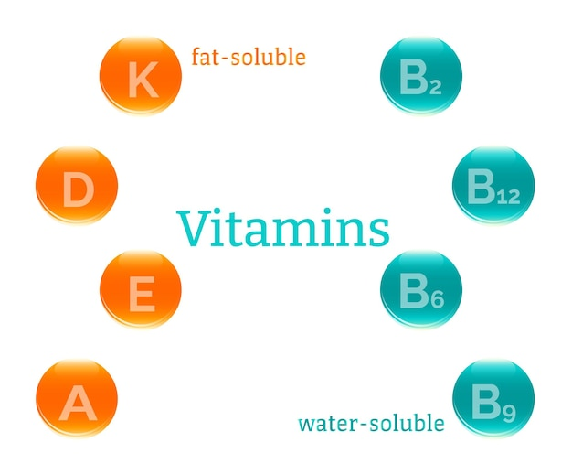

Slide 4
WATER SOLUBLE VITAMINS AND THEIR ROLE
Vitamin C
Offers antioxidant properties and aids collagen synthesis, vital for skin health.
Vitamin B1 (Thiamine)
Essential for carbohydrate metabolism, helping convert food into energy.
Vitamin B2 (Riboflavin)
Crucial for energy production, supporting the body's energy levels.
Vitamin B3 (Niacin)
Important for DNA repair and metabolism, contributing to overall cellular function.
Vitamin B9 (Folate)
Crucial for DNA synthesis and cell division, important during pregnancy.
Vitamin B6 (Pyridoxine)
Key player in neurotransmitter synthesis, impacting mood and cognitive functions.
Vitamin B7 (Biotin)
Involved in fatty acid synthesis, essential for skin and hair health.
Vitamin B5 (Pantothenic Acid)
Important for DNA repair and metabolism, contributing to overall cellular function.
Vitamin B12 (Cobalamin)
Important for red blood cell formation and neurological function, crucial for energy levels.

Slide 5
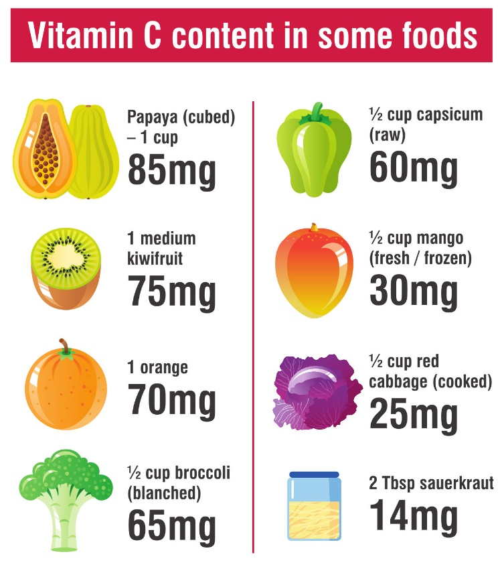
CLINICAL MANIFESTATIONS OF VITAMIN C DEFICIENCY
Clinical Manifestations | Description
Fatigue and Weakness | Generalized fatigue and weakness due to impaired collagen synthesis.
Skin Changes | - Petechiae: Small red or purple spots. - Ecchymosis: Larger bruises. - Dry, rough skin: Changes in skin texture due to lack of collagen.
Oral Manifestations | - Swollen, bleeding gums: Inflammation and bleeding. - Periodontal disease: Gum deterioration and tooth loss. - Oral ulcers: Sore spots in the mouth.
Joint and Muscle Pain | Swelling and pain in joints due to hemorrhage in connective tissues.
Anemia | Symptoms of anemia such as pallor and shortness of breath due to low hemoglobin.
Impaired Wound Healing | Slow healing of cuts and wounds due to compromised collagen formation.
Mood Changes | Depression, irritability, and mood swings linked to neurotransmitter synthesis.
Scurvy | Severe symptoms if untreated, including extreme fatigue, severe joint pain, and risk of infections.

Slide 6
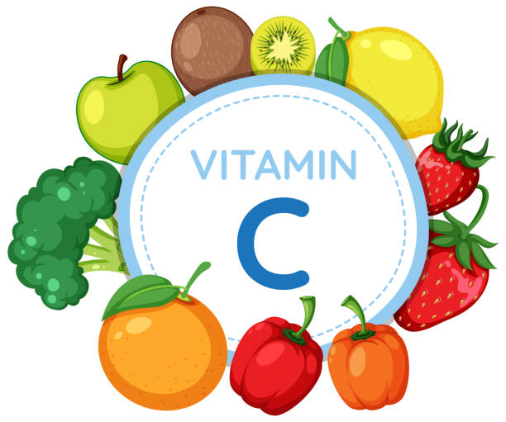
DIAGNOSIS
Clinical Evaluation
Medical History: The healthcare provider will take a detailed history to assess dietary intake, any underlying medical conditions, and symptoms experienced by the patient. Key questions may include:
  Dietary habits (fruits and vegetables consumed)
  Presence of symptoms (fatigue, skin changes, oral issues)
  History of alcohol use or gastrointestinal disorders that may affect absorption.
Physical Examination
A thorough physical examination may reveal signs of deficiency, such as:
  Petechiae or ecchymosis on the skin
  Swollen and bleeding gums
  Joint swelling or tenderness
Laboratory Tests
Serum Vitamin C Levels: A blood test is performed to measure the concentration of ascorbic acid in the serum.
  Normal levels: Typically above 0.6 mg/dL (34 µmol/L).
  Deficiency: Levels below 0.2 mg/dL (11 µmol/L) indicate deficiency.
Complete Blood Count (CBC): This test helps assess for anemia and other blood-related issues.
Iron Studies
May be conducted if anemia is present to determine iron status, as Vitamin C enhances iron absorption.

Slide 7

TREATMENT
Supplementation
Oral Vitamin C:
  Initial treatment typically involves high doses of oral ascorbic acid. Common dosages range from 500 mg to 1,000 mg daily.
  Dosage may be adjusted based on the severity of deficiency and individual response.
Intravenous Vitamin C
  In cases of severe deficiency or malabsorption (e.g., in patients with certain gastrointestinal disorders), intravenous administration may be necessary.
Dietary Changes
Increased Intake of Vitamin C-Rich Foods:
  Encourage patients to consume a diet rich in fresh fruits and vegetables. Key sources include:
    Citrus fruits (oranges, grapefruits)
    Berries (strawberries, blueberries)
    Kiwi, Bell peppers
    Broccoli, Tomatoes
Education on Food Preparation:
  Patients should be informed that cooking can destroy Vitamin C, so it is beneficial to consume some foods raw or lightly cooked.
Monitoring and Follow-Up
Regular Follow-Up Appointments:
  Schedule follow-up visits to monitor symptoms and ensure compliance with treatment.
  Repeat serum Vitamin C tests may be conducted to assess improvement.
Evaluation of Dietary Habits:
  Continuous assessment of dietary intake to ensure the patient maintains a balanced diet

Slide 8
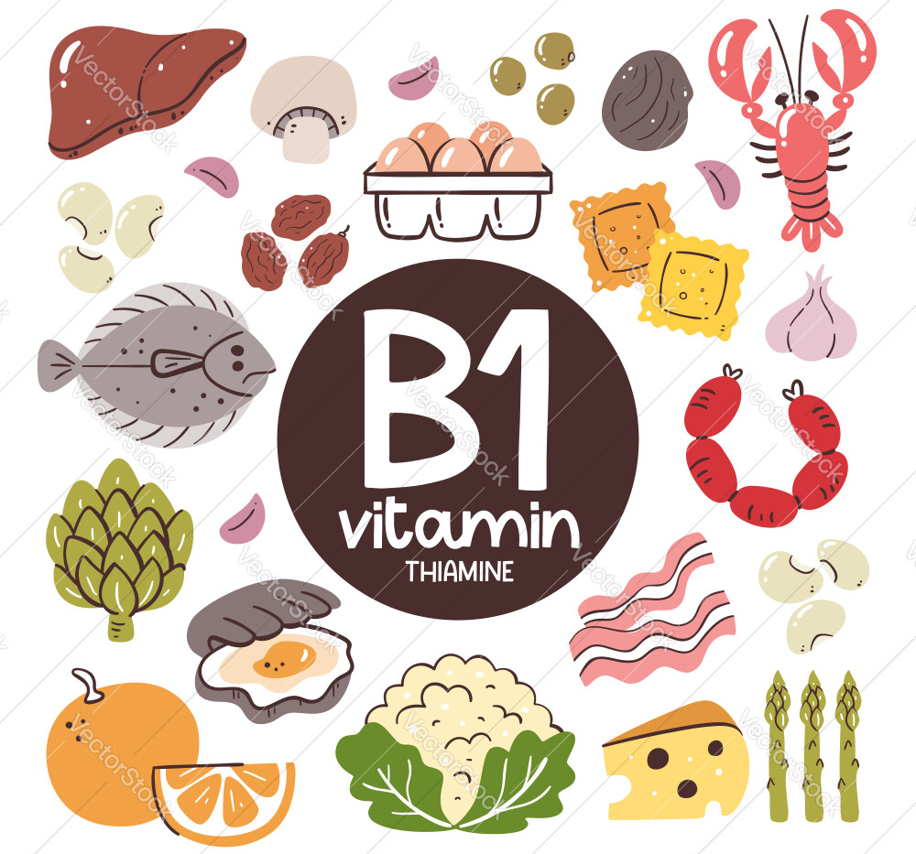
CLINICAL MANIFESTATIONS OF THIAMINE
Clinical Manifestations | Description
Fatigue and Weakness | Generalized fatigue and muscle weakness due to impaired energy metabolism.
Neurological Symptoms | - Peripheral Neuropathy: Tingling, numbness, or burning sensations in extremities. - Wernicke's Encephalopathy: Confusion, ataxia, and ophthalmoplegia. - Korsakoff Syndrome: Severe memory problems and cognitive impairment.
Cardiovascular Symptoms | - Beri Beri (Wet Type): Edema, tachycardia, and potential heart failure. - Beri Beri (Dry Type): Muscle wasting, weakness, and less cardiovascular involvement.
Gastrointestinal Symptoms | Loss of appetite, nausea, and abdominal discomfort due to impaired metabolism.
Mood Changes | Irritability, anxiety, and mood disturbances linked to neurological effects.

Slide 9

DIAGNOSIS
Diagnosing Vitamin B1 deficiency involves a combination of clinical evaluation, history-taking, and laboratory tests. Here’s a detailed breakdown:
Clinical Evaluation
Medical History:
  Dietary Intake: Assess the patient's diet for thiamine-rich foods. Common dietary sources include whole grains, legumes, nuts, seeds, and pork. Inquire about any restrictive diets or food preferences.
  Alcohol Consumption: Excessive alcohol intake is a significant risk factor for thiamine deficiency due to poor dietary habits and impaired absorption.
  Medical History: Note any underlying conditions such as:
    Chronic illnesses (e.g., diabetes, kidney disease)
    Malabsorption disorders (e.g., celiac disease, Crohn's disease)
    Previous gastrointestinal surgeries (e.g., gastric bypass)
Symptoms Assessment:
  Document the presence of symptoms associated with deficiency, such as fatigue, weakness, neurological signs (tingling, numbness), and cardiovascular symptoms (edema, rapid heartbeat).

Slide 10
Physical Examination
Conduct a thorough physical examination to identify signs of deficiency:
  Neurological Assessment: Evaluate for signs of peripheral neuropathy (reflexes, sensory testing) and cognitive function (orientation, memory).
  Cardiovascular Assessment: Check for tachycardia, heart murmurs, or signs of heart failure (e.g., edema).
  General Examination: Look for signs of malnutrition, such as weight loss or muscle wasting.
Laboratory Tests
Serum Thiamine Levels:
  A blood test is performed to measure thiamine concentration. Normal levels typically range from 70 to 180 nmol/L. Levels below 70 nmol/L indicate deficiency.
Transketolase Activity Test:
  This test measures the activity of the enzyme transketolase in red blood cells. A decrease in activity after administering thiamine (typically via IV) indicates a deficiency.
  The test is particularly useful in assessing functional thiamine status, as it can detect deficiency even when serum levels may still be borderline.
Complete Blood Count (CBC):
  Conduct a CBC to check for anemia, which may occur due to thiamine deficiency. Look for low hemoglobin and hematocrit levels.
Additional Tests (if indicated):
  Liver Function Tests: To assess the overall health of the liver, which may be affected by alcohol use.
  Thyroid Function Tests: As hypothyroidism can affect metabolism and may coexist with thiamine deficiency.

Slide 11

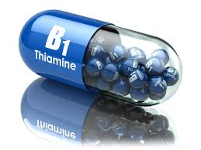
TREATMENT
Treatment | Description
Supplementation | - Oral Thiamine: 100 mg to 300 mg daily for mild to moderate cases. - Intravenous Thiamine: Up to 500 mg in severe cases (e.g., Wernicke's encephalopathy).
Dietary Changes | Increased intake of thiamine-rich foods such as whole grains, legumes, nuts, and pork.
Monitoring and Follow-Up | Regular follow-up to assess symptom resolution and adherence to treatment.
Patient Education | Educate about the importance of thiamine and dietary sources to prevent deficiency.

Slide 12
CLINICAL MANIFESTATIONS OF RIBOFLAVIN
Clinical Implication | Details
Signs and Symptoms | - Angular Cheilitis: Cracks and sores at the corners of the mouth. - Stomatitis: Inflammation of the mouth lining. - Glossitis: Inflammation of the tongue, smooth and discolored appearance. - Seborrheic Dermatitis: Greasy, scaly patches on the face and scalp. - Eye Symptoms: Photophobia, corneal vascularization, potential cataract formation.
Metabolic Implications | - Energy Production: Impaired ATP production due to reduced flavoprotein function. - Fatty Acid Oxidation: Reduced efficiency in fat metabolism.
Impact on Other Nutrients | - Impaired metabolism of Vitamin B6 and Niacin (Vitamin B3), affecting neurotransmitter synthesis and tryptophan conversion. - Potential impact on iron metabolism, leading to anemia.
Increased Risk in Certain Populations | - Infants and Children: Higher demand during growth periods. - Pregnant and Lactating Women: Increased nutritional needs. - Individuals with Malabsorption Disorders: Conditions like celiac disease or Crohn's disease impair absorption.
Associated Conditions | - Mouth and Skin Conditions: Various oral and dermatological issues. - Migraine: Possible reduction in migraine frequency with riboflavin supplementation.

Slide 13
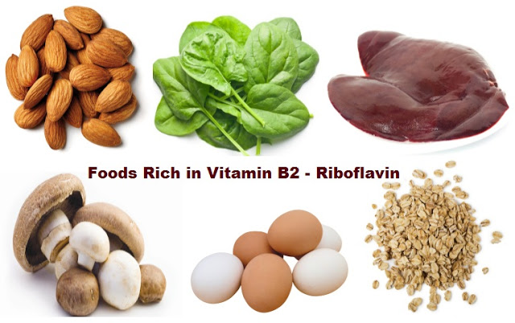
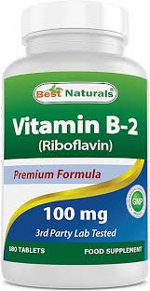
DIAGNOSIS AND TREATMENT
Diagnosis
Diagnosis typically involves assessing clinical signs, dietary intake, and, in some cases, measuring riboflavin levels in urine.
Treatment and Prevention
Dietary Sources: Emphasize the importance of riboflavin-rich foods, including dairy products, eggs, lean meats, green leafy vegetables, and fortified cereals.
Supplementation: In cases of deficiency, riboflavin supplements may be necessary to restore levels and alleviate symptoms.

Slide 14

Clinical Implication | Details
Signs and Symptoms | - Pellagra: Characterized by the three D's: - Dermatitis: Skin lesions in sun-exposed areas (rough, scaly patches). - Diarrhea: Gastrointestinal disturbances leading to watery stools. - Dementia: Cognitive decline, confusion, and neurological changes. - Glossitis: Inflammation of the tongue, smooth and swollen appearance. - Fatigue and Weakness: General feelings of tiredness and reduced energy levels.
Metabolic Implications | - Energy Production: Impaired ATP production due to reduced synthesis of NAD and NADP. - Fatty Acid and Cholesterol Metabolism: Impact on lipid metabolism, cholesterol levels, and cardiovascular health.
Impact on Other Nutrients | - Tryptophan Conversion: Niacin synthesized from tryptophan; deficiency may indicate inadequate protein intake. - Interactions with Other B Vitamins: Affects the functions of other B vitamins in metabolic pathways.
Increased Risk in Certain Populations | - Individuals with Malnutrition: Higher risk due to poor dietary intake. - Chronic Alcohol Users: Impaired absorption and metabolism of niacin. - Individuals with Medical Conditions: Conditions like Hartnup disorder affect tryptophan absorption.
Associated Conditions | - Cardiovascular Disease: Low niacin levels contribute to dyslipidemia and increased heart disease risk. - Neurological Issues: Long-term deficiency may lead to cognitive decline and mood disorders.
CLINICAL MANIFESTATIONS OF NIACIN

Slide 15

DIAGNOSIS
TREATMENT
Clinical Evaluation
Assess medical history focusing on dietary habits and intake of niacin-rich foods (meat, fish, legumes, nuts, whole grains).
Inquire about restrictive diets or underlying health conditions that may affect absorption (e.g., gastrointestinal disorders).
Physical Examination
Look for signs of dermatitis, especially in sun-exposed areas (characteristic of pellagra).
Conduct a neurological assessment to evaluate cognitive function and detect any mental status changes.
Laboratory Tests
Measure urinary niacin metabolites (e.g., N-methyl nicotinamide) to indicate niacin levels.
Perform serum niacin level tests (less common but possible).
Conduct a Complete Blood Count (CBC) to check for anemia.
Dietary Management:
  Encourage increased intake of niacin-rich foods:
    Meat (especially poultry and fish).
    Legumes (beans and peas).
    Nuts (peanuts, almonds).
    Whole grains (brown rice, oats).
    Fortified cereals.
Supplementation
  Prescribe oral niacin supplements if dietary intake is insufficient or symptoms persist:
    Typical dosages range from 100 to 500 mg per day, depending on deficiency severity.
  Consider intravenous niacin in severe cases or for individuals unable to take oral supplements.
Monitoring and Follow-Up
  Regularly assess symptom improvement and dietary intake.
  Adjust supplementation dosages based on patient response and potential side effects (e.g., flushing, gastrointestinal upset).

Slide 16
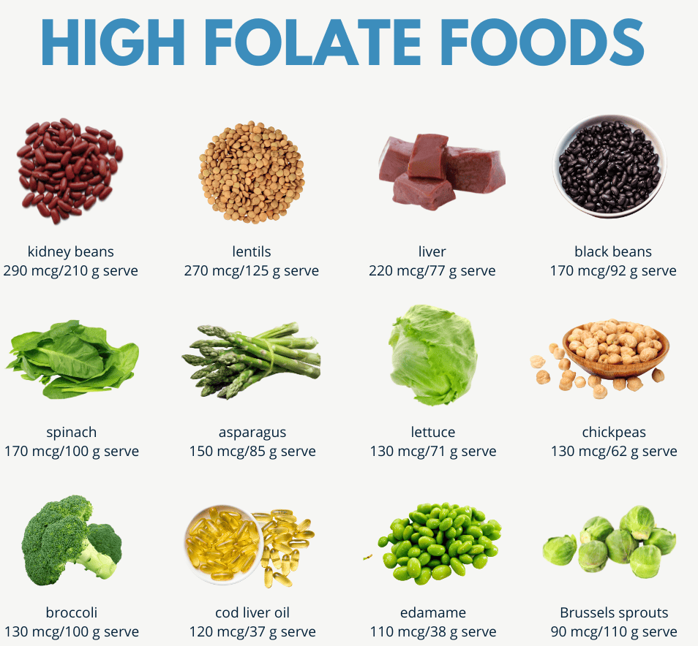

CLINICAL MANIFESTATIONS OF FOLATE
Clinical Implication | Details
Signs and Symptoms | - Megaloblastic Anemia: Fatigue, weakness, pallor due to large, immature red blood cells. - Glossitis: Inflammation and swelling of the tongue; smooth and red appearance. - Neural Tube Defects: Increased risk of congenital anomalies (e.g., spina bifida, anencephaly) in developing fetuses. - Mood Disorders: Higher risk of depression and cognitive decline.
Metabolic Implications | - DNA and RNA Synthesis: Essential for nucleotide production and cell division. - Homocysteine Metabolism: Deficiency can lead to elevated homocysteine levels, increasing cardiovascular disease risk.
Impact on Other Nutrients | - Vitamin B12 Interaction: Deficiency in folate can mask vitamin B12 deficiency, complicating diagnosis and treatment.
Increased Risk in Certain Populations | - Pregnant and Lactating Women: Higher requirements during these periods. - Individuals with Malabsorption Disorders: Conditions like celiac disease or Crohn's disease impair absorption. - Chronic Alcohol Users: Alcohol interferes with folate absorption and metabolism.
Associated Conditions | - Cardiovascular Disease: Elevated homocysteine levels from deficiency can increase heart disease risk. - Cognitive Impairment: Long-term deficiency may increase risk of dementia.

Slide 17
Diagnosis
Clinical Assessment | Medical History: - Review dietary intake for folate-rich foods (leafy greens, legumes, fortified grains). - Inquire about restrictive diets and symptoms (fatigue, mood changes). - Physical Examination: - Look for signs of megaloblastic anemia (pallor, jaundice). - Check for glossitis or other oral manifestations.
Laboratory Tests | Serum Folate Level: - Measure folate concentration in blood (normal: 3-17 ng/mL; deficiency: <3 ng/mL). - Red Blood Cell Folate Level: - Assess folate in red blood cells (normal: >160 ng/mL; deficiency: <160 ng/mL). Homocysteine Level: - Measure blood homocysteine levels; elevated levels may indicate deficiency.
Additional Tests | Complete Blood Count (CBC): - Check for anemia signs (low hemoglobin, hematocrit) and red blood cell morphology for megaloblasts. - Bone Marrow Examination if indicated, may be performed to evaluate megaloblastic changes.
Dietary Assessment | - Conduct detailed dietary recall or food frequency questionnaire to assess folate intake and identify deficiencies.
Consideration of Interactions | - Evaluate for vitamin B12 deficiency, as both deficiencies can present with similar hematological findings.
Treatment
Dietary Management | - Increase intake of folate-rich foods: - Leafy greens, legumes, nuts, seeds, and fortified cereals.
Supplementation | - Oral folic acid supplements: - Typical doses range from 400 to 800 mcg per day for adults; higher doses may be needed for specific conditions. - Intravenous folate: - In severe cases or malabsorption issues, intravenous administration may be required.
Monitoring and Follow-Up | - Regularly assess folate levels and monitor symptom improvement. - Adjust treatment based on response and dietary intake.

Slide 18
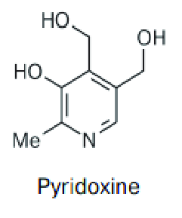
Clinical Implication | Details
Signs and Symptoms | - Dermatological Issues: Seborrheic dermatitis with oily, scaly patches on the skin (face, scalp). - Neurological Symptoms: Peripheral neuropathy (tingling, numbness, pain) and difficulty walking. - Mood Changes: Increased risk of depression, anxiety, and irritability due to neurotransmitter synthesis disruption. - Anemia: Microcytic anemia causing fatigue and weakness.
Metabolic Implications | - Amino Acid Metabolism: Essential for transamination processes, affecting neurotransmitter synthesis. - Heme Synthesis: Impairs hemoglobin formation, leading to anemia. - Glucose Metabolism: Involved in glycogenolysis, affecting energy production.
Impact on Other Nutrients | - Interactions with Other B Vitamins: Works with B12 and folate in amino acid and homocysteine metabolism.
Increased Risk in Certain Populations | - Chronic Conditions: Increased requirements in renal disease or autoimmune disorders. - Alcoholics: Alcohol interferes with pyridoxine metabolism. - Pregnant and Lactating Women: Increased physiological demand heightens risk of deficiency.
Associated Conditions | - Cardiovascular Disease: Low levels linked to elevated homocysteine, increasing cardiovascular risk. - Cognitive Decline: Chronic deficiency may contribute to cognitive impairment and neurodegenerative diseases.
CLINICAL MANIFESTATIONS OF PYRIDOXINE

Slide 19
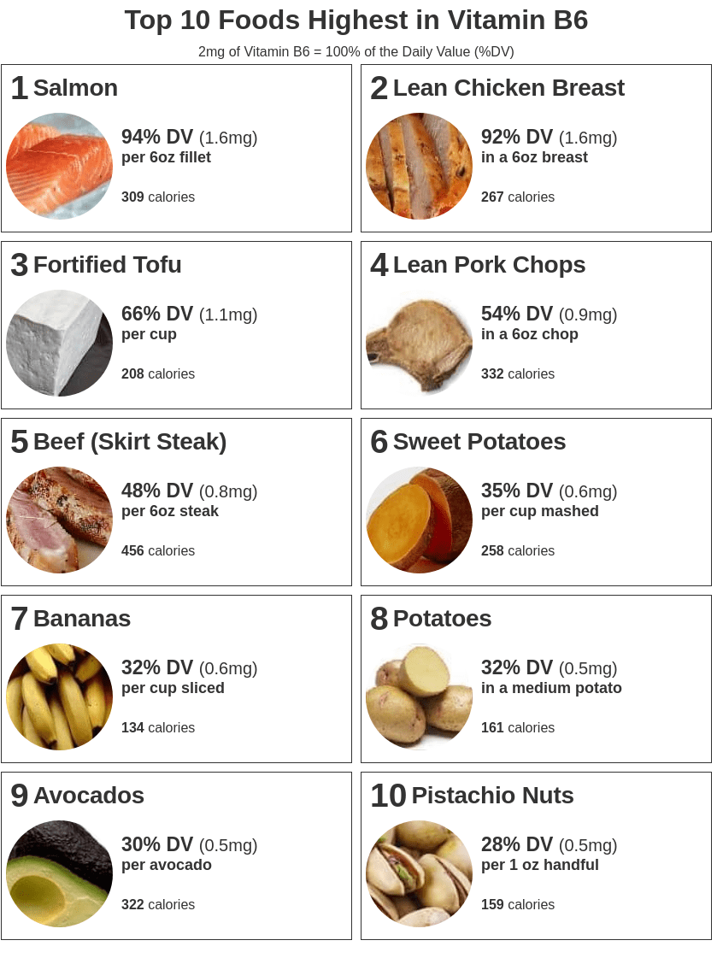
DIAGNOSIS and TREATMENT
Diagnosis of Vitamin B6 (Pyridoxine) Deficiency
Clinical Assessment:
  Review dietary intake and medical history for risk factors.
  Observe for signs of deficiency (dermatological, neurological, anemia).
Laboratory Tests:
  Plasma Pyridoxal Phosphate Level: Measure levels; normal is typically >20 ng/mL; deficiency is <20 ng/mL.
  Complete Blood Count (CBC): Check for microcytic anemia.
Treatment of Vitamin B6 (Pyridoxine) Deficiency
Dietary Management:
  Increase intake of pyridoxine-rich foods: poultry, fish, potatoes, bananas, fortified cereals.
Supplementation:
  Oral pyridoxine supplements: typical doses range from 25 to 100 mg/day, depending on severity.
Monitoring and Follow-Up:
  Regularly reassess symptoms and laboratory levels to ensure recovery and adjust treatment as needed.

Slide 20
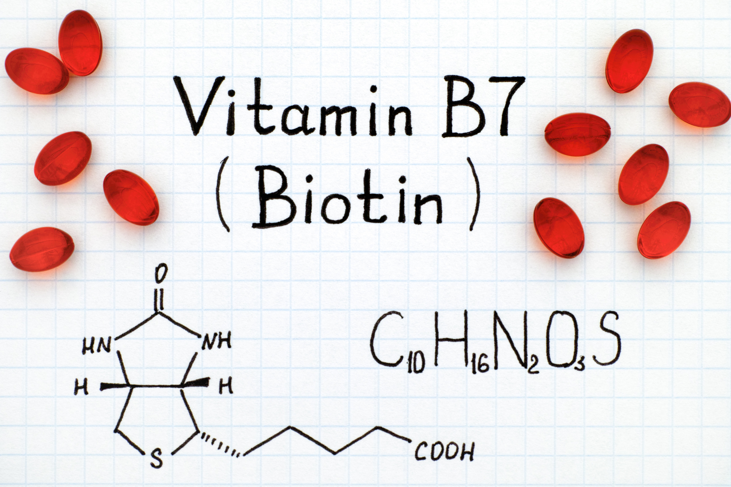
Clinical Implication | Details
Signs and Symptoms | - Dermatological Issues: - Scaly, red rashes around eyes, nose, and mouth (seborrheic dermatitis). - Thinning hair or hair loss (alopecia). - Neurological Symptoms: - Fatigue, depression, irritability. - Numbness and tingling in extremities. - Gastrointestinal Issues: - Nausea, vomiting, appetite loss.
Metabolic Implications | - Energy Production: - Acts as a coenzyme for carboxylase enzymes in fatty acid synthesis and gluconeogenesis. - Amino Acid Metabolism: - Involved in the metabolism of branched-chain amino acids.
Impact on Other Nutrients | - Interaction with Other B Vitamins: - Works closely with vitamins B1, B2, and B5 in energy metabolism.
Increased Risk in Certain Populations | - Long-term Antibiotic Users: - Antibiotics can disrupt gut flora producing biotin. - Individuals with Malabsorption Disorders: - Conditions like Crohn's disease or celiac disease. - Infants: - Risk from consuming raw egg whites (avidin binds biotin).
Associated Conditions | - Metabolic Disorders: - Inherited disorders like biotinidase deficiency lead to neurological issues.
CLINICAL MANIFESTATIONS OF BIOTIN

Slide 21
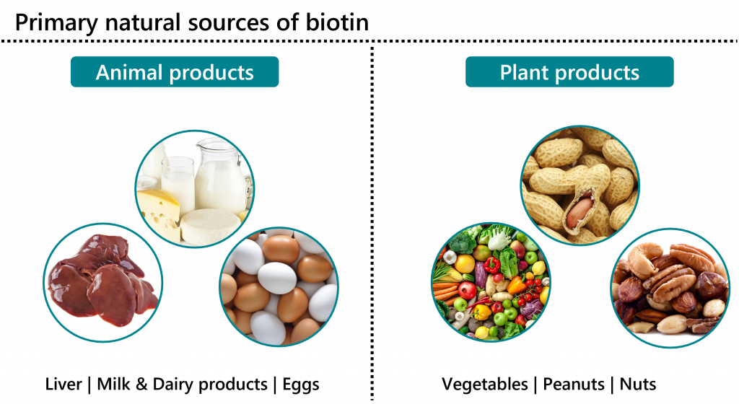
DIAGNOSIS AND TREATMENTS
Diagnosis of Vitamin B7 (Biotin) Deficiency
Clinical Assessment:
  Evaluate dietary intake and medical history for risk factors.
  Observe for characteristic signs and symptoms (dermatological, neurological).
Laboratory Tests:
  Serum Biotin Level: Measure levels; normal ranges vary but generally >200 ng/L is considered sufficient.
  Urinary Biotin Excretion: Assess biotin excretion; low levels may indicate deficiency.
Treatment of Vitamin B7 (Biotin) Deficiency
Dietary Management:
  Increase intake of biotin-rich foods: egg yolks, nuts, seeds, legumes, and whole grains.
Supplementation:
  Oral biotin supplements: typical doses range from 30 to 100 mcg/day, depending on severity.
Monitoring and Follow-Up:
  Regularly reassess symptoms and laboratory levels to ensure improvement and adjust treatment as necessary

Slide 22
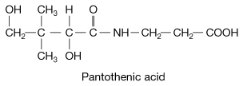
Clinical Implication | Details
Signs and Symptoms | - Fatigue and Weakness: General tiredness and decreased energy levels. - Mood Changes: Increased irritability, anxiety, and depression. - Digestive Issues: Nausea, abdominal cramps, and loss of appetite. - Dermatological Effects: Skin issues, such as acne and dermatitis.
Metabolic Implications | - Energy Metabolism: Involved in synthesizing coenzyme A (CoA) for fatty acid metabolism. - Synthesis of Hormones: Essential for producing steroid hormones in the adrenal glands.
Impact on Other Nutrients | - Interrelation with Other B Vitamins: Works with other B vitamins (e.g., B2, B3) in metabolic pathways.
Increased Risk in Certain Populations | - Alcoholics: Impaired absorption and metabolism increase deficiency risk. - Individuals with Malabsorption Disorders: Conditions like Crohn's disease may affect absorption. - Pregnant and Lactating Women: Increased physiological demand heightens deficiency risk.
Associated Conditions | - Adrenal Insufficiency: Low pantothenic acid levels may exacerbate adrenal insufficiency symptoms. - Growth and Development Issues: In children, deficiency can impact growth due to energy metabolism roles.
CLINICAL MANIFESTATIONS OF PANTHOTENIC ACID

Slide 23

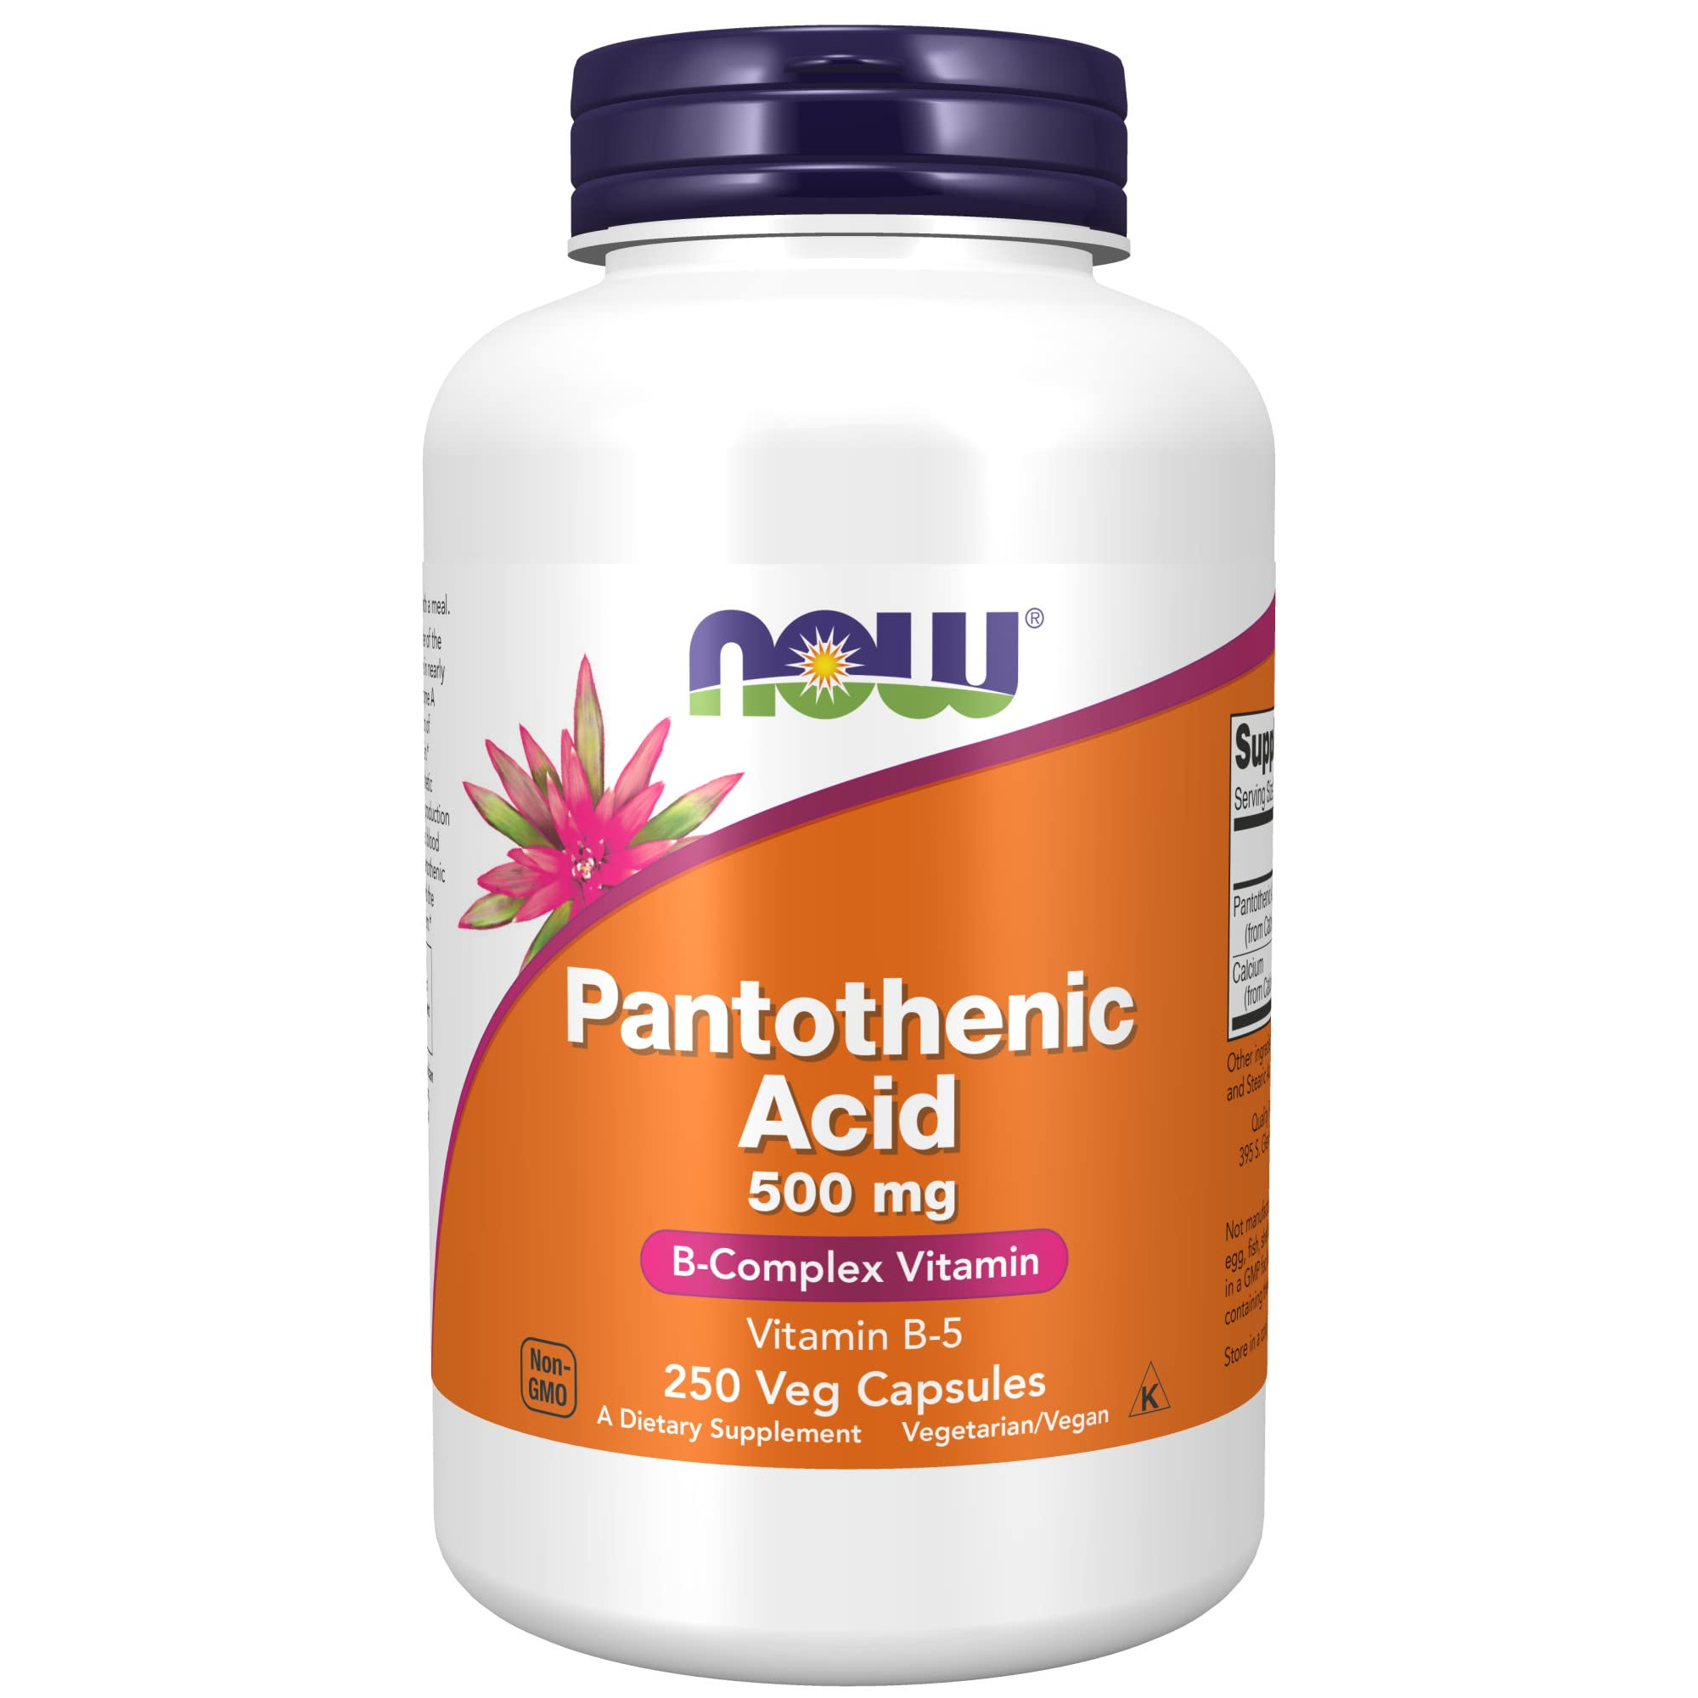
DIAGNOSIS AND TREATMENTS
Diagnosis of Vitamin B5 (Pantothenic Acid) Deficiency
Clinical Assessment:
  Evaluate dietary intake and medical history for risk factors.
  Observe for characteristic signs and symptoms (fatigue, mood changes, digestive issues).
Laboratory Tests:
  Serum Pantothenic Acid Level: Measure levels; normal ranges typically >100 ng/mL, but specific testing is less common.
  Urinary Excretion Test: Assess levels of pantothenic acid in urine; low excretion may indicate deficiency.
Treatment of Vitamin B5 (Pantothenic Acid) Deficiency
Dietary Management:
  Increase intake of pantothenic acid-rich foods: meats, whole grains, legumes, vegetables, and eggs.
Supplementation:
  Oral pantothenic acid supplements may be recommended, typically ranging from 5 to 10 mg/day.
Monitoring and Follow-Up:
  Regularly reassess symptoms and dietary intake to ensure improvement and adjust treatment as necessary.

Slide 24
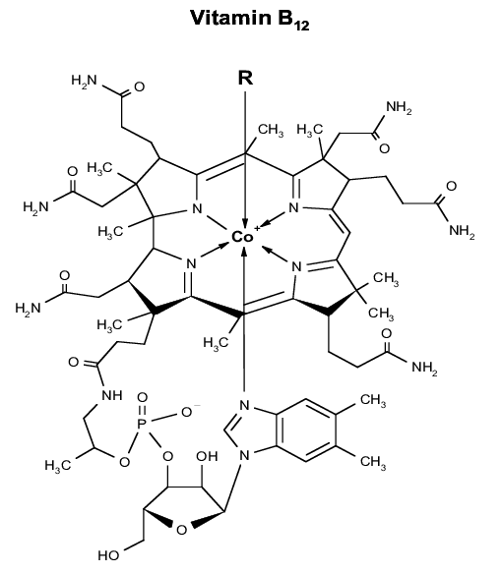
CLINICAL MANIFESTATIONS OF COBALAMINE
Clinical Implication | Details
Signs and Symptoms | - Hematological Issues: - Macrocytic anemia leading to fatigue, weakness, and pallor. - Neurological Symptoms: - Peripheral neuropathy (numbness, tingling). - Cognitive impairment (memory loss, mood changes). - Gastrointestinal Issues: - Glossitis and mouth ulcers; anorexia and weight loss.
Metabolic Implications | - DNA Synthesis: - Essential for DNA synthesis, affecting cell division. - Homocysteine Metabolism: - Converts homocysteine to methionine; deficiency can raise homocysteine levels.
Impact on Other Nutrients | - Interaction with Folate: - Works with folate in red blood cell formation; deficiency in one affects the other.
Increased Risk in Certain Populations | - Vegetarians and Vegans: - Limited dietary sources due to reliance on animal products. - Older Adults: - Reduced absorption from aging. - Individuals with Malabsorption Disorders: - Conditions like celiac disease or Crohn's disease.
Associated Conditions | - Neurological Disorders: - Long-term deficiency may contribute to neurodegenerative diseases. - Cardiovascular Disease: - Elevated homocysteine increases cardiovascular risk.

Slide 25
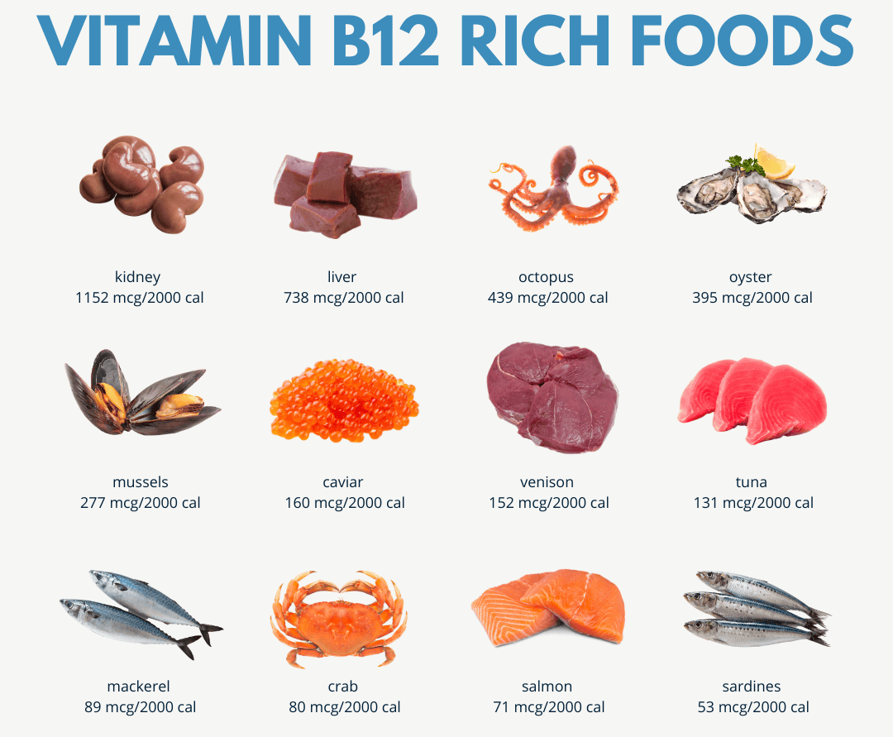
DIAGNOSIS AND TREATMENTS
Diagnosis
- Clinical evaluation, CBC, and laboratory tests to measure serum B12 and homocysteine levels.
Treatment and Prevention
- Dietary Sources:
- Encourage B12-rich foods (meat, fish, dairy, fortified cereals).
- Supplementation:
- Oral supplements (500 to 2000 mcg/day) or intramuscular injections for severe cases.

Slide 26

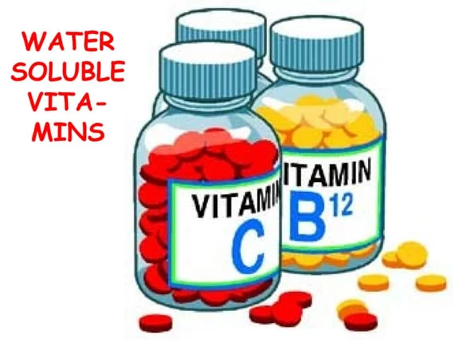
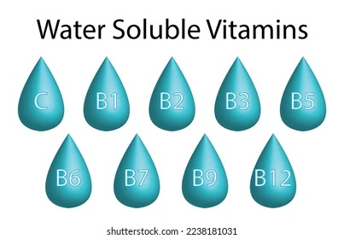
Water-soluble vitamins are crucial for energy metabolism, red blood cell production, and neurological function.
Deficiencies can lead to significant health issues, including anemia, cognitive decline, and skin problems.
Early diagnosis through clinical evaluation and dietary assessment is essential for effective management.
Treatment typically involves dietary modifications and supplementation tailored to individual needs.
Understanding these medical implications allows healthcare providers to enhance nutritional health and prevent complications, promoting overall well-being.

Slide 27


THANKS
Prof. Dr. Asif Ahmad, Director Institute of Food and Nutritional Sciences, PMAS-Arid Agriculture University Rawalpindi
asifahmad_1@yahoo.com

