Slide 1
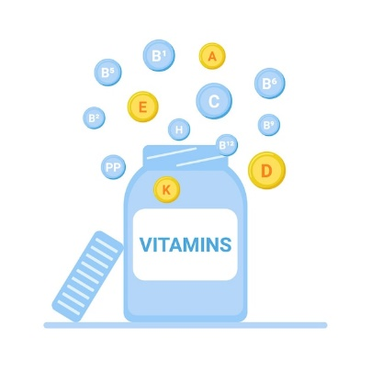
FAT SOLUBLE VITAMINS
PROF. DR. ASIF AHMAD
IFNS- PMAS UAAR

Slide 2
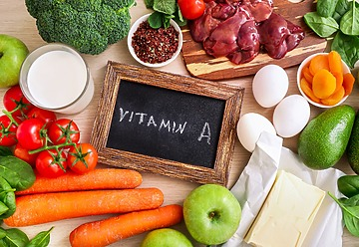
VITAMIN A
Vitamin A is a fat-soluble vitamin essential for numerous physiological functions in the body.
Forms:
Retinoids: Active forms found in animal products (e.g., retinol, retinal, retinoic acid).
Carotenoids: Precursors found in plant sources (e.g., beta-carotene).
Importance:
  Vital for vision, especially in low light conditions.
  Supports immune function and skin health.
  Plays a crucial role in cell growth and differentiation.
Sources:
  Animal sources: Liver, fish oils, dairy products, and eggs.
  Plant sources: Carrots, sweet potatoes, spinach, and other leafy greens (as carotenoids).

Slide 3
RETINOIDS
CAROTENOIDS
Plant-based Vitamin A precursors, converted to retinol in the body.
Sources: Found in colorful fruits and vegetables (carrots, sweet potatoes, leafy greens).
Types:
Beta-carotene: Most efficiently converted to Vitamin A.
Alpha-carotene, Beta-cryptoxanthin: Lesser, but still significant sources.
Additional Benefits: Antioxidant properties, may support eye health beyond Vitamin A activity.
Preformed Vitamin A, directly usable by the body.
Sources: Found in animal products (liver, fish, dairy).
Types:
Retinol: Primary form, converted to other active forms.
Retinal: Essential for vision, part of the visual cycle.
Retinoic Acid: Important for gene expression and cell differentiation.
Functions: Crucial for vision, immune health, and skin integrity.

Slide 4
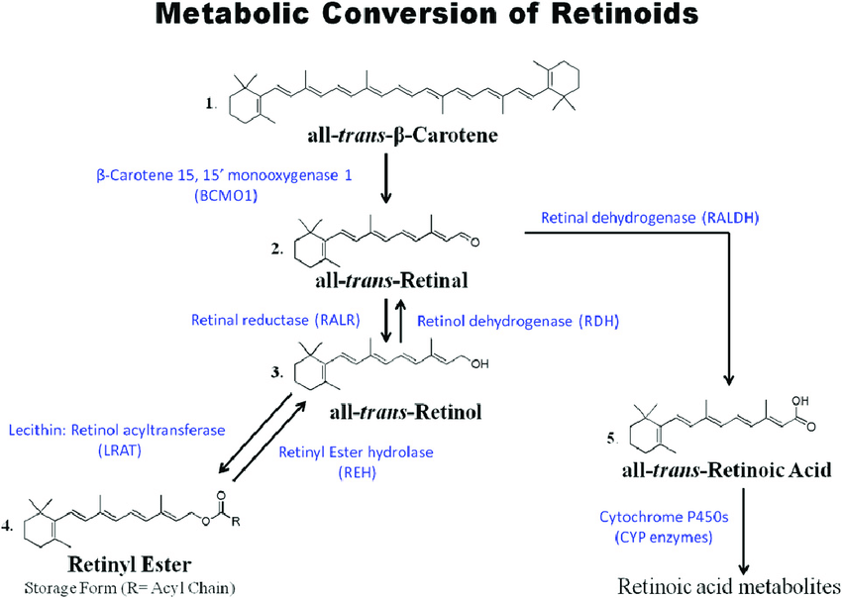

Slide 5
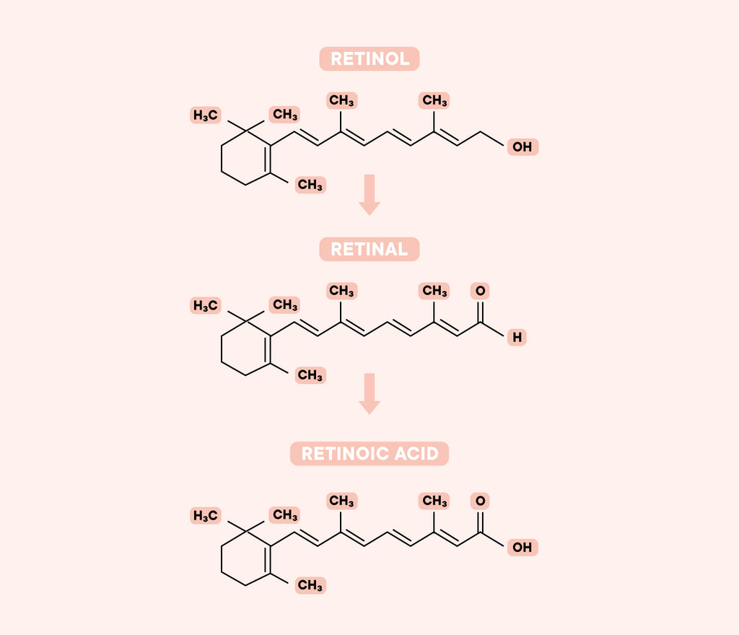
CHEMISTRY
Retinoids: Comprise retinol, retinal, and retinoic acid; characterized by a polyene chain with alternating double bonds.
Carotenoids: Long carbon chains with conjugated double bonds; beta-carotene is the most prominent form.
Chemical Forms:
  Retinol Alcohol form, can be stored in the liver.
  Retinal: Aldehyde form, essential for vision (binds with opsin to form rhodopsin).
  Retinoic Acid: Acid form, regulates gene expression.
Conversion in the Body:
Beta-Carotene is cleaved into retinol in the intestines.
Retinol can be oxidized to retinal, then further oxidized to retinoic acid.
Stability:
Sensitive to heat, light, and oxygen, requiring careful storage to prevent degradation.

Slide 6
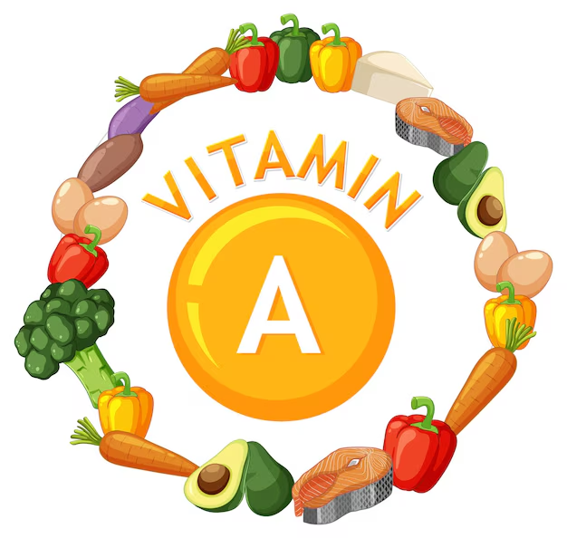
SOURCES
Animal-Based Sources (Retinoids):
Liver: Highest concentration; beef and chicken liver are particularly rich.
Fish Oils: Cod liver oil is a potent source.
Dairy Products: Whole milk, cheese, and butter contain retinol.
Eggs: Yolk provides retinoids in moderate amounts.
Plant-Based Sources (Carotenoids):
Orange and Yellow Vegetables: Carrots, sweet potatoes, and pumpkins, high in beta-carotene.
Leafy Greens: Spinach, kale, and collard greens (carotenoids are masked by chlorophyll).
Fruits: Mangoes, cantaloupe, and apricots provide beta-carotene.
Other Vegetables: Red bell peppers and tomatoes.
Fortified Foods:
Some cereals, dairy alternatives, and margarine are fortified with Vitamin A, particularly in regions with common deficiencies.

Slide 7
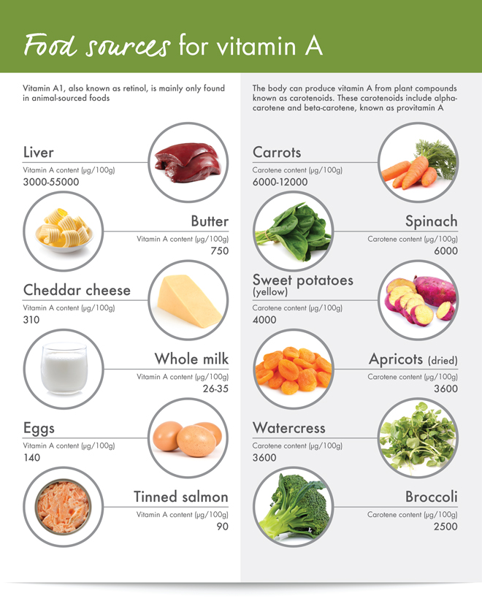
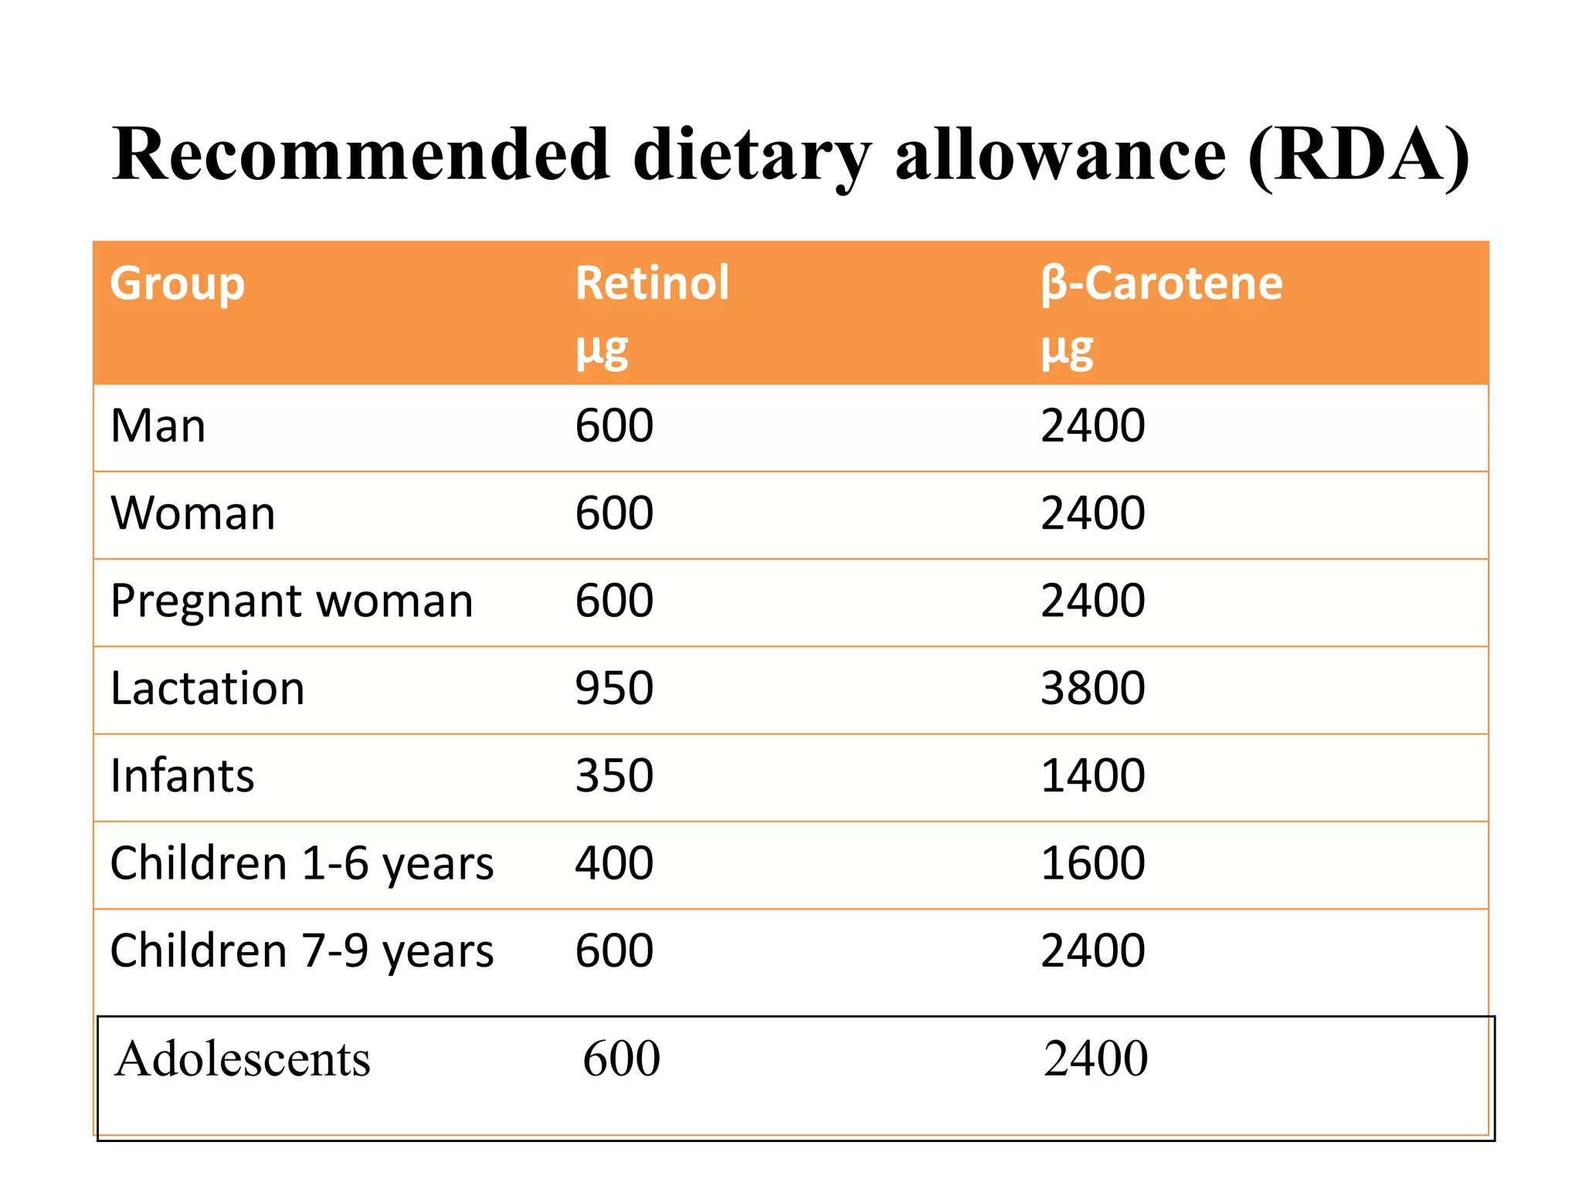

Slide 8
ROLE OF VITAMIN E IN BIOLOGICAL FUNCTIONS
1. Epithelial Cell Maintenance
Retinoic Acid:
  Vital for the differentiation and maintenance of epithelial tissues, supporting skin and mucous membranes.
2. Glycoprotein Synthesis
Retinoic Acid:
  Facilitates the synthesis of glycoproteins and mucopolysaccharides, which are crucial for mucus production and cellular functions.
3. Bone Remodeling
Sulfation:
  Vitamin A is essential for the sulfation of mucopolysaccharides in the bone matrix, contributing to bone health and remodeling.
4. Reproductive Health
Retinol:
  Critical for normal reproductive processes in both males and females, supporting gametogenesis and fetal development.
5. Regulation of Gene Expression
Retinoic Acid:
  Acts as a potent regulator of gene expression, influencing cellular differentiation and growth.
6. Antioxidant Activity
Carotenoids:
  Function as antioxidants, trapping peroxyl and free radicals, protecting cells from oxidative damage.

Slide 9
7. Role in Vision (Wald’s Visual Cycle)
Rhodopsin: The visual pigment in the retina, composed of opsin and 11-cis retinal (derived from Vitamin A).
Cycle Overview:
  Light Activation:
    Light triggers the conversion of 11-cis retinal to Lumi rhodopsin, followed by its transformation into Meta rhodopsin and then to All-trans retinal.
  Isomerization:
    Conversion occurs through the action of isomerases and reductases, facilitated by NADH + H⁺ and NAD⁺.
Explanation of Wald’s Cycle:
Rhodopsin Function:
  Present in rod cells, rhodopsin is essential for vision in dim light.
  When light strikes rod cells, it initiates a reaction cascade converting 11-cis retinal to All-trans retinal, leading to visual signaling.
Regeneration of 11-cis Retinal:
Conversion in Retina and Liver:
  In Retina: 11-cis retinal can be regenerated directly.
  In Liver:
    All-trans retinol is produced via retinal reductase, then isomerized back to 11-cis retinol, which is transported back to the retina and oxidized to regenerate 11-cis retinal.

Slide 10
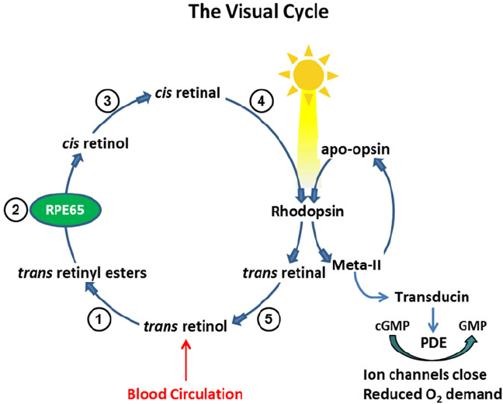

Slide 11
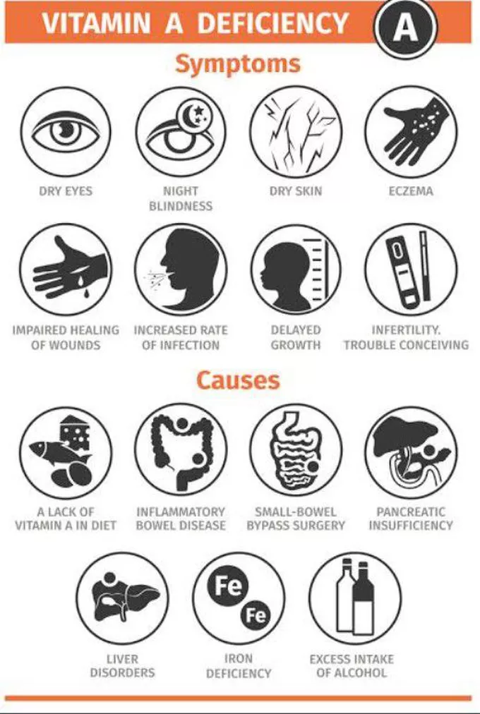
DEFICIENCY OF VITAMIN A
Symptoms:
  Night Blindness: Difficulty seeing in low light or darkness due to impaired rhodopsin formation.
  Xerophthalmia: Dryness of the conjunctiva and cornea, potentially leading to blindness.
  Impaired Immune Function: Increased susceptibility to infections, especially in children.
  Skin Issues: Dry, rough skin due to impaired epithelial cell maintenance.
  Keratinization: Excessive keratin buildup in epithelial tissues.
At-Risk Populations:
  Children: Particularly in developing countries where diets may lack sufficient Vitamin A.
  Pregnant Women: Increased demand during pregnancy may lead to deficiency if dietary intake is inadequate.
  Individuals with Malabsorption Disorders: Conditions such as celiac disease or cystic fibrosis can hinder Vitamin A absorption.

Slide 12
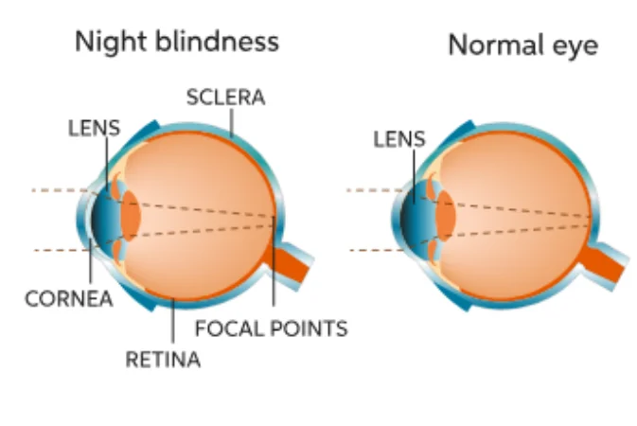
NIGHT BLINDENESS
Role of Rhodopsin: Vitamin A is essential for synthesizing rhodopsin, a pigment in rod cells of the retina, crucial for low-light vision.
Reduced Rhodopsin Levels: Deficiency in vitamin A lowers rhodopsin production, impairing the eye's ability to adjust to dim light.
Symptoms: Leads to difficulty seeing in low-light or at night, known as night blindness.
Progression: If untreated, it can worsen, leading to more severe eye issues and even permanent vision loss.

Slide 13
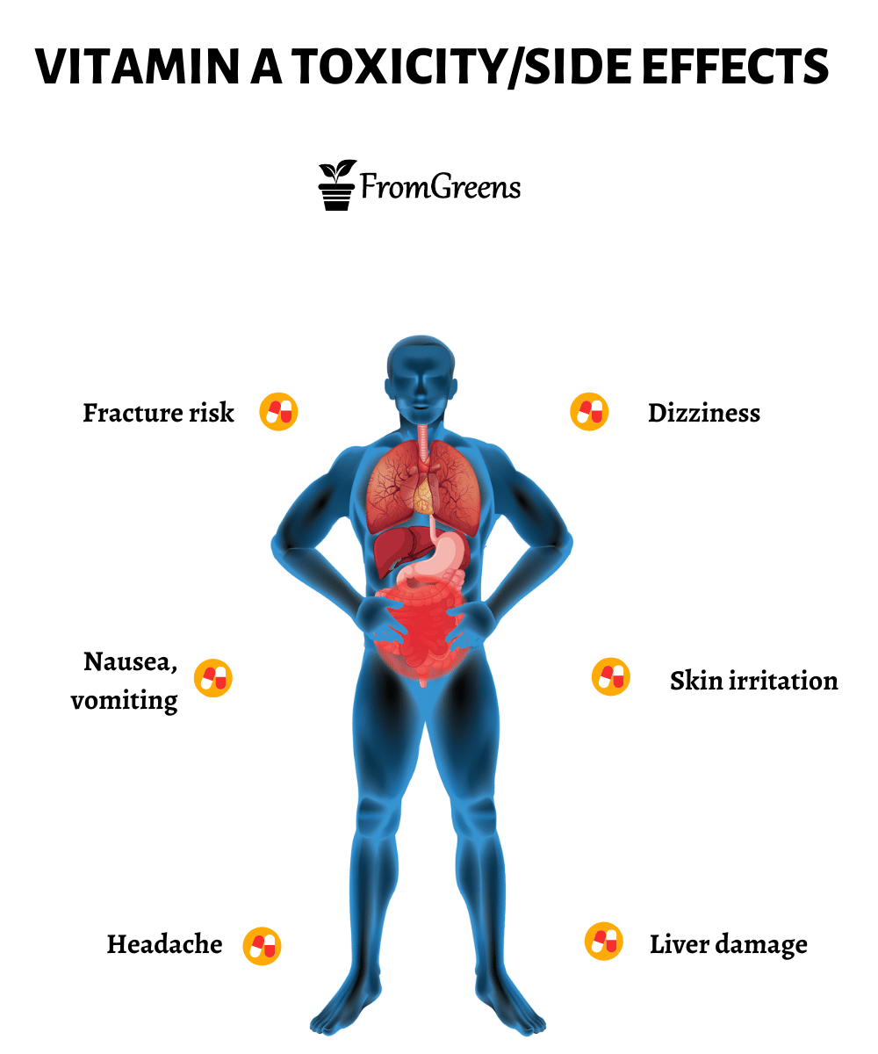
TOXICITY
Symptoms:
  Acute Toxicity: Nausea, vomiting, headaches, dizziness, and blurred vision.
  Chronic Toxicity:
    Liver damage and enlargement.
    Bone pain and potential fractures due to increased bone resorption.
    Skin changes (e.g., dryness, peeling).
Causes:
  Excessive Supplementation: High doses of Vitamin A supplements without medical supervision.
  Consumption of Animal Liver: Frequent eating of liver, which is rich in preformed Vitamin A, can lead to toxicity.
Management:
  Discontinue Supplements: Reduce or eliminate high-dose Vitamin A supplements.
  Monitor Liver Function: Regular assessments if toxicity is suspected.

Slide 14
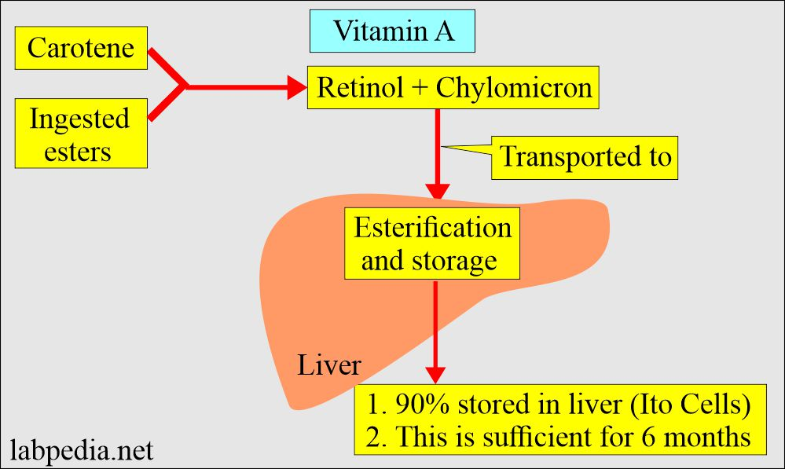
TRANSPORT AND STORAGE OF VITAMIN A

Slide 15
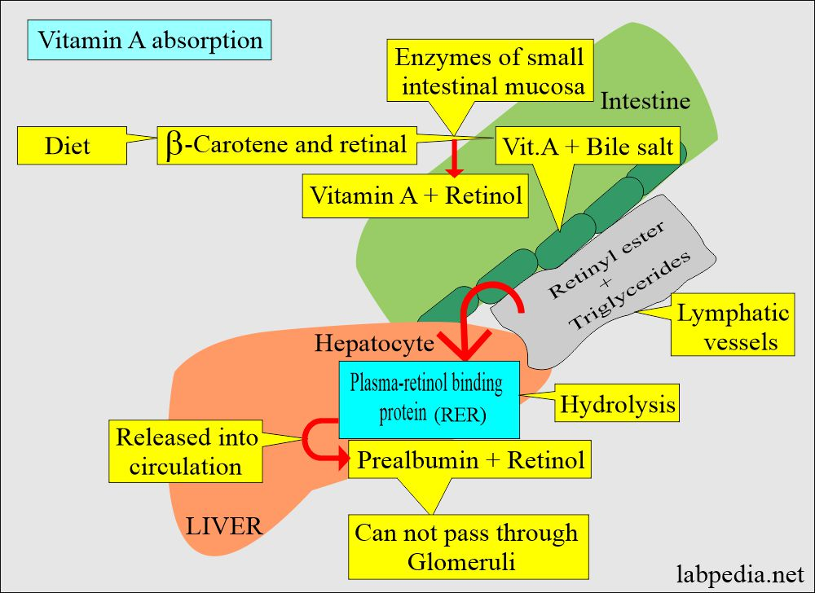
ABSORPTION OF VITAMIN A

Slide 16
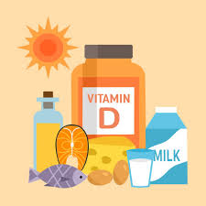
VITAMIN D
Vitamin D is a fat-soluble vitamin that plays a crucial role in calcium and phosphorus metabolism, bone health, and overall bodily functions.
Vitamin D consists of a group of compounds known as sterols, which act similarly to hormones in the body.
Forms of Vitamin D:
  Vitamin D2 (Ergocalciferol): Derived from yeast and fungi; often used in supplements.
  Vitamin D3 (Cholecalciferol): Synthesized in the skin upon exposure to sunlight; more effective in raising vitamin D levels in the blood.
  1,25-dihydroxyvitamin D (Calcitriol)Conversion: Both D2 and D3 are converted into the active form in the liver and kidneys.
Sources:
Sunlight: The body produces Vitamin D3 when the skin is exposed to UVB rays.
Dietary Sources: Fatty fish (e.g., salmon, mackerel), fish liver oils, fortified foods (e.g., milk, cereals), and egg yolks.
Functions:
Calcium Homeostasis: Enhances intestinal absorption of calcium and phosphate, crucial for bone formation and maintenance.
Bone Health: Essential for the development and maintenance of healthy bones.
Immune System Support: Plays a role in modulating immune responses.

Slide 17
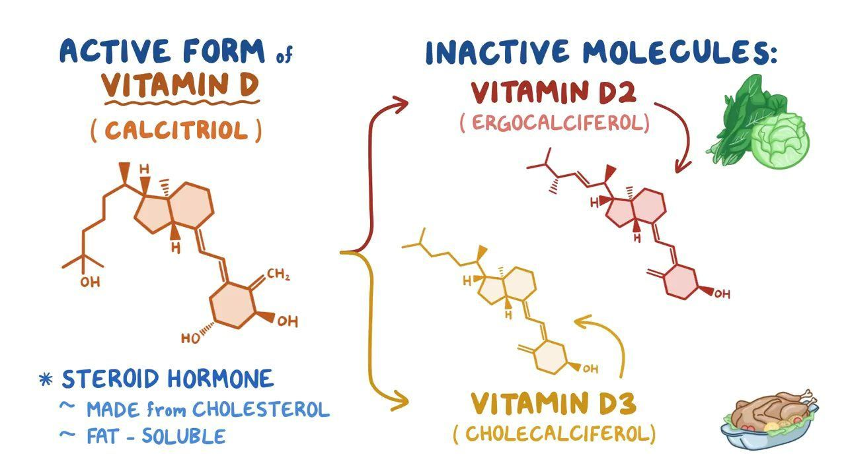

Slide 18
Type of Vitamin D | Chemical Name | Source | Active Form | Function
Vitamin D2 | Ergocalciferol | Found in yeast and fungi; obtained from dietary sources and supplements | No | Increases intestinal absorption of calcium and phosphorus; important for bone health.
Vitamin D3 | Cholecalciferol | Synthesized in the skin from sunlight; found in animal products (e.g., fatty fish, liver, egg yolks) | No | Enhances calcium and phosphorus metabolism; supports bone mineralization.
Active Form | 1,25-Dihydroxycholecalciferol | Produced from D2 and D3 in the liver and kidneys | Yes | Regulates calcium and phosphorus homeostasis; critical for bone health.
Vitamin D4 | 22-Dihydroergocalciferol | Found in some animal products; less common in the diet | No | Role in calcium metabolism is less understood but may have some biological activity.

Slide 19
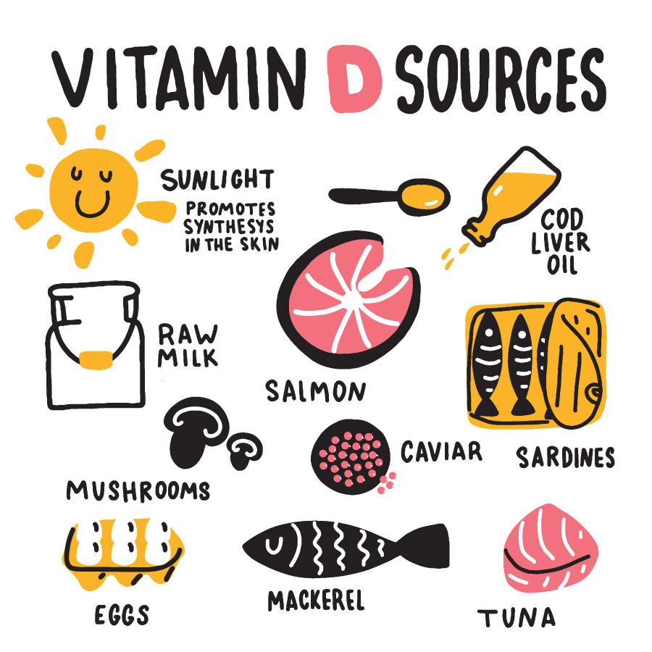
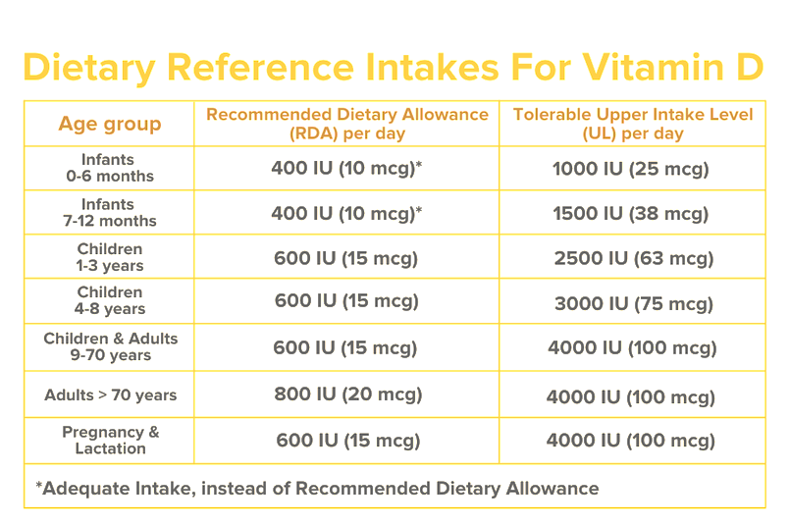

Slide 20
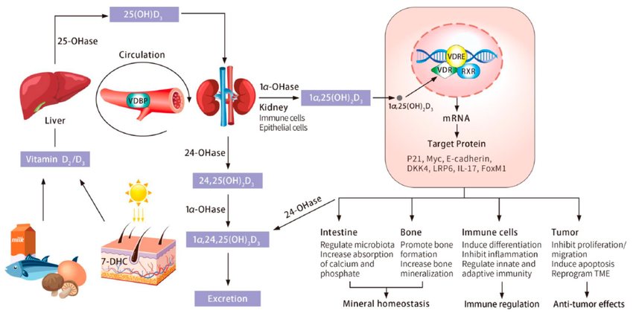
VITAMIN D METABOLISM AND BIOLOGICAL FUNCTIONS

Slide 21
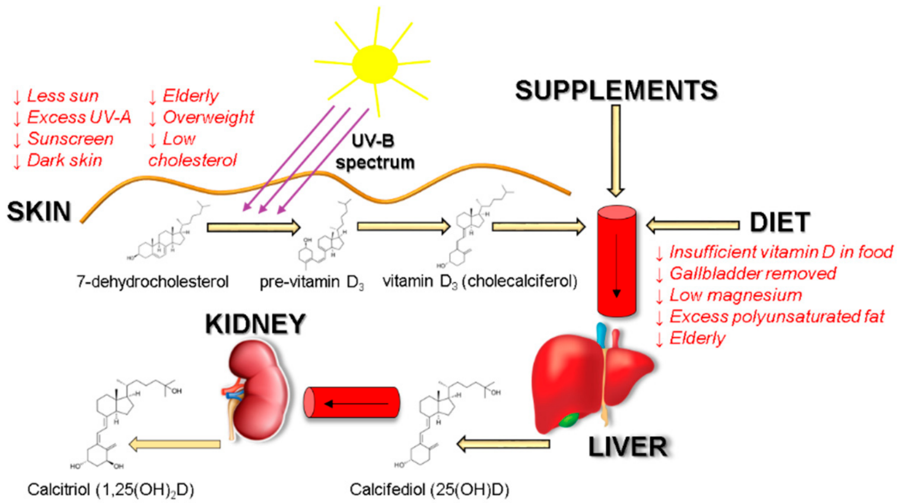
ABSORPTION OF VITAMIN D
Initial Absorption: Vitamin D (both D2 and D3) is absorbed in the small intestine, primarily in the ileum and jejunum.
Role of Bile: Requires bile salts for emulsification as it is fat-soluble; vitamin D then forms micelles.
Lymphatic Transport: Absorbed into intestinal cells and incorporated into chylomicrons, transported via the lymphatic system.
Liver Conversion: Chylomicrons carry vitamin D to the liver, where it is hydroxylated to 25-hydroxyvitamin D (25(OH)D), the storage form.
Kidney Activation: Further hydroxylated in the kidneys to 1,25-dihydroxyvitamin D (active form) when needed, especially in response to low calcium levels.

Slide 22
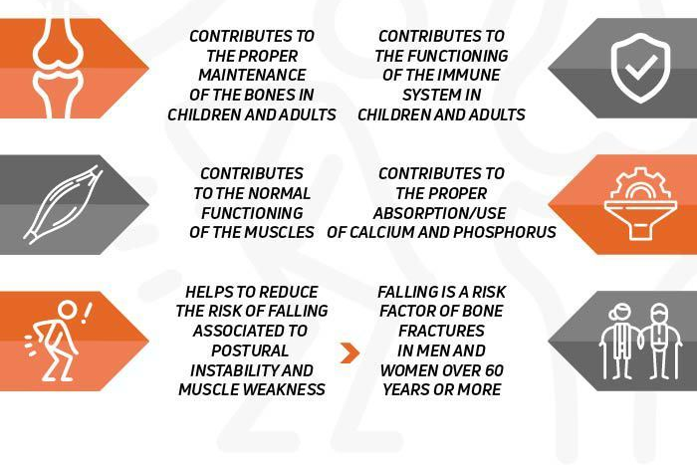
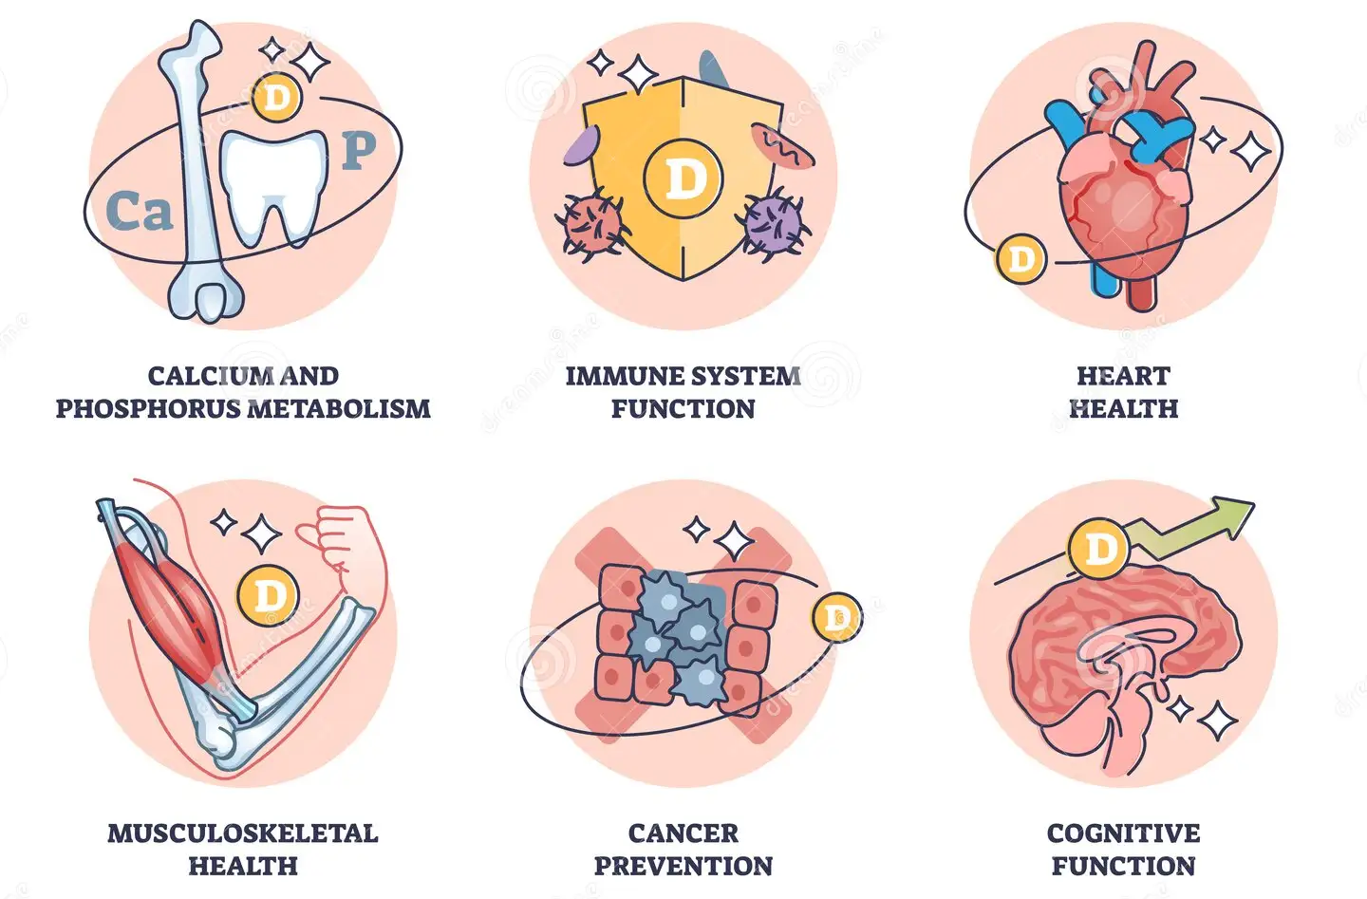
ROLE OF VITAMIN D

Slide 23
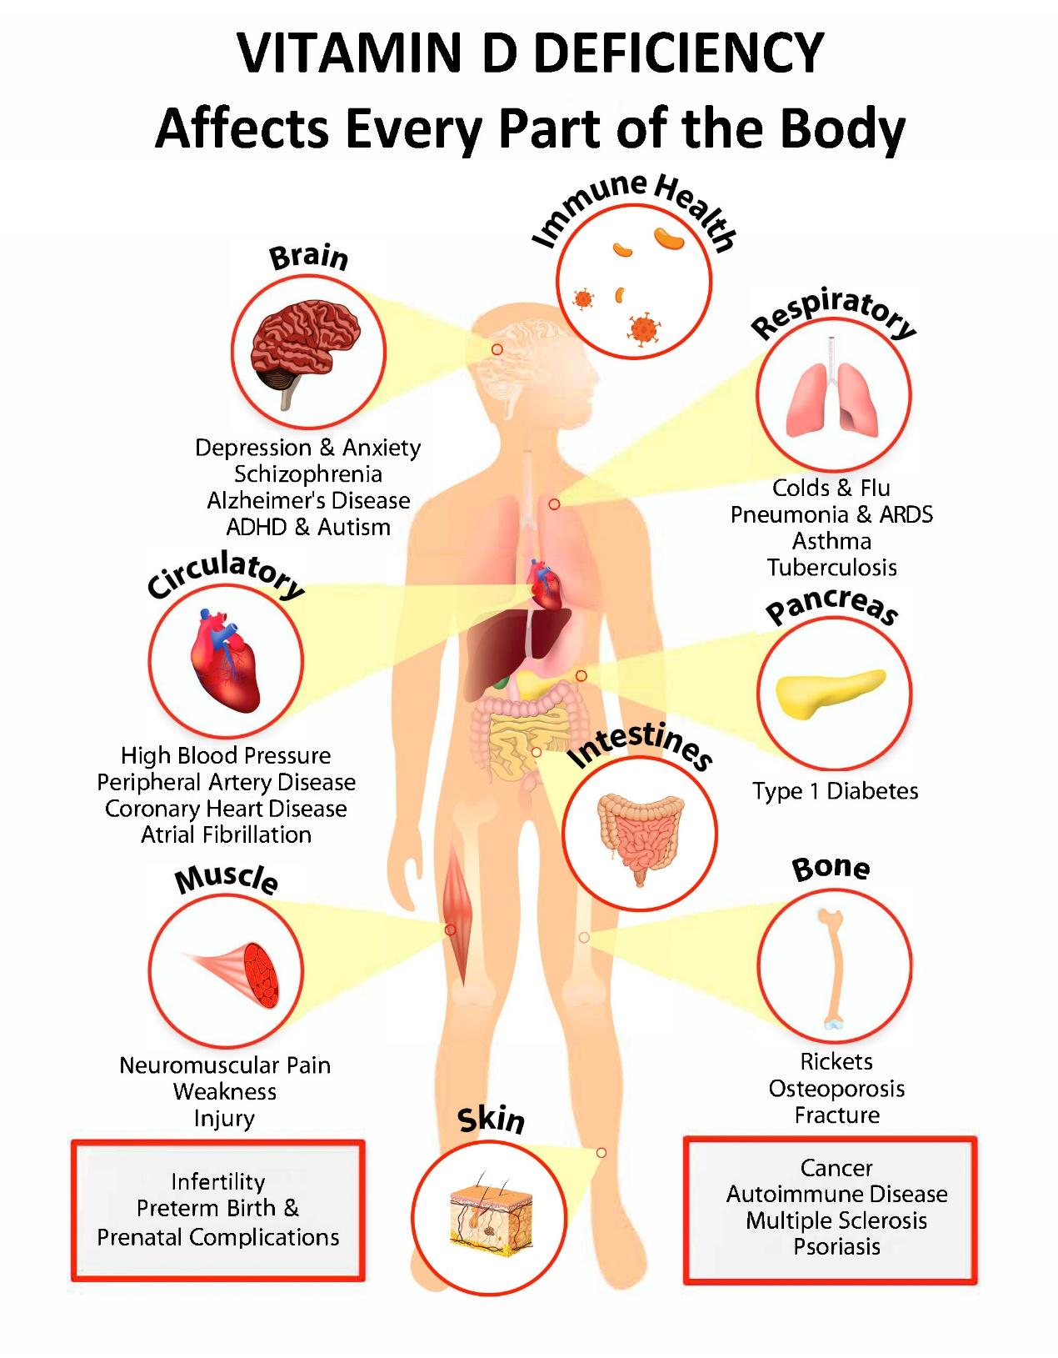
DEFICIENCY OF VITAMIN D
Causes:
Insufficient sunlight exposure (especially in northern latitudes).
Poor dietary intake.
Malabsorption syndromes (e.g., celiac disease, Crohn's disease).
Obesity (sequestration of vitamin D in fat tissues).
Symptoms:
Rickets: In children, characterized by bone deformities, delayed growth, and pain.
Osteomalacia: In adults, leading to bone pain, muscle weakness, and an increased risk of fractures.
Weak Immune Response: Increased susceptibility to infections.
Fatigue and Mood Changes: Link to depression and fatigue.
Long-term Effects:
Increased risk of osteoporosis.
Higher likelihood of cardiovascular diseases.
Potential link to chronic diseases (e.g., diabetes, certain cancers).

Slide 24
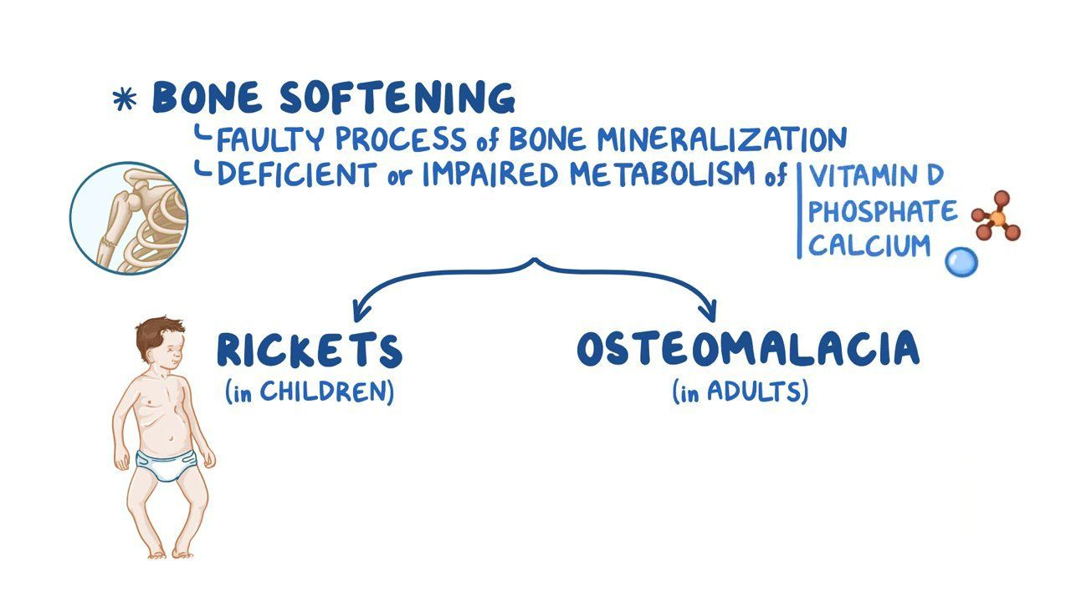
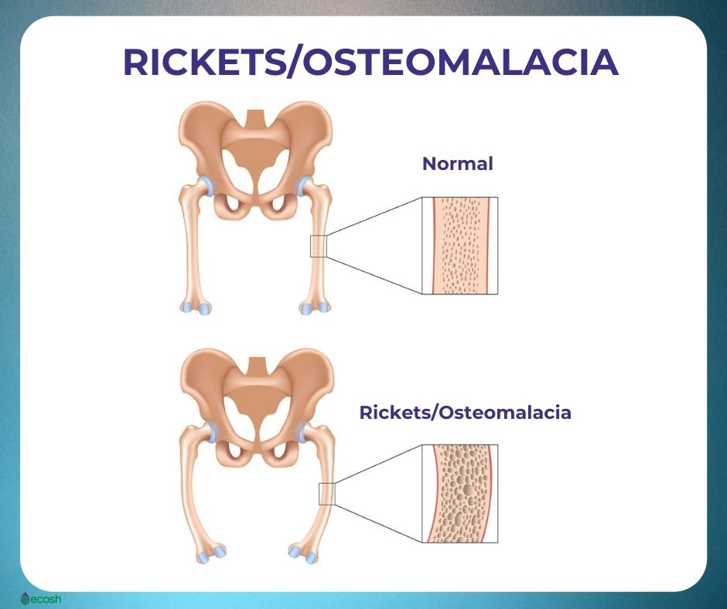

Slide 25
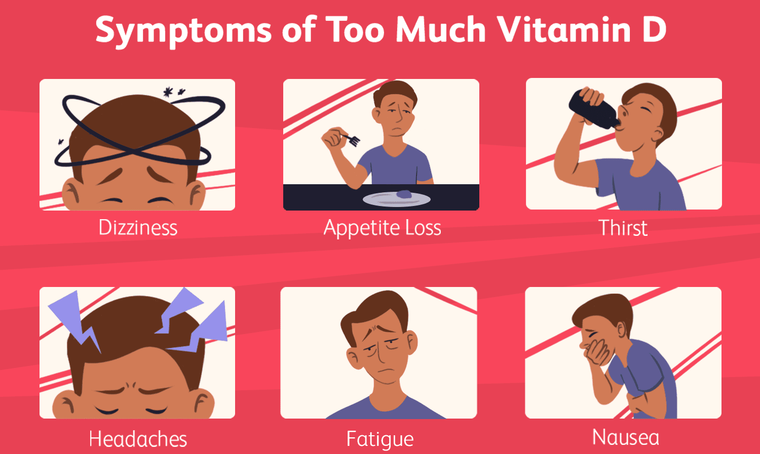
TOXICITY OF VITAMIN D
Causes:
Excessive supplementation (more than the recommended upper limit).
Rare cases due to high dietary intake.
Symptoms:
Hypercalcemia: Elevated blood calcium levels leading to nausea, vomiting, weakness, and frequent urination.
Kidney Damage: Potential for nephrocalcinosis (calcium deposits in the kidneys).
Bone Pain: Due to calcium being leached from bones.
Confusion and Cognitive Impairment: Neurological symptoms from calcium imbalance.
Management:
Discontinuation of vitamin D supplements.
Hydration and monitoring of calcium levels.

Slide 26
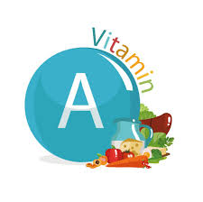
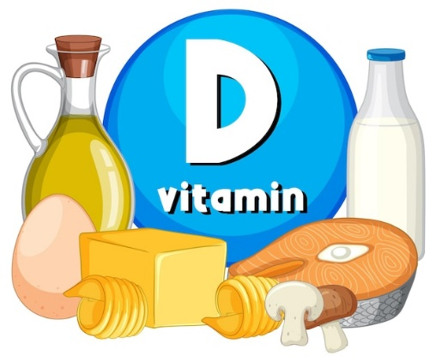
Feature | Vitamin A | Vitamin D
Chemical Forms | Retinoids (e.g., retinol, retinal, retinoic acid) and carotenoids (e.g., beta-carotene) | Vitamin D2 (ergocalciferol) and Vitamin D3 (cholecalciferol)
Source | Animal products (liver, fish, dairy) and plant sources (carrots, spinach, sweet potatoes) | Sunlight exposure (synthesized in skin) and dietary sources (fatty fish, fortified foods)
Primary Function | Vision, immune function, skin health, and cell growth | Regulation of calcium and phosphorus metabolism; bone health
Biological Role | Antioxidant, gene expression regulation, and epithelial maintenance | Hormone-like function affecting various biological processes
Deficiency Effects | Night blindness, dry skin, increased infection risk, and growth issues | Rickets in children, osteomalacia in adults, and weakened immune response
Toxicity Symptoms | Liver damage, headaches, nausea, and blurred vision | Hypercalcemia, kidney damage, nausea, and confusion
Recommended Dietary Allowance (RDA) | 900 mcg (men), 700 mcg (women) | 600 IU (15 mcg) for adults; higher for older adults
Absorption | Fat-soluble; requires dietary fat for optimal absorption | Fat-soluble; also requires dietary fat for absorption
Mechanism of Action | Acts through nuclear receptors affecting gene transcription | Binds to vitamin D receptors, influencing calcium and phosphate absorption and metabolism
VITAMIN A
VS
VITAMIN D

Slide 27
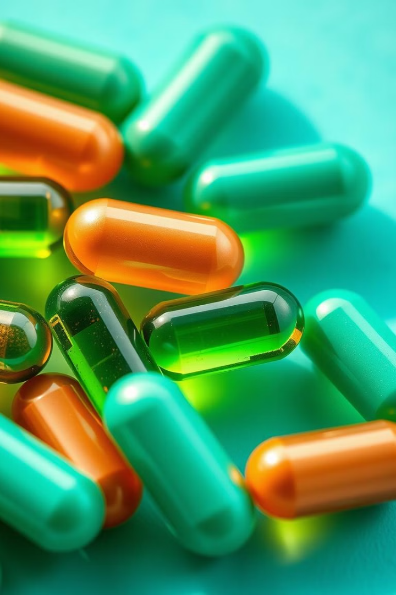

THANKS
Prof. Dr. Asif Ahmad, Director Institute of Food and Nutritional Sciences, PMAS-Arid Agriculture University Rawalpindi
asifahmad_1@yahoo.com

