Slide 1
Metabolism
Metabolism – process by which living systems acquire and use free energy to carry out vital processes
Catabolism (degradation)
  Nutrients and cell constituents are broken down for salvage and/or generation of energy
  Exergonic oxidation
Anabolism (biosynthesis)
  Endergonic synthesis of biological molecules from simpler precursors
  Coupled to exergonic processes through “high-energy” compounds

Slide 2
Role of Metabolism in Nutrition
Definition: the sum of all biochemical changes that take
place in a living organism.
Group these reactions into two types:
anabolic catabolic
Reactions: require energy release energy
Produce: more complex more simple compounds
compounds

Slide 3
Relationship Between Catabolic and Anabolic Pathways
Catabolic pathways
  Complex metabolites are transformed into simpler products
  Energy released is conserved by the synthesis of ATP or NADPH
Anabolic pathways
  Complex metabolites are made from simple precursors
  Energy-rich molecules are used to promote these reactions

Slide 4
Cofactors, Coenzymes and Prosthetic group
Prosthetic group: Tightly integrated into enzyme structure by covalent or non covalent bonding. It may be organic or inorganic.
Organic: Pyridoxal phosphate, FMN, FAD, TPP, Biotin,
Inorganic: Metal ions i.e Co, Cu, Mg, Mn, Fe
Cofactors: The catalytic activity of many enzymes depends on the presence of small molecules termed cofactors, although the precise role varies with the cofactor and the enzyme. Such an enzyme without its cofactor is referred to as an apoenzyme; the complete, catalytically active enzyme is called a holoenzyme.
Apo Enzyme +CoFactor → Holoenzyme
Cofactors can be subdivided into two groups: metals and small organic molecules
Metallo Enzy

Slide 6
Major Co Enzyme in Metabolism

Slide 7
Enzymes Are Classified into six functional Classes (EC number) by the International Union of Biochemists (I.U.B.). on the Basis of the Types of
Reactions That They Catalyze
EC 1. Oxidoreductases
EC 2. Transferases
EC 3. Hydrolases
EC 4. Lyases
EC 5. Isomerases
EC 6. Ligases
Notes:
7

Slide 8
Principle of the international classification
Each enzyme has classification number
consisting of four digits:
Example, EC: (2.7.1.1) HEXOKINASE
Notes:
8

Slide 9
EC: (2.7.1.1) these components indicate the following groups of enzymes:
2. IS CLASS (TRANSFERASE)
7. IS SUBCLASS (TRANSFER OF PHOSPHATE)
1. IS SUB-SUB CLASS (ALCOHOL IS PHOSPHATE ACCEPTOR)
1. SPECIFIC NAME
ATP,D-HEXOSE-6-PHOSPHOTRANSFERASE (Hexokinase)

Slide 10
1. Hexokinase catalyzes:
Glucose + ATP → glucose-6-P + ADP

Slide 11
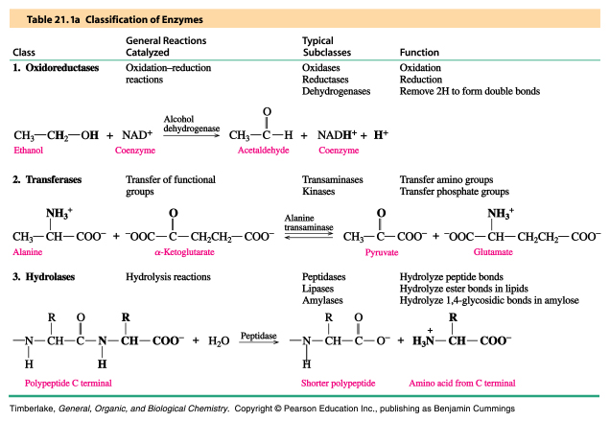
Oxidoreductases, Transferases and Hydrolases

Slide 12
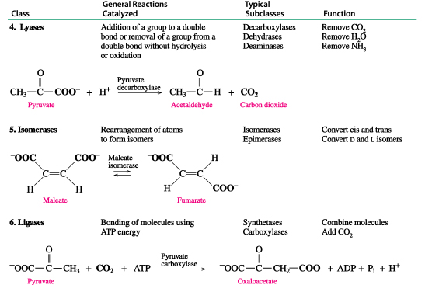
Lyases, Isomerases and Ligases

Slide 13
EC 1. Oxidoreductases
Biochemical Activity:
  Catalyse Oxidation/Reduction Reactions Act on many chemical groupings to add or remove hydrogen atoms.
Examples:
  Lactate dehydrogenase.
  Glucose Oxidase.
  Peroxidase.
  Catalase.
  Phenylalanine hydroxylase.
Notes:
13

Slide 14
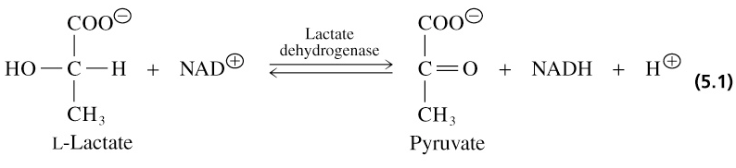
1. Oxidoreductases
Catalyze oxidation-reduction reactions
- oxidases - peroxidases - dehydrogenases
Notes:
14

Slide 15
EC 2. Transferases
Biochemical Activity:
  Transfer a functional groups (e.g. methyl or phosphate) between donor and acceptor molecules.
Examples:
  Transaminases (ALT & AST).
  Phosphotransferases (Kinases).
  Transmethylases.
  Transpeptidases.
  Transacylases.
Notes:
15
Kinases are specialized transferases that regulate metabolism by transferring phosphate from ATP to other molecules.AST,ALT,hexokinase
Kinases are specialized transferases that regulate metabolism by transferring phosphate from ATP to other molecules.AST,ALT,hexokinase

Slide 16
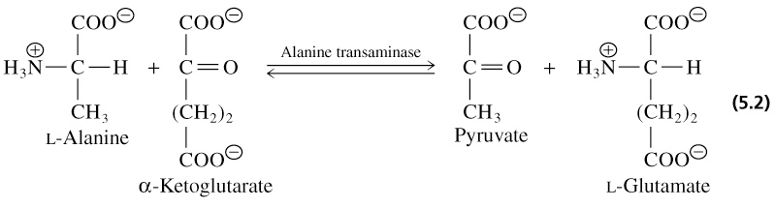
2. Transferases
A-X + B ↔ BX + A
Catalyze group transfer reactions
Notes:
16

Slide 17
EC 3. Hydrolases
Biochemical Activity:
  Catalyse the hydrolysis of various bonds Add water across a bond.
Examples:
  Protein hydrolyzing enzymes (Peptidases).
  Carbohydrases (Amylase, Maltase, Lactase).
  Lipid hydrolyzing enzymes (Lipase).
  Deaminases.
  Phosphatases.
  A-X + H²O ↔ X-OH + HA
Notes:
17

Slide 18
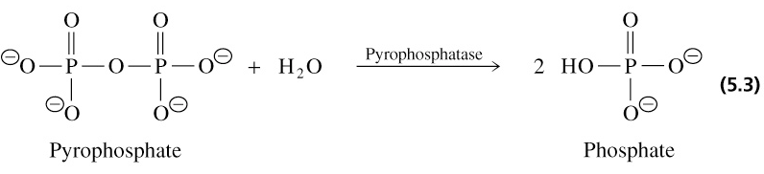
3. Hydrolases
Catalyze hydrolysis reactions where water is the acceptor of the transferred group
- esterases - peptidases - glycosidases
Notes:
18

Slide 19
EC 4. Lyases
Biochemical Activity:
  Cleave various bonds by means other than hydrolysis and oxidation.
  Add Water, Ammonia or Carbon dioxide across double bonds, or remove these elements to produce double bonds.
Examples:
  Fumarase.
  Carbonic anhydrase.
Notes:
19

Slide 20
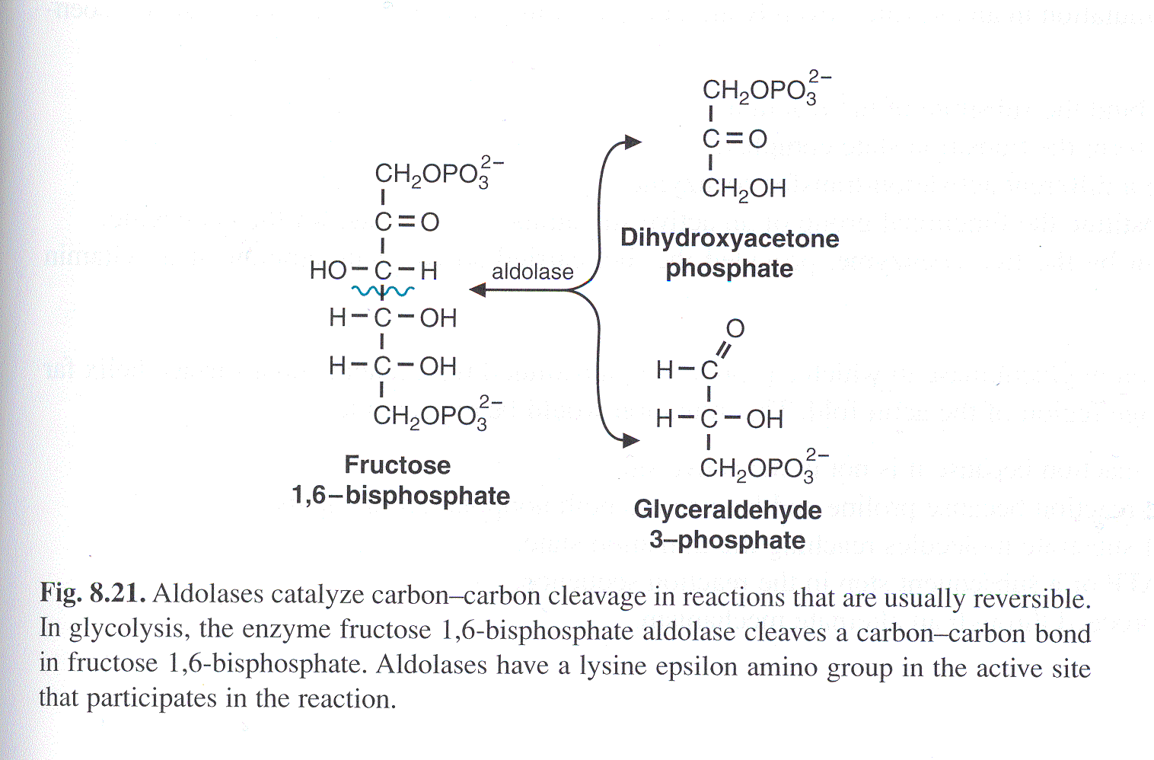
4. Lyases
Notes:
20

Slide 21
EC 5. Isomerases
Biochemical Activity:
  Catalyse isomerization changes within a single molecule.
  Carry out many kinds of isomerization:
    L to D isomerizations.
    Mutase reactions (Shifts of chemical groups).
Examples:
  Isomerase.
  Mutase.
Notes:
21
Isomerases are a general class of enzymes which convert a molecule from one isomer to another.. The general form of such a reaction is as follows:
A–B → B–A

Slide 22
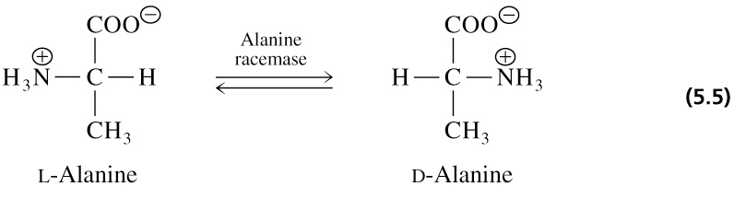
5. Isomerases
Catalyze isomerization reactions
Notes:
facilitate intramolecular rearrangements in which bonds are broken and formed or they can catalyze conformational changes.
22

Slide 23
EC 6. Ligases
Biochemical Activity:
  Join two molecules with covalent bonds Catalyse reactions in which two chemical groups are joined (or ligated) with the use of energy from ATP.
Examples:
  Acetyl~CoA Carboxylase.
  Glutamine synthetase
Notes:
23

Slide 24
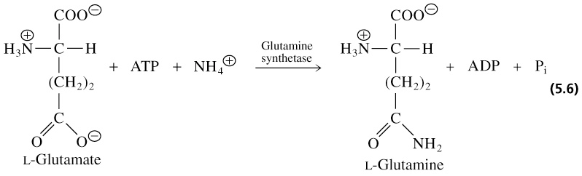
6. Ligases (synthetases)
Catalyze ligation, or joining of two substrates
Require chemical energy (e.g. ATP)
Notes:
24

Slide 25
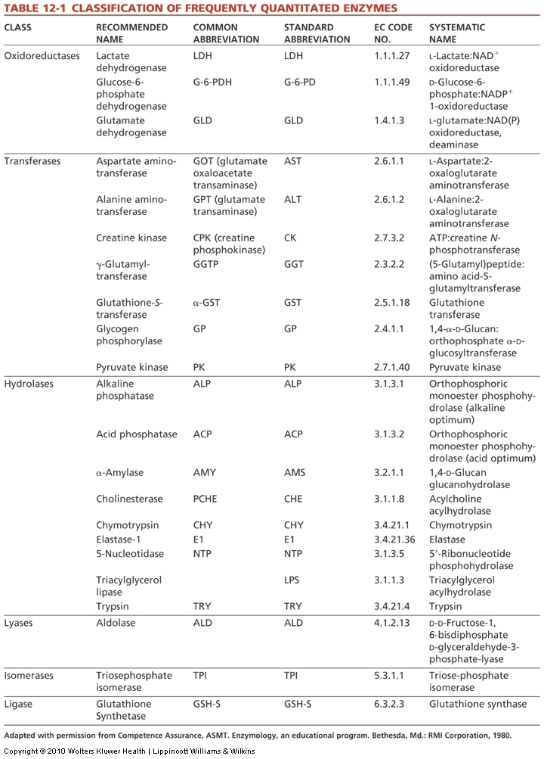
Notes:
25

