Slide 1
NIR Application in Food
Dr. Asif Ahmad

Slide 2
Introduction
IR (Near-infrared spectroscopy) is a technique that uses the electromagnetic spectrum to determine the molecular composition of a sample. NIR spectroscopy has various applications in the food industry, including analysis of raw materials, quality control, and process control. NIR is a non-destructive technique that can be used to determine various parameters of food products, including moisture content, fat content, protein content, and fiber content.
In this presentation, we will discuss the recent advances, process, flow diagram, and future research prospectus of NIR spectroscopy in the food industry.

Slide 3
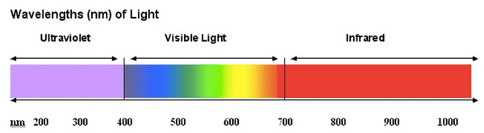
Definition of NIR
The near infrared (NIR) comprises low frequency radiation adjacent to red hues in the visible. The brightness we see in the NIR is due to reflected sunlight; not to temperature as many people, including some professionals, mistakenly believe.
The MIR spectroscopy (4000–400 cm⁻¹) measures information from frequencies of fundamental molecular vibrations, while NIR (800–2500 nm) spectra contain overtone and combination bands of fundamental vibrations

Slide 4
Importance of NIR in food analysis
Electromagnetic spectrum
Near Infrared, or NIR, spectroscopy is an analysis technique for fast, accurate food testing. NIR measurement is a widely-used method in the food and drink and agricultural industries, and it is a convenient, low cost alternative to chemical analysis. Near-infrared (NIR) spectroscopy is based on the absorption of electromagnetic radiation at wavelengths in the range 780–2500 nm. NIR spectra of foods comprise broad bands arising from overlapping absorptions corresponding mainly to overtones and combinations of vibrational modes involving CH, OH and NH chemical bonds. The concentrations of constituents such as water, protein, fat and carbohydrate can in principle be determined using classical absorption spectroscopy. However, for most food samples, this chemical information is obscured by changes in the spectra caused by physical properties such as the particle size of powders. This means that NIR spectroscopy becomes a secondary method requiring calibration against a reference method for the constituent of interest. As a consequence of the physics of diffuse transmittance and reflectance and the complexity of the spectra, calibration is normally carried out using multivariate mathematics (chemometrics).
Absorption of light
Based on the property of molecules to absorb the radiation light and experience a various vibrations characteristic of their composition, compounds in specific samples cloud be identified by IR techniques (Shiroma & Rodriguez-Saona, 2009). The interdisciplinary area of chemometrics, which allows design better experiments or selection of optimal analysis procedures, offers a great opportunity to explore the benefits of IR spectroscopy techniques. IR spectroscopy associated with chemometrics has proven to be rapid and non-destructive approach for screening or even analytical purposes in environmental and food research

Slide 5
Contd..
NIR spectroscopy is used routinely for the compositional, functional and sensory analysis of food ingredients, process intermediates and final products.
The major advantage of NIR is that usually no sample preparation is necessary, hence the analysis is very simple and very fast (between 15 and 90 s) and can be carried out on-line. One of the strengths of NIR technology is that it allows several constituents to be measured concurrently. In addition, for each fundamental vibration there exists a corresponding series of overtone and combination bands with each successive overtone band approximately an order of magnitude less intense than the preceding one. This provides a built-in dilution series which allows several choices of absorptions of different intensity containing the same chemical information. Finally, the relatively weak absorption due to water enables high-moisture foods to be analyzed.
The major limitation of NIR spectroscopy in food analysis is its dependence on less-precise reference methods.

Slide 6
Types of NIR instruments
Fourier transform NIR
The Fourier transform near-infrared spectroscopy (FT-NIRS) is a non-destructive fast technique capable of analyzing organic substances in a reliable way. Such analytical method has presented a great impact in the food industry and agriculture.To follow official supervision and regulation committee requirements, as well as, to contribute to the consumer health. This chemical analysis, which includes the determination of moisture, protein, ash, fat and carbohydrate contents, traditionally has been performed by laborious methods which are time demanding and generate much chemical waste. However, the methods that use the FT-NIRS technique provide precise and fast results, with minimal or null sample preparation and waste generation.
Nevertheless, due to spectral features in the NIR region and in order to simultaneously evaluate diverse parameters, multivariate calibration methods must be used to obtain quantitative information. Multivariate calibration methods are part of chemometrics, which needs a huge number of results from analytical trials for the development of a mathematical model.
The FT-NIRS technique and the multivariate calibration have already been used to determine some major contents in food, like Haughey et al. (in press) who described the evaluation of melamine content in soybean, determination of polymerized triacylglyceride in vegetable oils and protein in different vegetables.
The wide range of results of the developed models demonstrates that with only one spectroscopic technique, the FT-NIRS, it is possible to simultaneously analyze many parameters: moisture, protein, ash, lipid and carbohydrate. starch, protein and lipid contents ofcereal varieties may be determined by NIR, while an application of NMR, FT-Raman, FT-IR and NIR was necessary for Holse, Larsen, Hansen, and Engelsen (2011) in order to characterize carbohydrates, proteins, dietetic fibers and unsaturated fatty acids in leguminous plants.
Grating-based NIR

Slide 7
Advantages of NIR
Non-destructive
Rapid analysis
Minimal sample preparation

Slide 8
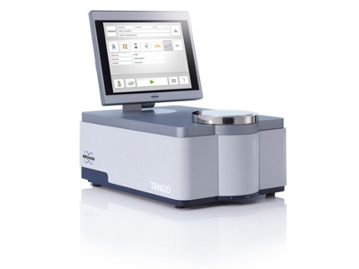
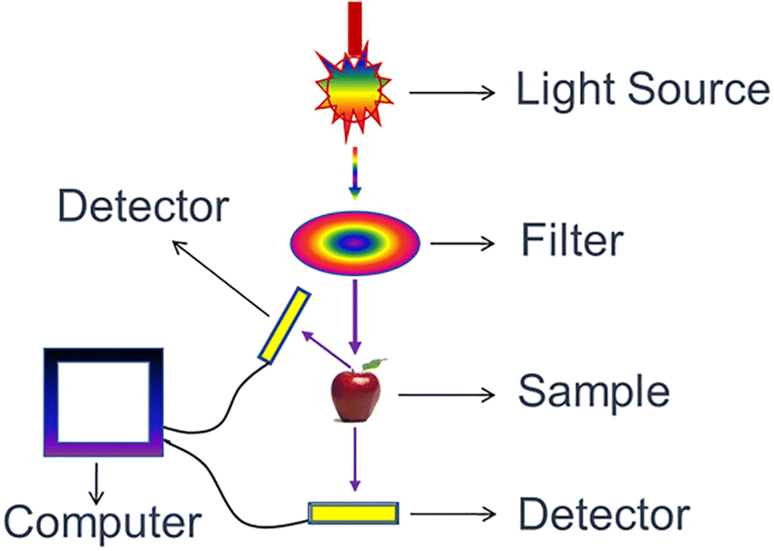
Applications of NIR in food analysis
Moisture content analysis
Fat content analysis
Protein content analysis
Fiber content analysis

Slide 9
Recent advances in NIR
Multivariate data analysis (https://www.youtube.com/watch?v=cIiHwnYRACo , https://www.youtube.com/watch?v=_jhx-kGO7jA)
Hyperspectral imaging: Hyperspectral imaging (HSI) is a technique that analyzes a wide spectrum of light instead of just assigning primary colors (red, green, blue) to each pixel. The light striking each pixel is broken down into many different spectral bands in order to provide more information on what is imaged.
Portable NIR instruments

Slide 10
Multivariate data analysis
Principle component analysis (PCA)
Partial least squares (PLS)

Slide 11
Hyperspectral imaging
Applications in food analysis
Food fraud can cause damage to consumer health and affect their confidence, destroy brands and generate large economic losses in the industry. Food authenticity allows to identify if food composition, geographical origin, genetic variety and farming system corresponds to what has been declared on the label. Although there are currently standardized methods to identify certain adulterants, the complexity of the food, the complexity of the supply chain and the appearance of new adulterants require the continuous development of analytical techniques to detect food fraud. NIR and Hyperspectral imaging (HSI) in tandem with chemometrics are non-destructive, non-invasive and accurate techniques for food authentication.

Slide 12
Portable NIR instruments
Definition of portable NIR instruments
Advantages of portable NIR instruments

Slide 13
NIR process
Sample preparation
Instrument calibration
Data analysis

Slide 14
Sample preparation
Homogenization
Moisture removal

Slide 15
Instrument calibration
Calibration standards
Validation of calibration

Slide 16
Data analysis
Multivariate data analysis
Chemometrics

Slide 17
Flow diagram of NIR analysis
Sample collection
Sample preparation
Instrument calibration
Data analysis
Result interpretation

Slide 18
Task To Do ( Students weekend work)
Slide 18: Fat content analysis using NIR
Principle of fat content analysis
Advantages of NIR in fat content analysis
Slide 19: Fat content analysis using NIR
Sample preparation
Instrument calibration
Data analysis
Slide 20: Fat content analysis using NIR
Result interpretation
Accuracy of NIR in fat content analysis
Moisture content analysis using NIR
Protein content analysis using NIR

