Slide 1
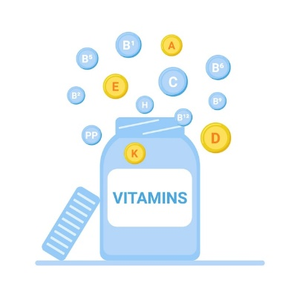
FAT SOLUBLE VITAMINS
PROF. DR. ASIF AHMAD
IFNS- PMAS UAAR

Slide 2
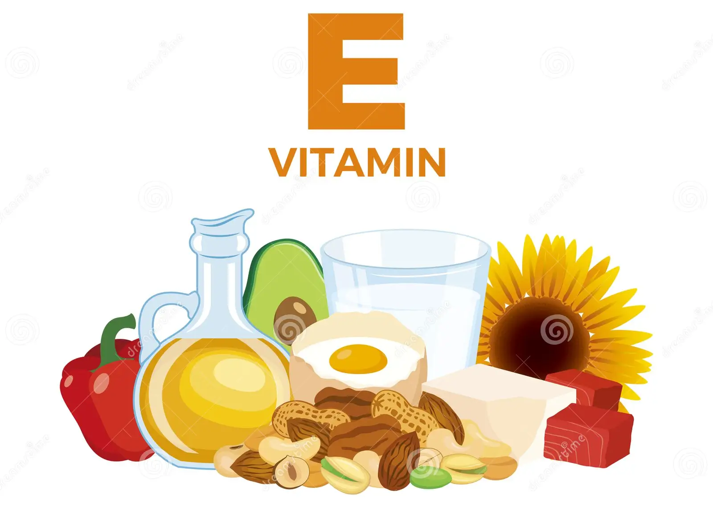
VITAMIN E
Vitamin E is a vitamin that dissolves in fat.
It is found in many foods including vegetable oils, cereals, meat, poultry, eggs, and fruits.
Vitamin E is an important vitamin required for the proper function of many organs in the body. It is also an antioxidant.
Forms: Exists in eight different forms, with the most biologically active being:
  Tocopherols: Includes alpha-tocopherol, beta-tocopherol, gamma-tocopherol, and delta-tocopherol.
  Tocotrienols: Includes alpha-tocotrienol, beta-tocotrienol, gamma-tocotrienol, and delta-tocotrienol.

Slide 3
TOCOPHEROLS
TOCOTRIENOLS
Tocopherols are a group of chemical compounds with antioxidant properties that help protect cells from oxidative damage.
Alpha-Tocopherol: The most biologically active form; has the highest antioxidant activity and is the form that meets human requirements.
Beta-Tocopherol: Less common but contributes to antioxidant activity.
Gamma-Tocopherol: Found in many foods and has significant antioxidant properties; may play a role in reducing inflammation.
Delta-Tocopherol: Less well-studied but believed to have unique health benefits
Tocotrienols are less common than tocopherols but have potent antioxidant effects and various health benefits.
Alpha-Tocotrienol: Has antioxidant properties and may help protect against cardiovascular disease.
Beta-Tocotrienol: Less common; studies suggest potential health benefits similar to alpha-tocotrienol.
Gamma-Tocotrienol: May have anti-cancer properties and support brain health.
Delta-Tocotrienol: Research indicates potential neuroprotective effects

Slide 4
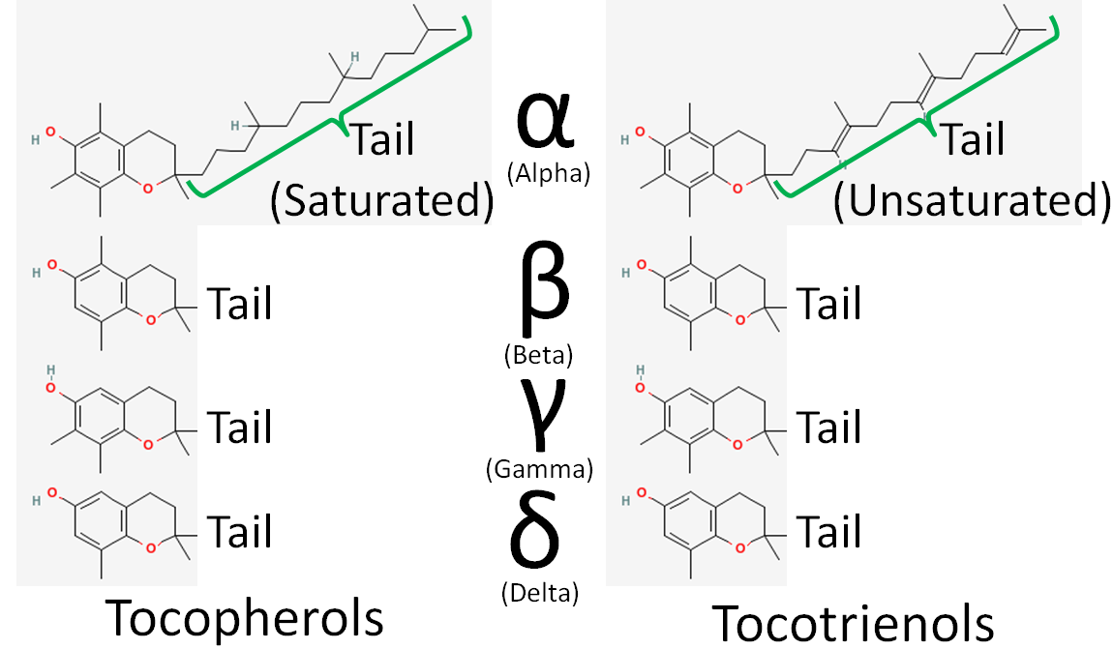

Slide 5
CHEMISTRY
Chemical Structure:
Vitamin E compounds are derived from chromanol, which consists of a chromane ring (benzene ring with a saturated side chain) and a hydroxyl (-OH) group.
1. Tocopherols: Characterized by a saturated phytyl side chain; they contain a methyl group at various positions on the chromanol ring.
  Alpha-Tocopherol: Methyl groups at positions 2, 4, and 5 (most biologically active).
  Beta-Tocopherol: Methyl groups at positions 2 and 5.
  Gamma-Tocopherol: Methyl groups at positions 2 and 7.
  Delta-Tocopherol: Methyl groups at positions 3 and 7.
2. Tocotrienols: Similar to tocopherols but have an unsaturated side chain, which contributes to their unique biological properties.
  Alpha-Tocotrienol: Contains three double bonds in the phytyl side chain.
  Beta-, Gamma-, and Delta-Tocotrienols: Similar variations as tocopherols but with differing methyl group positions.
Stability:
Sensitive to heat, light, and oxygen; antioxidant properties help protect against oxidative degradation.

Slide 6
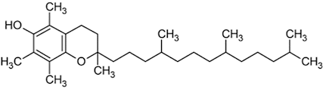
Compound | R₁ | R₂ | R₃ | Phytyl Chain
alpha-tocopherol | CH₃ | CH₃ | CH₃ | Saturated
gamma-tocopherol | H | CH₃ | CH₃ | Saturated
beta-tocopherol | CH₃ | H | CH₃ | Saturated
delta-tocopherol | H | H | CH₃ | Saturated
alpha-tocotrienol | CH₃ | CH₃ | CH₃ | Unsaturated
gamma-tocotrienol | H | CH₃ | CH₃ | Unsaturated
beta-tocotrienol | CH₃ | H | CH₃ | Unsaturated
delta-tocotrienol | H | H | CH₃ | Unsaturated

Slide 7
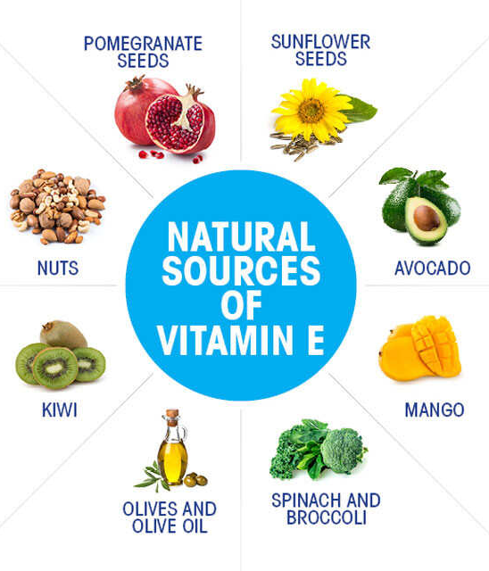
SOURCES
Natural Food Sources:
Vegetable Oils:
  Sunflower oil, wheat germ oil, safflower oil, and olive oil are rich sources.
Nuts and Seeds:
  Almonds, hazelnuts, sunflower seeds, and peanuts provide significant amounts of Vitamin E.
Green Leafy Vegetables:
  Spinach, kale, and Swiss chard are good sources, particularly when consumed raw or lightly cooked.
Fruits:
  Avocados, kiwis, and blackberries contain moderate levels of Vitamin E.
Fortified Foods:
Many breakfast cereals and juices are fortified with Vitamin E to enhance dietary intake.
Supplements:
Vitamin E is available as dietary supplements, often in the form of alpha-tocopherol or mixed tocopherols and tocotrienols.

Slide 8
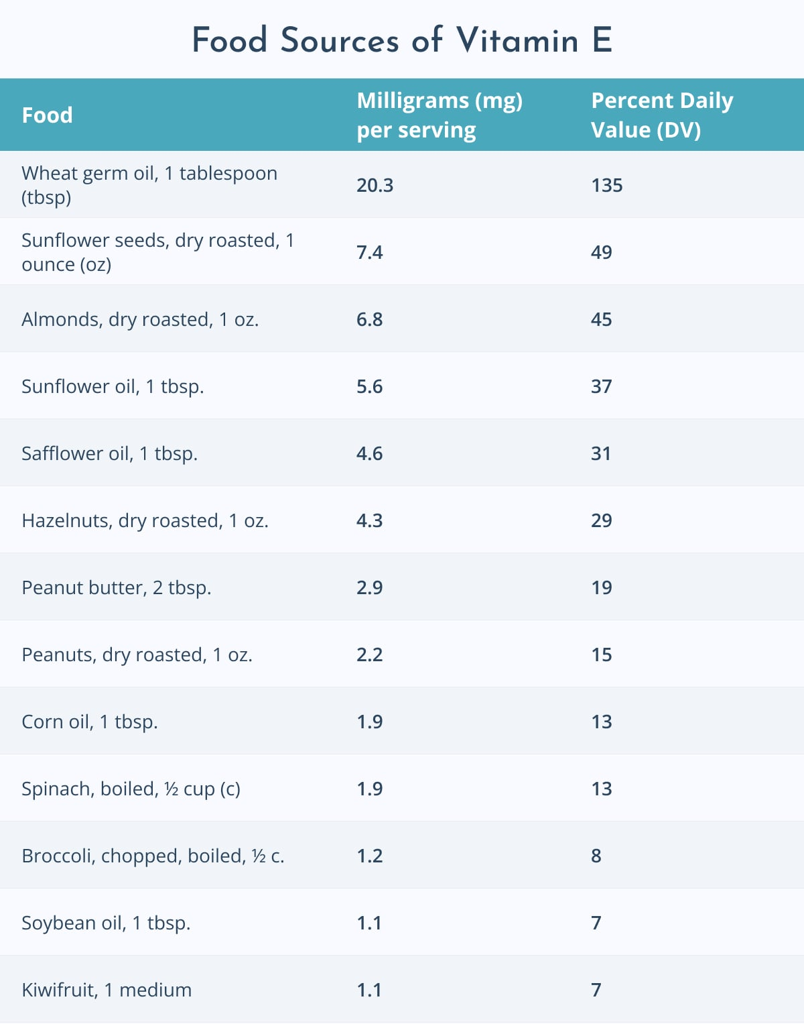
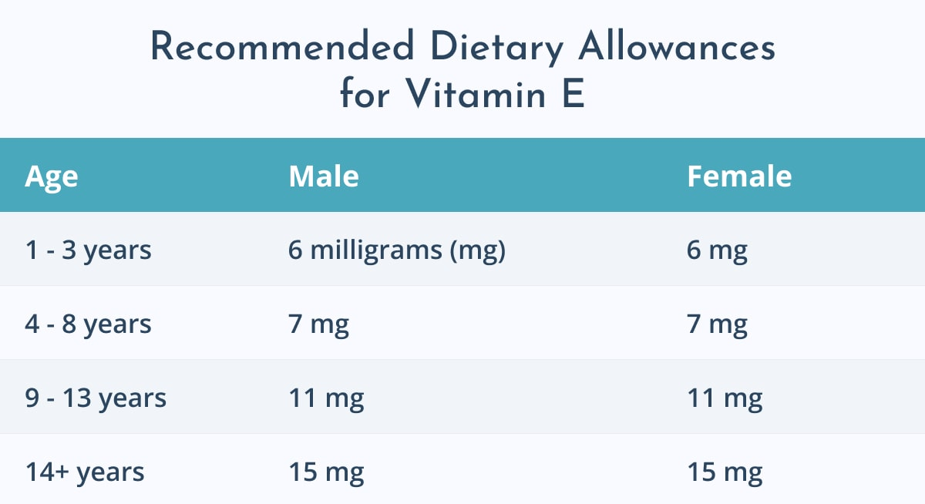
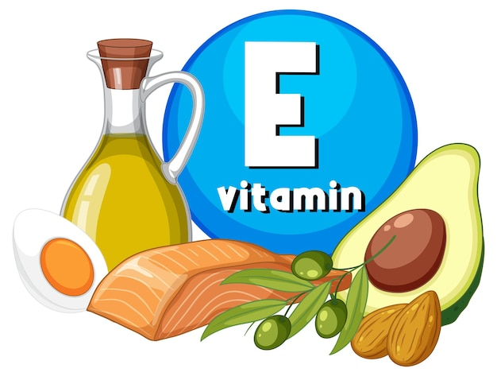

Slide 9
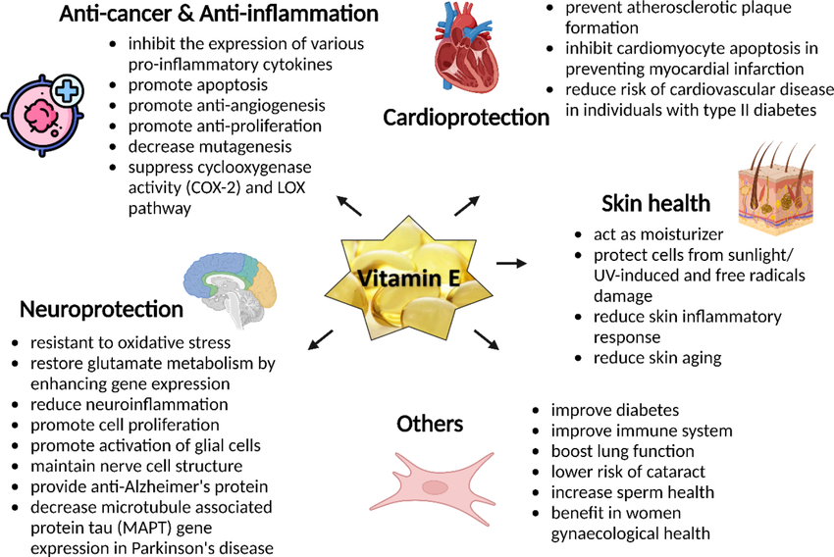
ROLE OF VITAMIN E IN BIOLOGICAL FUNCTIONS

Slide 10
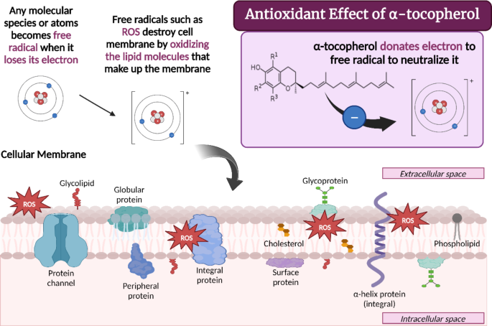

Slide 11
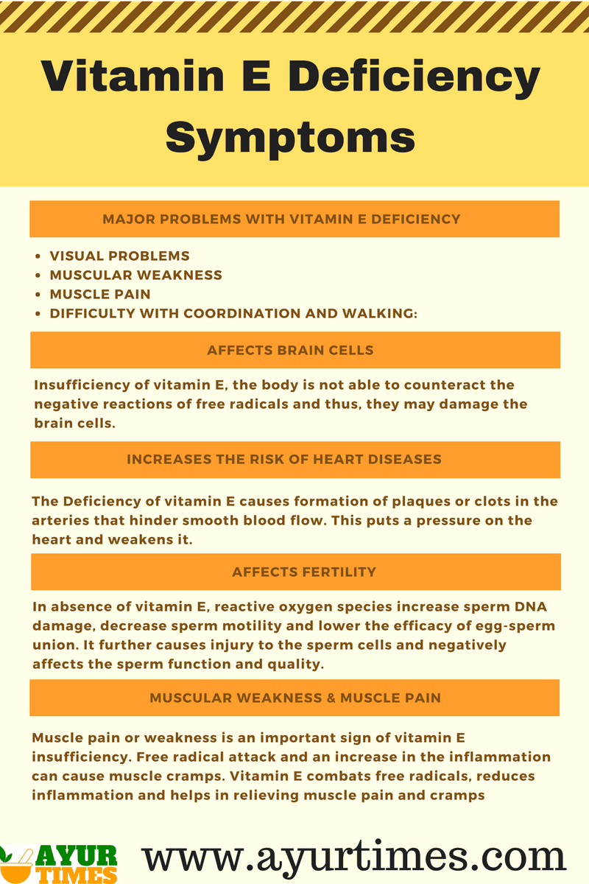
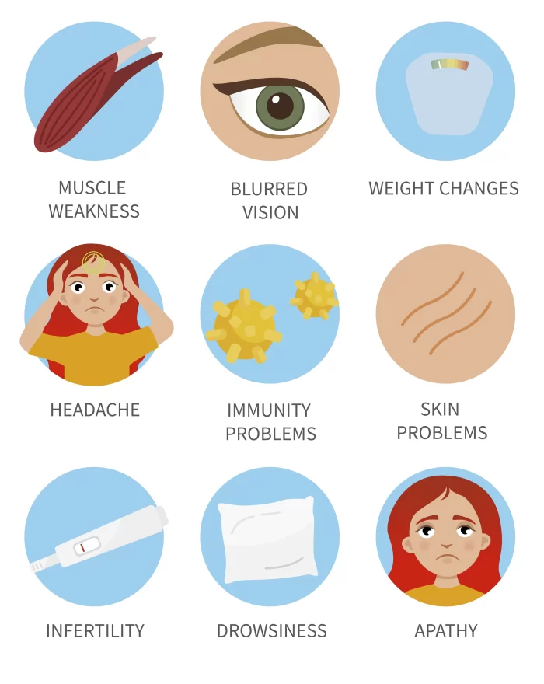

Slide 12
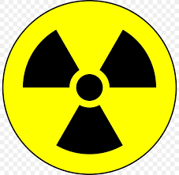
TOXICITY
Vitamin E toxicity is rare but can occur, primarily due to excessive supplementation rather than dietary intake.
Symptoms:
  Hemorrhagic Effects:
  Gastrointestinal Disturbances:
  Fatigue and Weakness:
Causes
Excessive Supplementation:
  Taking high-dose vitamin E supplements (above the recommended dietary allowance) can lead to toxicity.
Drug Interactions:
  Increased risk of bleeding when taken with anticoagulants (e.g., warfarin) or antiplatelet medications.
Consequences
Potentially serious complications, particularly related to bleeding.
Long-term high-dose vitamin E supplementation may have adverse effects on health, including an increased risk of prostate cancer in some studies.
Recommendations
Adhere to the recommended dietary allowance (RDA) for vitamin E and consult a healthcare provider before starting any supplementation.
Monitor for symptoms if taking high doses, especially if on blood-thinning medications.

Slide 13
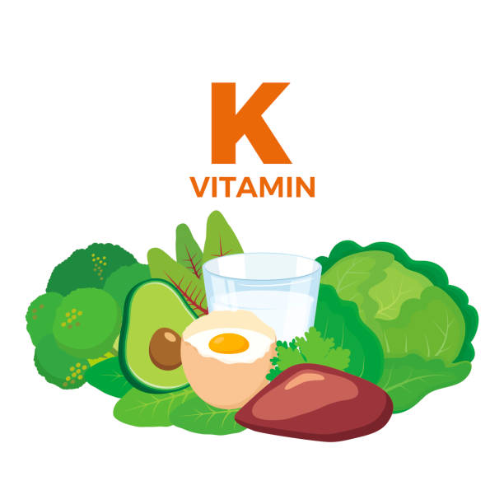
VITAMIN K
Vitamin K is a fat-soluble vitamin essential for various physiological functions, primarily involved in blood clotting and bone metabolism.
Forms
Vitamin K1 (Phylloquinone):
  Found in green leafy vegetables and some plant oils; the primary dietary source.
Vitamin K2 (Menaquinone):
  Found in fermented foods and animal products; includes various subtypes (MK-4, MK-7) that have distinct biological activities.
Vitamin K3 (Menadione):
  A synthetic form of Vitamin K that is not commonly found in natural foods but may be present in some supplements.
Importance
  Blood Clotting
  Bone Health
  Cardiovascular Health
Deficiency can lead to increased bleeding (hemorrhage) and weakened bones; particularly at risk are individuals with malabsorption disorders or those on long-term antibiotic therapy.

Slide 14
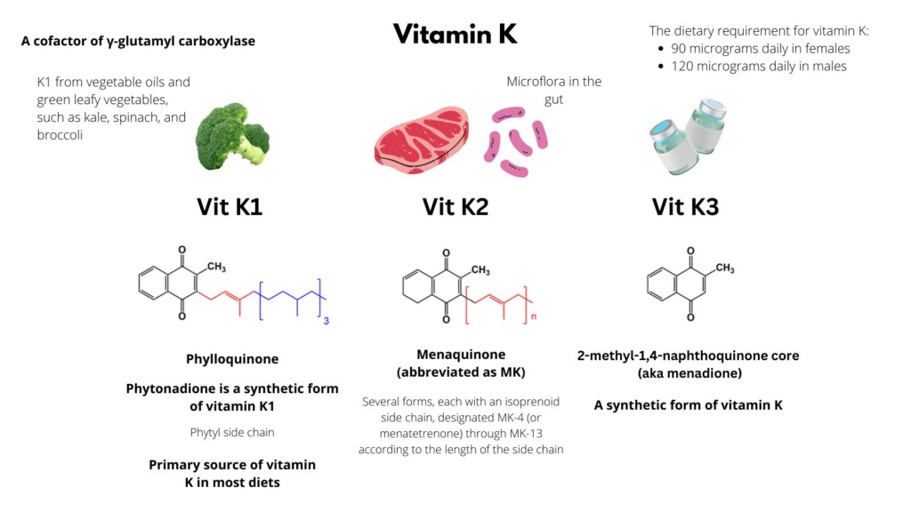

Slide 15
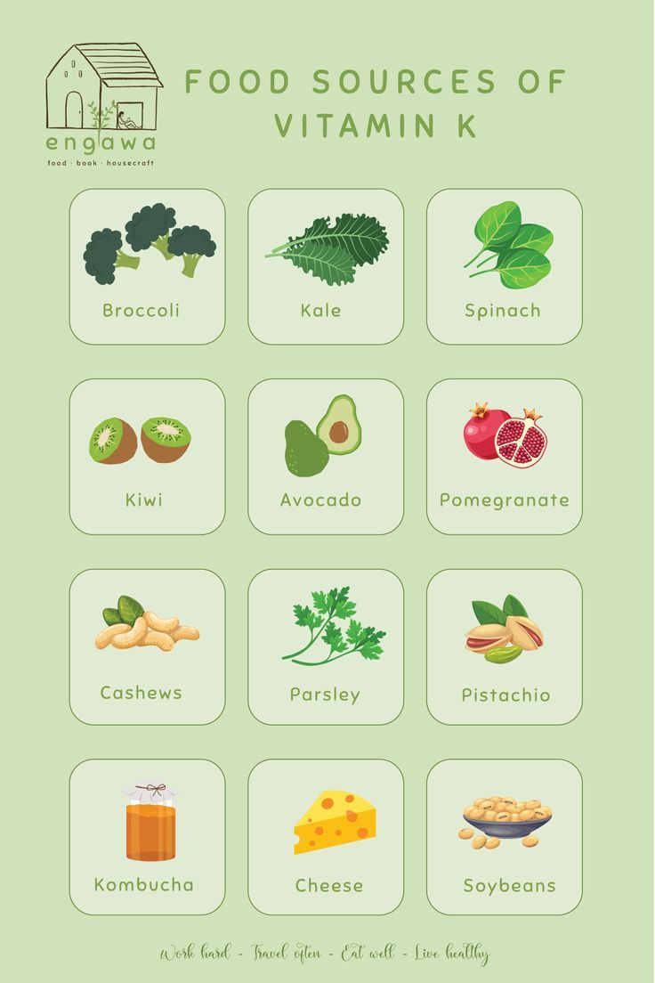
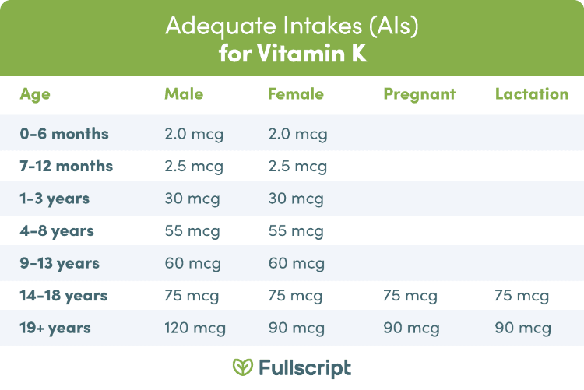
SOURCES OF VITAMIN K

Slide 16
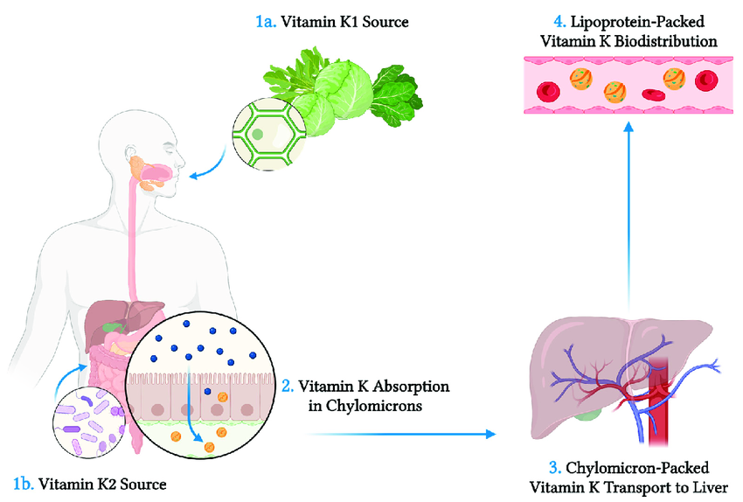
ABSORPTION OF VITAMIN K
1. Route of Absorption:
Vitamin K is primarily absorbed in the small intestine.
The presence of dietary fats enhances its absorption due to its fat-soluble nature.
Mechanism:
Incorporation into Micelles: Vitamin K1 (phylloquinone) and K2 (menaquinone) are incorporated into micelles formed by bile salts in the intestinal lumen.
Transport into Enterocytes: After micelle formation, Vitamin K is absorbed into the intestinal cells (enterocytes) through passive diffusion.
2. Transport in the Blood:
Once inside enterocytes, Vitamin K is incorporated into chylomicrons (lipoprotein particles) and released into the lymphatic system.
Chylomicrons then enter the bloodstream, delivering Vitamin K to various tissues, including the liver, where it is stored and utilized.
3. Storage:
Vitamin K is stored mainly in the liver, where it is available for synthesis of clotting factors and other functions as needed.

Slide 17
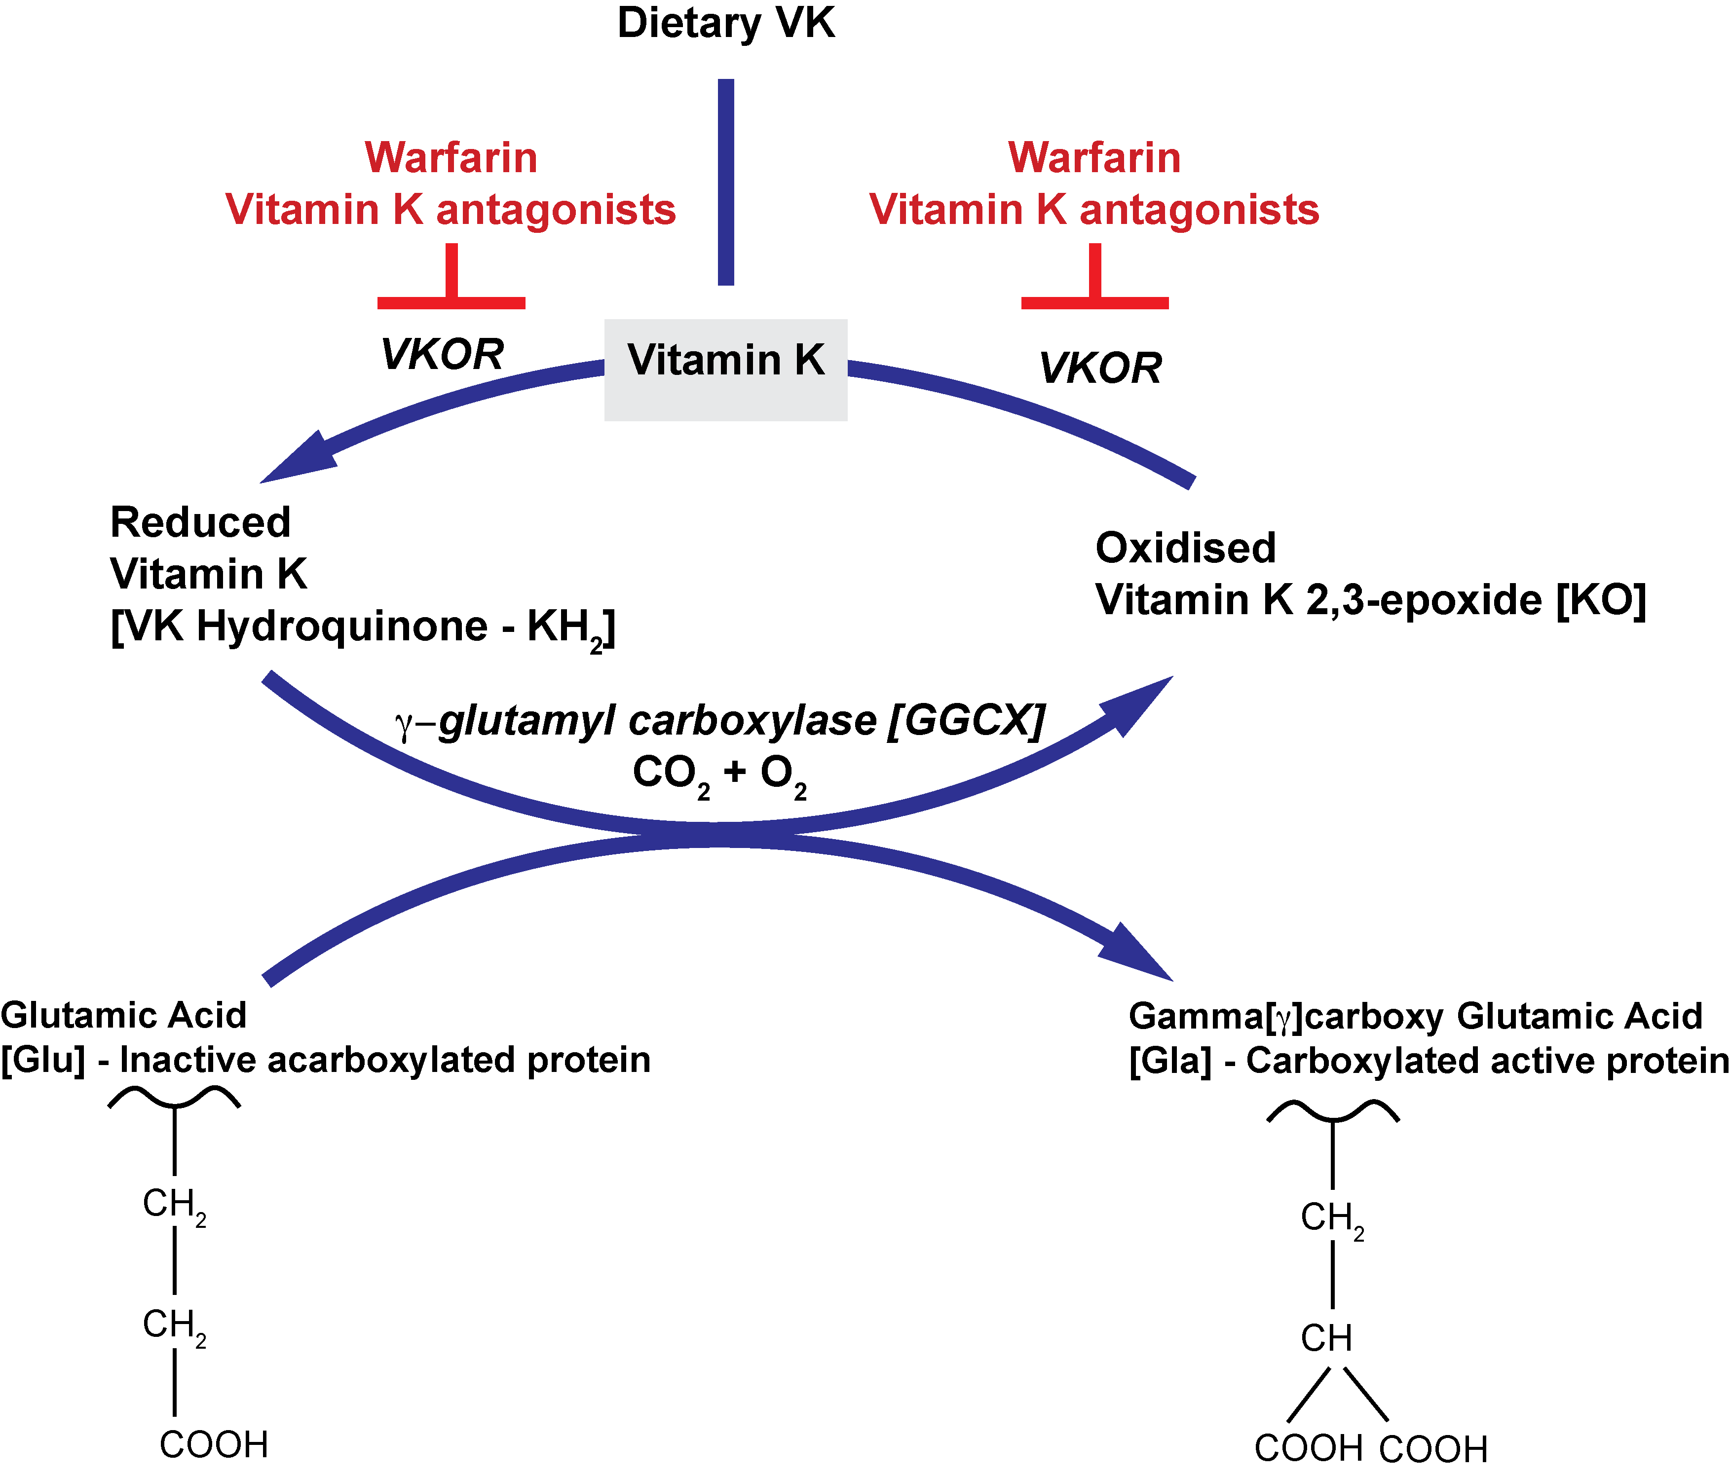
ROLE OF VIT-K IN BIOLOGICAL FUNCTIONS
1. Blood Clotting
Vitamin E is essential for synthesizing clotting factors II (Prothrombin), VII, IX, and X.
Activation of Clotting Factors:
Vitamin K acts as a cofactor for γ-glutamyl carboxylase, which converts specific glutamic acid residues in clotting factors into γ-carboxyglutamic acid (Gla).
Calcium Binding:
Gla residues enable clotting factors to bind calcium ions (Ca²⁺), crucial for their activation.
Formation of Fibrin Clot:
Activated prothrombin converts fibrinogen into fibrin, stabilizing the platelet plug and forming a clot.
Recycling of Vitamin K:
After its action, Vitamin K is converted to an inactive form but can be recycled back to its active form by VKOR (Vitamin K epoxide reductase).
Consequences of Deficiency:
Deficiency leads to impaired synthesis of clotting factors, increasing the risk of bleeding.

Slide 18
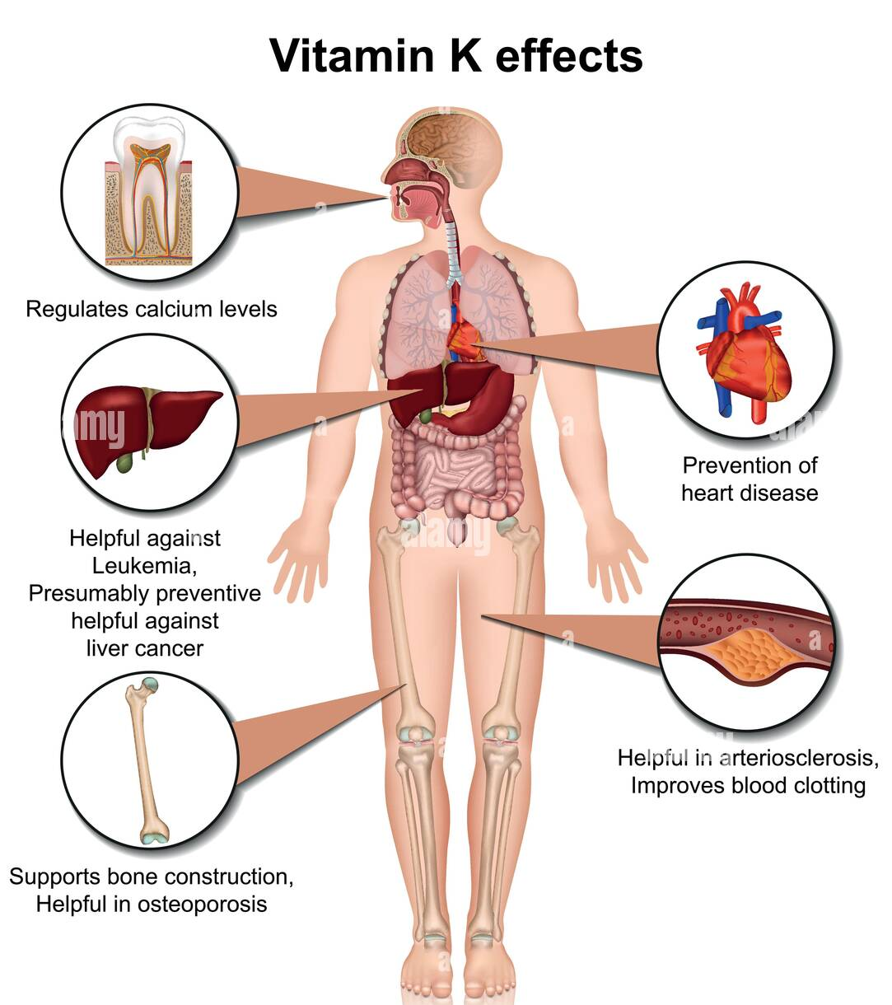
2. Bone Metabolism:
  Function: Plays a crucial role in bone mineralization and health.
  Mechanism: Vitamin K activates osteocalcin, a protein that binds calcium to the bone matrix, promoting bone density and strength.
3. Vascular Health:
  Function: Helps prevent arterial calcification, contributing to cardiovascular health.
  Mechanism: Vitamin K activates matrix Gla-protein (MGP), which inhibits vascular calcification and maintains arterial elasticity.
4. Cell Growth and Survival:
  Function: Involved in cell signaling and growth regulation.
  Mechanism: Vitamin K influences the synthesis of proteins involved in cell cycle regulation and apoptosis, contributing to normal cellular function.
5. Potential Role in Cancer Prevention:
  Function: Emerging evidence suggests a role in cancer prevention.
  Mechanism: Vitamin K may have antioxidant properties and influence pathways related to cancer cell growth and apoptosis.

Slide 19
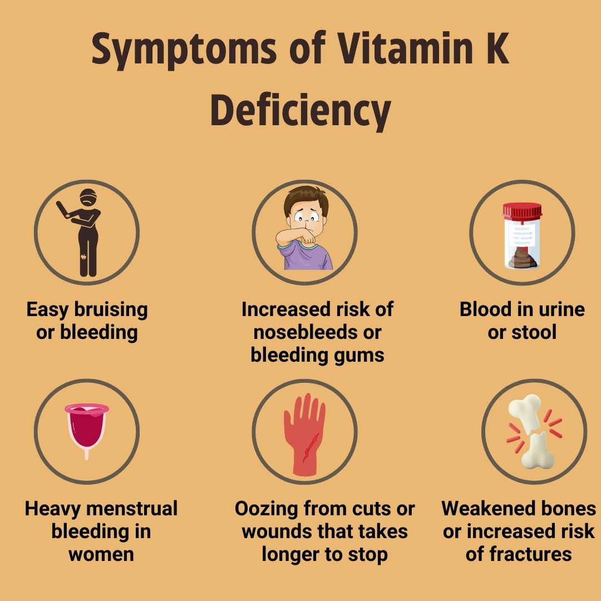
DEFICIENCY OF VITAMIN K
Rare but can lead to serious health issues due to its role in blood clotting.
Causes:
Inadequate Intake: Low consumption of leafy greens and fermented foods.
Malabsorption Disorders: Conditions like celiac or Crohn’s disease affect absorption.
Antibiotic Use: Disruption of gut bacteria that synthesize vitamin K2.
Cholestasis: Obstruction of bile flow impairs vitamin K absorption.
At-Risk Populations:
Newborns: Administered vitamin K injection at birth.
Individuals with Malabsorption: Higher risk for those with GI issues.
Long-term Anticoagulant Users: Affected by medications impacting vitamin K.
Conclusion:
Early detection and dietary adjustments or supplementation are crucial for prevention.

Slide 20
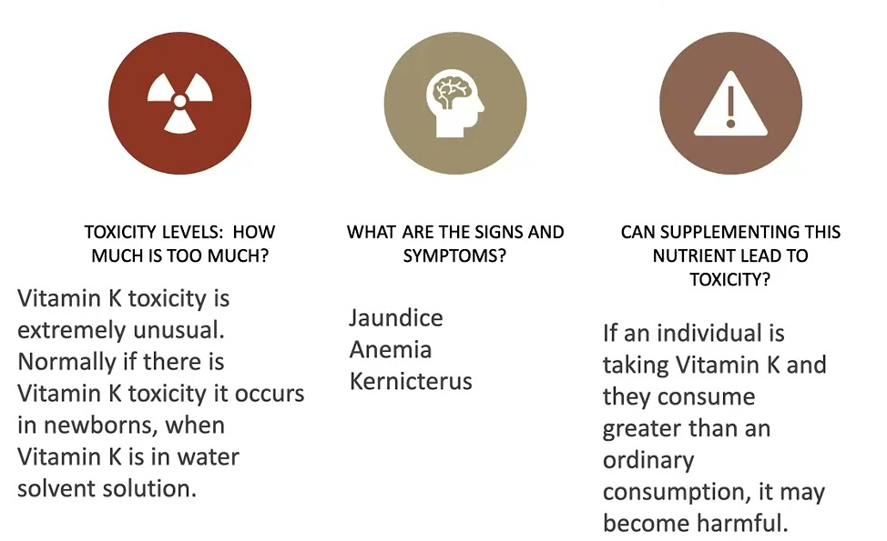
TOXICITY OF VITAMIN K

Slide 21
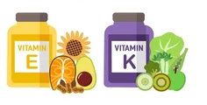
Interaction Aspect | Vitamin E | Vitamin K | Importance of Interaction
Function | Antioxidant that protects cell membranes | Essential for synthesizing clotting factors | Both vitamins work together to maintain overall health and prevent oxidative damage to vitamin K.
Role in Blood Clotting | High doses may interfere with clotting | Critical for blood coagulation | Balance is essential; excess vitamin E can inhibit vitamin K's effectiveness in clotting.
Bone Health | Protects bone cells from oxidative stress | Regulates calcium metabolism | Both contribute to bone integrity; their interaction supports overall bone health.
Hormonal Balance | Involved in hormone synthesis | Supports calcium regulation and bone health | Proper hormonal function can influence both vitamins’ roles in metabolism and health.
Clinical Significance | High doses in anticoagulant therapy may need monitoring | Critical for individuals with malabsorption | Balanced intake is crucial for individuals on blood thinners or those with dietary restrictions.
INTERACTION OF VITAMIN E
AND
VITAMIN K

Slide 22
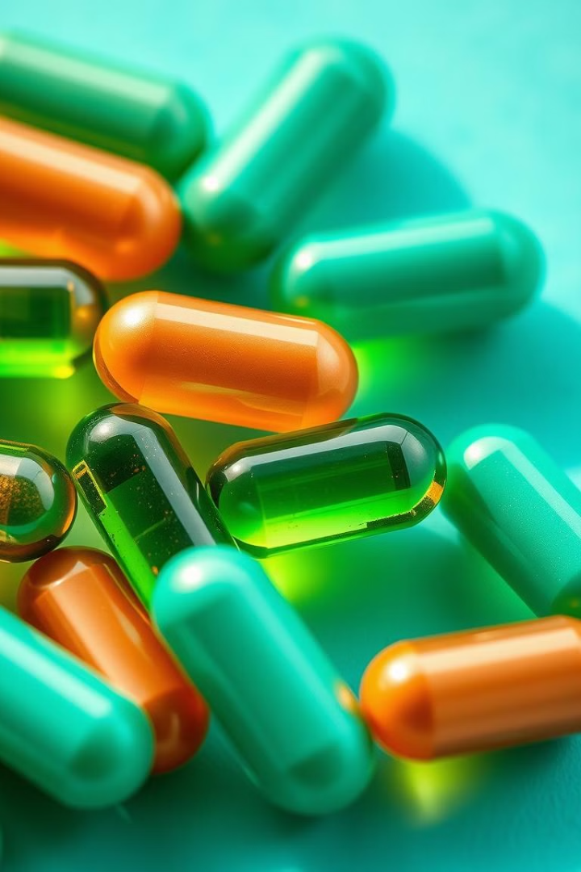

THANKS
Prof. Dr. Asif Ahmad, Director Institute of Food and Nutritional Sciences, PMAS-Arid Agriculture University Rawalpindi
asifahmad_1@yahoo.com

