Slide 1

MASS SPECTROPHOTOMETRY
FT-722
DR.ASIF AHMAD

Slide 2
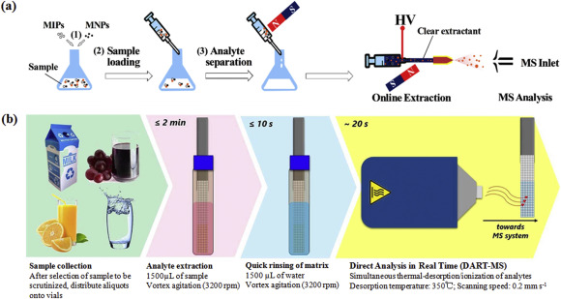
WHAT IS MASS SPECTROPHOTOMETRY
Mass spectrophotometry involves the ionization of molecules, separation of ions based on their mass-to-charge ratio, and detection of ions to generate a mass spectrum.
The key components of a mass spectrometer include an ion source, mass analyzer, and detector. The process begins with the sample being ionized, either by electron impact, electrospray ionization, or matrix-assisted laser desorption/ionization.
The ions are then accelerated, separated based on their mass-to-charge ratio, and detected, providing information about their abundance and molecular structure.

Slide 3

FOOD ANALYSIS
Mass Spectrometry in Food Analysis covers the MS-based analysis of different aspects of food quality, which include nutritional value, profile of macronutrients (proteins, lipids, and carbohydrates), micronutrients (vitamins), and nutraceutical active compounds.
Additionally, sensory quality, flavor, food pigments, safety, and detection of pesticides, contact materials, veterinary drugs and pharmaceuticals, organic pollutants, and pathogens are determined.

Slide 4
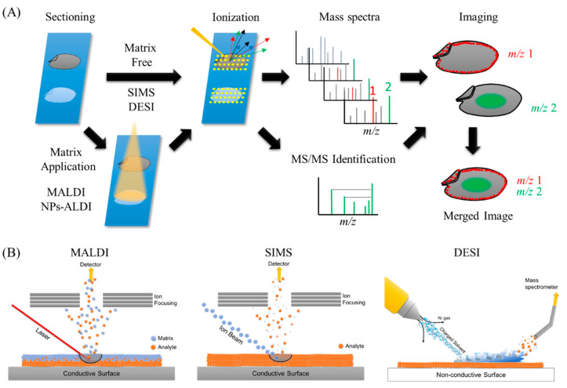
Ionization processes of the most widely used methods in mass spectrometry imaging (MSI) and the general overview of MSI workflow.

Slide 5
Examples of matrices used in MS
Matrices | Analytes
N-(1-naphthyl)ethylenediamine dihydrochloride (NEDC) | glucose
3-amino-4-hydroxybenzoic acid (AHBA) | glycan
3-aminoquinoline (3AQ) | glycan
2-,4-,6-trihydroxyacetophenone (THAP) | glycolipids
N,N-dimethylaniline (DMA) | hemicellulose
1,5-diaminonapthalene (DAN) | lipids
2-mercaptobenzothiazole (MBT) | lipids
dihydroxyacetone phosphate (DHAP) | lipids, glycan
2,5-dihydroxybenzoic acid (DHB) | lipids, glycopeptide, polymer
9-aminoacridine (9-AA) | lipids, metabolites
3-hydroxypicolinic acid (3HPA) | nucleotides
anthranilic acid (ANA) | nucleotides
nicotinic acid (NA) | nucleotides
picolinic acid (PA) | nucleotides
sinapinic acid (SA) | peptides, protein

Slide 6
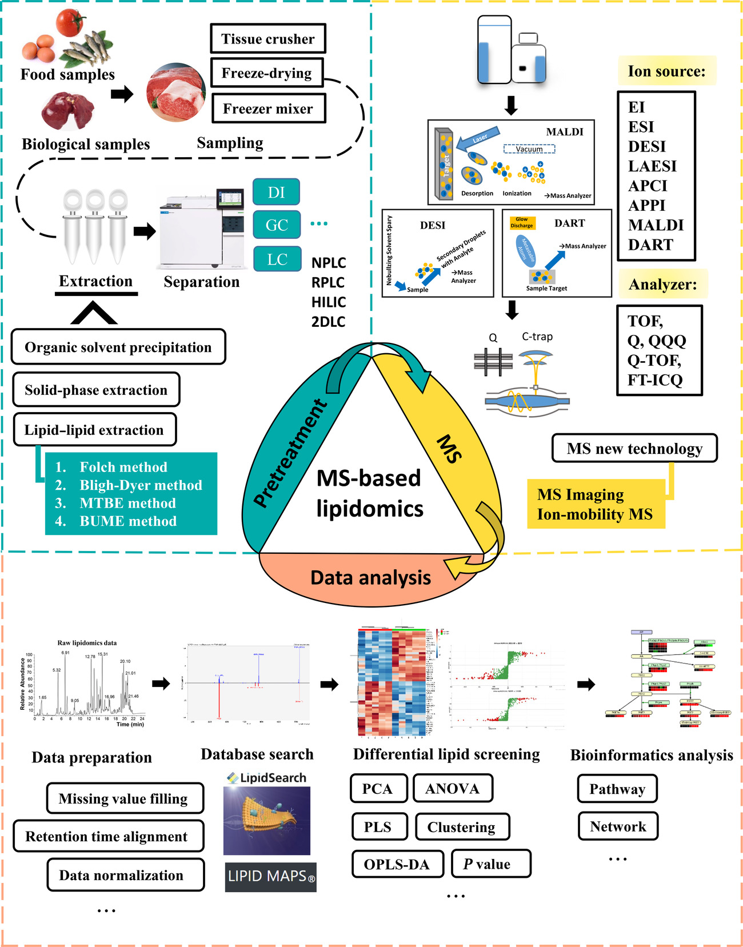
LIPIDS
Lipid imaging of food products has been widely applied since lipids constitute a large portion of the organic molecules and they exist within a cell and are easily detected by various types of MSI, especially MALDI-MSI
Lipids in food products will exhibit a different composition and distribution owing to the differences in areas, states, and environments in which they are produced. For example, Goto-Inoue et al. showed that the molecular compositions of triacylglycerols are different in red sea bream (Pagrus major) which are wild or farmed by using MALDI-MSI
In former, saturated-fatty-acid-containing triacylglycerols are major molecular species, while docosahexaenoic-acid-containing triacylglycerol levels are significantly higher in the later than in the former. In addition, they assessed the muscle fiber types in those fishes using phospholipids as specific markers of each types of muscle fiber which they found
Enomoto et al. revealed the distributions of sphingomyelin and phosphatidylcholine (PC) species in pork chop.

Slide 7
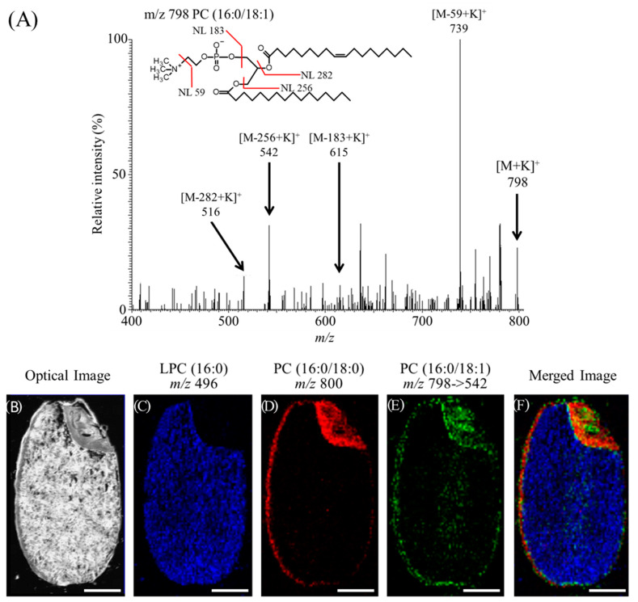
MSI analysis of phosphatidylcholines (PCs) containing oleic acid in a section obtained from rice seed

Slide 8
CARBOHYDRATES
Carbohydrates are responsible for providing energy and are found in significant portions in a large number of food. They encompass a diverse class of organic components, including mono- and disaccharides, oligosaccharides, and polysaccharides.
In addition, the type and number of constituent sugars, and the mode of binding between them adds to the diversity of carbohydrates. The distribution of carbohydrates in foods such as strawberries, barley grain, maize seeds and apples were analyzed by DESI and MALDI-MSI
Horikawa et al. confirmed the distribution of hexose, sucrose, and sorbitol in apples by MALDI-MSI; there was a linear correlation between the results of HPLC analysis and the ion intensity obtained by MSI, which demonstrated that MSI can quantify simple sugars in tissue sections
There are limitations to the current application of MSI in characterizing carbohydrates. The analysis is limited to simple carbohydrates, and the analysis of more complex carbohydrates remains an analytical challenge. The identification of saccharides with the same mass (e.g., glucose, galactose, and fructose) is not currently possible with MSI technology.

Slide 9
PROTEINS
Although the identification of proteins by mass spectrometry of peptide fragments has been performed extensively using MALDI-MS, there are a few examples of peptide evaluation in food compared with studies of lipids and carbohydrates. The localization of peptides in food has been analyzed in a variety of food including crabs, fishes, prawns, peaches, tomatoes and hams
Denaturation of proteins and peptides has been shown to negatively affect the nutritional, sensory, and quality characteristics of cooked ham. Using MALDI-MSI, Gallego et al. compared ionic intensities of m/z 650–1800 that appeared to derive from peptides in two different pig muscles (outer Semimembranosus and inner Biceps femoris); the higher levels of peptides in the outer muscle may indicate that proteolysis is more likely to occur within inner pig muscles which ultimately becomes ham
Through the comparison of MALDI-MSI analyses of ham with different degrees of denaturation, Theren et al. identified peptides that correlate with internal ham denaturation, i.e., markers of ham denaturation
These findings may elucidate the mechanisms of denaturation that occur within ham and lead to the discovery of new ways to prevent denaturation, which may reduce food waste. MSI analysis may enhance food quality control and aid in the prevention of economic losses associated with food waste

Slide 10
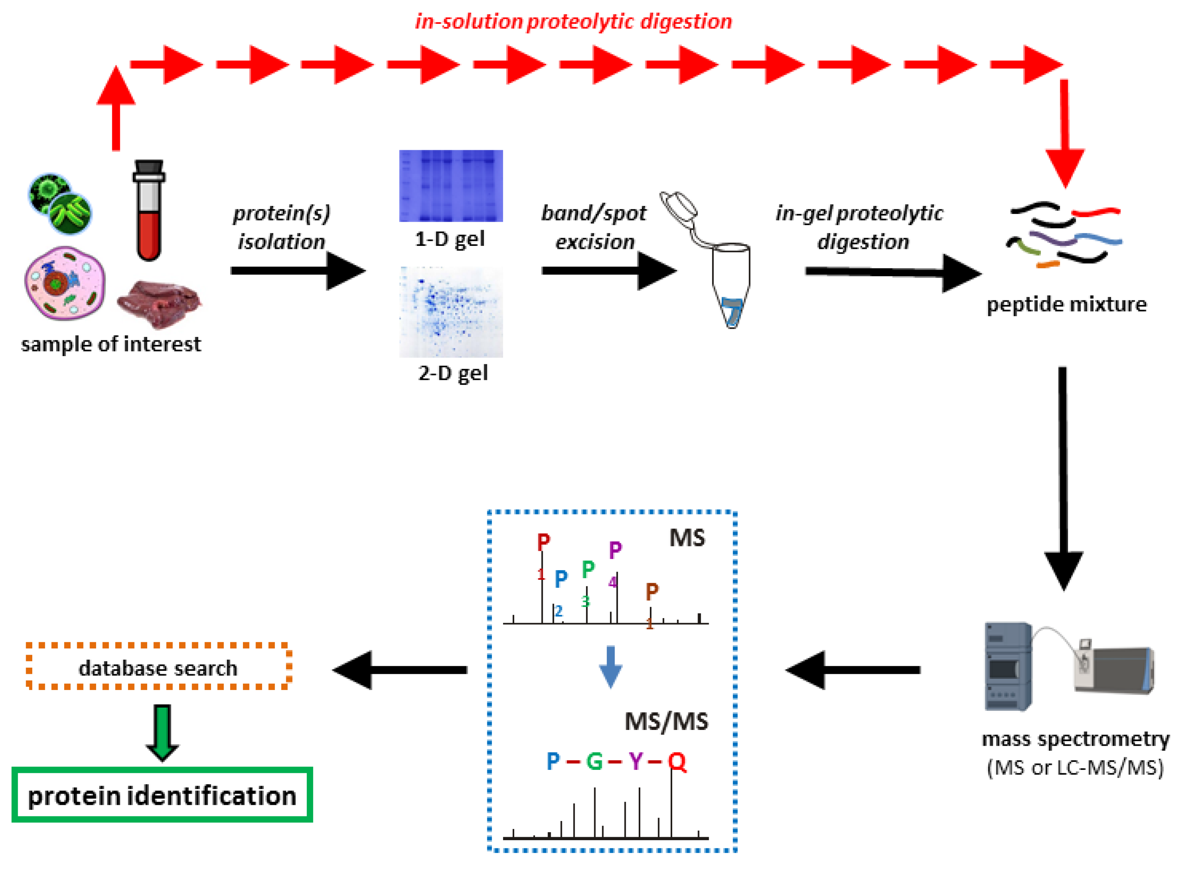
PROTEIN QUANTIFICATION

Slide 11
MICRONUTRIENTS
Micronutrients include vitamins and minerals, which are essential for the development and maintenance of health, and disease prevention. Micronutrients are only needed in small amounts, but they are not produced by the body and must be obtained from the diet. Therefore, an efficient intake of micronutrients from food is desirable.
If micronutrients are known to be present within the food, selective ingestion of the portions enriched with abundant micronutrients may lead to more efficient intake of food. SIMS is a technology that has been widely used for elemental analysis of MSI in the field of food science. The imaging experiments of several elements such as Mg, Ca, Na, K, Se, Fe, and S have been conducted on wheat and rice grain
High-resolution SIMS-MSI revealed the subcellular distribution of Fe, P, and S in rice, which indicated that most Fe co-localized with P
This analysis also indicated that phytic acid localized to the aleurone layer, but a small amount of Fe was retained in parts of the subaleurone and outer endosperm in a pattern that did not colocalize with P.
The removal and washing of bran from rice may remove phytic acid, which chelates Fe, and may aid in the selective ingestion of Fe inside rice that is not bound to phytic acid.

Slide 12
Evaluation of Acidity in Food Product Using MSI
Managing the acidity levels of citrus fruits is important for determining the taste of fruits. A high level of acidity, which is common in unripe fruits, makes the fruit taste sour. Conversely, overripe fruits have very low levels of fruit acids and therefore lack their characteristic flavor. During the ripening process fruit acids are degraded and their sugar content increases, and the sugar/acid ratio reaches a very high value. A novel reactive matrix coupled with MALDI-MSI was developed and applied for acidity analysis in Ponkan citrus fruits
As a reactive matrix to detect pH in situ, glycosyl-3-aminoquiniolin (Gly-3AQ) degrades into 3AQ owing to its acid-catalyzed hydrolysis under acidic environment, which is then detected and visualized by MSI.

Slide 13
APPLICATIONS IN FOOD SCIENCE AND TECHNOLOGY
Food Authentication and Quality Control:
Mass spectrometry can be used to authenticate and verify the quality of food products. It enables the detection of adulterants, contaminants, and residues, such as pesticides, veterinary drugs, and mycotoxins. It can also identify the geographical origin, species, and varietal authenticity of food ingredients.
By analyzing specific markers or isotopic ratios, mass spectrometry can identify the origin of products, such as the country or region of wine, coffee, or tea.

Slide 14

b. Food Safety and Contaminant Analysis:
Mass spectrophotometry plays a crucial role in food safety analysis by identifying and quantifying harmful contaminants, including heavy metals, allergens, toxins, and microbial toxins. It enables rapid and sensitive detection, allowing for effective monitoring and control of foodborne hazards.
Mass spectrometry is widely used for the detection and quantification of contaminants in food, ensuring food safety and regulatory compliance. For instance, it can detect pesticide residues in fruits and vegetables, veterinary drug residues in meat and dairy products, mycotoxins in grains and nuts, and heavy metals in seafood. By accurately identifying and quantifying these contaminants, mass spectrometry helps in ensuring the safety and quality of food products

Slide 15
c. Flavor and Aroma Analysis:
Mass spectrometry is employed to analyze volatile compounds responsible for the aroma and flavor of food products. By identifying and quantifying these compounds, it helps in assessing the sensory quality and authenticity of food.
Mass spectrometry also aids in the evaluation of the sensory qualities of food and beverage products.

Slide 16
d. Nutritional Analysis:
Mass spectrophotometry facilitates the analysis of nutrients and bioactive compounds in food, including vitamins, amino acids, fatty acids, and phytochemicals. It aids in nutritional labeling, dietary assessment, and understanding the health benefits of food components.
For example, it can determine the vitamin content in fortified foods, amino acid profiles in protein sources, or the presence of functional compounds in herbal extracts.

Slide 17
e. Food Processing and Product Development:
Mass spectrometry is used to monitor and optimize food processing steps, such as fermentation, roasting, and thermal treatment. It helps in understanding the chemical changes that occur during processing and assists in the development of new food products with desired attributes.
Mass spectrometry is also used in the development of new food products by analyzing volatile compounds, lipid profiles, or sensory attributes to achieve desired characteristics.

Slide 18
MS ANALYSIS OF BIOACTIVE COMPOUNDS
Mass spectrometry (MS) plays a crucial role in the analysis of bioactive compounds in various fields, including food science, pharmaceuticals, and natural product research. It allows for the identification, characterization, and quantification of these compounds, providing insights into their structure, properties, and biological activities. Here are some key aspects of analyzing bioactive compounds by MS

Slide 19
1. Identification of Bioactive Compounds:
Mass spectrometry facilitates the identification of bioactive compounds by comparing their mass spectra with reference spectra or databases. The accurate determination of the molecular weight and fragmentation patterns aids in the identification of unknown compounds. Techniques such as liquid chromatography-mass spectrometry (LC-MS) and gas chromatography-mass spectrometry (GC-MS) are commonly used for compound identification.

Slide 20
2. Structural Elucidation:
Mass spectrometry allows for the structural elucidation of bioactive compounds by analyzing their fragmentation patterns. Fragmentation techniques such as collision-induced dissociation (CID) or electron impact (EI) generate characteristic fragment ions that can be used to deduce the molecular structure of the compound. This information is valuable for understanding the structure-activity relationship and mode of action of bioactive compounds.

Slide 21
3. Quantification of Bioactive Compounds:
Mass spectrometry enables the quantification of bioactive compounds in complex matrices. Isotope dilution, a technique that uses stable isotope-labeled internal standards, is commonly employed for accurate quantification. By comparing the ratio of the analyte to the internal standard, mass spectrometry allows for precise determination of compound concentrations, even at trace levels.

Slide 22
4. Metabolomics and Profiling:
Mass spectrometry-based metabolomics involves the comprehensive analysis of small molecules (metabolites) in biological samples.
It enables the profiling and quantification of a wide range of bioactive compounds, such as amino acids, sugars, organic acids, and lipids.
Metabolomics studies provide insights into metabolic pathways, biomarker discovery, and the impact of bioactive compounds on physiological processes.

Slide 23
5. Targeted Analysis of Bioactive Compounds:
In targeted analysis, specific bioactive compounds of interest are selectively analyzed using mass spectrometry. This approach is often used to quantify known bioactive compounds or trace the fate of specific compounds during metabolism or bioavailability studies. Selected reaction monitoring (SRM) or multiple reaction monitoring (MRM) techniques are commonly employed for targeted analysis, providing high sensitivity and selectivity.

Slide 24
6. Imaging Mass Spectrometry:
Imaging mass spectrometry combines mass spectrometry with spatial information, allowing for the visualization and mapping of bioactive compounds within biological samples. It provides insights into the spatial distribution and localization of compounds in tissues, facilitating the study of their physiological roles and interactions.

Slide 25
7. High-Resolution Mass Spectrometry:
High-resolution mass spectrometry offers enhanced mass accuracy and resolution, enabling more precise analysis of bioactive compounds. It allows for the differentiation of closely related compounds, determination of elemental compositions, and identification of metabolites with complex structures.

Slide 26
RECENT ADVANCES
Recent advancements in mass spectrophotometry have further enhanced its capabilities in food science and technology:
High resolution mass spectrometry
Metabolomics and lipidomics
Imaging mass spectrophotometry
Data analysis and multivariate approaches
Ambient ionization techniques

Slide 27
A. Data Analysis and Multivariate Approaches:
Advanced data analysis techniques, including multivariate analysis and chemometrics, are used to process the complex data generated by mass spectrometry.
These approaches help in pattern recognition, classification, and prediction, facilitating the interpretation and extraction of meaningful information from large datasets.

Slide 28
B. Ambient Ionization Techniques:
Ambient ionization techniques, such as desorption electrospray ionization (DESI) and direct analysis in real time (DART), allow for the direct analysis of food samples without extensive sample preparation.
These techniques offer rapid analysis, real-time monitoring, and non-destructive testing, making them suitable for various food applications.

Slide 29
ADVANTAGES OF MS
High Sensitivity and Selectivity: Mass spectrophotometry provides exceptional sensitivity, allowing for the detection and quantification of trace-level compounds in complex matrices. It can identify and measure compounds even at very low concentrations, ensuring accurate analysis of target analytes. Additionally, the high selectivity of mass spectrometry allows for precise identification and differentiation of compounds based on their mass-to-charge ratio.
Wide Analytical Range: Mass spectrophotometry covers a broad range of molecular weights, from small molecules to large biomolecules. It can analyze a wide variety of compounds, including volatile and non-volatile organic compounds, inorganic ions, peptides, proteins, lipids, and carbohydrates. This versatility makes mass spectrometry suitable for diverse applications in food science, including contaminant analysis, nutritional profiling, and flavor characterization.

Slide 30
Structural Elucidation: Mass spectrophotometry enables the structural elucidation of compounds based on fragmentation patterns. By analyzing the fragmentation pathways of ions, it provides valuable information about molecular structures, allowing for the identification of unknown compounds and confirmation of known compounds. This capability is particularly useful in determining the authenticity and quality of food products.
Rapid Analysis and High Throughput: Mass spectrophotometry offers rapid analysis, making it suitable for high-throughput applications in the food industry. It allows for the simultaneous analysis of multiple compounds in a single run, minimizing the time required for sample analysis. This advantage is particularly beneficial for routine testing, quality control, and large-scale screening of food samples.

Slide 31
Quantitative Analysis: Mass spectrophotometry facilitates accurate and precise quantitative analysis of compounds in complex matrices. By using stable isotope-labeled internal standards and calibration curves, it enables the determination of compound concentrations with high accuracy and reproducibility. This capability is essential for assessing nutritional composition, measuring contaminants, and verifying compliance with regulatory standards.
Non-Destructive Analysis: Mass spectrophotometry can often be performed in a non-destructive manner, allowing for sample preservation and potential further analysis. Techniques such as ambient ionization or desorption/ionization on porous silicon (DIOS) enable the direct analysis of samples without extensive sample preparation, avoiding chemical derivatization or extraction steps. This advantage is valuable for analyzing delicate or limited sample quantities.

Slide 32
THANKYOU!

