Slide 1
Beverage: Recent Advances
Dr. Asif Ahmad

Slide 2
Top 10 Beverage Technology Trends & Innovations
The emerging beverage technology trends primarily focus on improving sustainability to address growing concerns over climate change. Industry 4.0 technologies such as the Internet of Things (IoT), artificial intelligence (AI), big data, advanced analytics, and robotics are also becoming mainstream in the beverage industry. These technologies improve the overall productivity of beverage production, from sourcing and manufacturing to product distribution and sales. eCommerce is another major emerging trend that is meeting rapidly changing customer preferences. Moreover, it allows beverage brands to reach their consumer more efficiently with much lesser upfront costs. In addition, blockchain-based solutions and advanced beverage production systems enhance supply chain visibility and production throughput, respectively.

Slide 3
Innovation Map outlines the Top 10 Beverage Technology
For this in-depth research on the Top Beverage Technology Trends & Startups, we analyzed a sample of 2 338 global startups and scaleups. The result of this research is data-driven innovation intelligence that improves strategic decision-making by giving you an overview of emerging technologies & startups in the beverage industry. These insights are derived by working with our Big Data & AI-powered StartUs Insights Discovery Platform, covering 2 500 000+ startups & scaleups globally. The platform quickly delivers an exhaustive overview of emerging technologies within a specific field as well as identifies relevant startups & scaleups early on.
In the Innovation Map below, you get an overview of the Top 10 Beverage Technology Trends & Innovations that impact companies worldwide. Moreover, the Beverage Technology Innovation Map reveals 20 hand-picked startups, all working on emerging technologies that advance their field.

Slide 4
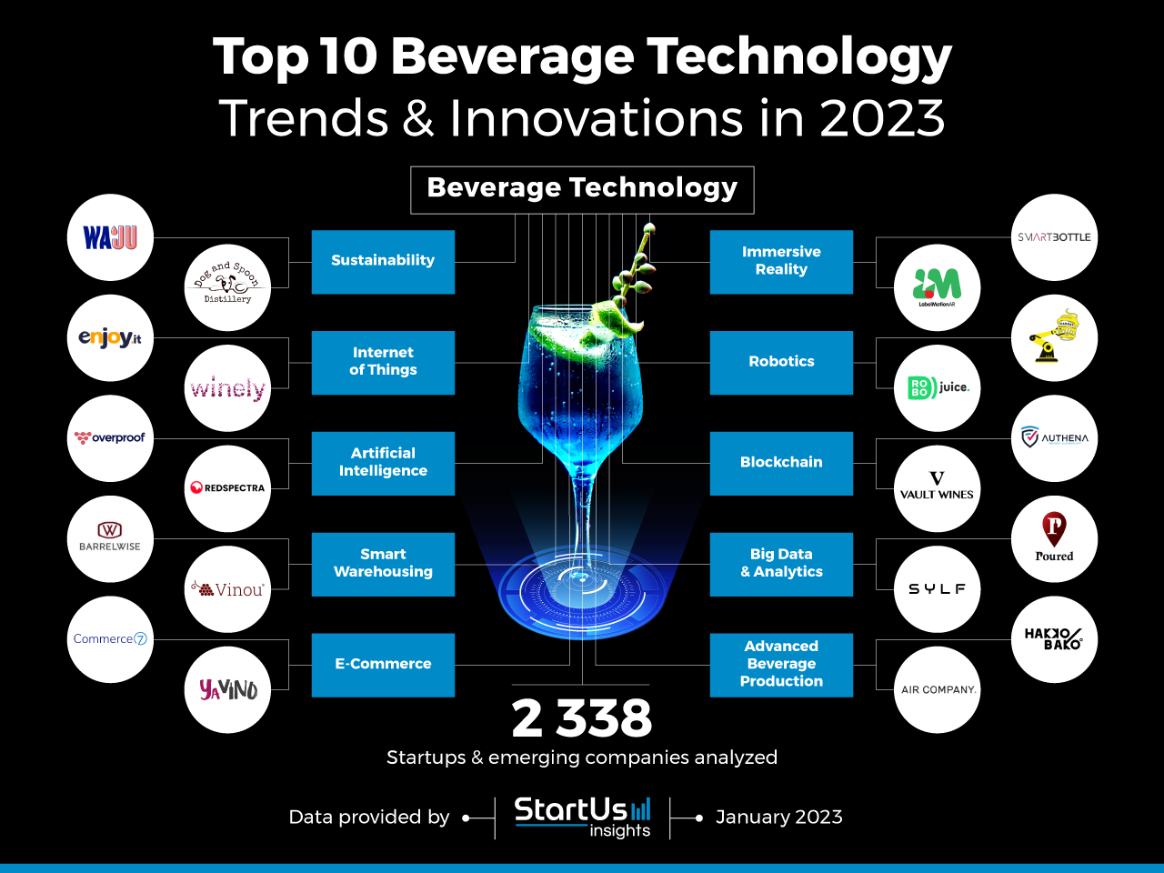

Slide 5
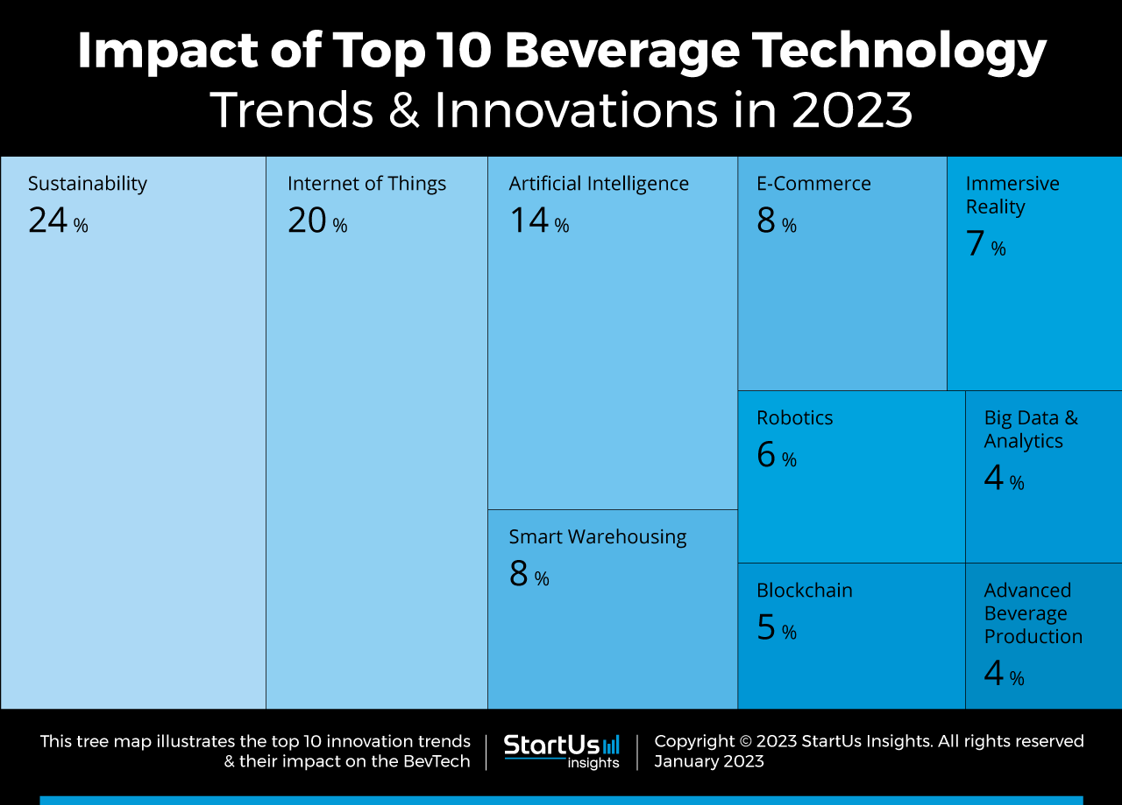

Slide 6
Global Startup Heat Map
The Global Startup Heat Map below highlights the global distribution of the 2 338 exemplary startups & scaleups that we analyzed for this beverage industry trends research. Created through the StartUs Insights Discovery Platform, the Heat Map reveals that the US is home to most of these companies while we also observe increased activity in Europe and India.
Below, you get to meet 20 out of these 2 338 promising startups & scaleups as well as the solutions they develop. These 20 startups were hand-picked based on criteria such as founding year, location, funding raised, and more. Depending on your specific needs, your top picks might look entirely different.

Slide 7
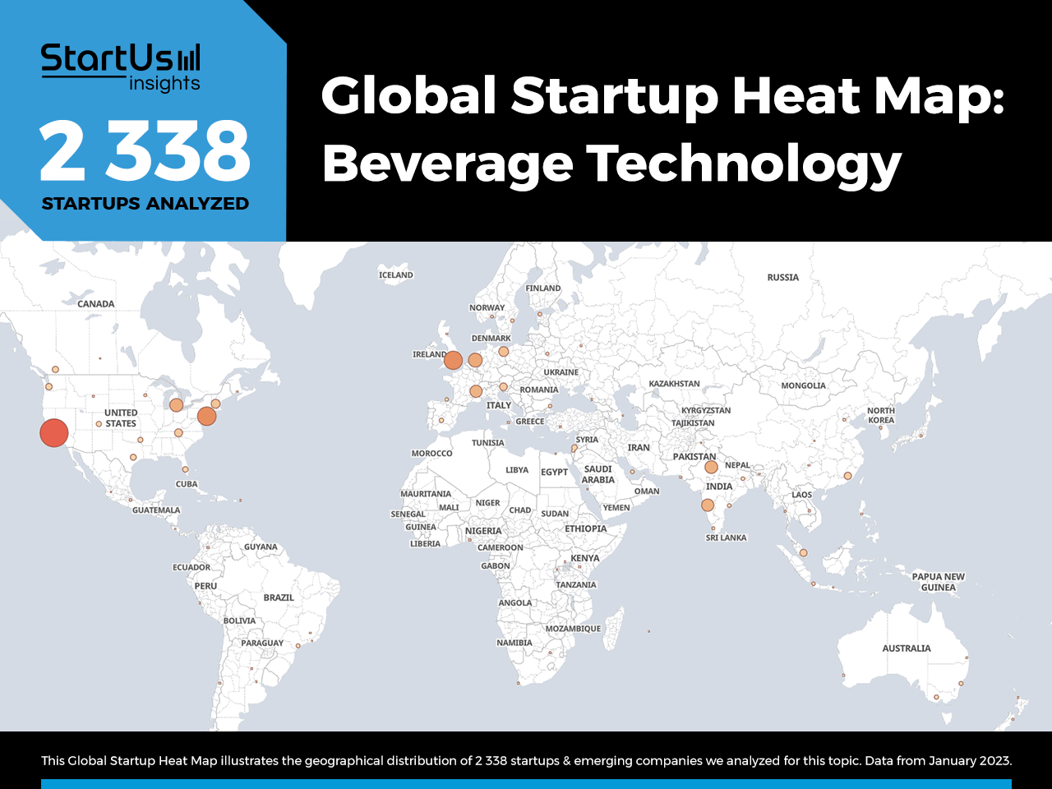

Slide 8
Beverage Startups
1. Sustainability
Concerns over global warming and climate change are driving companies and consumers to adopt sustainability. This is why sustainability is fast emerging as the top trend in the beverage industry. Consumers are aware of various environmental impacts caused by the industry and support brands that align with their sustainability goals. As a result, BevTech startups develop solutions that reduce the carbon footprint of beverage production operations through energy-efficient integrations and novel production techniques. Apart from these, beverage companies now use sustainable materials in their packaging choices, for example, plastic-free or reusable packaging. This significantly reduces the ecological impacts as single-use packaging is a major contributor to land and marine plastic pollution.
WAJU provides Fruit-Sourced Water
WAJU is a US-based startup that provides sparkly water sourced from fruits. The startup upcycles the water from the dehydration steps in fruit processing. It combines this water with other organic fruit ingredients free from antibiotics and genetically modified organisms (GMOs) to develop its drinks. Since the process takes feedstock from the sidestream of fruit processing, the overall sustainability of WAJU’s product is significantly greater than conventional processes. Moreover, it offers consumers fruit-sourced vitamin C and antioxidants without glucose spikes.
Dog and Spoon Distillery enables Sustainable Gin Production
UK-based startup Dog and Spoon Distillery facilitates sustainable gin production. The startup’s distillery runs on a solar-powered system and relies on sustainably sourced energy when there is no sunlight. In addition, it uses a biomass boiler to heat the distillery year-round. This approach decouples energy consumption of the startup from the grid and, hence, allows to cut down their emissions significantly. It also combines a custom-built water system to recycle water and plastic-free packaging, further reducing environmental impact.

Slide 9
2. Internet of Things
Digitization of industrial processes enables beverage manufacturers to establish a connected ecosystem from sourcing to distribution. Besides, the need for improved food safety standards and transparency is accelerating the integration of IoT into the beverage sector. Consequently, companies are able to improve their operational efficiency and constantly monitor manufacturing processes. To achieve this, startups provide various IoT devices, including humidity, fluid level, motion, optical, and temperature sensors. Leveraging these solutions enables production and floor managers to track various environmental and process parameters to ensure optimal productivity. Besides, such solutions streamline inventory management and facilitate product tracking across the supply chain.
Enjoy enables Self-Service Beer Counters
Brazilian startup Enjoy develops Enjoy Self-Service, an IoT-based solution to facilitate self-service at beer counters. It combines an embedded circuit unit to control machine lines and a measurement module to release, close, and measure flow along with a front module for consumer access. It allows the customers to control how much drink they need, avoid waiting in lines and track consumption details. This allows bars, pubs, and taprooms to increase the use of beer taps, reduce wastage, improve barrel management, and, in turn, save costs.

Slide 10
Artificial Intelligence
The use cases of IoT are enhanced further by applying artificial intelligence in beverage production. With the data from the connected devices, AI solutions extract the overall picture of manufacturing processes and derive meaningful insights into operations. In addition, it automates production operations such as cooling, inventory management, and flavor profiling. AI-based solutions also assist operation and maintenance (O&M) planning by enabling order forecasting and predictive maintenance, respectively. At the consumer end, AI algorithms running on kiosks and smartphone apps personalize product recommendations. BevTech startups leverage these insights to produce new flavors based on consumer preferences and social media trends.

Slide 11
Overproof offers Beverage Market Intelligence
US-based startup Overproof provides beverage market intelligence for alcohol brands. The startup’s platform, OVERPROOF PORTAL, applies AI algorithms on sales and consumer data to streamline the planning and execution of products, processes, and marketing. It is a hyper-smart customer relationship management (CRM) platform that combines market insights and company business data to create market strategies. This allows alcohol brands to mitigate guesswork in sales and marketing, thus optimizing targeting and campaign development.
Redspectra Instruments enables Sales Forecasting
Indian startup Redspectra Instruments provides sales forecasting for breweries. The startup’s tapping system uploads the sales data to the cloud where its AI algorithms provide sales analytics and stocking decisions. In breweries, it also couples the tapping system with the Redspectra Instruments’ inline analyzers to synchronize production with predicted demand.

Slide 12
Smart Warehousing
Automating various aspects of warehouses allows beverage manufacturers to increase productivity while minimizing labor and wastage costs. Smart warehousing ensures an effective material handling system that prevents damage or loss. Voice-controlled warehouse operations and the use of automated guided vehicles (AGVs) for product handling are on the rise, along with automated flow control and bottling solutions. In addition, advanced warehousing solutions facilitate inventory management of final products as well as raw materials.

Slide 13
BarrelWise Technologies develops a Barrel Management System
BarrelWise Technologies is a Canadian startup that provides a smart barrel management system for winemakers. The startup’s sensor allows cellar hands to eliminate handling and restocking of barrels to maintain sulfide levels. To achieve this, the device analyses sulfur dioxide concentration in less than a minute, allowing users to monitor wine characteristics across the cellar. The startup’s solution significantly reduces contamination risks during sampling while reducing the time spent on each barrel.

Slide 14
Vinou facilitates Digital Cellar Management
German startup Vinou provides a digital wine cellar management platform. The startup’s platform, Vinou-Cellar, combines all data generated within the cellar, including fermentation curves. It enables digital communication to the wine laboratories and provides an optional fully automated wine bookkeeping approved by the viticulture authority. Vinou, thereby, speeds up cellar operations and offers all the relevant information under a single platform, facilitating barrel, cellar, and sales management.

Slide 15
eCommerce IN Beverage INDUSTRY
The rise of social media and online food aggregation platforms is encouraging beverage companies to take their products into online markets. Apart from facilitating direct consumer interactions
Commerce7 develops an eCommerce Platform
Canadian startup Commerce7 builds an eCommerce platform for wineries. The startup’s customer-centric solution onboards new customers through a questionnaire and personalizes product recommendations. Besides, the platform provides upfront pricing of each product, thereby increasing sales. Among other features, it offers advanced product merchandising, in cart upselling, and dynamic product suggestions that further boost sales.
YaVino offers Wine Subscriptions
Spanish startup YaVino provides wine subscriptions. The startup selects four different wines and ships them to the subscribers. It also provides a range of products from various locations, wineries, and processes. This, in turn, allows consumers to taste a wide selection of wines at the comfort of home and without any shipping costs.

Slide 16
Robotics in Beverage Industry
Advancements in AI and data analytics accelerate the integration of robotics into beverage production lines and consumer-facing services. The range of applications on the manufacturing side includes vineyard management and protection, inventory management, packaging, and distillery automation.
Hannas Robotic Coffee Shop provides Autonomous Coffee Shops
US-based startup Hannas Robotic Coffee Shop develops autonomous robot coffee shops for use in pickup stations and dine-ins. Customers place their orders via self-service kiosks or tablets which are then sent to the robots. Customers are notified via email or text to pick up the order at pick-up stations, whereas robotic waiters serve the coffee at dine-ins.

Slide 17
RoboJuice is a US-based startup that offers robotic kiosks for dispensing beverages. The startup’s kiosks use a dispenser unit for ingredient storage and distribution, a cutting system to shave ingredients, and a self-cleaning blender, along with artificial intelligence. This allows the kiosks to calibrate continuously and ensure error-free servings of juices and smoothies, thus improving product consistency. Besides, the startup only utilizes organic ingredients, providing healthy drinks.

Slide 18
Blockchain Technology in Beverage Industry
Blockchain-based solutions strengthen food safety and traceability in the beverage sector. The technology provides immutable data into products in storage and transit, allowing brands to monitor their inventory constantly and identify counterfeits. Moreover, it ensures that no substandard or counterfeit product reaches the end-consumers that may cause severe health risks and impact brand image. Authena provides Brand Authentication
Authena is a Swiss startup that develops an NFC-based solution for brand authentication. The startup utilizes blockchain, tamper-proof tags, and digital seals to enable traceability. With this solution, beverage companies track the status of their product at each stage of the supply chain and allow customers and third parties to read the product history at any time and verify product authenticity.

Slide 19
Vault Wines facilitates Beverage Product Traceability
Georgian startup Vault Wines develops a beverage product traceability solution. It leverages blockchain for secure record-keeping, customizable enterprise resource planning (ERP) features, and scannable holograms. The startup’s software, Vault Software, allows autonomous data collection and facilitates winery asset management to track, trace, and authenticate wines.

Slide 20
Big Data & Analytics
With social media, consumers generate and interact with beverage brands through visual content and surveys, creating data points at each step. The beverage industry uses big data and analytics to generate insights from this consumer data. Such solutions provide detailed visibility into customer behavior patterns that allow beverage brands to target their products and campaigns effectively. Along with IoT, big data and analytics enable beverage production companies to streamline operations. These include energy management, logistics optimization, maintenance tasks, and yield prediction, among others.

Slide 21
POURED is a US-based startup that offers a Software-as-a-Service (SaaS) platform for beverage distribution data collection. The startup’s AI-powered platform combines data related to on- and off-premise product placements across various markets and provides them to the users.
US-based startup Sylf develops an alcohol dispensing kiosk that provides brand performance data. The startup utilizes cloud computing, artificial intelligence, and IoT to convert brick-and-mortar businesses into digital touchpoints. This allows Sylf to gather live consumption data to guide strategic business decisions and analyze product performances.

Slide 22
Advanced Beverage Production
Advancements in forward osmosis are enabling beverage companies to improve efficiency in concentrating beverage products such as beer and coffee. Startups also develop ultra-fast cooling systems based on reverse microwaves to serve wine at recommended temperatures within minutes rather than waiting for the bottle to chill in the fridge. These technologies, among others, allow beverage manufacturers to improve product quality and food security.
Hong Kong-based startup HakkoBako builds HB Pro, a smart fermentation chamber. HB Pro combines advanced heating and cooling technology and provides precise temperature control through an in-built touch screen and smartphone app. This allows fermented product manufacturers to automate fermentation programs and optimize conditions for microbes to thrive, providing better control over flavor. The startup also offers various fermentation programs to start and manage operations quickly.

Slide 23
US-based startup Air Company advances CO2-to-ethanol technology. The startup captures CO2 emissions from traditional fermentation and industrial alcohol plants and splits water into hydrogen (H2) and oxygen (O2) using hydrolysis. The hydrogen and CO2 combine in the Carbon Conversion Reactor, whereas the oxygen is released into the atmosphere. The Carbon Conversion Reactor is a continuous flow system with a proprietary catalyst that converts this CO2-H2 mixture into highly pure ethanol, methanol, and water. Later, a distillation process removes water and methanol and another step adds water to create vodka.

