Slide 1

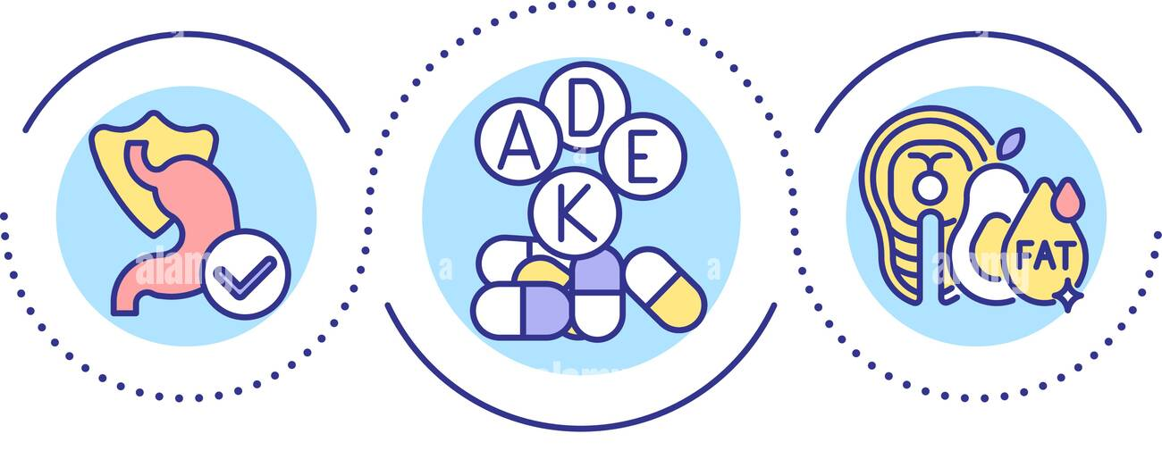
FAT SOLUBLE VITAMINS : ABSORPTION , STORAGE AND TOXICITY
Prof. Dr. Asif Ahmad
IFNS- PMAS UAAR

Slide 2
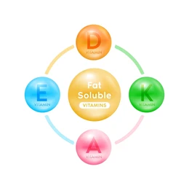
FAT SOLUBLE VITAMINS
Group of vitamins that dissolve in fat and are stored in the body’s fatty tissues and liver.
Unlike water-soluble vitamins, they don’t need daily replenishment as they’re stored in the body.
Includes Vitamin A, D, E, and K
Characteristics of Fat-Soluble Vitamins:
Absorption: Requires dietary fats for absorption.
Storage: Stored in the liver and adipose tissues, reducing the need for daily intake.
Potential for Toxicity: Can accumulate in the body, leading to toxicity if consumed in excess.
Each plays a vital role in maintaining health, supporting processes such as cell growth, immune defense, and blood coagulation

Slide 3
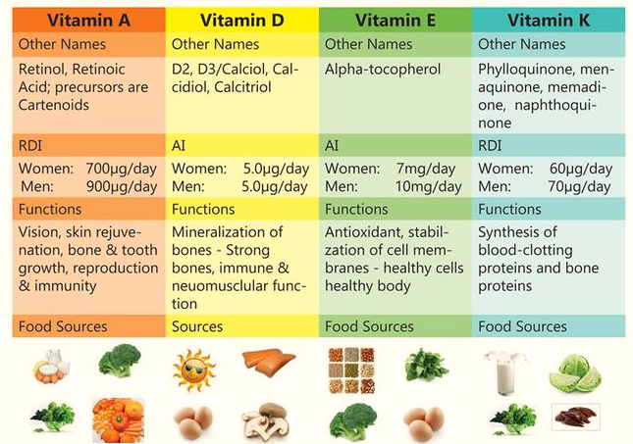

Slide 4
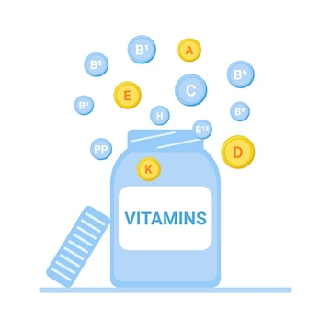
OVERVIEW OF FAT SOLUBLE VITAMINS ABSORPTION
Primary Absorption Site:
  Absorption of fat-soluble vitamins mainly occurs in the small intestine.
Dependency on Dietary Fat:
  Requires the presence of dietary fats to be absorbed efficiently.
  Vitamins A, D, E, and K are incorporated into fat-containing micelles for transport.
Role of Bile Salts and Pancreatic Enzymes:
  Bile salts (from the liver and stored in the gallbladder) emulsify fats, forming micelles that carry fat-soluble vitamins.
  Pancreatic lipase helps to break down dietary fats, aiding in vitamin absorption.
Absorption Pathway Overview:
  Solubilization: Bile salts mix with fat-soluble vitamins to form micelles in the intestine.
  Transport to Enterocytes: Micelles bring vitamins to enterocytes (intestinal cells).
  Formation of Chylomicrons: Within enterocytes, vitamins are packed into chylomicrons for transport.
  Entry into Circulation: Chylomicrons enter the lymphatic system, then into the bloodstream, distributing vitamins to tissues.

Slide 5
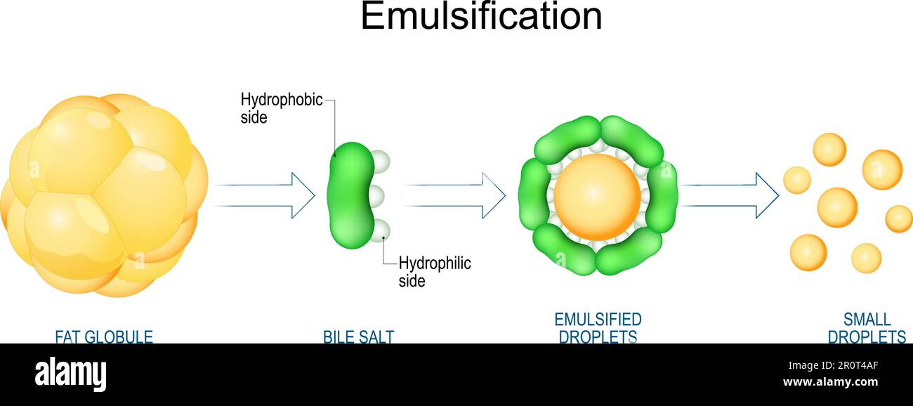
MECHANISM OF ABSORPTION
Step 1: Emulsification by Bile Salts
Mechanism:
Fat-soluble vitamins (A, D, E, K) are often bound to dietary fats. In the small intestine, the liver secretes bile, which is stored in the gallbladder.
Upon eating, bile is released into the intestine, where bile salts break down large fat droplets into smaller, more manageable particles.
This action increases the surface area for the digestive enzymes to act on, enabling better absorption.
Outcome: This step allows fat-soluble vitamins to mix with fats and facilitates the next stage of micelle formation.

Slide 6
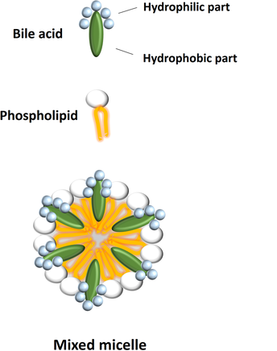
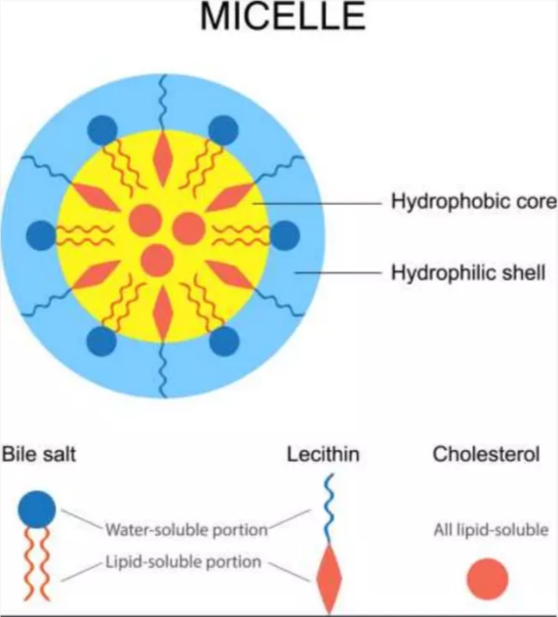
Step 2: Formation of Micelles
Mechanism:
Bile salts combine with fat-soluble vitamins and digested lipids to form tiny, water-soluble structures called micelles.
These micelles have a hydrophilic exterior and a hydrophobic core that protects fat-soluble vitamins inside.
Outcome: Micelles act as transport vehicles, carrying the vitamins to the surface of the intestinal cells (enterocytes) for absorption.

Slide 7
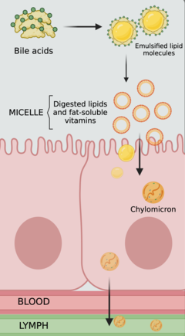
Step 3: Absorption by Enterocytes
Mechanism:
Micelles transport the vitamins to the brush border membrane of enterocytes lining the small intestine.
Here, the vitamins diffuse across the cell membrane passively because of their lipid solubility.
Outcome: Once inside the enterocytes, vitamins separate from the micelles and are ready for transport within the cell.
Step 4: Incorporation into Chylomicrons
Mechanism:
Inside the enterocytes, fat-soluble vitamins are repackaged into lipid transport molecules known as chylomicrons, along with other absorbed lipids like triglycerides.
Chylomicrons are lipoproteins with a core of fats and fat-soluble vitamins and an outer layer of phospholipids, cholesterol, and proteins.
Outcome: Chylomicrons stabilize the vitamins and prepare them for safe transport through the lymphatic system.
Step 5: Entry into Circulation
Mechanism:
  Chylomicrons exit the enterocytes and enter the lymphatic system, a network of vessels that eventually drains into the bloodstream.
  They bypass the liver initially and circulate through the body, delivering vitamins to target tissues or storing them in the liver and adipose (fat) tissue.
Outcome: This transport system allows the body to store fat-soluble vitamins and release them as needed.

Slide 8
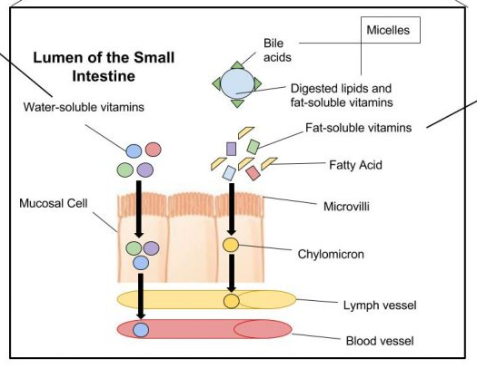
The light blue highlighted part of the figure shows how fat soluble vitamins are generally absorbed in blood

Slide 9
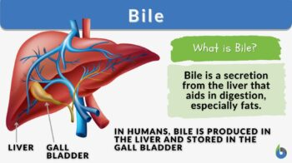
ROLE OF BILE IN ABSORPTION
Bile salts are amphipathic molecules derived from cholesterol, produced by the liver and stored in the gallbladder. They consist of both hydrophobic (water-repelling) and hydrophilic (water-attracting) regions.
Function:
Their primary role is to facilitate the digestion and absorption of dietary fats and fat-soluble vitamins in the small intestine.
Emulsification:
  Process: When food containing fat enters the small intestine, bile is released from the gallbladder into the intestinal lumen.
  Function: Bile salts emulsify large fat globules into smaller droplets, increasing the surface area available for pancreatic enzymes (like lipase) to act upon.
  Outcome: This process is crucial for the effective breakdown of dietary fats, making fat-soluble vitamins more accessible for absorption.

Slide 10
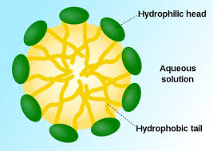
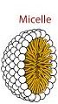
ROLE OF MICELLES IN ABSORPTION
Micelles are small, spherical structures formed from bile salts, fatty acids, monoglycerides, and fat-soluble vitamins.
Mechanism:
  Assembly: As bile salts emulsify fats, they interact with these smaller lipid molecules, forming micelles in the intestinal lumen.
  Structure: The hydrophobic interior of micelles encapsulates fat-soluble vitamins and digested lipids, while the hydrophilic exterior allows micelles to remain suspended in the aqueous environment of the intestinal contents.
Function:
Micelles transport fat-soluble vitamins (A, D, E, K) to the brush border of enterocytes (intestinal absorptive cells) where absorption occurs.
The presence of micelles increases the solubility of fat-soluble vitamins in the intestinal fluid, allowing them to be readily absorbed by enterocytes through passive diffusion.
This increases the bioavailability of fat-soluble vitamins, ensuring that adequate amounts can be absorbed into the body.
Transportation:
  Movement: Once the fat-soluble vitamins are within the micelles, they can efficiently move toward the intestinal wall, where they are absorbed into the cells lining the intestine.

Slide 11
Vitamin | Absorption | Storage | Toxicity
Vitamin A | - Absorbed in the small intestine with dietary fats. - Requires bile salts and micelles for emulsification. - Preformed vitamin A (retinol) and carotenoids (e.g., beta-carotene) are the main forms. | - Primarily stored in the liver as retinyl esters. - Smaller amounts stored in adipose tissue and other organs. - The liver can release retinol into the bloodstream as needed.. | - Hypervitaminosis A can occur with excessive intake. - Symptoms include nausea, headache, dizziness, and liver damage.
Vitamin D | - Absorbed in the small intestine with dietary fats. - Synthesized in the skin upon UVB exposure. - Requires bile salts for emulsification and absorption. | - Stored in the liver and adipose tissues. - The body can store large amounts for later use; however, it may take weeks to months to deplete these stores. | - Hypervitaminosis D can lead to hypercalcemia (high blood calcium levels). - Symptoms include nausea, vomiting, and kidney damage.
Vitamin E | - Absorbed in the small intestine with dietary fats. - Requires bile salts for emulsification and micelle formation. - Exists mainly as tocopherols and tocotrienols. | Primarily stored in adipose tissue, cell membranes, and the liver. - The body has a reserve of vitamin E to maintain adequate levels, but depletion can occur if intake is low. | - Generally low toxicity, but excessive supplementation can cause bleeding problems and gastrointestinal issues. - Symptoms include nausea and diarrhea.
Vitamin K | - Absorbed in the small intestine with dietary fats. - Requires bile salts for absorption. - Exists as phylloquinone (K1) from plants and menaquinones (K2) from animal sources. | Stored mainly in the liver, but smaller amounts are found in adipose tissue and bone. - Phylloquinone (K1) has a shorter half-life than menaquinones (K2). | - Toxicity is rare but can occur with excessive supplementation. - High doses may interfere with anticoagulant medications, causing blood clotting issues.

Slide 12
FACTORS AFFECTING ABSORPTION OF FAT SOLUBLE VITAMINS
Factor | Description
Dietary Fat | - Adequate intake of dietary fat is essential for the absorption of fat-soluble vitamins. - The presence of fat enhances the solubility of these vitamins in the intestinal environment.
Bile Salts | - Bile salts are crucial for emulsifying fats and forming micelles, which are necessary for the absorption of fat-soluble vitamins in the small intestine.
Gastrointestinal Health | - Conditions such as celiac disease, Crohn’s disease, and other gastrointestinal disorders can impair absorption by damaging the intestinal lining or affecting bile production.
Age | - Aging may reduce the efficiency of fat absorption due to decreased bile production, reduced pancreatic function, or changes in gut microbiota.
Medications | - Certain medications, such as cholestyramine (a cholesterol-lowering drug), can bind bile salts and reduce the absorption of fat-soluble vitamins. - Other medications affecting gastrointestinal motility may also impact absorption.
Nutritional Status | - Deficiencies or imbalances in other nutrients can affect the absorption of fat-soluble vitamins. - For example, deficiencies in zinc may impair the absorption of vitamin A.
Preparation of Food | - Cooking methods can influence the bioavailability of fat-soluble vitamins. - For example, cooking can break down cell walls in vegetables, making vitamins A and E more accessible.
Alcohol Consumption | - Excessive alcohol intake can interfere with fat absorption and liver function, impairing the storage and metabolism of fat-soluble vitamins.
Presence of Other Compounds | - Certain compounds can enhance or inhibit absorption. For instance, dietary fiber can bind to fat-soluble vitamins, reducing their absorption. Conversely, phytochemicals in some foods may improve their bioavailability.

Slide 13
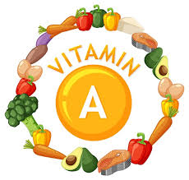

REGULATION OF FAT SOLUBLE VITAMINS
Vitamin A:
Hormonal Control: The regulation of vitamin A is influenced by various hormones, including retinoic acid (the active metabolite of vitamin A) and thyroid hormones. Retinoic acid plays a crucial role in gene expression, affecting the metabolism and mobilization of vitamin A from the liver.
Feedback Mechanisms: The body maintains homeostasis by adjusting the release of vitamin A based on its needs. If dietary intake is high, the liver will store excess vitamin A as retinyl esters, while low intake will trigger the liver to release retinol into the bloodstream.
Vitamin D:
Calcium Homeostasis: Vitamin D regulation is intricately linked to calcium levels in the body. The parathyroid hormone (PTH) and calcitonin are key regulators. When calcium levels are low, PTH stimulates the conversion of vitamin D to its active form, calcitriol, which increases calcium absorption in the intestines and reabsorption in the kidneys.
Sunlight and Diet: The synthesis of vitamin D in the skin through sunlight exposure (UVB rays) is a primary source. Dietary intake and synthesis both contribute to vitamin D levels, which are further regulated based on the body's calcium needs.

Slide 14
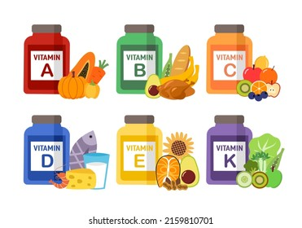
Vitamin E:
Dietary Intake and Liver Function: The liver regulates vitamin E levels by adjusting the synthesis of lipoproteins that transport vitamin E in the bloodstream. Higher dietary intake leads to increased plasma levels of vitamin E, while deficiencies can result in reduced levels in circulation.
Antioxidant Regulation: Vitamin E acts as an antioxidant and its regulation is influenced by oxidative stress levels in the body. Increased oxidative stress can enhance the demand for vitamin E, leading to greater mobilization from storage sites.
Vitamin K:
Dietary Sources and Gut Microbiota: Vitamin K regulation is primarily influenced by dietary intake and the synthesis of menaquinones (K2) by gut bacteria. The body can utilize both phylloquinone (K1) from plant sources and menaquinones from fermented foods and intestinal bacteria.
Liver Utilization: The liver plays a central role in the metabolism of vitamin K. It utilizes vitamin K for synthesizing clotting factors, and its levels are maintained through a balance between dietary intake, synthesis, and the body's demand for coagulation processes.
The regulation of fat-soluble vitamins is a complex interplay of dietary intake, hormonal signaling, and physiological needs. Each vitamin has specific regulatory mechanisms that ensure adequate levels are maintained while preventing toxicity. Understanding these regulatory processes is crucial for optimizing health and preventing deficiencies or excessive accumulation of these vitamins

Slide 15

In conclusion, the absorption, storage, and regulation of fat-soluble vitamins (A, D, E, and K) are vital processes that significantly impact overall health.
These vitamins require dietary fat for effective absorption and are stored primarily in the liver and adipose tissues, providing a reserve for the body’s needs.
Regulation is achieved through complex hormonal feedback mechanisms and dietary intake, ensuring that vitamin levels remain balanced.
However, excessive intake can lead to toxicity, underscoring the importance of moderation and awareness of dietary sources. Understanding these aspects is crucial for promoting optimal health and preventing deficiencies or toxicities.

Slide 16
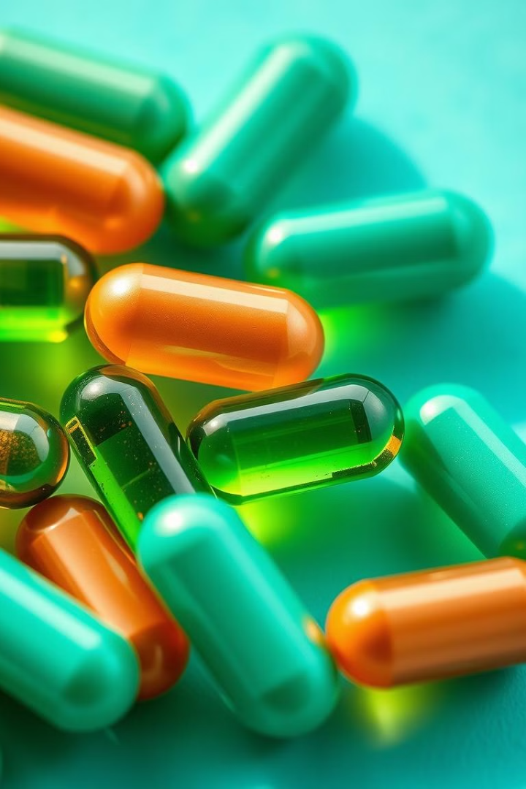

THANKS
Prof. Dr. Asif Ahmad, Director Institute of Food and Nutritional Sciences, PMAS-Arid Agriculture University Rawalpindi
asifahmad_1@yahoo.com

