Slide 1
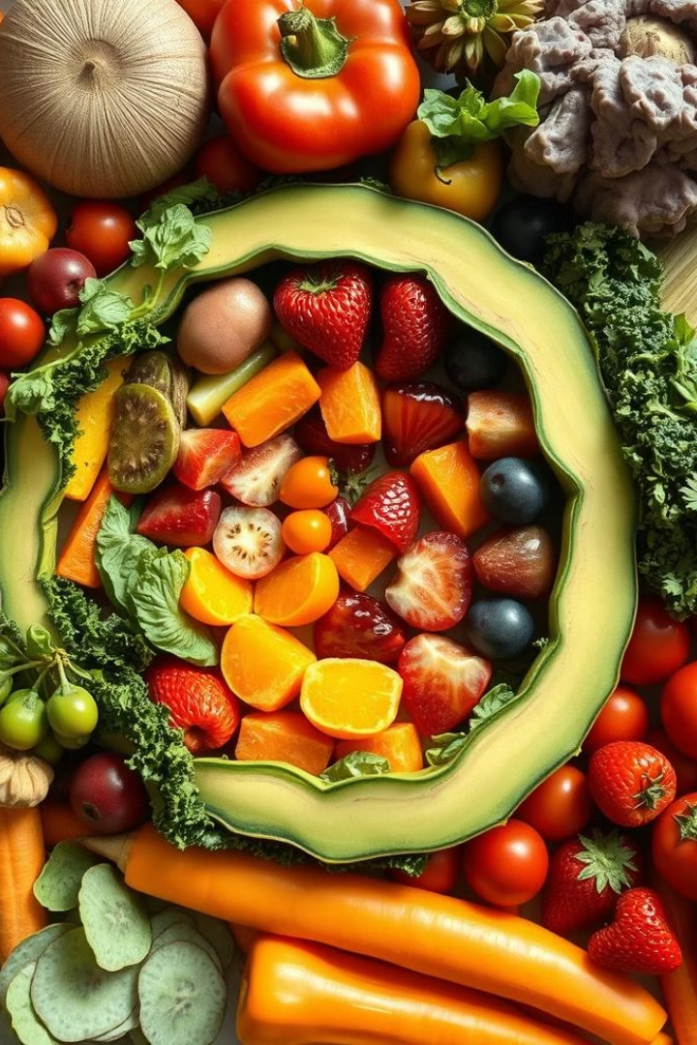
Water-Soluble Vitamins: Vitamin C and B1 (Thiamine)
Water-soluble vitamins play crucial roles in our bodies. This presentation focuses on two essential nutrients: Vitamin C and Vitamin B1 (Thiamine). We'll explore their structures, sources, functions, and deficiency symptoms.
AA
by Asif Ahmad

Slide 2
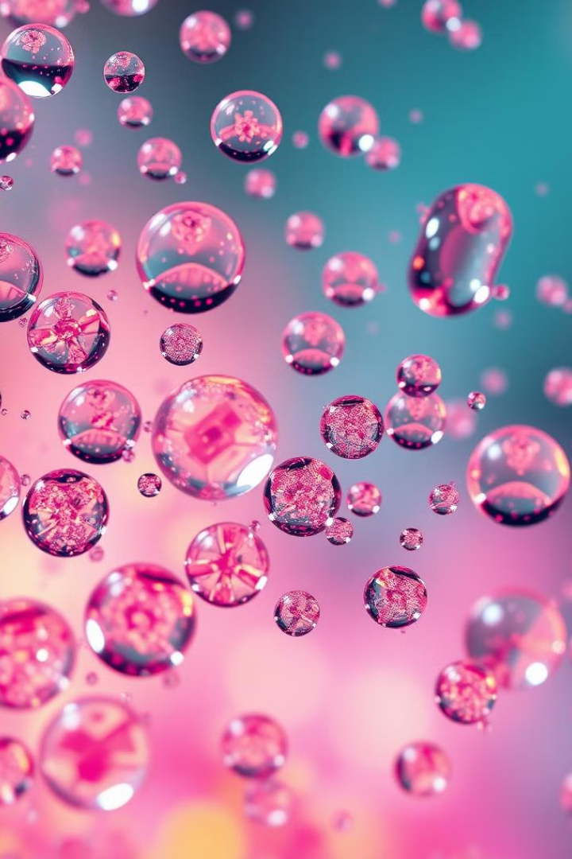
Introduction to Water-Soluble Vitamins
1
Solubility
2
Excretion
Water-soluble vitamins dissolve easily in water. They're not stored long-term in the body.
Excess amounts are typically excreted through urine. Regular intake is necessary.
3
Diversity
This group includes Vitamin C and eight B-complex vitamins. Each has unique functions.

Slide 3

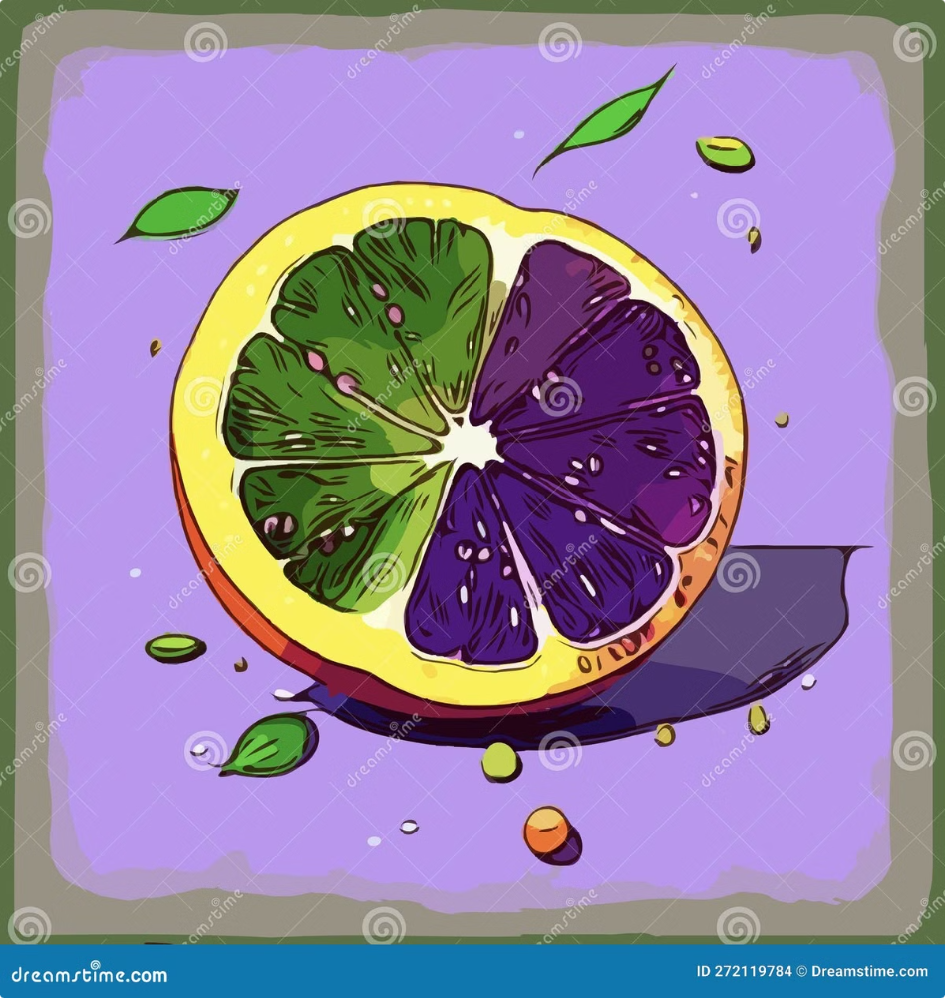
Vitamin C (Ascorbic Acid)
Antioxidant
Collagen Production
Vitamin C protects cells from oxidative stress. It neutralizes harmful free radicals.
Essential for collagen synthesis. Supports healthy skin, bones, and blood vessels.
Immune Booster
Enhances immune system function. Helps the body fight off infections and diseases.

Slide 4
Structure of Vitamin C
Chemical Formula
Isomers
Stability
C6H8O6. Six carbon atoms form a ring structure with hydroxyl groups.
L-ascorbic acid is the biologically active form. D-ascorbic acid isn't utilized by humans.
Easily oxidized. Heat, light, and alkaline conditions can degrade Vitamin C.

Slide 5

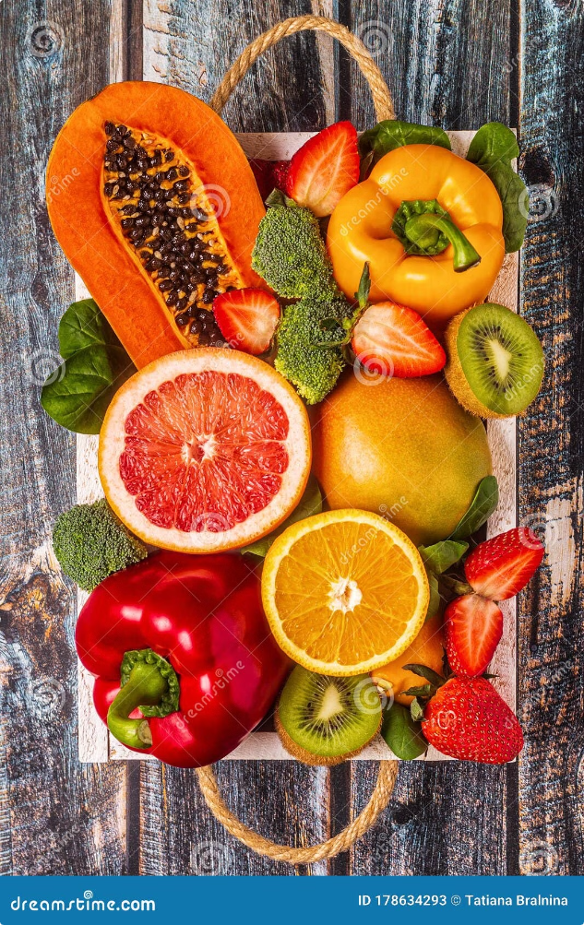




Dietary Sources of Vitamin C
Citrus Fruits
Green Vegetables
Oranges, lemons, and grapefruits are excellent sources of Vitamin C.
Broccoli, Brussels sprouts, and kale contain significant amounts of Vitamin C.
Berries
Bell Peppers
Strawberries, blueberries, and raspberries are rich in Vitamin C.
Red and green bell peppers are surprisingly high in Vitamin C.

Slide 6
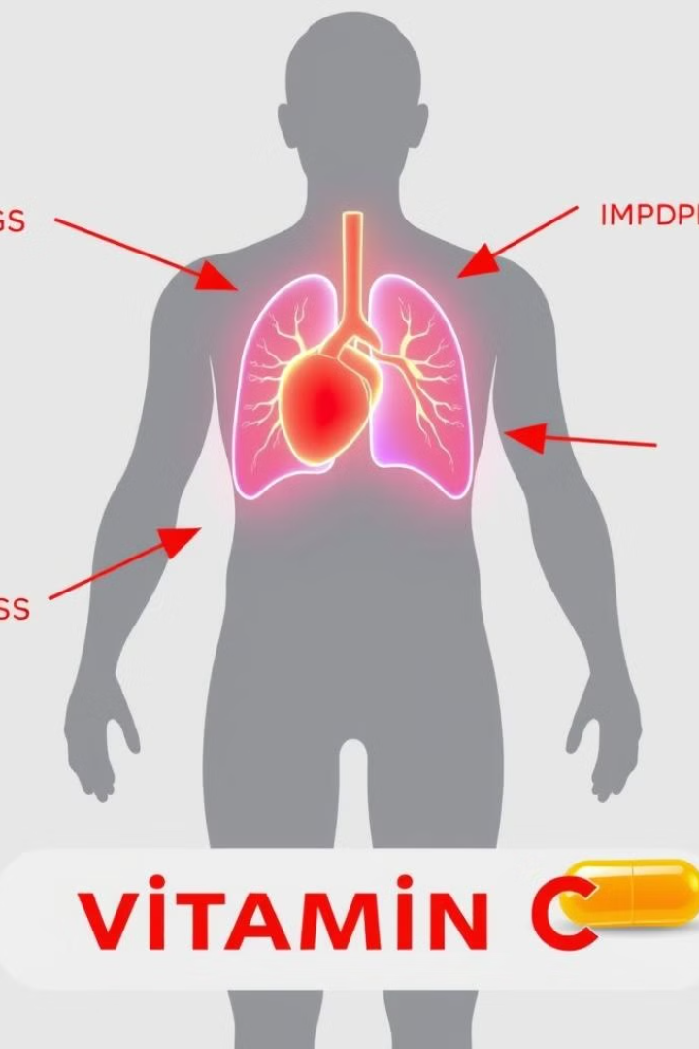




Functions of Vitamin C
Collagen Synthesis
Vitamin C is crucial for producing collagen, essential for skin and bone health.
Antioxidant Protection
It neutralizes free radicals, protecting cells from oxidative damage and aging.
Iron Absorption
Enhances the absorption of non-heme iron from plant-based foods in the gut.
Immune Support
Boosts the production and function of white blood cells, strengthening immunity.

Slide 7


Vitamin C Deficiency (Scurvy)
Symptom
Description
Fatigue
Weakness and tiredness due to impaired metabolism
Bleeding Gums
Swollen, bleeding gums and loose teeth
Poor Wound Healing
Slow healing of cuts and bruises
Joint Pain
Aching joints and muscle weakness

Slide 8
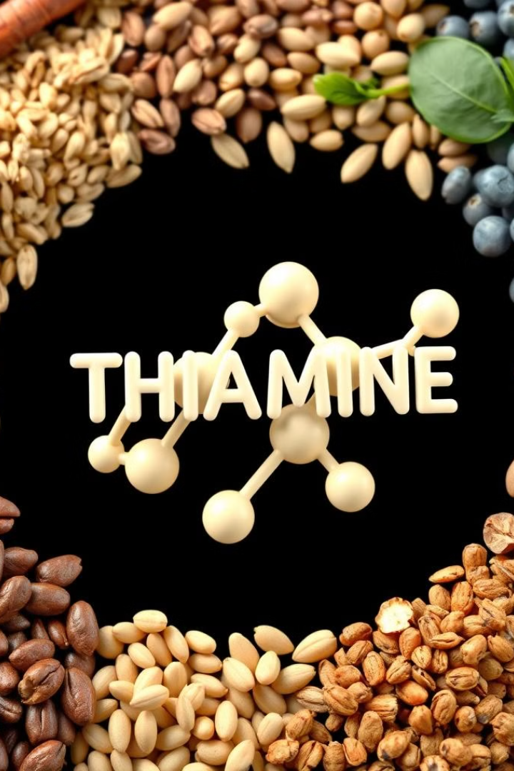
Vitamin B1 (Thiamine)
1
Discovery
Identified in 1897 by Christiaan Eijkman. First vitamin structure determined in 1936.
2
Naming
Initially called "anti-beriberi factor". Later renamed Thiamine, meaning "sulfur-containing vitamin".
3
Modern Understanding
Recognized as crucial for energy metabolism and neurological function in all living organisms.

Slide 9
Structure and Sources of Vitamin B1
Chemical Structure
Food Sources
Absorption
Contains thiazole and pyrimidine rings linked by a methylene bridge. Formula: C12H17N4OS.
Whole grains, legumes, nuts, and fortified cereals are rich in Thiamine.
Absorbed in the small intestine. Excess is excreted in urine within hours.

Slide 10
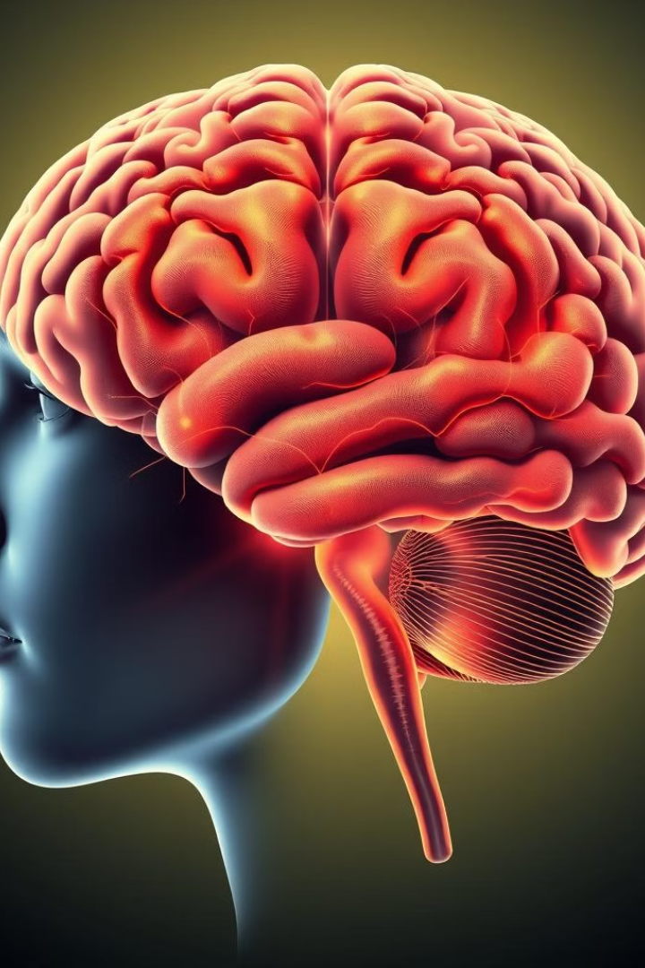
Functions of Vitamin B1
1
Energy Metabolism
2
Nervous System Health
Essential coenzyme in carbohydrate metabolism. Helps convert food into usable energy (ATP).
Crucial for proper nerve function. Helps in the production of neurotransmitters.
3
Muscle Function
4
Cognitive Function
Supports proper muscle contraction. Important for heart muscle function.
Plays a role in maintaining cognitive abilities. Deficiency can lead to confusion.

Slide 11
THANKS
A

